Slide 1
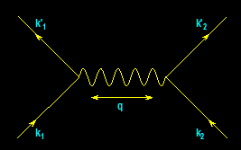
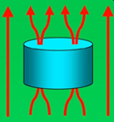
From
Electrons
Paired
To
Electric
Power
…And…
Back
Again
?
-- A Personal Journey in Superconductivity --
-- IBM, EPRI, and Beyond --
Paul M. Grant
www.w2agz.com
Aging IBM Pensioner
IBM Almaden Research Center
650 Harry Road
San Jose, CA
ARC Auditorium
10:30AM – 11:30AM
Friday, 6 May 2011

Slide 2
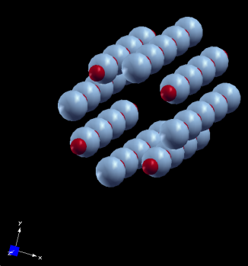
A DFT (LDA+U) Study of the Electronic Properties of Square-Planar Coordinated
Copper Monoxide Structures
… And Now for Something Completely Different …
Back to the Future…
My IBM SJRL Day Job of the 60s and 70s…
Electronic Structure Calculations
Notes:
2
2
2

Slide 3
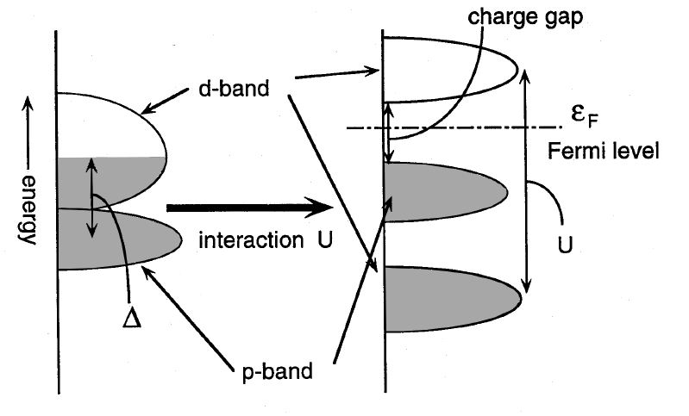
Transition Metal Oxides
“Should be Metals, But Aren’t” (Charge Transfer Insulators, Instead)
RPA Doesn’t Work!
Mott
Hubbard
Anderson
Brooks
Feinlieb
After Imada, et al, RMP 70, 1039 (1998)‏
Notes:
3

Slide 4
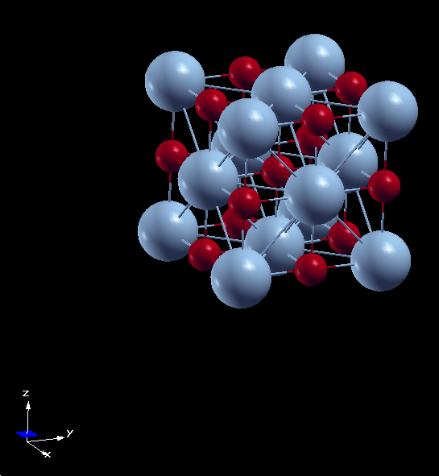
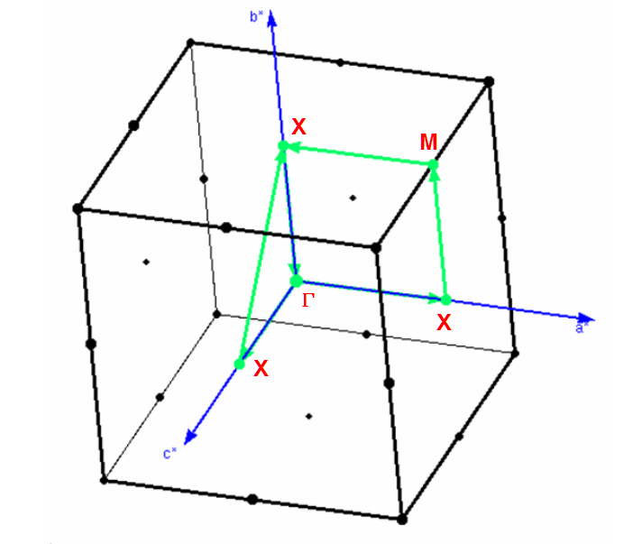
Cubic Rocksalt TMOs
Direct and Reciprocal Lattices
TM
O
Cubic Rocksalt TMO
a = b = c

Slide 5
Cubic Rocksalt Divalent TMOs
TMO 3d Config Properties
MnO 5 MH-CTI (5.6)
FeO 6 MH-CTI (5.9)
CoO 7 MH-CTI (6.3)
NiO 8 MH-CTI (6.5)
CuO 9
XX Doesn't Exist!
Why Not?
See Imada, Fujimore, Tokura, RPM 70 (1988)‏
Notes:
5

Slide 6
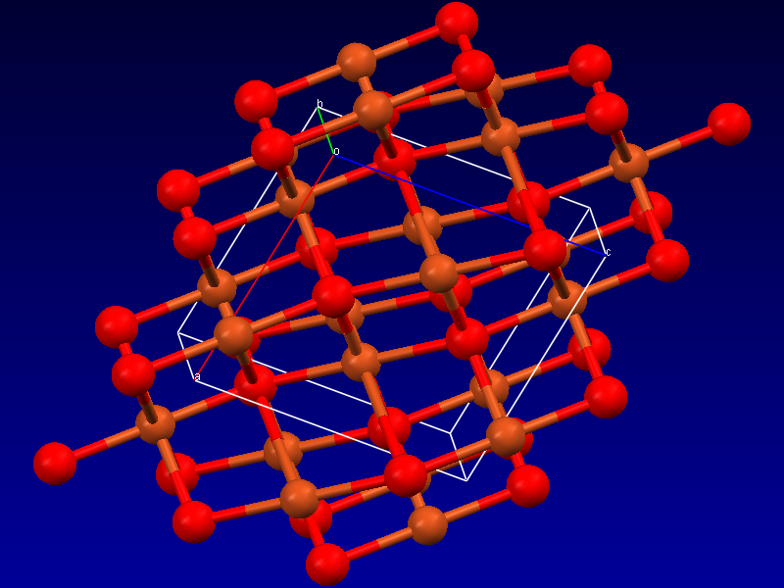
Tenorite (Monoclinic CuO)‏
What God wants…just ask her!
Cu
O
Notes:
6
6

Slide 7

Can Application of DFT (LDA+U) Help Unravel the Cubic Rocksalt CuO Enigma?
…Let’s see…
DFT & (LDA + U)‏
Implemented in LMTO by Anisimov, et al, JPCM 2, 3973 (1990)‏
  Applied to NiO, MnO, FeO, CoO and La₂CuO₄
Plane-Wave Pseudopotential Implementation by Cococcioni and de Gironcoli, PRB 71, 035105 (2005)‏
  Applied to FeO and NiO
  Download open-source package from http://www.pwscf.org
Notes:
7

Slide 8
Proxy Structures
A New Materials Science Discipline
You want to understand the basic physics of some given system…(e.g., HTSCs)
So try to synthesize a simple proxy…(e.g., rocksalt CuO)
But “Mother Nature” won’t “agree.” (She’s a woman!)
However, you can build it in a computer and perform various “ab initio” experiments.
And from such, numerically calculate “observables,” e.g., “response functions.”
Try it out…it’s lots of fun! And perhaps you’ll discover something as well!

Slide 9

Tools
QUANTUM-ESPRESSO Suite of Codes
  DFT (LDA+U) plus electron-phonon
  Graphics by Tone Kolalj (XCrysDen)
  www.quantum-espresso.org
“Dial-in” Parameters
  G² = 40 Ry ρ = 320 Ry
  Convergence ≤ 10⁻⁶ Ry
  “Smearing” = Methfessel-Paxton
  Psuedopotentials: Ultrasoft, XC = Perdew-Zunger
  Cu: 3d⁹4s² O: 2s²2p⁴
  Hardware
  3.33 GHz Intel Core i7 – 12 GB+ (Gaming Box – Home Built)
  Software
  Linux Kubuntu
Viva Italia!

Slide 10
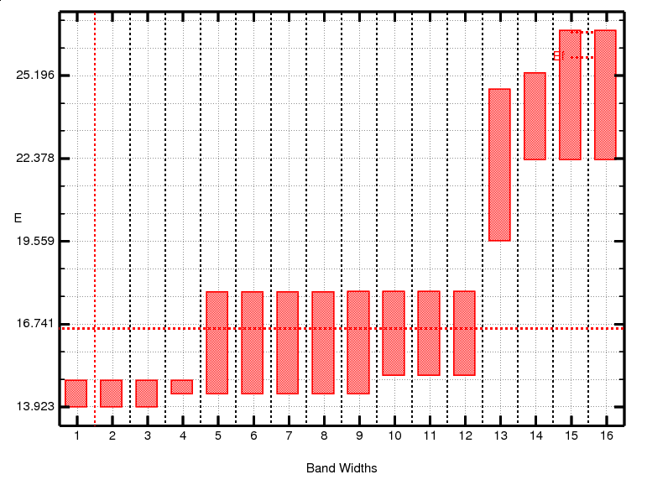
Rocksalt CuO Band Widths
U = 0 eV
Note Degeneracies!
8 Cu3d – O2p Bands
Notes:
10

Slide 11
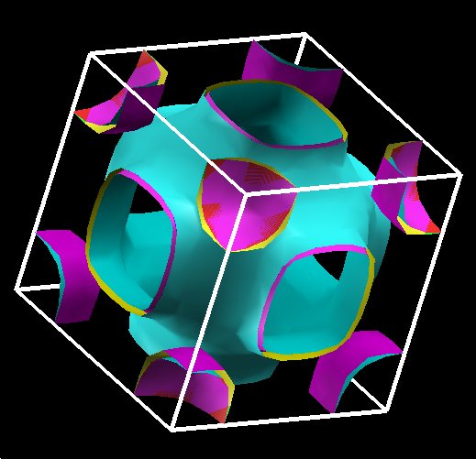
Rocksalt CuO Fermiology (U = 0 eV)
(8 Bands Combined)
Note (Near) Degeneracies!
Jahn-Teller Unstable?
Alex M?
(maybe you were on the right track, after all!)
Notes:
11

Slide 12
Non-Magnetic (U = 0) Cubic Rocksalt CuO
-- Electron-Phonon Properties --
α²F(ω)
λ ~ 0.6 – 0.7
Consistent with other non-magnetic “HTSCs”
 | T_{C} (K) | λ | μ*
K₃C₆₀ | 16.3 | 0.51 | -
Rb₃C₆₀ | 30.5 | 0.61 | -
Cs₃C₆₀ | 47.4 | 0.72 | -
σ = 0.04
Notes:
12
12

Slide 13
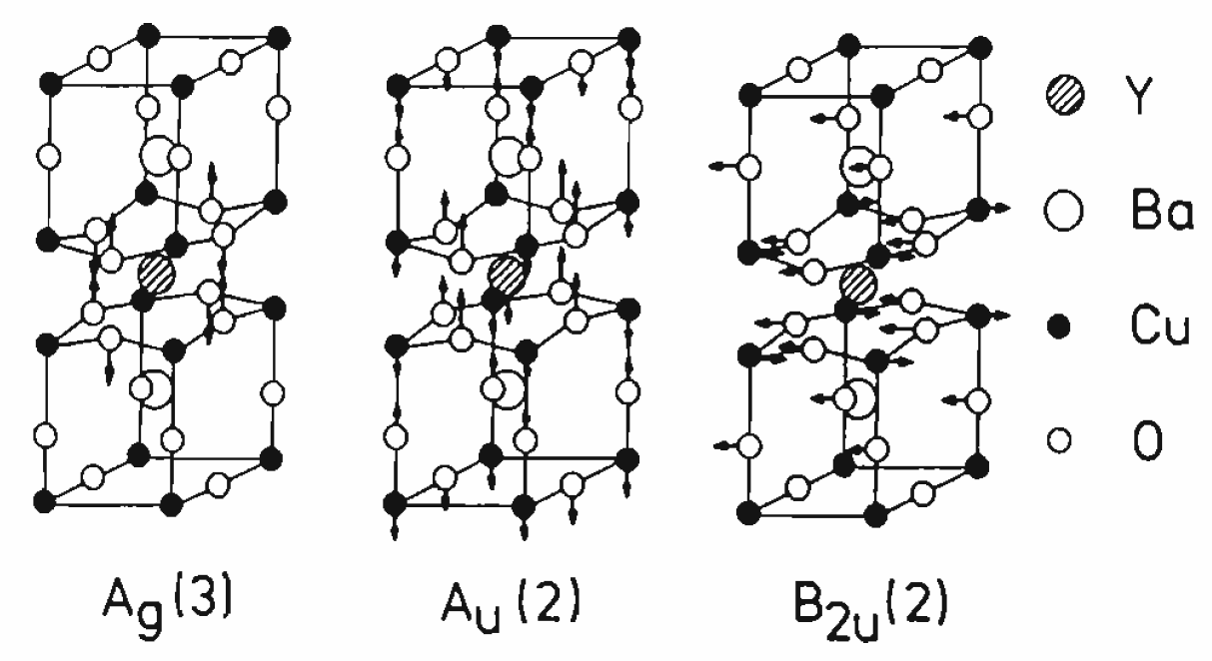
Are There
Phonons w/ High-Tc in YBCO?
Fig. 38: Pintschovius and Reichardt, in Furrer, ISBN 0-7923-5226-2

Slide 14
Yes -- They’re There!
Pyka, et al., PRL 70, 1457, (1993)
Harashima, et al., Physica C263, 257 (1996)

Slide 15
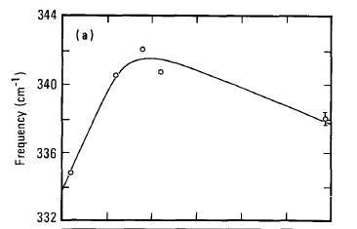

Macfarlane, Rosen, Seki, SSC 63, 831 (1987)
Raman Spectroscopy of YBCO

Slide 16
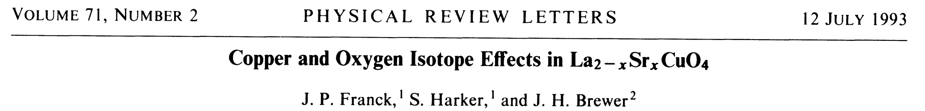
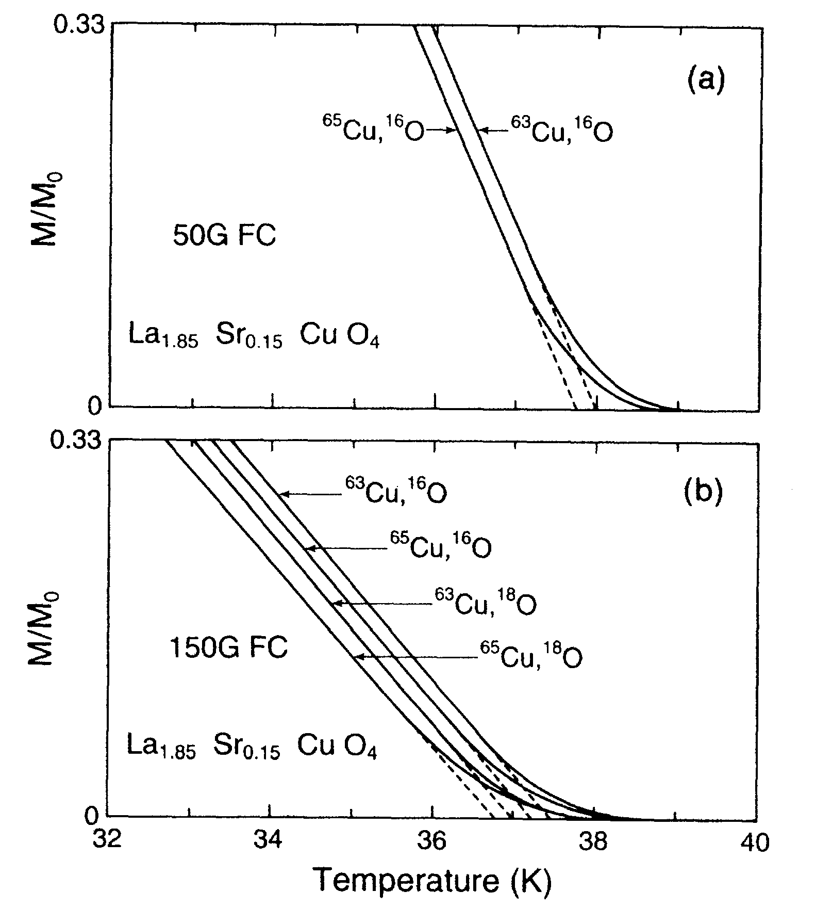

Slide 17
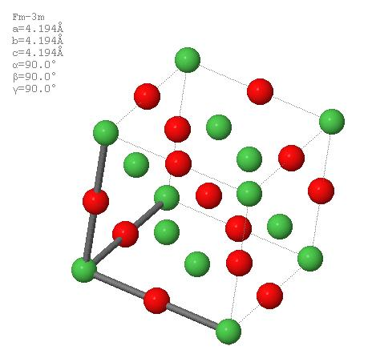
Proto-TMO AF-II Rocksalt Unit Cell
[111]
Applies to:
MnO
FeO
CoO
NiO
CuO ?

Slide 18
Proto-TMO AF-II Rocksalt
[⁻1⁻1⁻1]

Slide 19
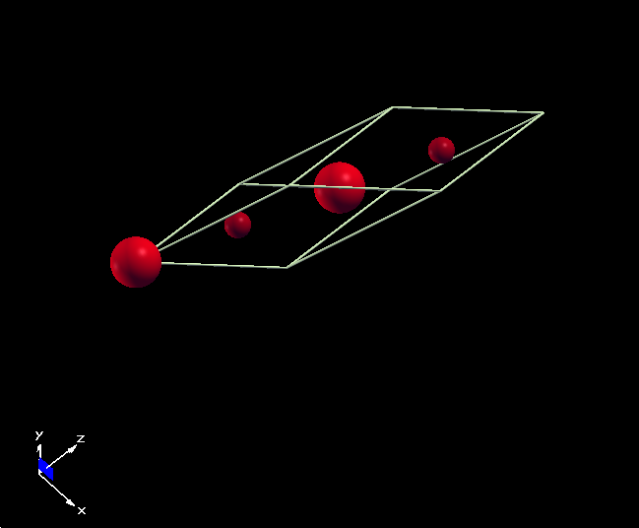
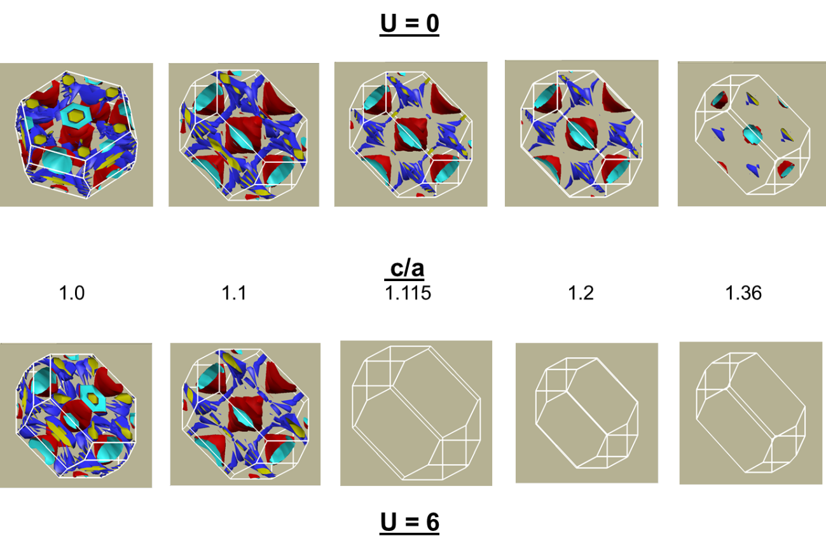
The Answer(s) !
TMO Asymmetric Type II
af-CuO Cell
LDA+U Calcs
Grant, IOP-CS 129 (2008) 102042
(Click Here)
Tetragonal Distortion
Siemons, et al, PRB 79 (2009) 195122
(Click Here)

Slide 20
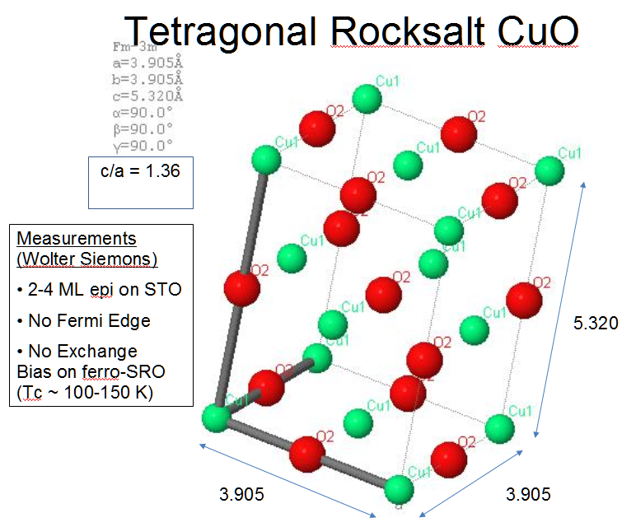
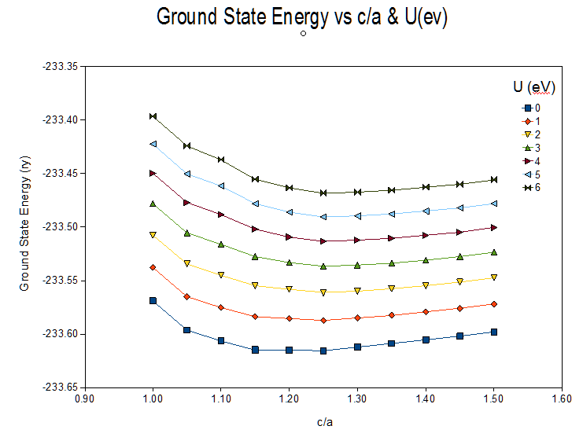
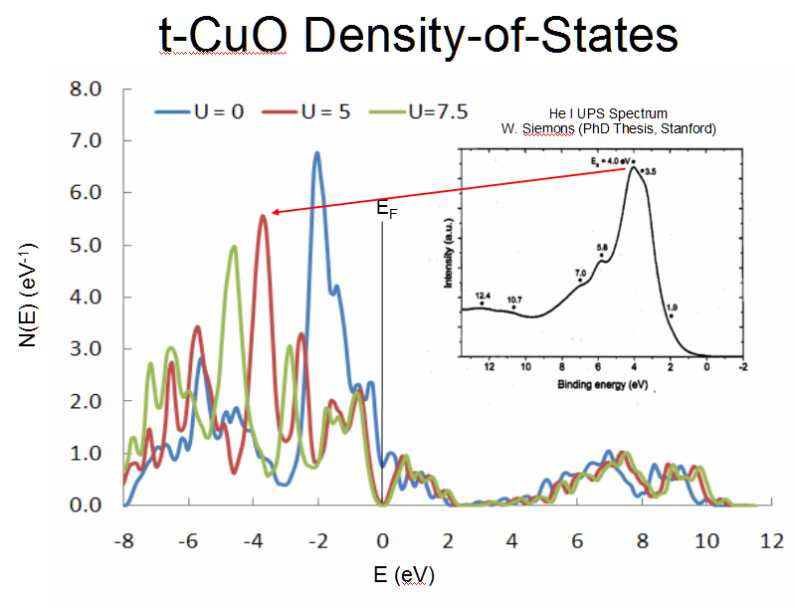

Slide 21
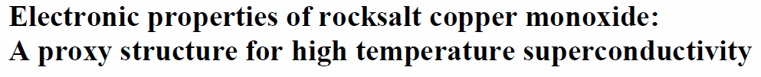

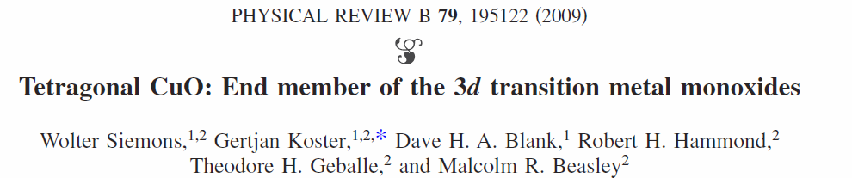
References
“Electronic Properties of Rocksalt Copper Monoxide,”
APS MAR09-2008-006217, P. M. Grant, Pittsburgh (2009)

Slide 22

The Great Quantum Conundrum
T
“Non-Fermi Liquid”
‘Nematic Fermi Fluids’
“Whatever!”
“SDW”
“NEEL”
“A-F”
“Whatever!”
“Fermi Liquid”
“Dilute Triplon Gas”
“Whatever!”
“Insulator”
g*
_{“QCP”}
“Conductor”
g
ρ_{local}

Slide 23
The Colossal Quantum Conundrum
T
“Real Metal”
“Fermi Liquid”
“Funny Metal”
“Pseudogap”
“Fond AF Memories”
“SDW”
“NEEL”
“A-F”
“Funny Metal”
“Pseudogap”
“Fond AF Memories”
Superconductivity
“Insulator”
g*
_{“QCP”}
“Conductor”
g
ρ_{local}

Slide 24
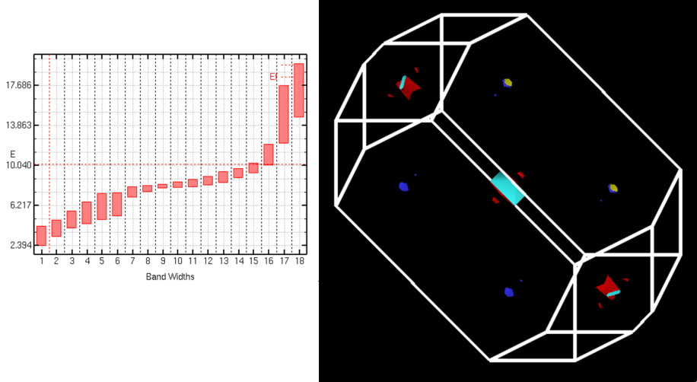
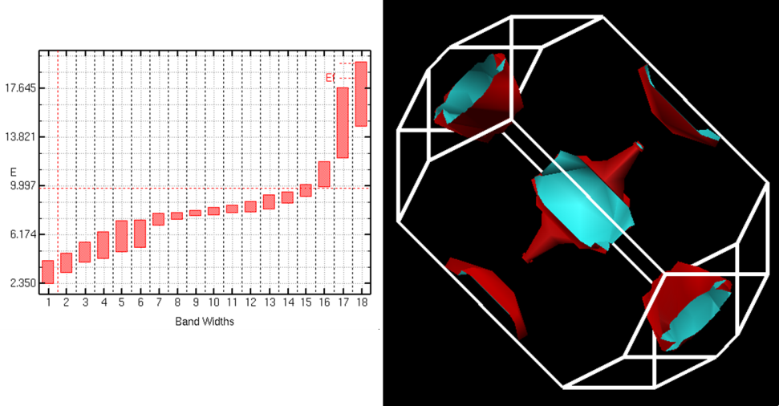
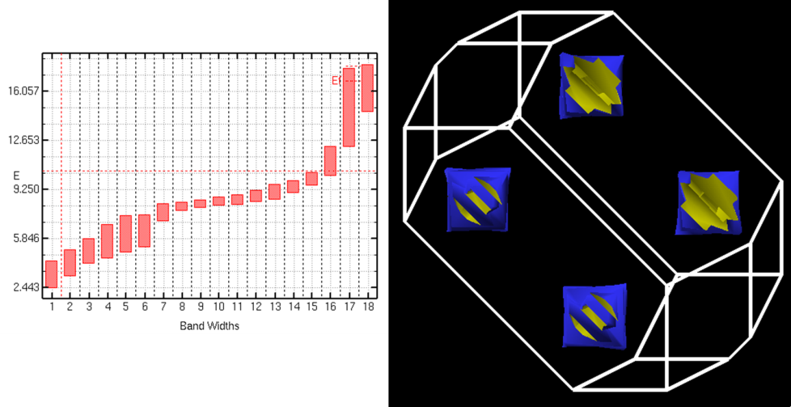
Hubbard (eV)
“Doping” (-e/CuO)
U = 0
n = 0.00
n = +0.15
n = -0.15

Slide 25
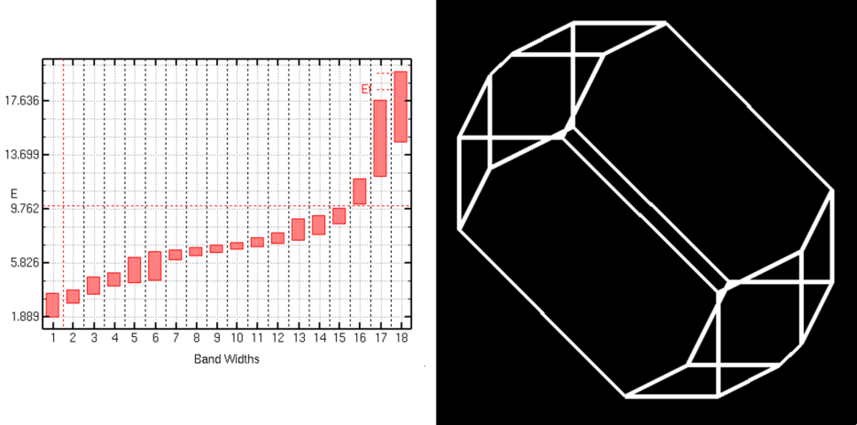
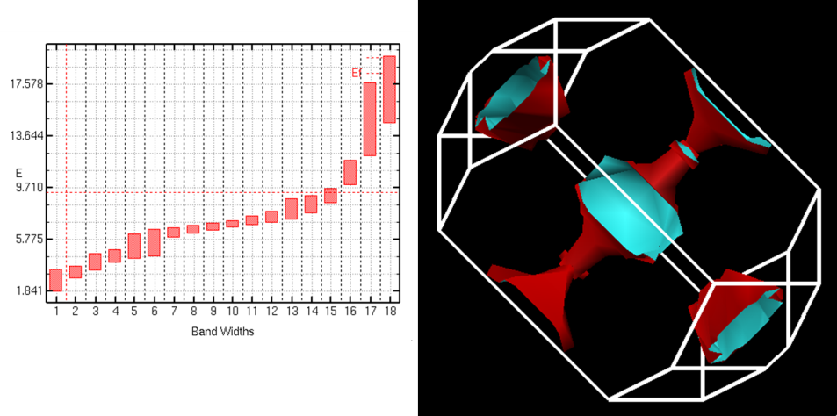
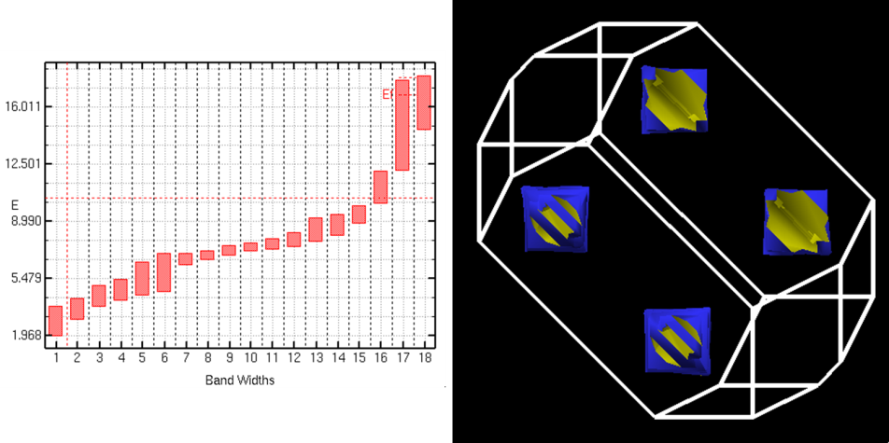
Hubbard (eV)
“Doping” (-e/CuO)
U = 3
n = 0.00
n = +0.15
n = -0.15

Slide 26
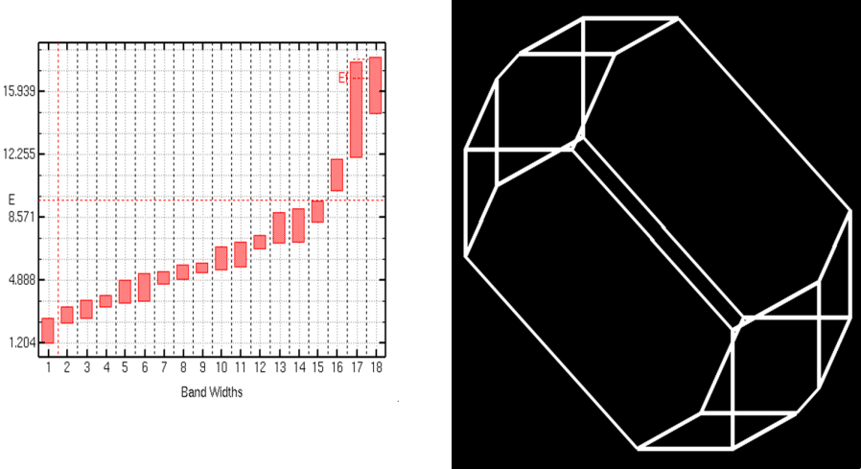
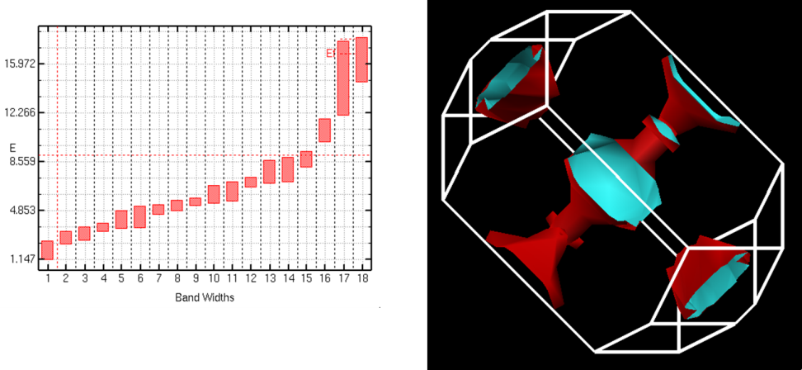
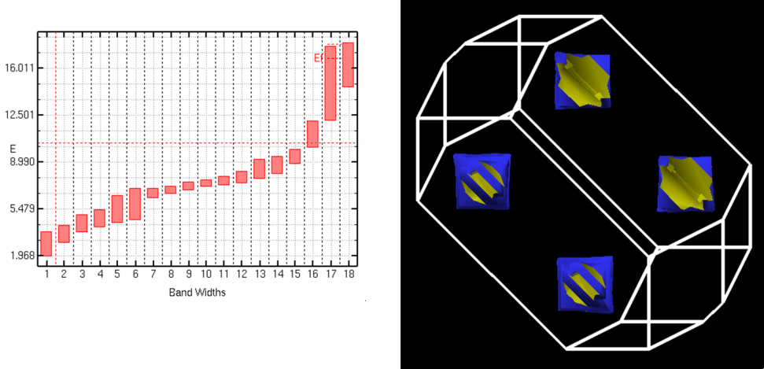
Hubbard (eV)
“Doping” (-e/CuO)
U = 6
n = 0.00
n = +0.15
n = -0.15

Slide 27
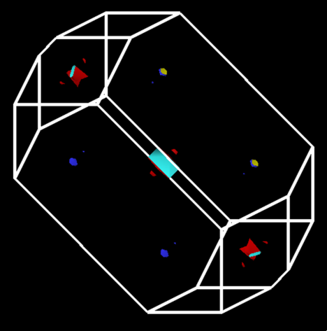
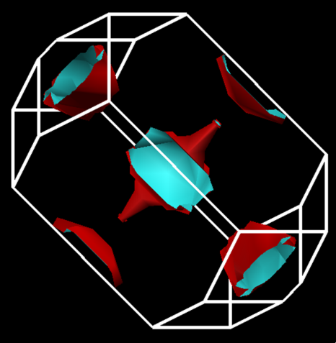
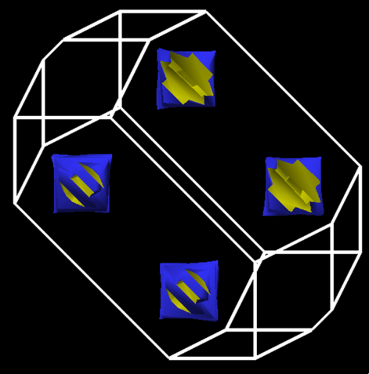
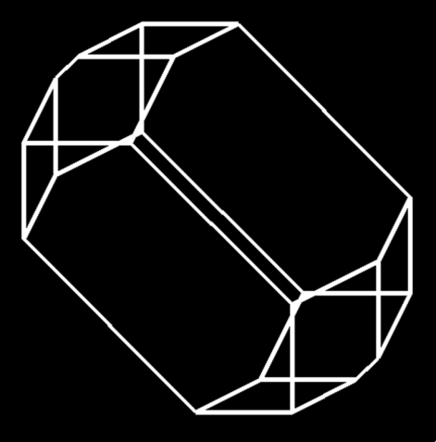
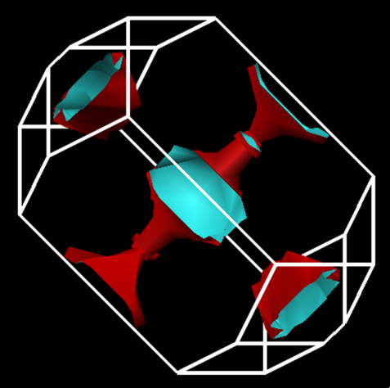
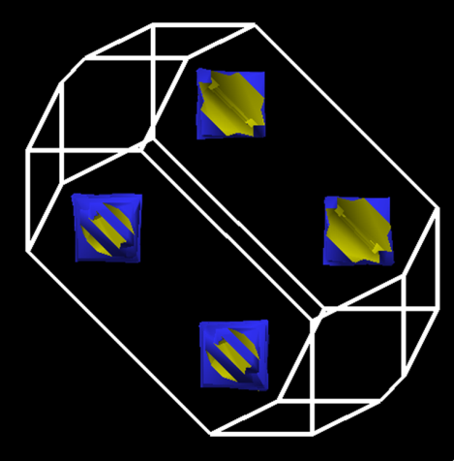
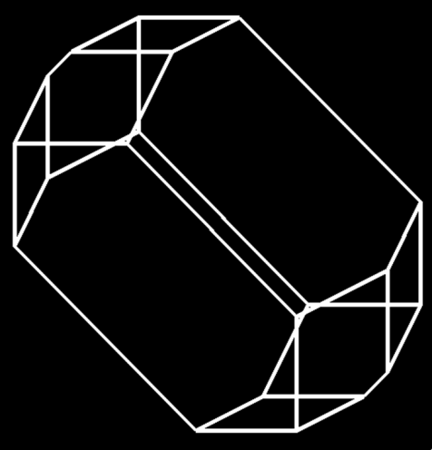
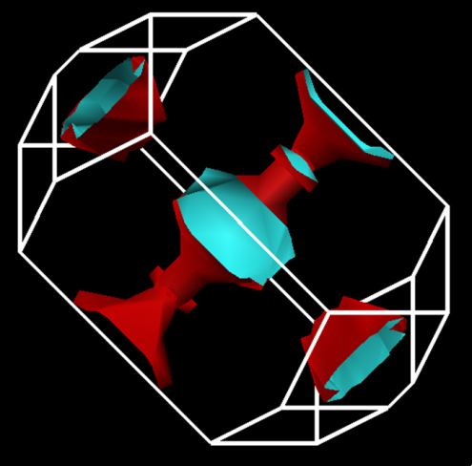
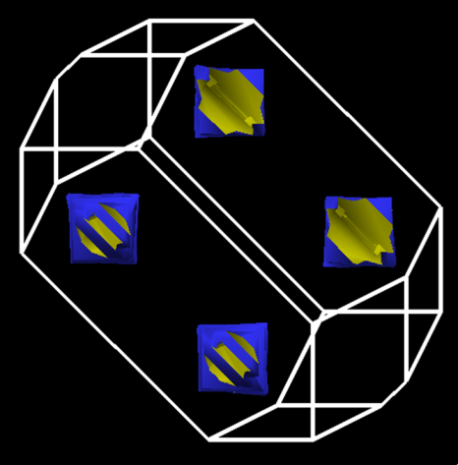
n
0.00
+0.15
-0.15
U
0
3
6

Slide 28
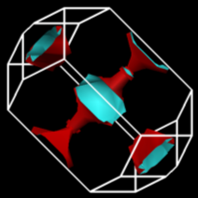
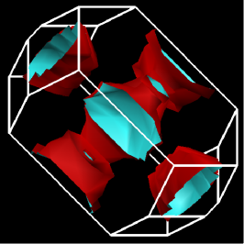
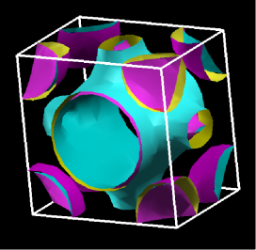
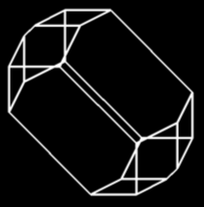
The Colossal Quantum Conundrum
T
U~U₀ exp(-α g), g < g*; 0, g > g*
U = 3
“Real Metal”
“Fermi Liquid”
“Funny Metal”
“Pseudogap”
“Fond AF Memories”
“SDW”
“NEEL”
“A-F”
“Funny Metal”
“Pseudogap”
“Fond AF Memories”
U = 6
U = 0
Superconductivity
“Insulator”
g*
“Conductor”
g
Somewhere in here there has to be “BCS-like” pairing!

Slide 29
Shakes or Spins or Both?
Are They Copacetic, Competitive…or…
…just another Conundrum?
What formalism is the HTSC analogy to Migdal-Eliashberg-McMillan?
(In other words, how do I calculate the value of the BCS gap?)
Original Strong Coupling, Eliashberg (JETP, 1960), McMillan (PR, 1968)
Generalized Linhard Response Function (RPA + fluctuations) Hu and O’Connell (PRB 1989)
Dielectric Response Function Kirznits, Maximov, Khomskii (JLTP 1972)

Slide 30

McMillan Strong Coupling
(Computationally implemented by Wierzbowska, et al., cond-mat/0504077, 2006)
What’s the HTSC equivalent?

Slide 31
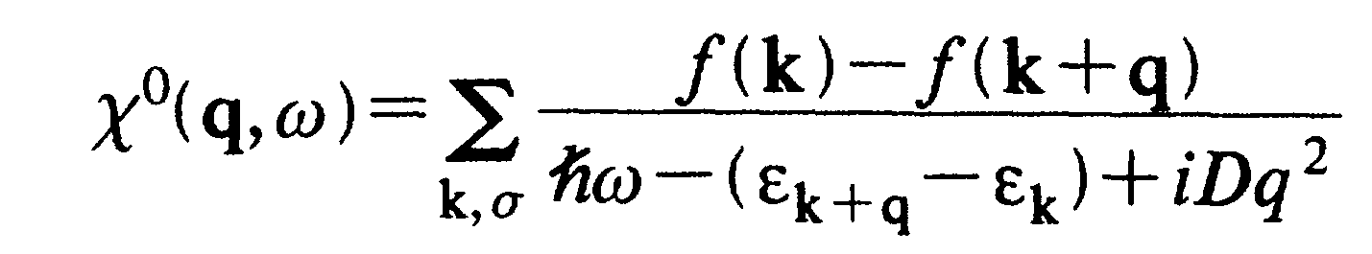
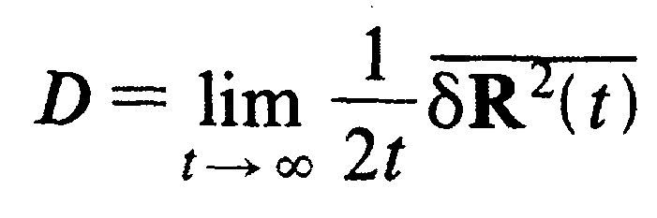
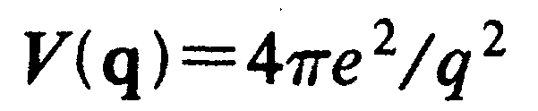
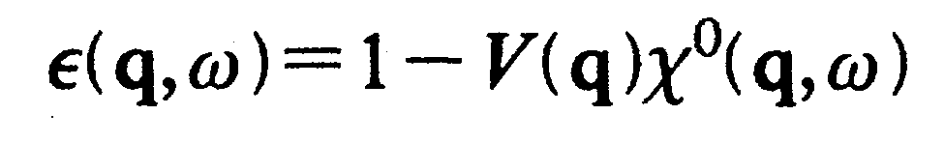
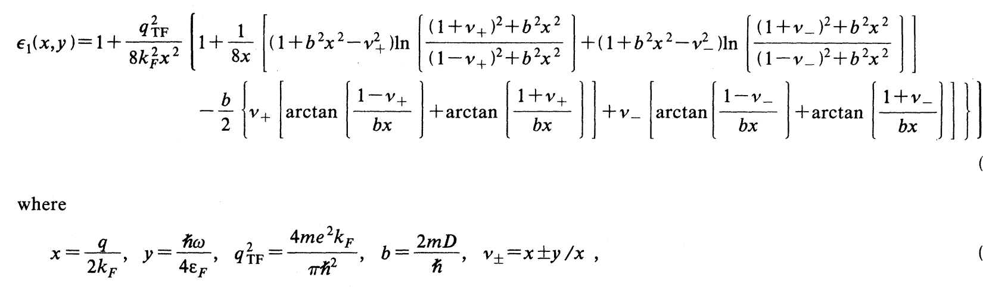
Generalized Linhard Function
“Fluctuations?”
“Empirical?”
HO (1989)

Slide 32
Dielectric Response Function
In principle, KMK can calculate the BCS gap for general “bosonic” fields, be they phonons, magnons, spin-ons, excitons, plasmons…or morons!
KMK (1972)

Slide 33
Bottom Line
Can studying CuO proxies with DFT
+ LDA+U
+ phonons
+ spins
provide insight into the origins of High-T_{C}?
I say “Yes,” but…
Size Matters…
…and I need a…
BIGGER COMPUTER!

Slide 34
Other CuO Proxy Structures
- Studies in Progress -

Slide 35

Films & Tubes
2.00 Å
5.226 Å
a = b = 3.905 Å
c = 6 x 3.905 = 23.43 Å
2 CuO segments per quadrant
16 Å between tubes

Slide 36

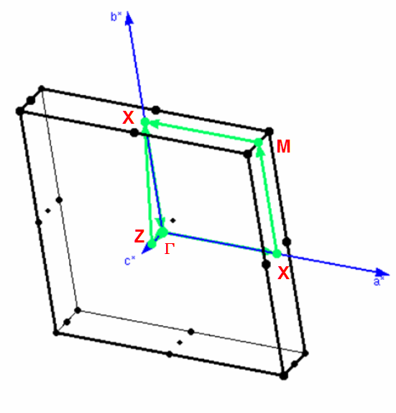
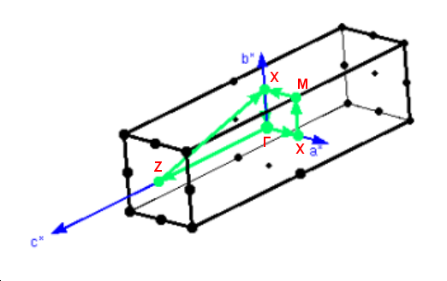
Films & Tubes
Zones

Slide 37



Films & Tubes
States
Landauer – Buettiger?

Slide 38
-- OK…Enough Already !
-- That’s all for now !
-- But Stayed Tuned…

