Slide 1



SLAC NATIONAL ACCELERATOR LABORATORY
100 Years of Superconductivity:
Perspective on Energy Applications
Paul M. Grant
W2AGZ Technologies
www.w2agz.com
SLAC
2575 Sand Hill Road
Menlo Park, CA 94025 USA
Session B4:07 Applied Physics
Friday 11/11/11 = 2:42-2:54 PM
Kavli 3rd Floor CR

Slide 2
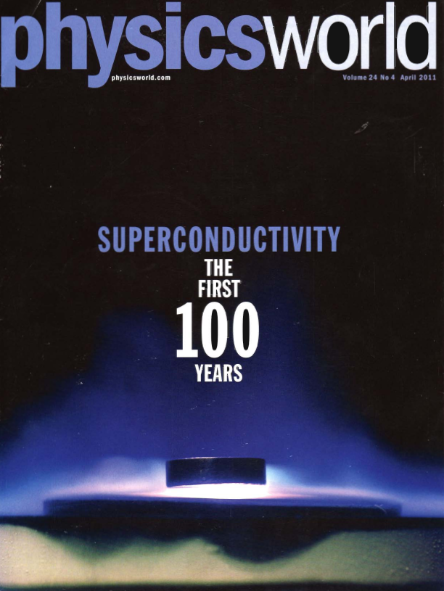

Slide 3

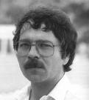
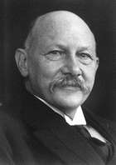

Discovery Anniversaries
100 25
1911 (4.2 K)
1986 (20-40 K)
Gilles Holst
Georg Bednorz
H. Kammerlingh-Onnes
Alex Mueller

Slide 4
To read this article, click here. To visit a nauseatingly long list of other popular presentations and publications by the author, click here.

Slide 5
1986
Another Big Surprise!
Onset T_{C} = 40 K !
Bednorz and Mueller
IBM Zuerich, 1986

Slide 6
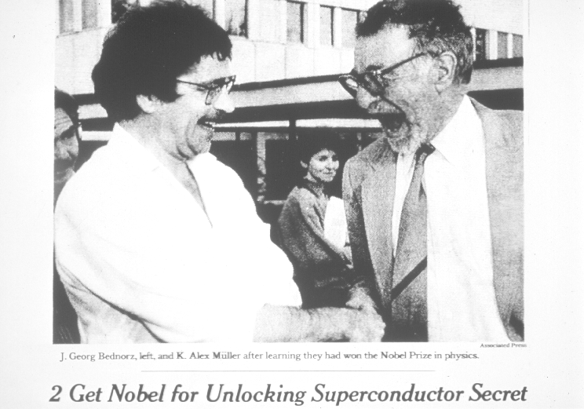
1987
“The Prize!”

Slide 7
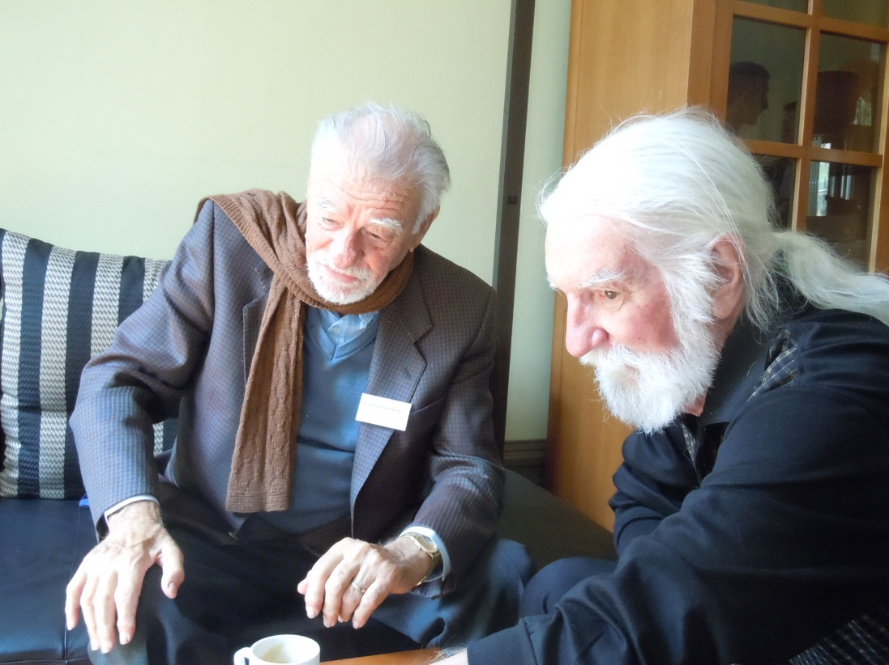
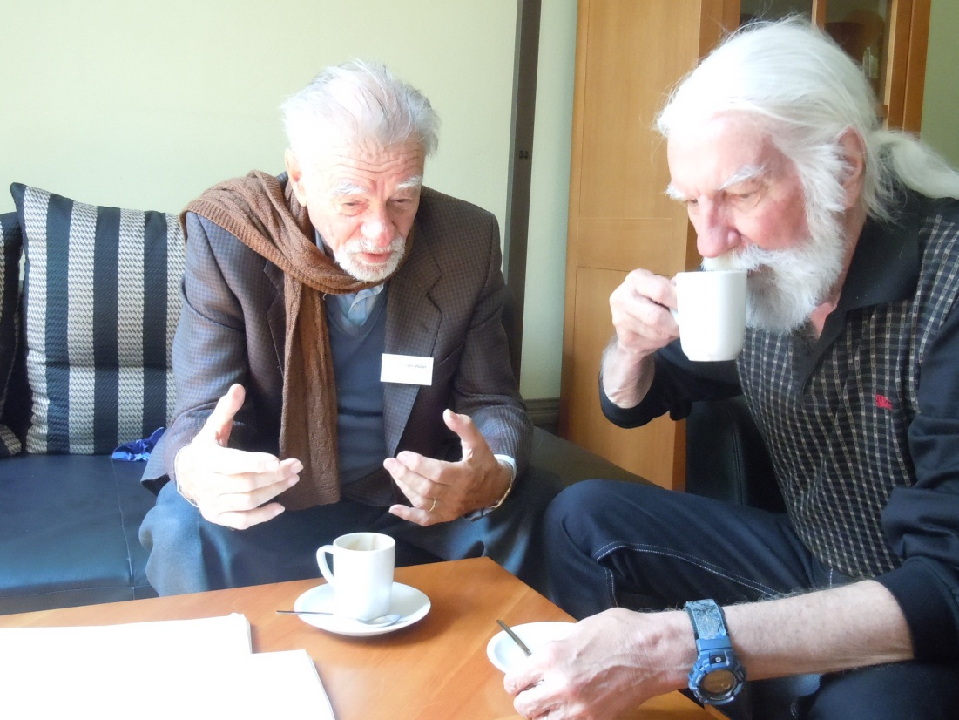
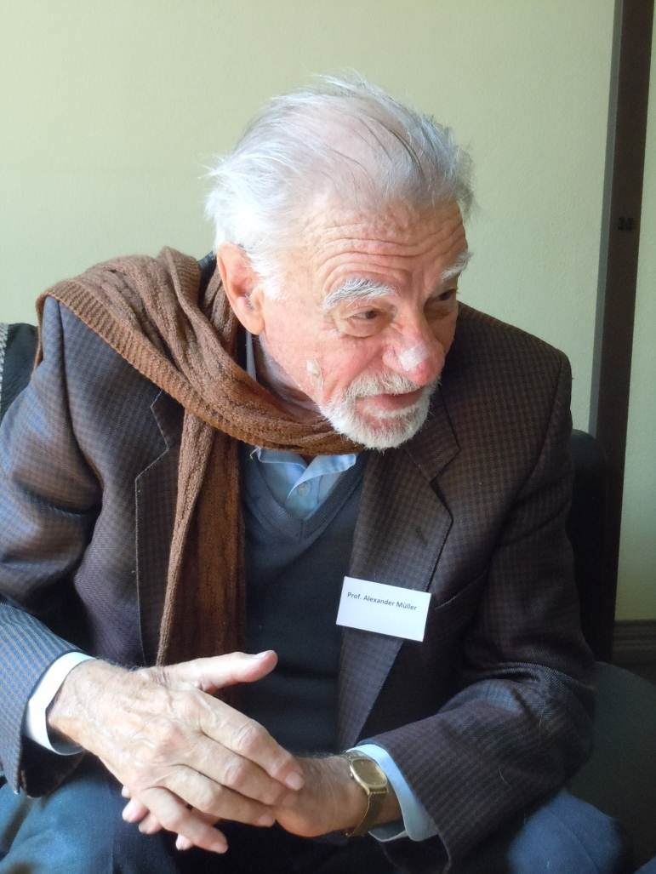
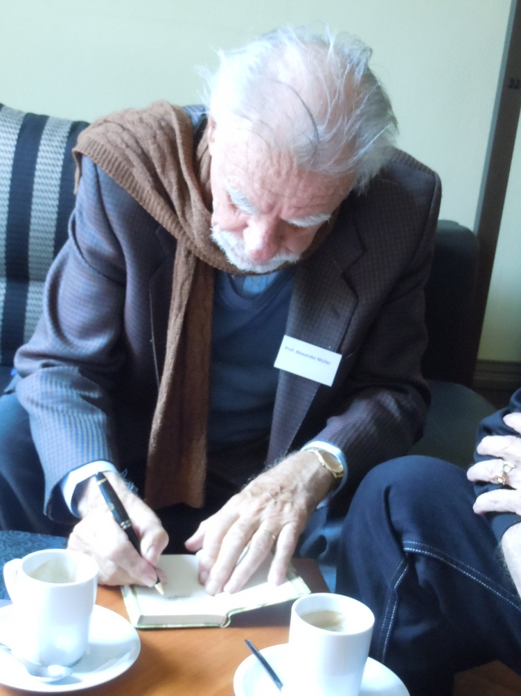



Slide 8
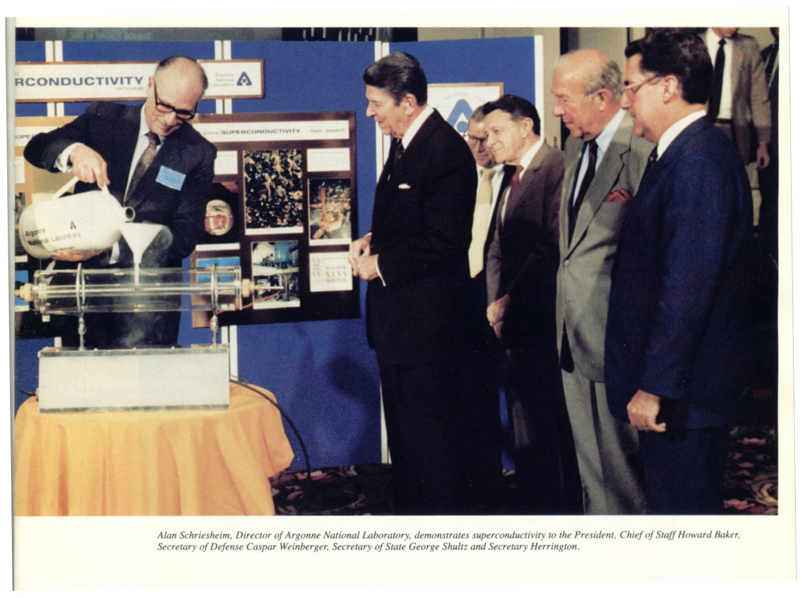
“The Great Communicator”
To view a video of Reagan’s talk and other selected “outakes” from the
Woodstock of Physics Era, go to http://www.w2agz.com/Video%20Content/Superconductivity/ or click here.
NB! Some of these wmv files are huge, so deploy a good, fast “streamer.”
Notes:
8

Slide 9
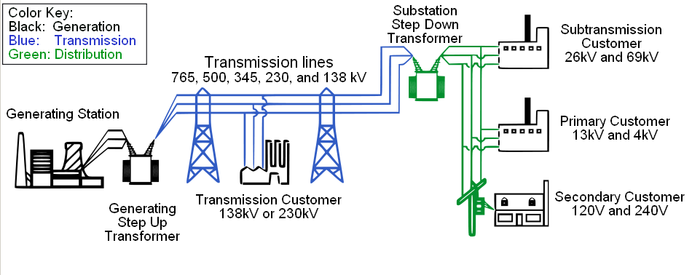
Where Can We Apply Superconductivity to Electric Power?
Potentially Everywhere
Notes:
9
9

Slide 10
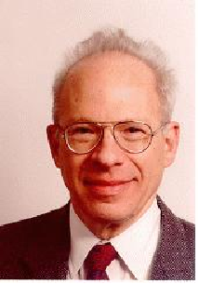

(pdf)
Submitted 24 June 1966
“What’s past is prologue” (Bill S.)
Rationale: Huge growth in generation and consumption in the 1950s; cost of transportation of coal; necessity to locate coal and nuke plants far from load centers.
Furthermore, the utilities have recently become aware of the advantages of power pooling. By tying together formerly independent power systems they can save in reserve capacity (particularly if the systems are in different regions of the country), because peak loads, for example, occur at different times of day, or in different seasons. To take advantage of these possible economies, facilities must exist for the transmission of very large blocks of electrical energy over long distances at reasonable cost.

Slide 11
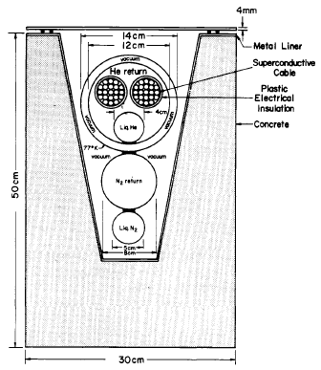
Specs
LHe cooled
Nb₃Sn (T_{C} = 18 K)
  J_{C} = 200 kA/cm²
  H* = 10 T
Capacity = 100 GW
  +/- 100 kV dc
  500 kA
Length = 1000 km

Slide 12
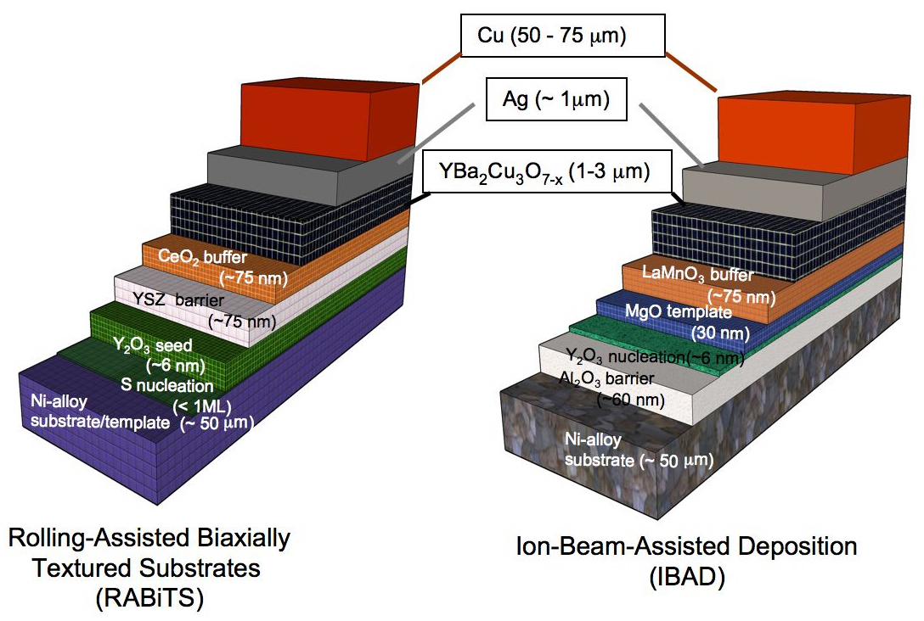
Gen II Coated Conductor
American Superconductor
SuperPower

Slide 13
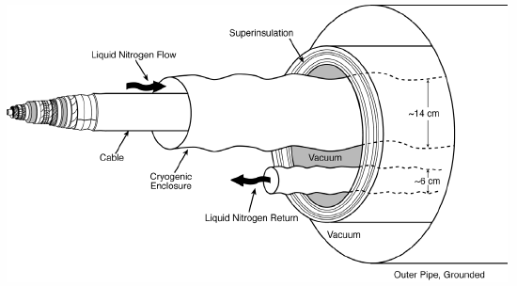
A Superconducting dc Cable
EPRI Report 1020458 (2009)
Hassenzahl, Gregory, Eckroad, Nilsson, Daneshpooy, Grant
Monopole Specs
100-kV, 100-kA, 10-GW
66 K < T< 69 K

Slide 14
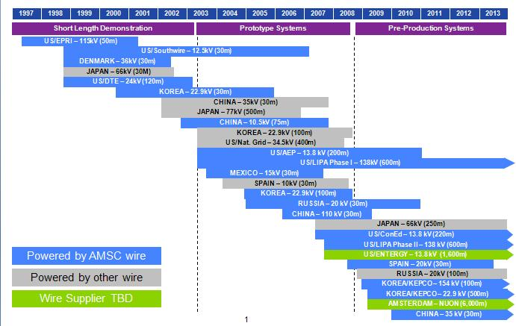
HTSC Cable Projects Worldwide
Past, Present…Future?
Notes:
14

Slide 15
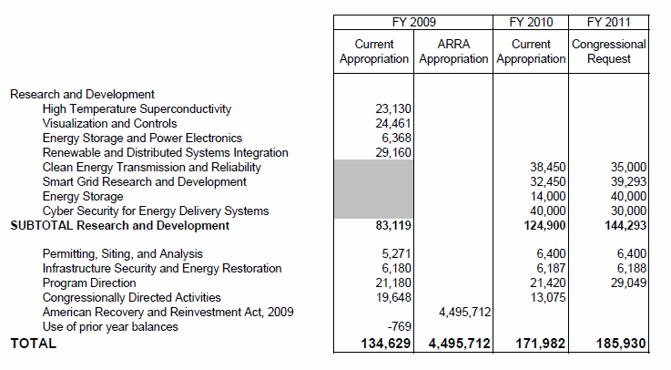
US Department of Energy
Budget of the Office of Electricity Delivery and Energy Reliability: FY 2010-11 (10³ USD)
? ?
WOW ! “Obama Cash”

Slide 16
A Modest Proposal
-Upbraiding the Utilities-
More than a half-century of successful demonstrations/prototyping power applications of superconductivity (1950s - >2000, in Japan and US)…low- and high-Tc…now sitting “on the shelf.”
Why aren’t they “in the field” today?
Is their absence due to…
  Cost?
  Hassle?
  or “lack of compelling” need?
  or “all of the above?”

Slide 17
US utilities have long claimed to “want”…
  Efficient long-length cables
  Oil-free transformers
  Energy Storage
  Fast fault current limiters at high voltage (FCLs)
  Efficient rotating machinery (aka, motors and generators)
Well, we got ‘em. Utilities claim:
  They’re too high-cost, because,
    The wire is too expensive.
    They have to be kept too cold.
    Electricity is cheap, and “in field” energy efficiency is not a “compelling” driver
  Anyway, we can solve our needs by incrementally improving the “old” ways (don’t ever underestimate the ingenuity of a utility engineer to improvise, adopt and adapt)

Slide 18
“Then…a modest proposal…”
If the “cost” of the wire in any given application were to be “zero,”…
Would the utilities then “buy them?” And sign a “letter of intent” to purchase “x” number?
  e.g., Fault Current Limiters, for which US utilities have long claimed a need
“Zero cost” would be obtained as a Federal or State “tax credit” for the wire cost of the quantity purchased by the utility equipment vendor or the utility itself…
Well?

Slide 19
Questions for US HTSC Wire Manufacturers
American Superconductor
  Estimated gross revenue from wire sales (and actual delivery) for FY2011?
  Note: 3Q10 gross revenue from wire sales was 1.8% of total quarter
  Flash: On 10/17/11 American Superconductor becomes AMSC!
SuperPower
  Same as AMSC #1 above
  Estimated employee/manpower growth in CY2011
Ultera/Southwire
  Is Carrolton plant cable (Gen 1) still in operation?
  Plans to replace/extend?
Nexans/AMSC/LIPA
  Status of Gen II wire/cable upgrade
AMSC/ConEd/DHS
  Status/funding of Project Hydra

Slide 20
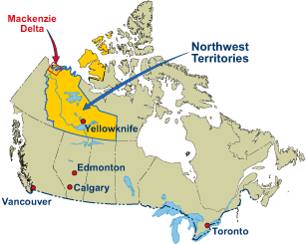
A Canadian’s View of the World
Notes:
A Canadian Worldview
Talking Points
Much of North America’s remaining natural gas reserves are located along the Artic Ocean North Shore and shared between the US (Alaska) and Canada. For the past 25 years, the Canadian government, with private companies, has researched the construction of a massive pipeline from the Mackenzie River Delta to Alberta. It now appears this project may go forward in 2006 with gas transport beginning in 2009. More information can be found at the MVP website, http://www.mackenziegasproject.com.
The Mackenzie Valley Project (MVP) presents an example of opportunities that might arise elsewhere in the world to combine the delivery of natural gas with wellhead generated electricity via a Liquid Natural Gas SuperCable (to be discussed).
It is estimated that the Mackenzie Delta reserves, once full production begins, will last 15 – 20 years. When exhausted, remote “wellhead” sites such as these present opportunities for the construction of “hydricity” producing nuclear plants to supplant indefinitely natural gas, and delivery hydrogen and electricity over the same SuperCable pipeline, if it has been pre-engineered for such conversion.

Slide 21
Mackenzie Valley Pipeline

Slide 22
It’s 2030
The Gas runs out!
We have built the LNG SuperCable years before
Put HTCGR Nukes on the now empty gas fields to make hydrogen and electricity (some of the electricity infrastructure, e.g., I/C stations, already in place)
Enable the pre-engineered hydrogen capabilities of the LNG SuperCable to now transport protons and electrons.
Notes:
It’s 2030
Talking Points
Mostly self-explanatory.
The LNG version of the SuperCable must properly designed to eventually carry hydrogen.
Water supplies for hydrogen feed-stock must be available...may require de-salinization.

Slide 23
The Hydricity SuperCable
Dual Delivery of Hydrogen and Electric Power
Flowing liquid hydrogen or cold H₂ gas under pressure delivers power and also serves as the refrigerant to …
Enable the transmission of large amounts of electric power losslessly using superconductors
Thermal Insulation
Electrical Insulation
I
I
Enclosed in underground tunnel or trench
Notes:
The Hydricity SuperCable
Talking Points
Here illustrated are the essential elements of the Hydricity SuperCable, the multi-kilometer “umbilical cord” of the SuperGrid. Details on various possible designs can be reviewed by clicking on “More…” above the EPRI logo. Important points are:
Hydrogen is at once an energy (power) delivery agent, a means of storing electricity, and can act as a cryogen to support the lossless direct current transmission of electricity over superconducting wires.
This slide is intended to illustrate generally how this could be accomplished in a simple hydricity cable circuit laid underground in a trench or tunnel.
The nominal dimensions of the cable cross-section for 1 GW delivery of hydrogen and electricity would been 5 cm for the inner hydrogen cylinder surrounded by 0.5 cm of superconductor. The hydrogen can be either in its liquid state (21 Kelvin) or cold, high pressure gas (77 Kelvin, 2000 psia), both states at sufficiently low temperatures to operate the present generation of high temperature superconductors.
There are many variations on this basic design, which can be found by clicking “More…” above the EPRI logo.

Slide 24
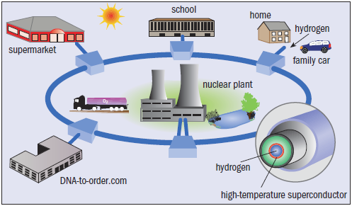
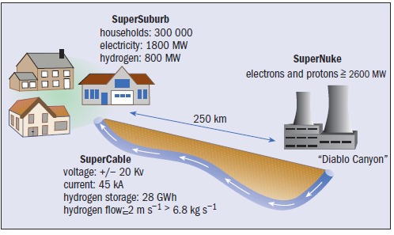
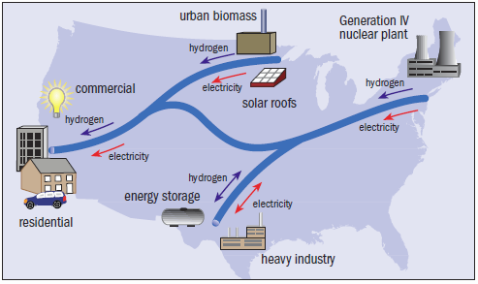
SuperCities - SuperSuburbs – SuperGrids
Grant, Overbye, Starr, SciAm 295, 76 (2006)

Slide 25
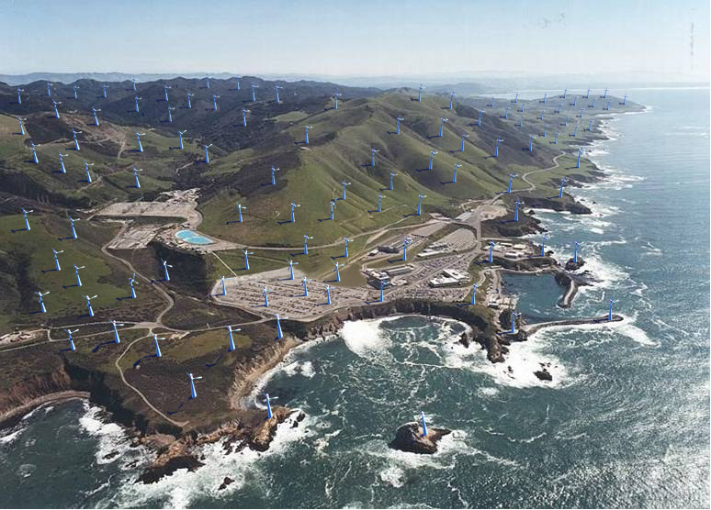
Diablo Canyon
Notes:
25

Slide 26
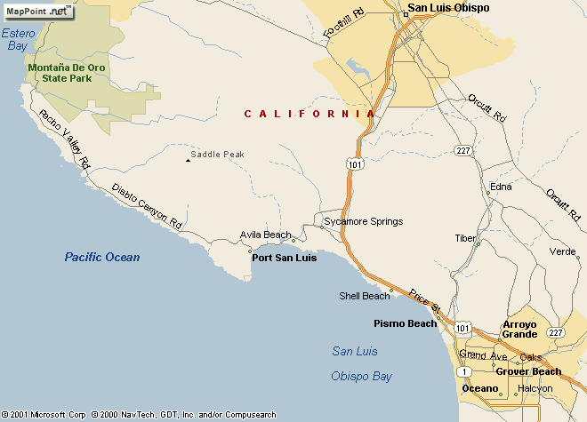
California Coast Power
Diablo Canyon
2200 MW
Power Plant
Wind Farm
Equivalent

Slide 27

Powering Europe with Sahara Solar
IASS Workshop, May 2011

Slide 28
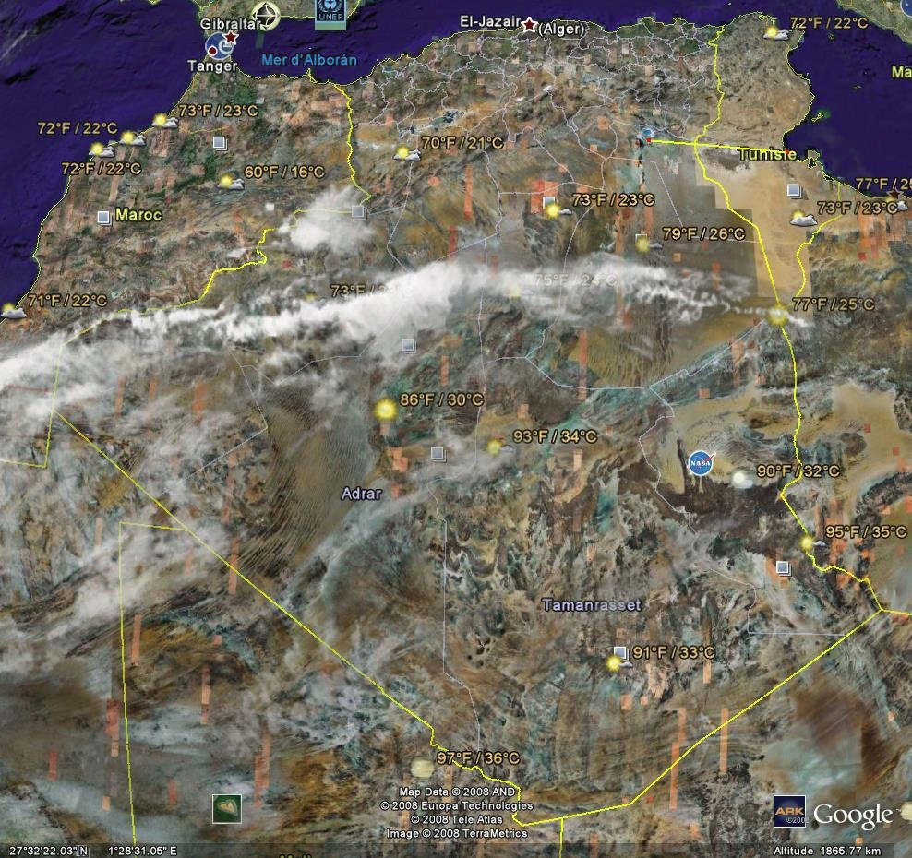
Go Where the Sun Shines

Slide 29
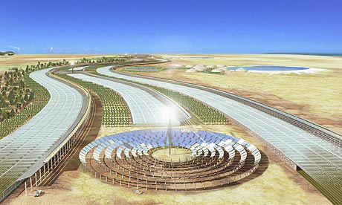
Solar – PV & Thermal

Slide 30
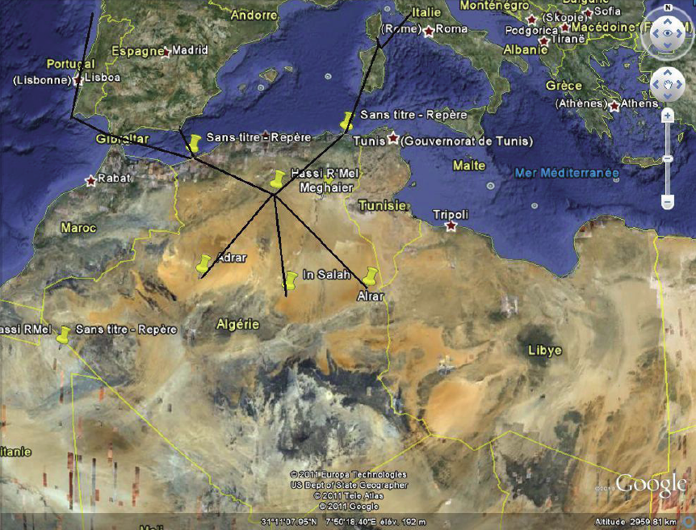
Superconducting SolarPipe

Slide 31
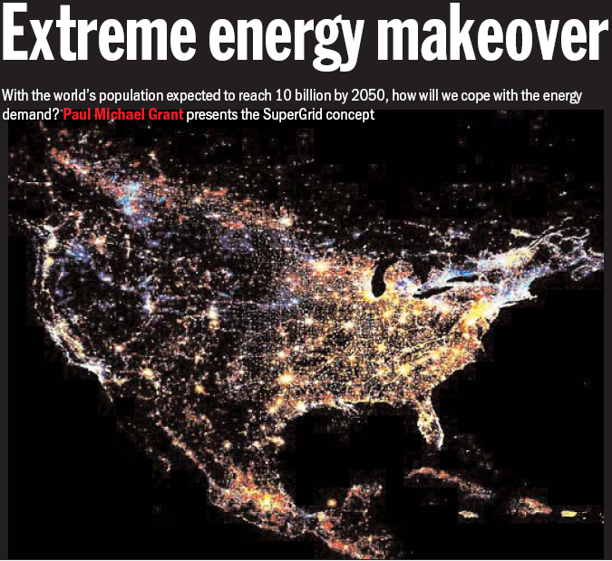
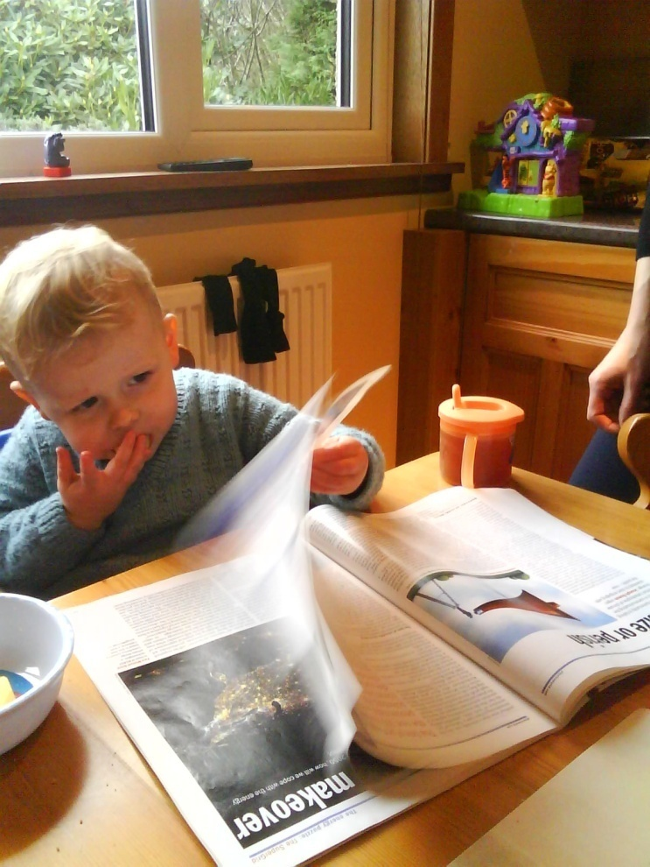
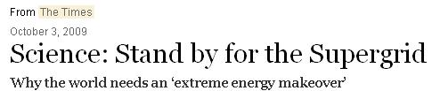
Physics World, October 2009
…a future editor of
Nature…?
Go here for pdf of Times piece
Notes:
31

Slide 32
Superconductors
- The Long Road Ahead –
Foner & Orlando (1988)
“Widespread use of these
[high temperature] superconducting technologies will have far more to do with
questions of public policy and economics than with the nature of the new materials.”

Slide 33
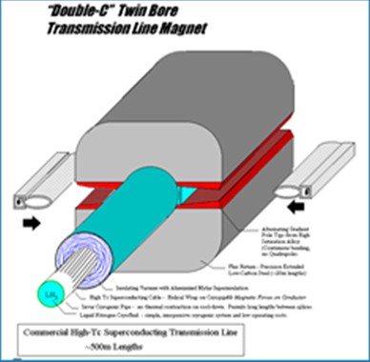
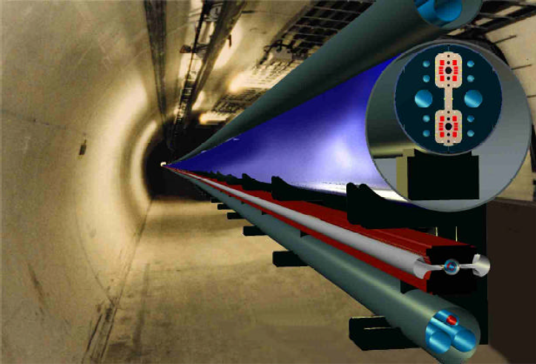
The Next American Big-Bang-a-Tron
(“The Pipetron” or “Beyond Higgs”)
See Lance Cooley’s IASS Talk
Bob Wilson
Bill Foster
Peter Limon
Ernie Malamud
...Limon Report
150 TeV COM Hadron Collider
based on superferric magnets energized by a 50 kA superconducting dc cable – Tunnel enclosure ~ 2.5 m dia, 800 km circumference.

Slide 34
Some Obscure Axioms of History
There is nothing new under the sun
Ecclesiastes 1:9-14
What’s past is prologue
The Tempest, by Bill S.
Those who cannot remember the past are bound to repeat it
George Santayana
History is more or less bunk
Henry Ford
I can’t think about tomorrow...I’m as lost as yesterday
Tomorrow, by Bob Seger (mp3)
If I’m not smart enough to solve it (any problem...social or scientific), neither is anyone else!
Anon. (hint: initials PMPG)

Slide 35

“You can’t always get what you want…”

Slide 36

“…you get what you need!”
(mp3)

