Slide 1



SLAC NATIONAL ACCELERATOR LABORATORY
The Great Quantum Conundrum
Paul M. Grant
W2AGZ Technologies
www.w2agz.com
SLAC
2575 Sand Hill Road
Menlo Park, CA 94025 USA
SLAC
Sand Hill Road
Menlo Park, CA

Slide 2
1986
Another Big Surprise!
Onset T_{C} = 40 K !
Bednorz and Mueller
IBM Zuerich, 1986

Slide 3
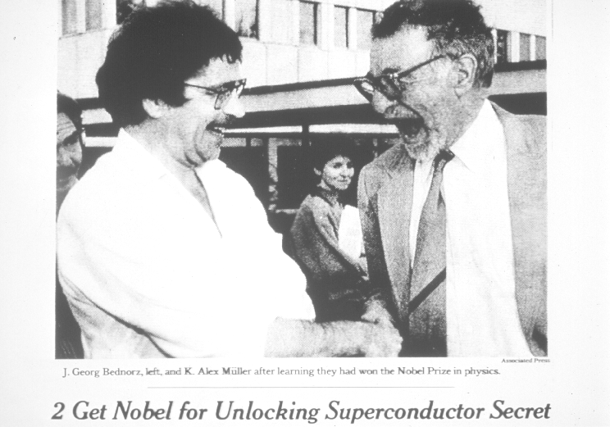
1987
“The Prize!”

Slide 4
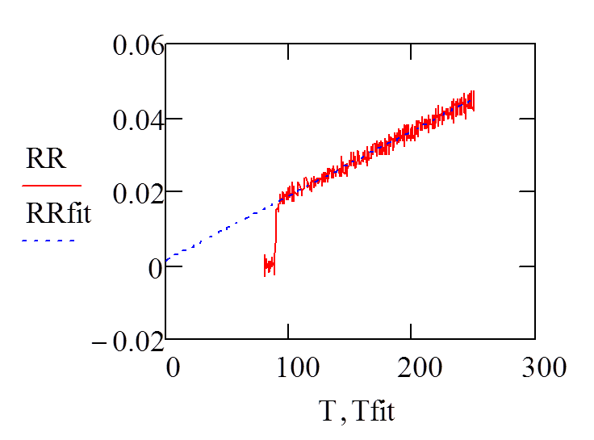
A quarter-centrury after Bednorz-Mueller, it is still not clear why:
Tc is so high
The normal state appears non-Fermi liquid-like
That is the Great Quantum Conundrum

Slide 5
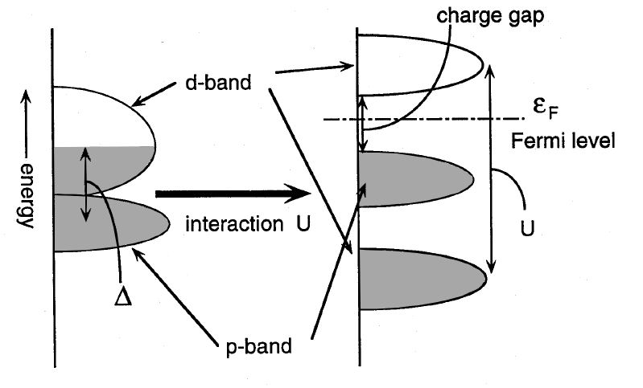
Transition Metal Oxides
“Should be Metals, But Aren’t” (Charge Transfer Insulators, Instead)
RPA Doesn’t Work!
Mott
Hubbard
Anderson
Brooks
Feinlieb
After Imada, et al, RMP 70, 1039 (1998)‏
Notes:
5

Slide 6
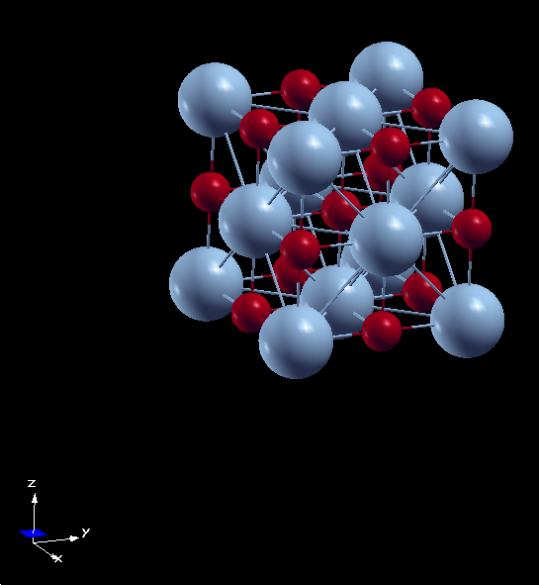
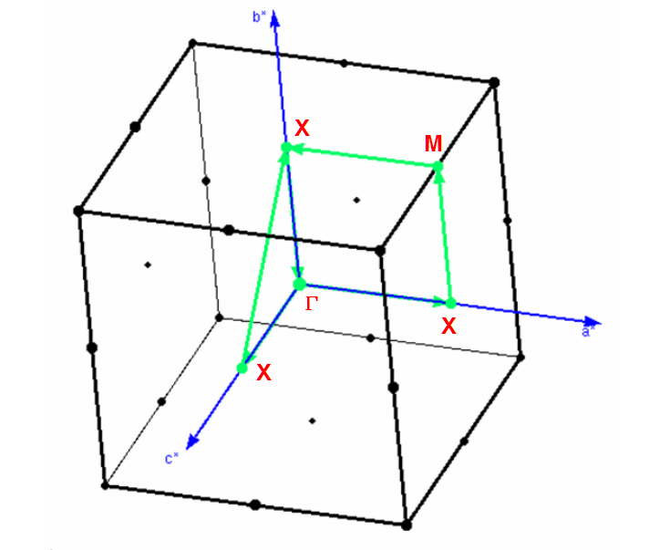
Cubic Rocksalt TMOs
Direct and Reciprocal Lattices
TM
O
Cubic Rocksalt TMO
a = b = c

Slide 7
Cubic Rocksalt Divalent TMOs
TMO 3d Config Properties
MnO 5 MH-CTI (5.6)
FeO 6 MH-CTI (5.9)
CoO 7 MH-CTI (6.3)
NiO 8 MH-CTI (6.5)
CuO 9
XX Doesn't Exist!
Why Not?
See Imada, Fujimore, Tokura, RPM 70 (1988)‏
Notes:
7

Slide 8
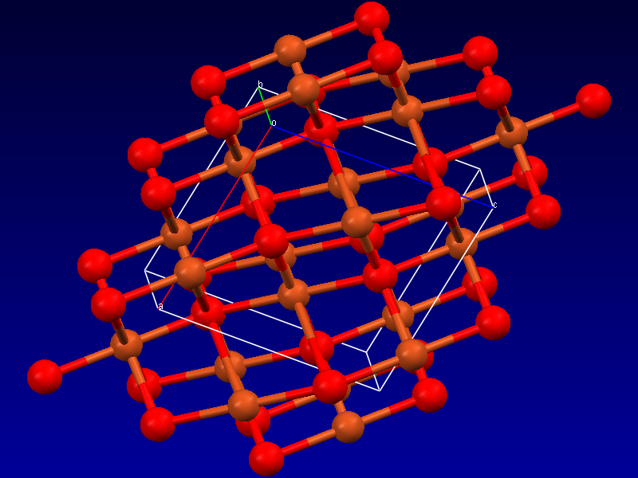
Tenorite (Monoclinic CuO)‏
What God wants…just ask her!
Cu
O
Notes:
8
8

Slide 9
Cubic Rocksalt Divalent TMOs
TMO 3d Config Properties
MnO 5 MH-CTI (5.6)
FeO 6 MH-CTI (5.9)
CoO 7 MH-CTI (6.3)
NiO 8 MH-CTI (6.5)
CuO 9
XX Doesn't Exist!
Why Not?
See Imada, Fujimore, Tokura, RPM 70 (1988)‏
Notes:
9

Slide 10
Tenorite (Monoclinic CuO)‏
What God wants…just ask her!
Cu
O
Notes:
10
10

Slide 11

The Great Quantum Conundrum
T
“Non-Fermi Liquid”
‘Nematic Fermi Fluids’
“Whatever!”
“SDW”
“NEEL”
“A-F”
“Whatever!”
“Fermi Liquid”
“Dilute Triplon Gas”
“Whatever!”
“Insulator”
g*
_{“QCP”}
“Conductor”
g
ρ_{local}

Slide 12
The Colossal Quantum Conundrum
T
“Real Metal”
“Fermi Liquid”
“Funny Metal”
“Pseudogap”
“Fond AF Memories”
“SDW”
“NEEL”
“A-F”
“Funny Metal”
“Pseudogap”
“Fond AF Memories”
Superconductivity
“Insulator”
g*
_{“QCP”}
“Conductor”
g
ρ_{local}

Slide 13
Cubic Rocksalt Divalent TMOs
TMO 3d Config Properties
MnO 5 MH-CTI (5.6)
FeO 6 MH-CTI (5.9)
CoO 7 MH-CTI (6.3)
NiO 8 MH-CTI (6.5)
CuO 9
XX Doesn't Exist!
Why Not?
See Imada, Fujimore, Tokura, RPM 70 (1988)‏
Notes:
13

Slide 14
Tenorite (Monoclinic CuO)‏
What God wants…just ask her!
Cu
O
Notes:
14
14

Slide 15
The Great Quantum Conundrum
T
“Non-Fermi Liquid”
‘Nematic Fermi Fluids’
“Whatever!”
“SDW”
“NEEL”
“A-F”
“Whatever!”
“Fermi Liquid”
“Dilute Triplon Gas”
“Whatever!”
“Insulator”
g*
_{“QCP”}
“Conductor”
g
ρ_{local}

Slide 16
The Colossal Quantum Conundrum
T
“Real Metal”
“Fermi Liquid”
“Funny Metal”
“Pseudogap”
“Fond AF Memories”
“SDW”
“NEEL”
“A-F”
“Funny Metal”
“Pseudogap”
“Fond AF Memories”
Superconductivity
“Insulator”
g*
_{“QCP”}
“Conductor”
g
ρ_{local}

Slide 17
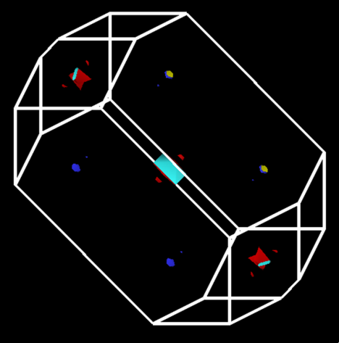
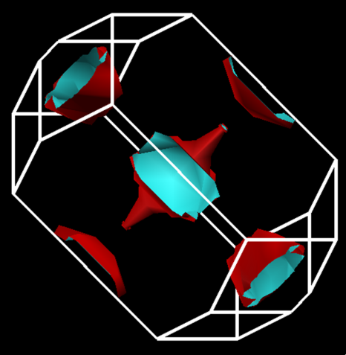
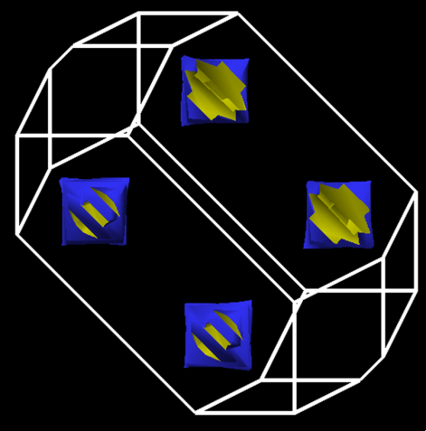
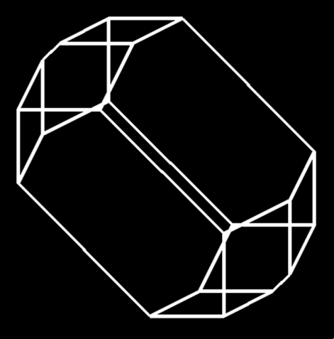
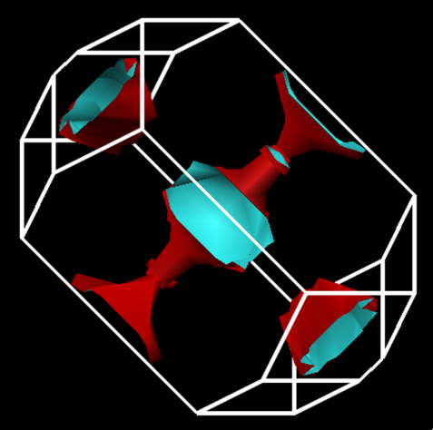
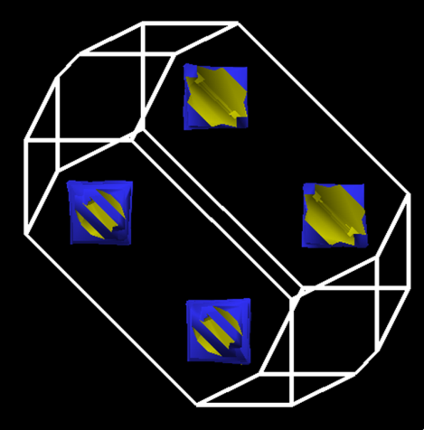
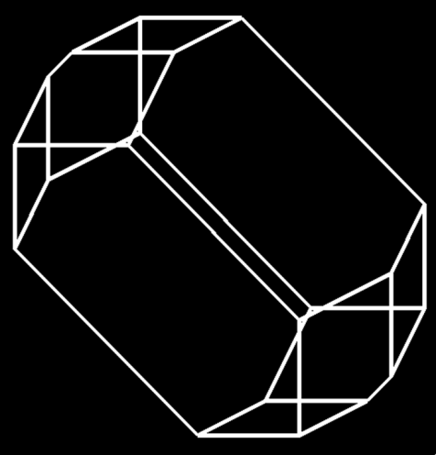
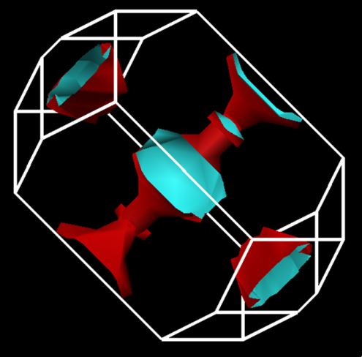
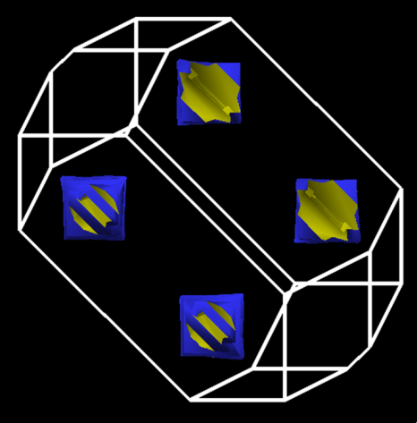
n
0.00
+0.15
-0.15
U
0
3
6

Slide 18
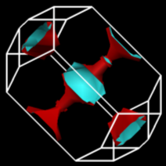
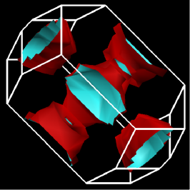
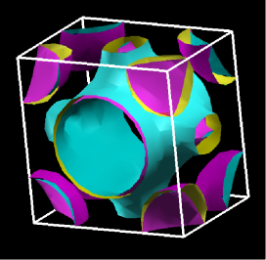
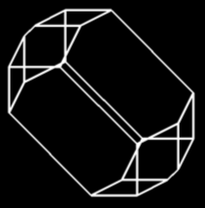
The Colossal Quantum Conundrum
T
U~U₀ exp(-α g), g < g*; 0, g > g*
U = 3
“Real Metal”
“Fermi Liquid”
“Funny Metal”
“Pseudogap”
“Fond AF Memories”
“SDW”
“NEEL”
“A-F”
“Funny Metal”
“Pseudogap”
“Fond AF Memories”
U = 6
U = 0
Superconductivity
“Insulator”
g*
“Conductor”
g
Somewhere in here there has to be “BCS-like” pairing!

Slide 19
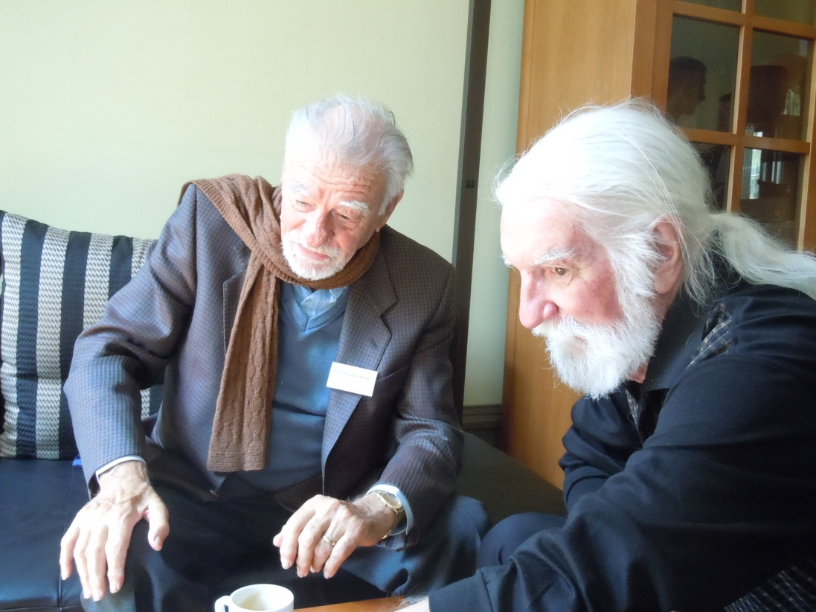
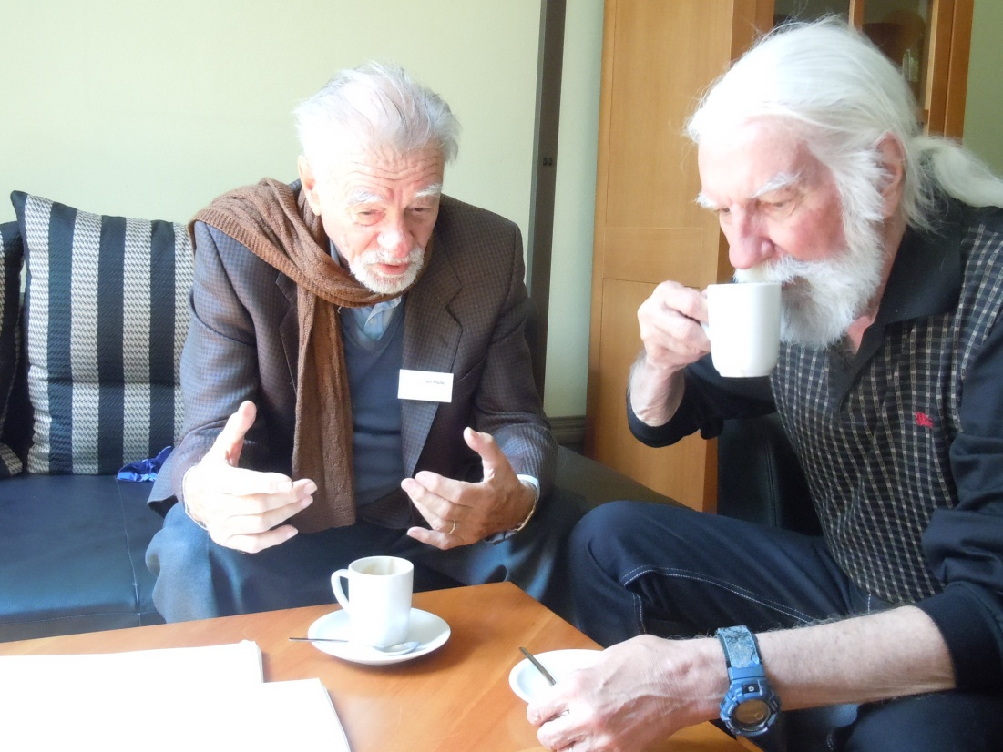
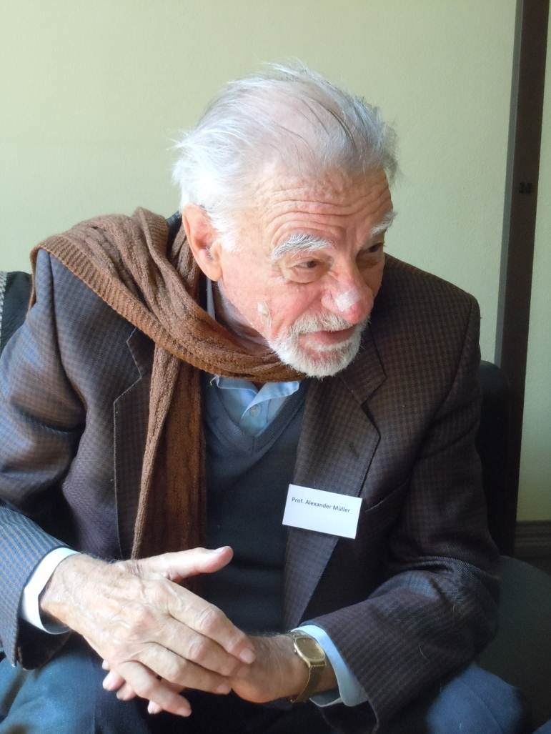
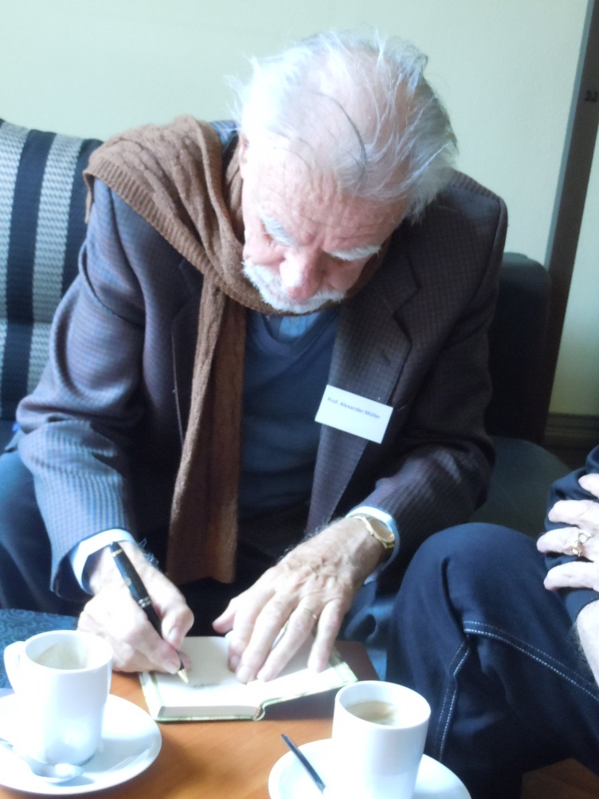



Slide 20
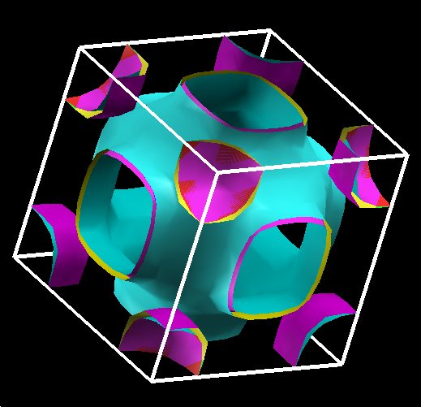
Rocksalt CuO Fermiology (U = 0 eV)
(8 Bands Combined)
Note (Near) Degeneracies!
Jahn-Teller Unstable?
Alex M?
(maybe you were on the right track, after all!)
Notes:
20

Slide 21
Non-Magnetic (U = 0) Cubic Rocksalt CuO
-- Electron-Phonon Properties --
α²F(ω)
λ ~ 0.6 – 0.7
Consistent with other non-magnetic “HTSCs”
 | T_{C} (K) | λ | μ*
K₃C₆₀ | 16.3 | 0.51 | -
Rb₃C₆₀ | 30.5 | 0.61 | -
Cs₃C₆₀ | 47.4 | 0.72 | -
σ = 0.04
Notes:
21
21

Slide 22
Shakes or Spins or Both?
Are They Copacetic, Competitive…or…
…just another Conundrum?
What formalism is the HTSC analogy to Migdal-Eliashberg-McMillan?
(In other words, how do I calculate the value of the BCS gap?)
Original Strong Coupling, Eliashberg (JETP, 1960), McMillan (PR, 1968)
Generalized Linhard Response Function (RPA + fluctuations) Hu and O’Connell (PRB 1989)
Dielectric Response Function Kirznits, Maximov, Khomskii (JLTP 1972)

Slide 23
McMillan Strong Coupling
(Computationally implemented by Wierzbowska, et al., cond-mat/0504077, 2006)
What’s the HTSC equivalent?

Slide 24
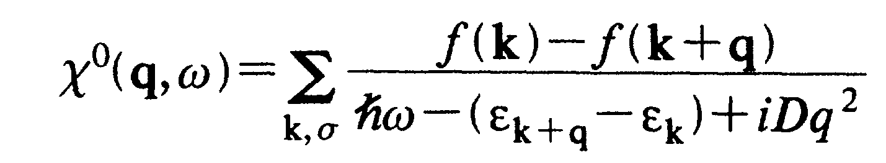
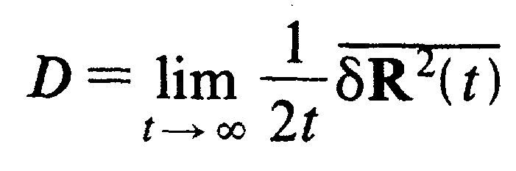
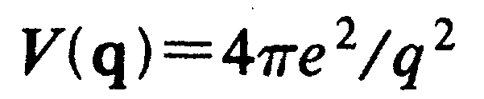
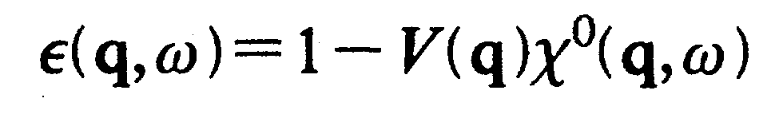
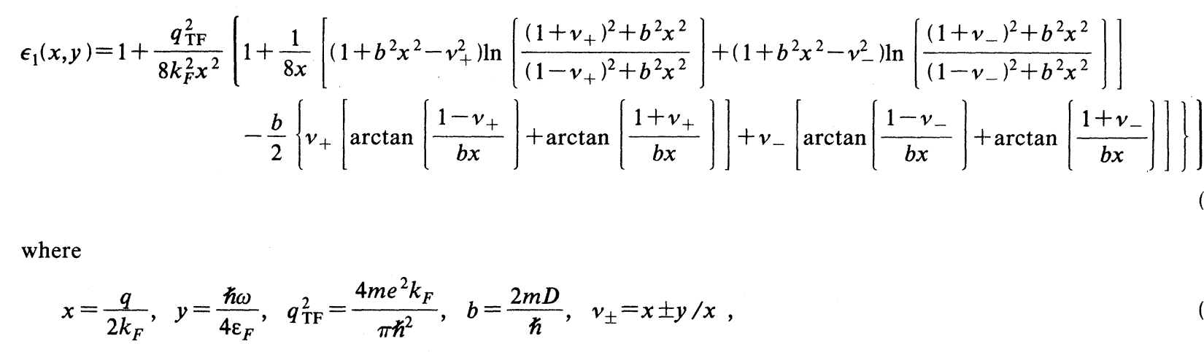
Generalized Linhard Function
“Fluctuations?”
“Empirical?”
HO (1989)

Slide 25
Dielectric Response Function
In principle, KMK can calculate the BCS gap for general “bosonic” fields, be they phonons, magnons, spin-ons, excitons, plasmons…or morons!
KMK (1972)

Slide 26
So...
Let’s “Shut up and start calculating.”
  David Mermin, Cornell, as quoted by yours truly, in Nature 4 August 2011.
I’d like to help...
  Then,

Slide 27
Bottom Line
Can studying CuO proxies with DFT
+ LDA+U
+ phonons
+ spins
provide insight into the origins of High-T_{C}?
I say “Yes,” but…
As Bob Laughlin says, “Size Matters…!”
…and I need a…
BIGGER COMPUTER!

