Slide 1
Setup

Slide 2
A Personal Journey in Superconductivity
(and a few other “interesting technologies!”)
-- IBM, EPRI, and Beyond --
Paul M. Grant
www.w2agz.com
Aging IBM Pensioner
Energy/SIG Presentation
1060 La Avenida
Mountain View, CA
Kelly Building
12:00N – 1:00PM
Tuesday, 7 August 2012

Slide 3
PMG Timeline
IBM (1953-1993)
  Project SAGE (IBM, MIT, USAF) (1953-56)
  IBM Education Plan (1956-65)
  San Jose/Almaden (1965-90)
  Sabbatical @ UNAM (1990-93)
EPRI (1993-2004)
  Science Fellow (Superconductivity, Power Electronics Devices, Fusion, “Novel Concepts”)
  5-10 M$ Annual Program
W2AGZ Technologies (2004-?)
  Visionary Energy Societies (SuperCity, SuperSuburb, SuperGrid)
  “Due Diligence” Consulting
  Visiting Scholar, Stanford University
  Staff Associate, JPL/NASA/CalTech
  Superconductivity Committee Member, IASS, Potsdam, Germany
  Writing Commentary for Nature, Physics World, Physics Today, Power Magazine, Cold Facts, SJ Merc-News...
  Uncovering the Secret of HTSC !

Slide 4
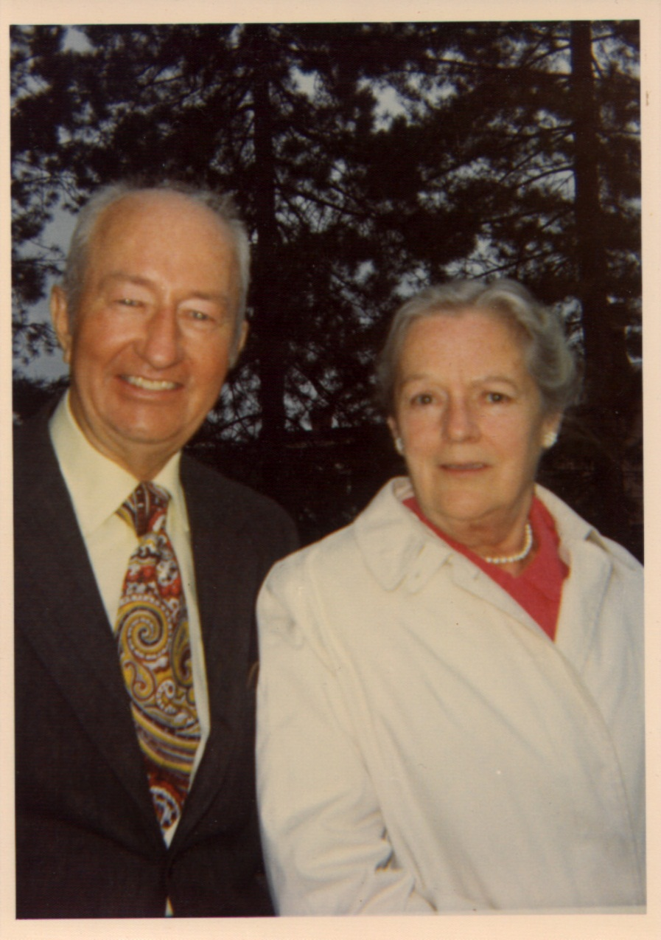
…in their shoes…
Paul Archibald Grant
  W2AGZ
  US Navy, WWII
  IBM, 1948-1974
  Ski Patrol, 1948-1970
Mary Ann Whalen Grant
  CYO BB Champ, 1921
  NYS Bowling Champ, 1939
  Women’s Baseball, ‘33-’47
  CHG&E, 1927-1965

Slide 5
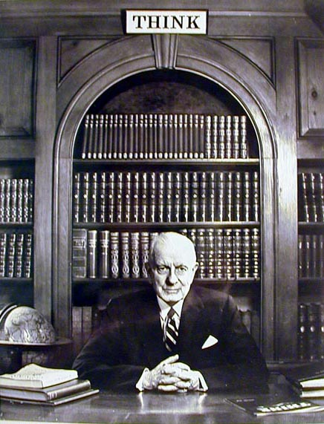
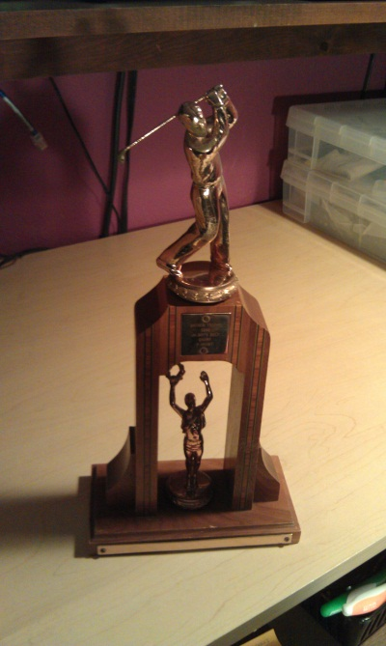
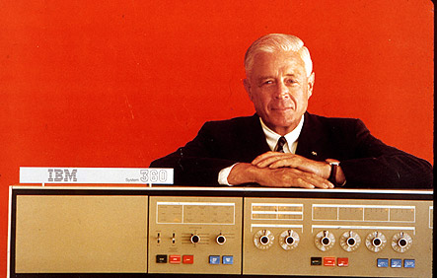
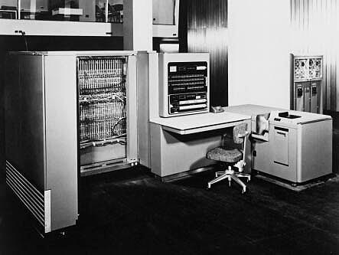
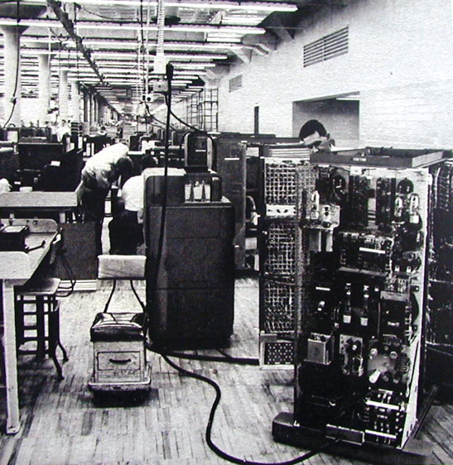
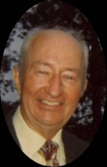
IBM – 100 Years
1952
Grant-Whalen IBM Family
-Poughkeepsie-
604 (1948)
701 (1952)

Slide 6
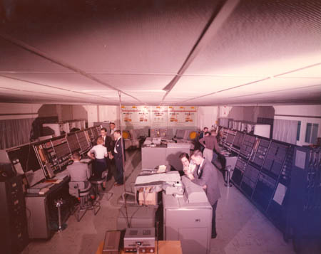
1953
Project Sage – IBM/MIT
Notes:
6

Slide 7
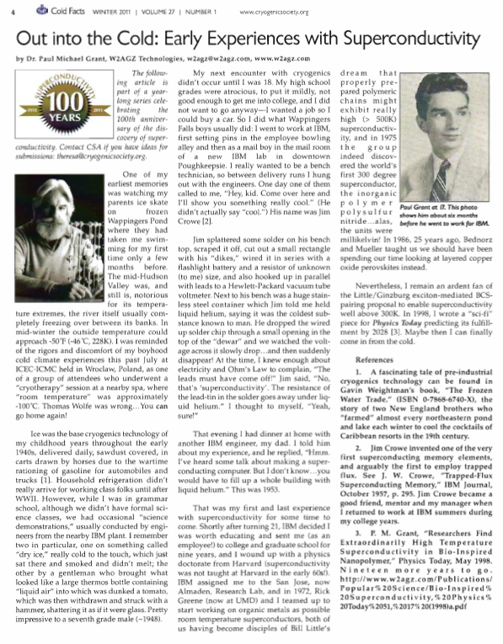
Big Blue
BRAT!

Slide 8
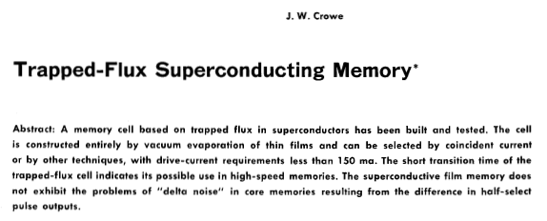
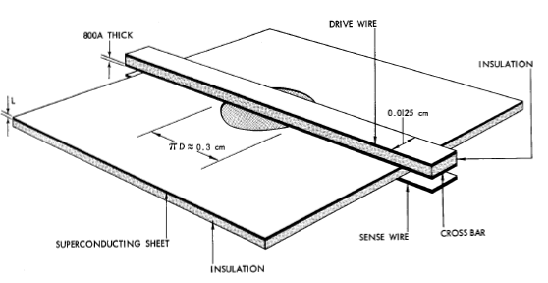

Slide 9
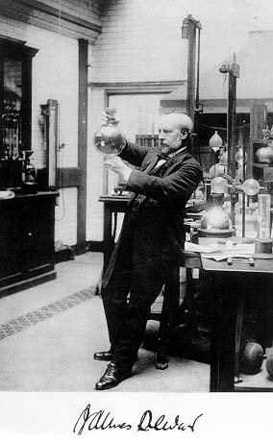
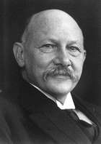
Fathers of Cryogenics
CH₄ 112 K
O 90
N₂ 77
Ne 27
H₂ 20
He 4.2
Dewar
Kammerlingh-Onnes

Slide 10
Models of
Electrical Conductivity
The First Idea:
(
(
R
(
(
(
Just Goes
to Zero!
(
(
(
•
(
•
e⁻
(
e⁻
(
(
T

Slide 11
Models of
Electrical Conductivity
The Most Popular:
R
e⁻
Freezes Out!
T

Slide 12
Models of
Electrical Conductivity
Reality:
R
Limited by
Impurities!
•

e⁻
T

Slide 13

1911
A Big Surprise!
Gilles Holst
Thus the mercury at 4.2 K has entered a new state, which, owing to its particular electrical properties, can be called the state of superconductivity
H. Kamerlingh-Onnes (1911)

Slide 14

Magnetic Properties
H on
H off
H on
H on
0
0
χ
χ
-1/4
-1/4
T
T
Expected (Lenz’ Law)
Weird ! (Meissner Effect)

Slide 15
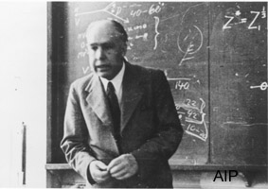
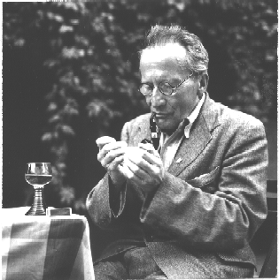
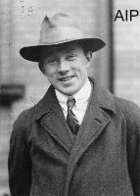
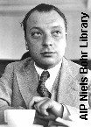
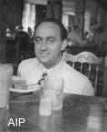
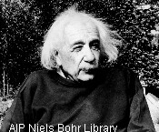
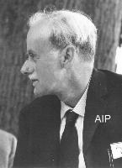

Explanation ???
This Group Tried...
And Failed !

Slide 16
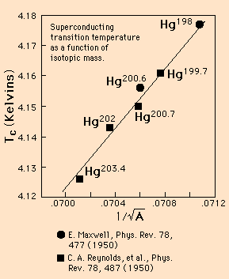
Isotope Effect
Somehow the mass of the atomic nucleus is involved!
Wow...is that ever counterintuitive!

Slide 17
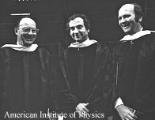
These Guys Got It Right!
B ----- C ----- S (1972 Nobel for Physics)
There has to be a regime
where the lattice vibrations
act to bind electrons together
rather than scatter them with
loss as given by Ohm’s Law.
Bardeen: “It’s a macroscopic quantum state”
Cooper: “It’s got twice the charge you’d expect”
Schrieffer: “’s a statistical wavefunction”

Slide 18
Physics of Superconductivity
a la BCS
Electrons Pair Off!
BCS Equation
•
+
+
e⁻
+
+
•
e⁻

Slide 19
“Cooper’s Problem”
Homework Problem: Formalism Applies to any “V₀ boson”...More Later.

Slide 20
T_{C} vs. Year:
1911 - 1980
Low-Tc Application Workhorses
25
Nb₃Ge
20
Nb₃Sn
NbN
V₃Si
15
Temperature (K)
10
NbTi
Pb
5
Hg
0
Cubic Metals
1900
1910
1920
1930
1940
1950
1960
1970
1980
Year

Slide 21
Low-Tc Applications

Slide 22
Yesterday (Wilkinson)
Submitted 28 February 1966
ac Cables: 760 MVA (3φ), 275 kV, 1600 A
  Be 77 K
  Al 20 K
  Nb 4 K (a “soft” superconductor!)
Objective: Efficiency, not increased capacity!

Slide 23
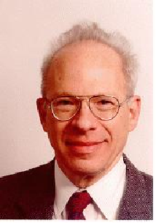

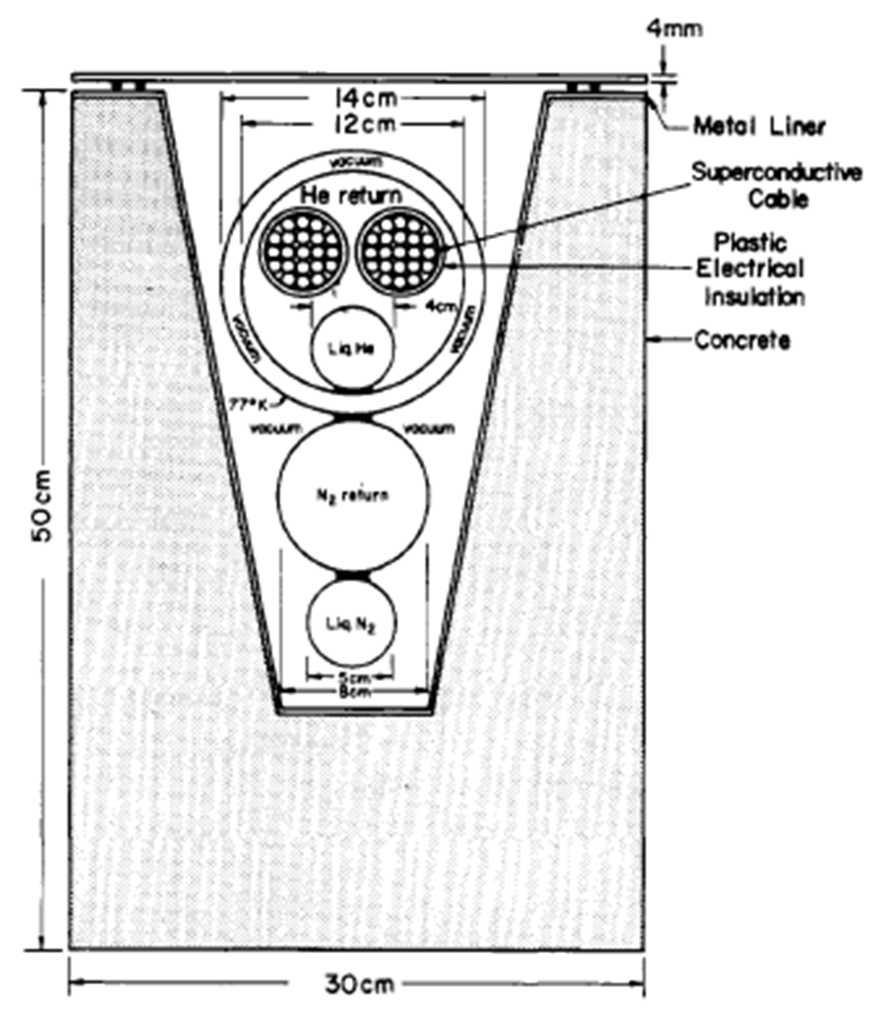
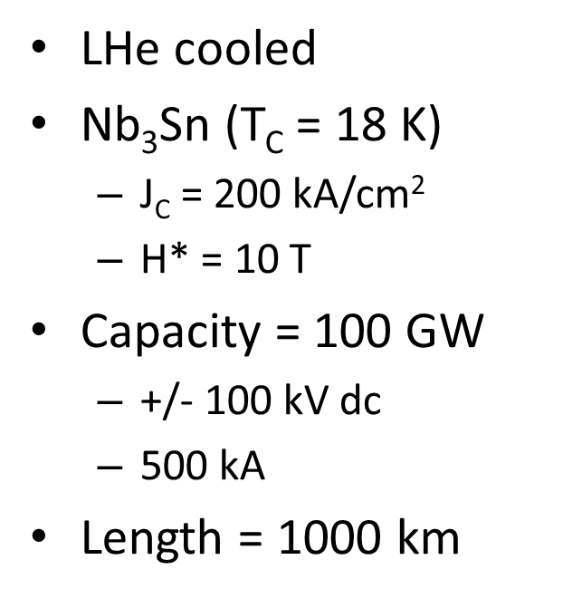
Yesterday (Garwin - Matisoo)
Submitted 24 June 1966

Slide 24
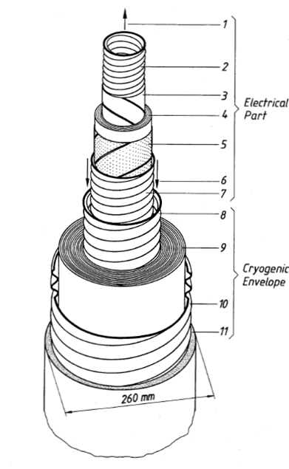
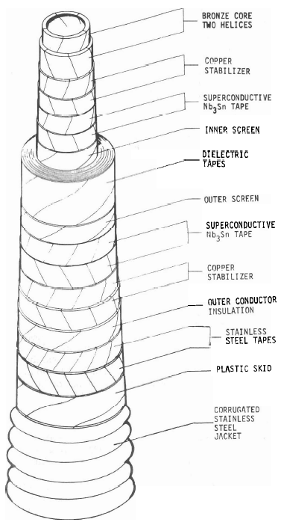
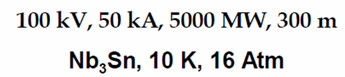
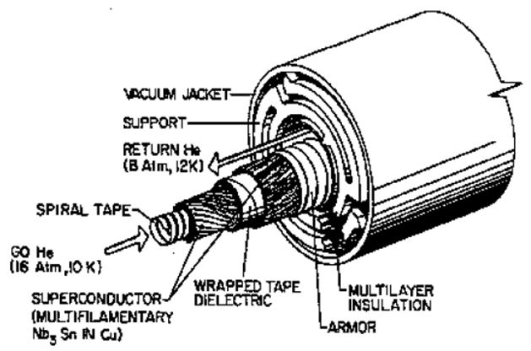
Yesterday (3 Real Cables)
Graz, Austria
(Late 1970s)
Brookhaven
(Early 1980s)
LANL
(Early 1980s)
330 MW, 110 kV,
3 kA, Nb, 4.2 K, 50 m
1000 MVA, 138 kV, 2.4 kA, Nb₃Sn, 7.5 K, 115 m

Slide 25
Yesterday (Japan 1975-85)
Generators
  “Super-GM”
Transformers
  For installation near hydroplants
SMES
Levitated Transport (Shinkansen)
Cables (small scale demos)

Slide 26
Yesterday (IBM)
Crowe Cell
  Replace magnetic cores
    Cores got faster
Josephson (a long story)
  Speed
    Blindsided by high-current bipolars
  Low Power
    Blindsided by MOSFET
  Upside: Most sensitive SQUIDS available

Slide 27
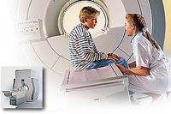
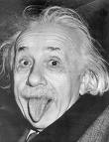
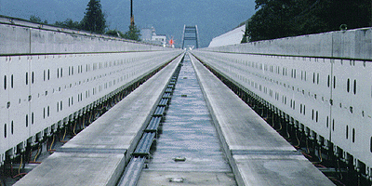
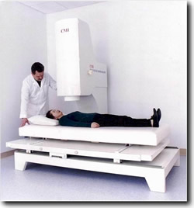
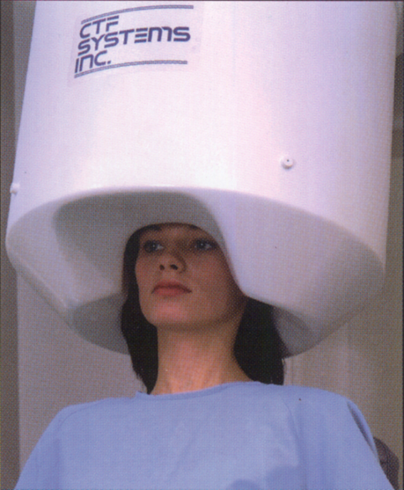
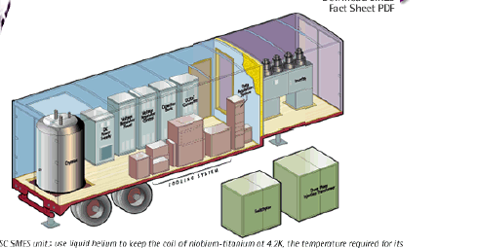
Today
Quantum Computing

Slide 28
1986
Another Big Surprise!
La_{2-x}Ba_{x}CuO_{4-y}
Onset T_{C} = 40 K !
Bednorz and Mueller
IBM Zuerich, 1986

Slide 29
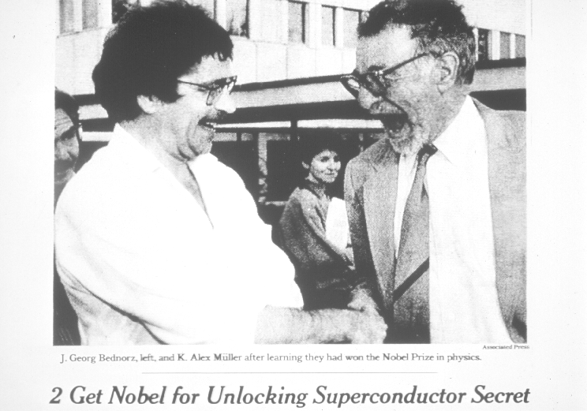
1987
“The Prize!”

Slide 30
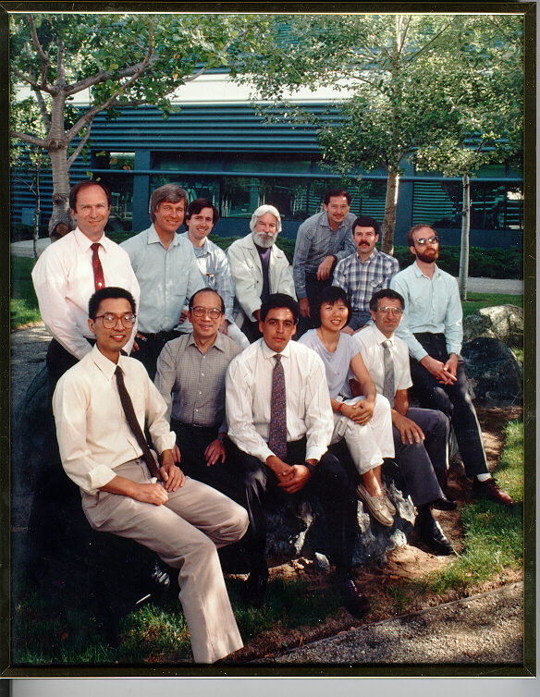
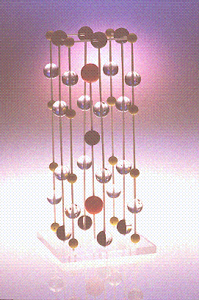
March 3, 1987
“123” Structure Discovered at IBM Almaden

Slide 31
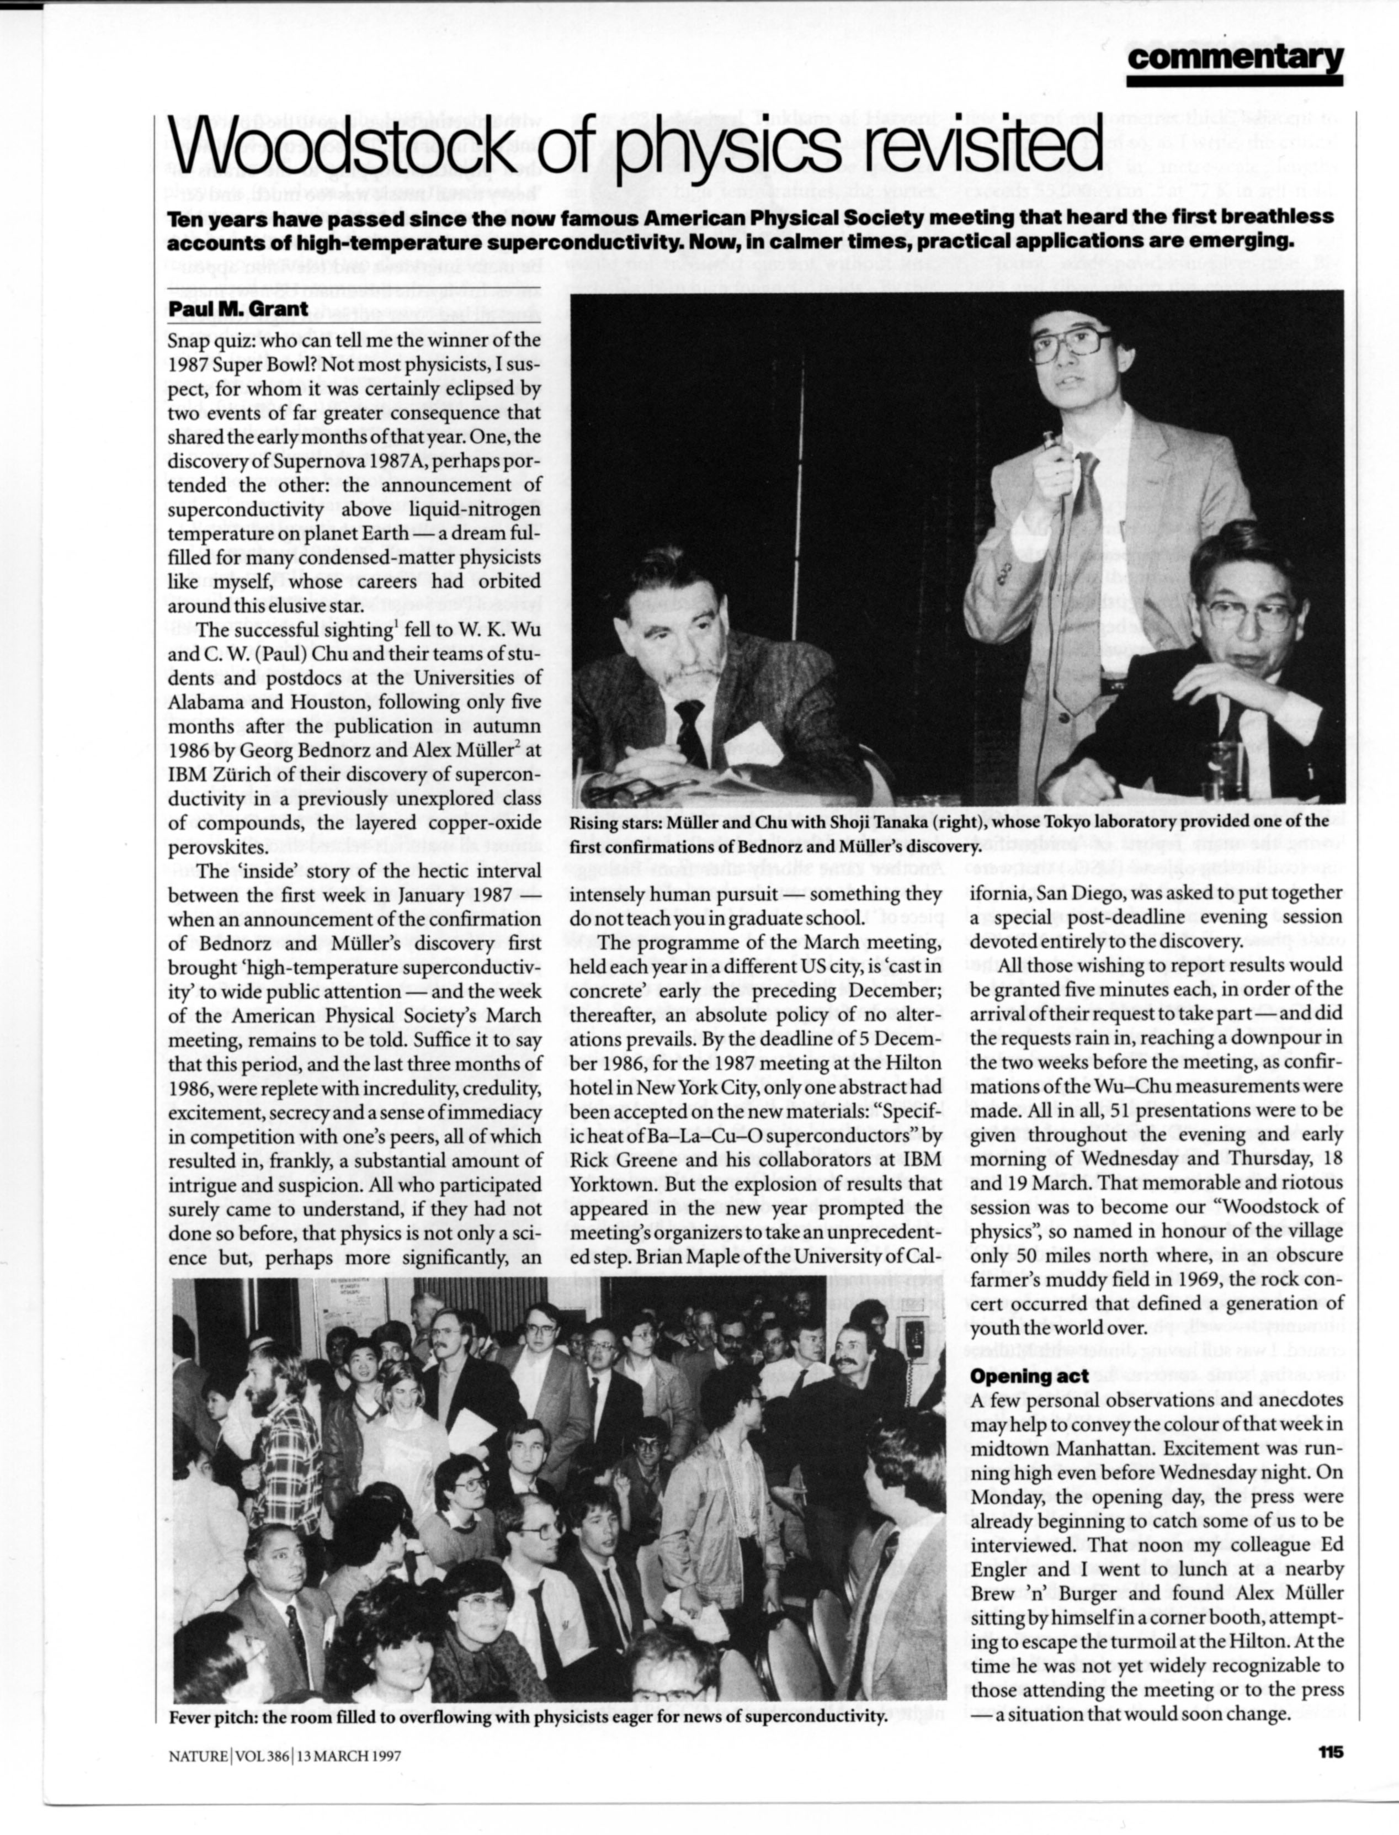

Woodstock of Physics
NYC, 1987
Physicists’ Night Out!

Slide 32
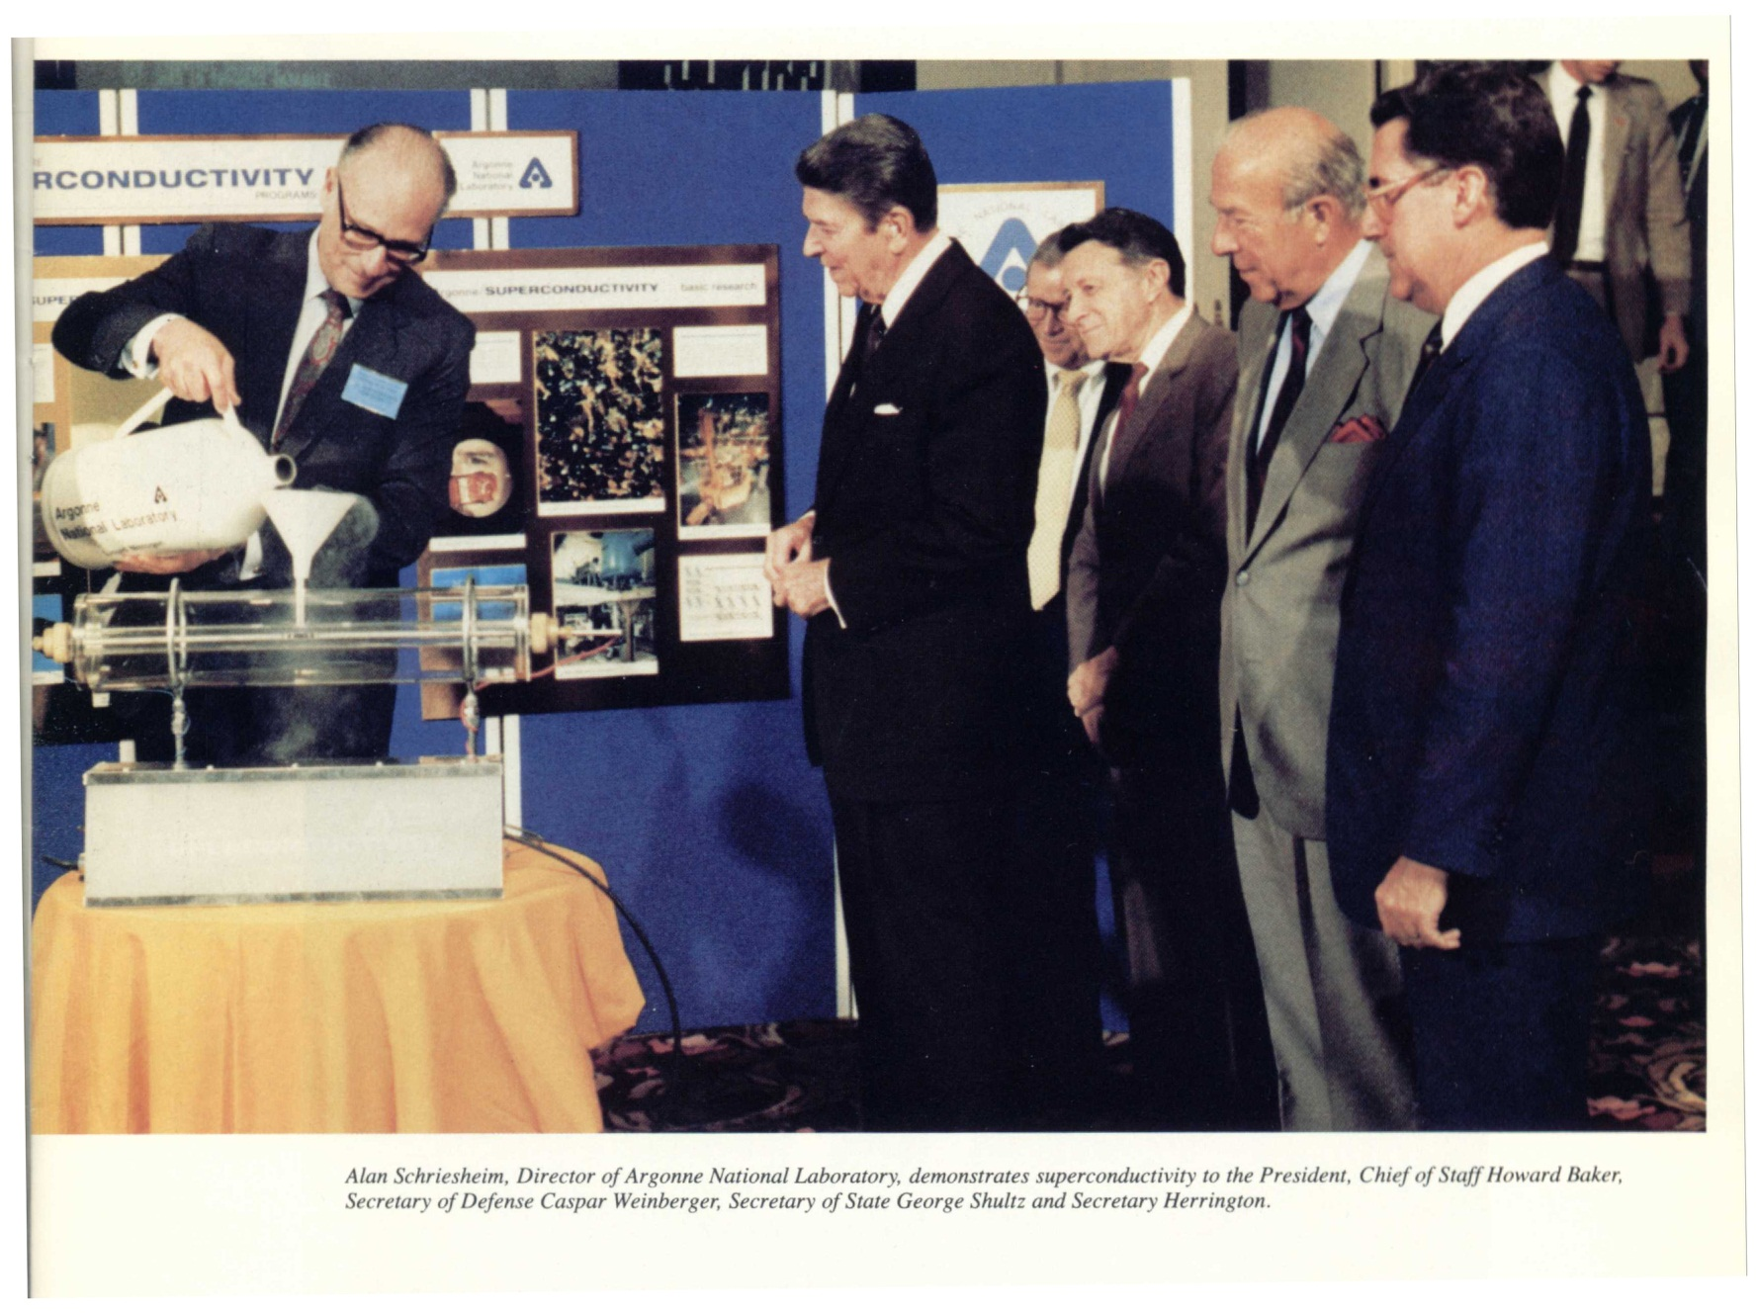
“The Great Communicator”

Slide 33
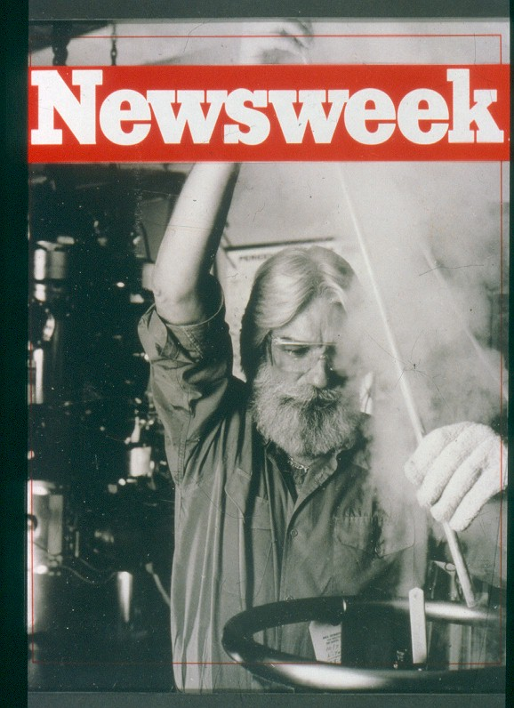
15 Nanoseconds of Fame

Slide 34
High-Tc Applications

Slide 35
HTSC Today
200
164 K
150
Hg-1223
100
Temperature, T_{C} (K)
High-T_{C}
50
La-214
Hg
Low-T_{C}
V₃Si
0
1900
1920
1940
1960
1980
2000
Year

Slide 36
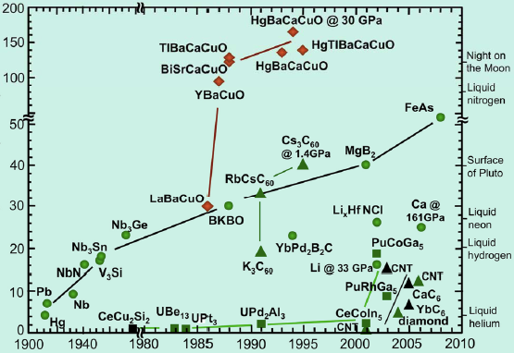
Today in Detail
Tc (K)
Year

Slide 37
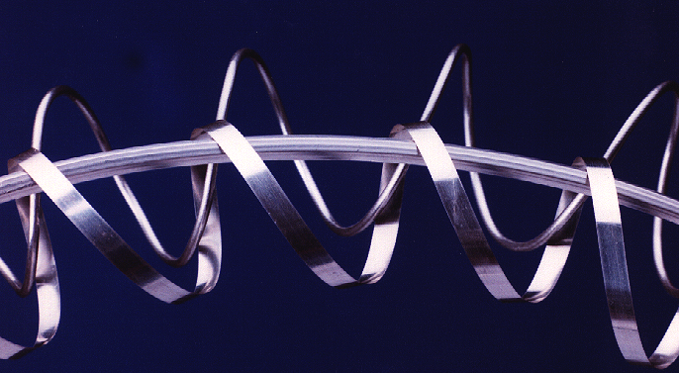

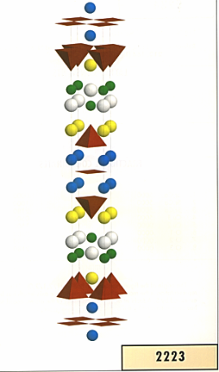
Practical HTSC Wire is Available
Gen 2
Oxide Powder
1.
Powder
Preparation
2.
Billet Packing
& Sealing
3.
A. Extrusion
Deformation
C. Rolling
& Processing
B. Wire Draw
4.
Oxidation -
Heat Treat
Gen 1

Slide 38
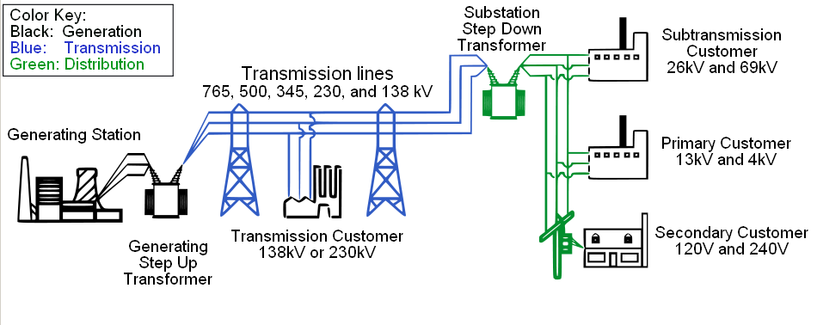
Where Can We Apply Superconductivity to Electric Power?
Potentially Everywhere
Notes:
38
38

Slide 39
HTSC Utility Market (2006)
10 More Years!
Notes:
39

Slide 40
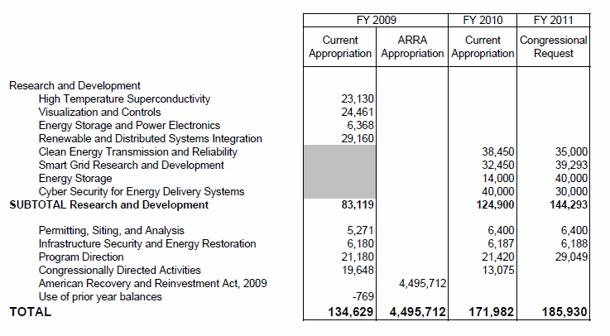
US Department of Energy
Budget of the Office of Electricity Delivery and Energy Reliability: FY 2010-11 (10³ USD)
? ?
WOW ! “Obama Cash”

Slide 41
EPRI & Superconductivity
1993-2003 ($18M)
Universities | Industry | Institutions
Wisconsin | AMSC* | LANL
Stanford | Superpower | LBNL
MIT | IBM | ORNL
Houston | Pirelli | DOE (Partner)
Maryland | Westinghouse | CCAS
 | Detroit Edison
*Coated Conductor Alliance ($4M(EPRI)+$6M(AMSC))

Slide 42
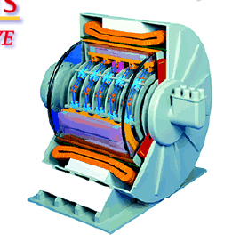
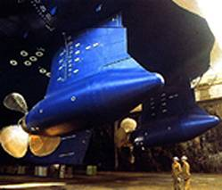
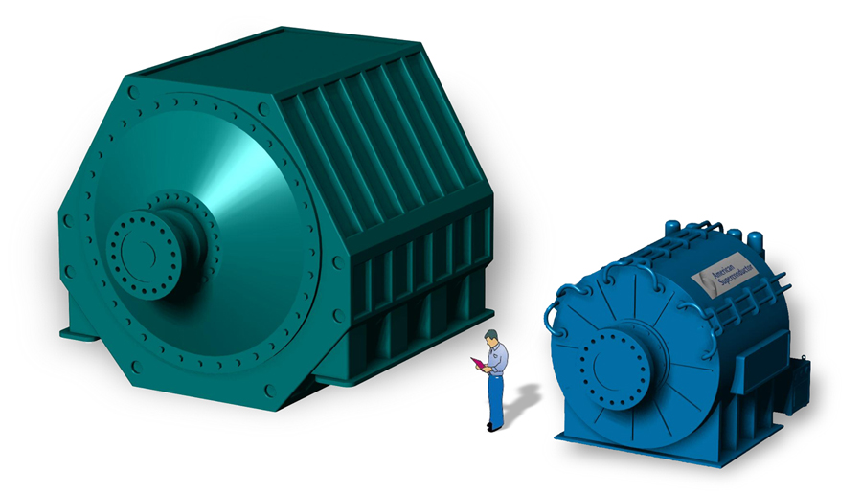
Rotating Machinery - Motors
25,000 hp
Small, Light (1/5 Conventional)
High Power Density
Quiet
Robust

Slide 43
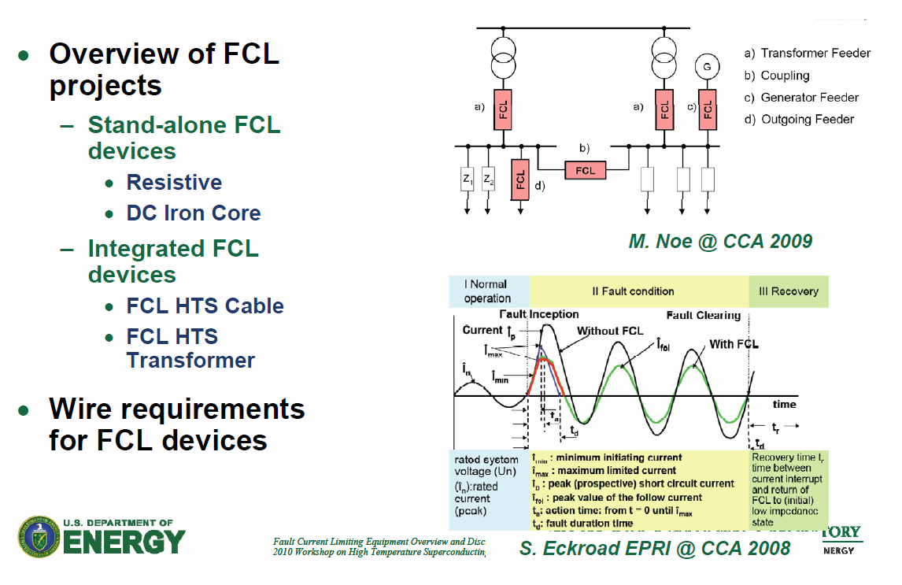
Some Current “FCL” Projects
Thanks…Robert Duckworth

Slide 44

HTSC FCL/XFMR Combo (2009)

Slide 45



Cables

Slide 46

AMSC/Nexans
Long Island Power Authority

Slide 47



Various ac HTSC Cable Designs
Ultera-ORNL
Sumitomo
Nexans-AMSC
Pirelli

Slide 48




Various dc HTSC Cable Designs
EPRI: Schoenung, Hassenzahl, Grant (1997)
+/- 50 kV, 50 kA, 5 GW
BICC: Beales, et. al, (1995)
40 K, +/- 20 kV, 10 kA, 400 MW
EPRI: Hassenzahl, Gregory, Eckroad, Nilsson, Daneshpooy, Grant (2009)
+/- 50 kV, 100 kA, 10 GW

Slide 49

HTSC Cable Demonstration Projects Worldwide
Past, Present…Future?
?
Notes:
49

Slide 50
Is There a Future for HTSC Superconductivity?

Slide 51

The US Transmission Grid(s)
300,000 km
500 companies
10% Losses

Slide 52


Pacific Intertie
HVDC, +/- 500 kV, 3.1 kA, 3.1 GW
1,362 km
~50% of LA Power Consumption
T&D Losses ~ 10%
Celilo I/C Station
“A Mountain of Silicon”

Slide 53







Fathers of Electricity
Edison
Practitioners
Insull
Tesla
Coolidge
Thomson
&
Sprague
Langmuir
Steinmetz

Slide 54
Can “New” Transmission Technology Help?
Yes, but probably not superconductivity in a big way, at least for a while.
More likely, “smart” grid stuff will come first
  HVDC cables and lines
  FACTS to increase present corridor capacity by 30%
  IT and communications plus an “OS/360” to more effectively and efficiently management power flows

Slide 55
A Modest Proposal
-Upbraiding the Utilities-
More than a half-century of successful demonstrations/prototyping power applications of superconductivity (1950s - >2000, in Japan and US)…low- and high-Tc…now sitting “on the shelf.”
Why aren’t they “in the field” today?
Is their absence due to…
  Cost?
  Hassle?
  or “lack of compelling” need?
  or “all of the above?”

Slide 56
US utilities have long claimed to “want”…
  Efficient long-length cables
  Oil-free transformers
  Energy Storage
  Fast fault current limiters at high voltage (FCLs)
  Efficient rotating machinery (aka, motors and generators)
Well, we got ‘em. Utilities claim:
  They’re too high-cost, because,
    The wire is too expensive.
    They have to be kept too cold.
    Electricity is cheap, and “in field” energy efficiency is not a “compelling” driver
  Anyway, we can solve our needs by incrementally improving the “old” ways (don’t ever underestimate the ingenuity of a utility engineer to improvise, adopt and adapt)

Slide 57
“Then…a modest proposal…”
If the “cost” of the wire in any given application were to be “zero,”…
Would the utilities then “buy them?” And sign a “letter of intent” to purchase “x” number?
  e.g., Fault Current Limiters, for which US utilities have long claimed a need
“Zero cost” would be obtained as a Federal or State “tax credit” for the wire cost of the quantity purchased by the utility equipment vendor or the utility itself…
Well?

Slide 58

“Superconduct-ress”

Slide 59

Mr. Electric Utility Good Ol’ Boy

Slide 60

Miss Same Old Technology

Slide 61

Together Forever?

Slide 62


“Al Gore” – He’s Available !
Notes:
62

Slide 63
Electronics
“A room temperature device !”

Slide 64
Woodstock + 25
So where are we?
There remains no (generally accepted) theory to explain high-Tc
Nonetheless, we now have a high performance wire technology that works and is available in long lengths
And there has been > 100 successful demonstrations of HTSC power equipment and applications
Yet there exist no significant markets for HTSC applications – power or electronic
WHY?

Slide 65
Because...
There’s not enough money to be made
...and made quickly.
Old technologies can be improved incrementally and simultaneously achieve better performance more cheaply and increase market share
...but not in the mature energy sector!

Slide 66


“Point 3) Example”
1956
The First Hard Drive
5 Megabytes
$300,000
6 ¢/byte
2011 (+55)
HP Personal Media
2 Terabytes
$100
5 nano-¢/byte
IBM 305 Ramac
I got two of ‘em!

Slide 67
The Economic Troika That
Drives and Exploits
Technology Innovation
Societal
Sustain the Economy
“enlightenment”
“infrastructure”
Entrepreneurial
Create the Economy
“stuff”
“jobs”
A Thread
Across the Ocean
Governmental
Protect the Economy
“agencies”
“military”

Slide 68




“A Thread Across the Ocean”
Isambard Kingdom Brunel
English Engineer
Cyrus Field
American Capitalist
William Thomson
Irish Physicist
“The Story of the Trans-Atlantic Cable (1854 – 1866)”
John Steele Gordon

Slide 69



Atlantic Cable Timeline & Designs
1857
“Broke”
1858
“Worked for a Month”
2 $/m
(2005)
1865
“Parted”
(Recovered in 1866)
1866
Success!

Slide 70
What Kept Them Going?
The investors knew, that if communications with Europe could be cut from 2 weeks to 2 minutes, they’d all get…
FILTHY RICH!
  Estimates are that the total cost of the project in 2005 dollars was $100 M
  First year 1867 revenue in 2005 dollars
  was $10 M !!

Slide 71


The After-Story
1870
1903

Slide 72
Is There a Future for Superconductivity?
-Yes-
The Ideal Energy Society

Slide 73


My Virtual Grandfather (@ 94)

Slide 74
Our Visionary Energy Society
- The Next “Thread?” -
Carbonless
  No CO₂
Non-Eco-Invasive
  Minimal land/ecology impact
Off-the-table
  Large scale renewables (wind, solar, bio)
  Sequestration

Slide 75
Implementing Technology Menu
Generation
  HTGCR Nuclear (80%)
    electrons
    protons
  PV Solar Roofs (20%)
Transmission
  Hydricity SuperCable
Storage
  Hydrogen + Hydricity Fuel Cell
End Use Power
  Electricity
  Hydrogen

Slide 76


Published in
SCIENTIFIC
AMERICAN
July, 2006
“System Crash”
Omni Productions,
Vancouver, BC
CBC Broadcast October, 2008
Notes:
76

Slide 77
Implementation Technology
The Hydricity SuperCable
Dual Delivery of Hydrogen and Electric Power
Flowing liquid hydrogen or cold H₂ gas under pressure delivers power and also serves as the refrigerant to …
Enable the transmission of large amounts of electric power losslessly using superconductors
Thermal Insulation
Electrical Insulation
I
I
Enclosed in underground tunnel or trench
Notes:
The Hydricity SuperCable
Talking Points
Here illustrated are the essential elements of the Hydricity SuperCable, the multi-kilometer “umbilical cord” of the SuperGrid. Details on various possible designs can be reviewed by clicking on “More…” above the EPRI logo. Important points are:
Hydrogen is at once an energy (power) delivery agent, a means of storing electricity, and can act as a cryogen to support the lossless direct current transmission of electricity over superconducting wires.
This slide is intended to illustrate generally how this could be accomplished in a simple hydricity cable circuit laid underground in a trench or tunnel.
The nominal dimensions of the cable cross-section for 1 GW delivery of hydrogen and electricity would been 5 cm for the inner hydrogen cylinder surrounded by 0.5 cm of superconductor. The hydrogen can be either in its liquid state (21 Kelvin) or cold, high pressure gas (77 Kelvin, 2000 psia), both states at sufficiently low temperatures to operate the present generation of high temperature superconductors.
There are many variations on this basic design, which can be found by clicking “More…” above the EPRI logo.

Slide 78



SuperCities & SuperGrids
Nuclear Power can generate both electricity and hydrogen – “Hydricity”
Hydricity can be distributed in underground pipelines like natural gas
School
School
H
Home
H
Supermarket
Home
Supermarket
2
2
The infrastructure can take the form of a SuperGrid
Family Car
Family Car
Nuclear
…or a
SuperCity
Nuclear
plant
plant
H
DNA
H
DNA
-
-
to
to
-
-
order.com
order.com
2
2
HTSC/MgB
HTSC/MgB
2
2
Notes:
78
The Vision Concept
Talking Points
The green, enviro- eco-gentle symbiosis of nuclear, hydrogen and superconductivity can be pictured in two limiting forms:
That of a “SuperGrid,” spanning a nation and perhaps even a continent. Throughout the spine of the hydrogen-electricity transmission system would be located nuclear power plants spaced apart on a length scale of 50 – 100 km, supplying both hydrogen and electricity – hydricity -into the network.
That of a “SuperCity,” comprising an urban residential/commercial/industrial complex of perhaps 2-3 million people. Hydrogen for personal and bus transportation, space conditioning and thermal processing, and electricity for all other power applications would be supplied by one or two peripheral nuclear power plants. These plants would be sited in connection with waste disposal and recycling facilities. Oxygen as a byproduct of hydrogen production would add in sewage and waste treatment and fire the combustion of waste biomass (zero-sum CO₂ emission), including methane decay gas, to supplement the nuclear-generated electrical power. In addition, all structures would housed under roofs engineered to supply both thermal and photovoltaic solar energy (“Solar roofs” do not require use of additional land area and thus are in accord with the enviro-eco-gentle paradigm.
A number of intermediary regional configurations also could be contemplated.

Slide 79
SuperSuburb

Slide 80
Some Other Possibilities

Slide 81

A Canadian’s View of the World
Notes:
A Canadian Worldview
Talking Points
Much of North America’s remaining natural gas reserves are located along the Artic Ocean North Shore and shared between the US (Alaska) and Canada. For the past 25 years, the Canadian government, with private companies, has researched the construction of a massive pipeline from the Mackenzie River Delta to Alberta. It now appears this project may go forward in 2006 with gas transport beginning in 2009. More information can be found at the MVP website, http://www.mackenziegasproject.com.
The Mackenzie Valley Project (MVP) presents an example of opportunities that might arise elsewhere in the world to combine the delivery of natural gas with wellhead generated electricity via a Liquid Natural Gas SuperCable (to be discussed).
It is estimated that the Mackenzie Delta reserves, once full production begins, will last 15 – 20 years. When exhausted, remote “wellhead” sites such as these present opportunities for the construction of “hydricity” producing nuclear plants to supplant indefinitely natural gas, and delivery hydrogen and electricity over the same SuperCable pipeline, if it has been pre-engineered for such conversion.

Slide 82

The Mackenzie Valley Pipeline
http://www.mackenziegasproject.com
Nota Bene!
As of August, 2012, funding for the MVP has been reduced by about 30% due to the rapidly decreasing price of natural gas in North America, primarily due to expanding available “fracking accessible reserves” in the US. However, such means the MVP scenario will only expand globally. E.g., to Poland, Mexico, Asia and elsewhere.
1220 km
18 GW-thermal
2006 - 2010
60% NG used to make electricity on arrival in USA. Generate electricity at Delta “wellhead” and ship via HVDC SuperCable.
LNG Pipe+HTSC Cable in same ROW.
2030: When NG runs out, build nukes at wellhead sits to make protons and electons.
The delivery infrastructure is already there!
Notes:
Mackenzie Valley Gas Pipeline
Talking Points
The total length of the pipeline is some 1220 kilometers (760 miles). Two lines are planned, one to carry high pressure methane and a much smaller one for heavier liquefied petroleum gases (butane, etc.). The “thermal power” to be delivered is around 18 GW, about the same as the electrical equivalent generated at China’s Three Gorges. The towns located along the line are the sites of re-pressurization stations, which, in a SuperCable setting, could contain cryogenic refrigeration and pumping equipment.

Slide 83

Transporting Tens of Gigawatts to the Green Market
12 – 13 May 2011
Institute for Advanced Sustainability Studies
Potsdam, Germany

Slide 84

An American Experiment!

Slide 85

Powering Europe with Sahara Solar

Slide 86


Slide 87

Go Where the Sun Shines

Slide 88

Solar – PV & Thermal

Slide 89

Superconducting SolarPipe

Slide 90







Slide 91
Room Temperature Superconductivity

Slide 92


Room Temperature Superconductor
Little, Ginzburg, 1963
1D metallic chains are inherently unstable to dimerization and gapping of the Fermi surface, e.g., (CH)x. Ipso facto, no “1D” metals can exist!
₊
-
-
₊
₊
-
-
₊
₊
-
-
₊
Diethyl-cyanine iodide

Slide 93


Does the
Hold the Key to Room Temperature Superconductivity?
50th Anniversary of Physics Today, May 1998

Slide 94


Slide 95
The Eventual Hydrogen Economy?

Slide 96
Alternative Energy Scenarios
- Too Good to be True! -
Go To: www.w2agz.com/

Slide 97

March,1989
- Jones, Fleischmann, Pons -
- The Energy Salvation of Mankind -
“Cold Fusion”
Deuterium ( from “heavy water”)-loaded palladium cathode under “high electrolytic” local field “fuses” a la “hydrogen bomb.”
Result “boils” electrode water producing steam useable to power steam turbine and thus electricity.
Sure...
Is this really possible ???

Slide 98
Muon-Catalyzed D₂ Fusion
Sakharov-Frank-Alvarez-Jackson-Jones
1940s – 1970s
...but not frequently enough to be a practical energy source!
After
Electron -> Muon
Substitution
Deuterium Atom
+
-
+
-
p
e
p
μ
n
n
The C-O-M will “wobble” causing the nucleus to “fuse” with its neighbor...occasionally...
muon mass ~ 200 x electron

Slide 99
Excerpts from Cold Fusion Wikipedia Page...
Announcement
In mid-March 1989, both research teams were ready to publish their findings, and Fleischmann and Jones had agreed to meet at an airport on March 24 to send their papers to Nature via FedEx.^{[24]} Fleischmann and Pons, however, pressured by the University of Utah, which wanted to establish priority on the discovery,^{[25]} broke their apparent agreement, submitting their paper to the Journal of Electroanalytical Chemistry on March 11, and disclosing their work via a press release ^{[26]} and press conference on March 23.^{[23]} Jones, upset, faxed in his paper to Nature after the press conference.^{[24]}
Response and fallout
On May 1, 1989, the American Physical Society held a session on cold fusion in Baltimore, including many reports of experiments that failed to produce evidence of cold fusion. At the end of the session, eight of the nine leading speakers stated that they considered the initial Fleischmann and Pons claim dead with the ninth, Johann Rafelski, abstaining.^{[6]} Steven E. Koonin of Caltech called the Utah report a result of "the incompetence and delusion of Pons and Fleischmann," which was met with a standing ovation.^{[46]} Douglas R. O. Morrison, a physicist representing CERN, was the first to call the episode an example of pathological science.^{[6][47]}

Slide 100
...Continued
Subsequent research
After 1991, cold fusion research continued in relative obscurity, conducted by groups that had increasing difficulty securing public funding and keeping programs open. Research continues today in a few specific venues, but the wider scientific community has generally marginalized the research being done and researchers have had difficulty publishing in mainstream journals.^{[6][7][11]}
Small but committed groups of cold fusion researchers have continued to conduct experiments using Fleischmann and Pons electrolysis set-ups in spite of the rejection by the mainstream community.^{[11][72]} Often they prefer to name their field Low Energy Nuclear Reactions (LENR) or Chemically Assisted Nuclear Reactions (CANR),^{[73]} also Lattice Assisted Nuclear Reactions (LANR), Condensed Matter Nuclear Science (CMNS) and Lattice Enabled Nuclear Reactions; one of the reasons being to avoid the negative connotations associated with "cold fusion".^{[72][74]} The new names avoid making bold implications, like implying that fusion is happening on them.^{[75]} Proponents see them as a more accurate description of the theories they put forward.^{[76]}

Slide 101



February 12, 2012
Sidney Kimmel, Founder, Jones Apparel
Jeanne Manning
Billionaire businessman Sidney Kimmel is putting $5.5 million toward making “cold fusion” successes more reliable. His interest in the topic had been piqued in 2009 by a television program.
Wrong! Kimmel hired one of his LA PAs to “flog” Energetics to CBS well before the the 60 M production, as well as being an early financial backer.
To recap that year: producers of the TV program 60 Minutes had wanted to find out whether cold fusion is real. They looked for an independent scientist to check it out and chose Rob Duncan, vice chancellor of research at Missouri University and an expert in measuring energy. He was said to have been a skeptic about cold fusion before 60 Minutes sent him to Israel to investigate the work of a company called Energetics Technologies. Duncan was given free rein in Energetics’ cold fusion laboratory and came back convinced that the process is real.
Wrong! Duncan was “sympathetic” to CF prior to the 60 M segment. He became a “true believer” after his trip to Israel, even though he did not actively participate in any measurements. Think of “Saul on his way to Damascus.”
It took a while for Kimmel’s interest to translate into funding for the university, but recently Duncan learned about the generous gift of money and equipment. Kimmel’s donation will create a Sidney Kimmel Institute for Nuclear Renaissance which will involve researchers from the Missouri University Research Reactor, and physics, engineering and chemistry departments.
Whoa! Conflict of interest ??? Hmm...

Slide 102

Cold Fusion After 20 Years

Slide 103

Scott, this is New York. Keep your hand on your wallet!

Slide 104


Bohr Was Wrong!
“As was Schrödinger, Heisenberg, Pauli, Dirac...”
“yeah, right”
According to Quantum Mechanics, the ground state energy of the hydrogen atom is given by,
According to Randall Mills (MD Harvard), Founder Blacklight Power, this energy should be one-half R_{E} because the charge density of hydrogen’s electron exists (he says) only on an infinitely thin spherical shell, to wit:
Mills claims a catalytic process to capture the transition to this lower ground state energy from water “for free.” No, this is not cold fusion revisited.
No verification has ever been published in a major recognized peer-reviewed scientific journal.

Slide 105


Oh, No!
Whoops!
Spelling error...
Probably a Harvard Law graduate

Slide 106
From: Eric Hermanson <eric@alum.mit.edu>
Sent: Monday, July 23, 2012 5:53 PM
To: pmpgrant@w2agz.com
Cc: w2agz@w2agz.com
Subject: On the Hydrino
Paul --
Re: http://www.w2agz.com/TrapDoors.htm
... and your other related critical commentaries on the subject, referenced on the Internet.
I think you may be one of the most uninformed people on the planet, and in my opinion 'lazy' to boot, and that's both a shame and an irony given the greatly above average intelligence you posses. History may not treat you kindly.
- Eric
...Sigh...

Slide 107
Got Lots More “Bad Science” War Stories...
Alternative Medicine
New Tesla Society (Dennis Lee)
Antigravity Shields (Plodkletnov)
IAS (“Digital Wave Technology”)
Media Fusion (“NetFlix over Powerlines”)
NEX (“Noble Gas Power (??)”)
Magnetostrictive 2nd Law Violations
QuEnergy (Heat Transfer via Superconductivity)
Joe Newman
Schoen Imbroglio (The 2002 Shame of Bell Labs)
Starlite (2009...Nuclear Blast Shield)
...Sorry. Outa time. Invite me back!

Slide 108
Where there is no vision,
the people perish…
Proverbs 29:18

Slide 109

“You can’t always get what you want…”

Slide 110

“…you get what you need!”

Slide 112
Spares & Extras

Slide 113



SuperCities - SuperSuburbs – SuperGrids
Grant, Overbye, Starr, SciAm 295, 76 (2006)

Slide 114
Caveat Emptor
(wisdom from Garwin-Matisoo, 1967)
“…for low power levels and sufficiently short distances…it will be more economical to use conventional ac EHV transmission.”
“…the use of superconducting power lines appears feasible. Whether it is necessary or desirable is another matter entirely.”

Slide 115


Specifications
2-1000 MW HVDC Bipolar Circuits
Circuit 1: 130 miles, Greene County → Bronx County
Circuit 2: 140 miles, Albany County → New York County
Each Circuit: +/- 500 kV, 1000 A Bipolar (2 cables ea.)
Financials
$750 M ($400 M “VC”, $350 M “Futures”)
Loan Payment (4%, 40 yrs, 750 M$) = 35 M$/yr
Labor, Overhead, Maintenance = 5 M$/yr
Tariff = 0.5 ¢/kWh
Profit (NOI) @ 50% Capacity = 4 M$/yr
Profit (NOI) @ Full Capacity = 48 M$/yr
Why didn’t it go forward?
Wire C/P = 100 $/kA×m
HTSC Cost = $87 M

Slide 116


Pirelli (Prysmian)
Energy Cables
$190 M
Sayerville, NJ → Levittown LI, NY
- 600 MW (+/- 250 kV, 1200 A)
- 65 miles (105 km)
- $400 M
- 2007
T 77 K | C/P $/kA×m | Cost ($M)
Cu | 7 | 1.8
HTSC | 100 | 25.1
Financials
40 yrs @ 4%: $ 20M
LOM: 1 M
NOI (100%): 5 M

Slide 117

US Electricity Flow - 2007
1 Quad = 0.29 TkWh
US Generation Capacity = 1.1 TW
Gross Generation = 4.33 GWh
(T&D Losses)/(End Use) = 10%

Slide 118
Electricity -
The Crown Jewel of the US Economy
§
~$2 trillion total asset value
§
$344 billion annual revenues
§
142 million customers
§
3273 utilities
Without electric power the $14.3 trillion
U.S. economy would come to a halt

Slide 119


Slide 120
Recuirs Jes’ Minmal Skil Levil
Harvard PhD…OK
But…
Ya gotta pass the IBEW union apprentice exam too!

Slide 121

Rotating Machinery - Wind Generators

Slide 122



Wind Power Factoids
KK Wind Equivalent (8 GW)
Power per Tower 8 MW
Number of Towers 1000
Inter-tower Distance 1000 ft
Total Area (miles x miles) 43.5 x 43.5
1 mile
Kashiwazaki Kariwa: 8 GW !

Slide 123

Diablo Canyon
Notes:
123

Slide 124


Fault Current Limiters 101

Slide 125


Project Hydra
DHS, NYC, ConEd, AMSC
Concept: Combine High Capacity HTSC Cables With FCL Functionality

Slide 126
US Department of Energy
Budget of the Office of Electricity Delivery and Energy Reliability: FY 2010-11 (10³ USD)
DOE Conclusion: HTSC Power Technology is now “on the shelf” and ready to deploy !
? ?
WOW ! “Obama Cash”

Slide 127

US Electricity Generation Sources
Notes:
127

Slide 128
US Electricity Flow - 2007
1 Quad = 0.29 TkWh
US Generation Capacity = 1.1 TW
Gross Generation = 4.33 GkWh
(T&D Losses)/(End Use) = 10%
Notes:
128

Slide 129







Enfranchisement of Women

