Slide 1
Abstract

Slide 2
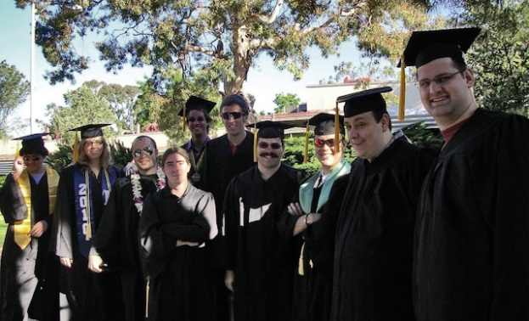
Possible Quantum Transport in (RE)Ba₂Cu₃O_{7-y} Perovskites
Session H4: Condensed Matter IV: Atoms and Molecules Talk H4.00001, 2:00 PM, Saturday, 3 November 2012
Paul Michael Grant
APS Senior Life Fellow Staff Associate, JPL/CalTech
IBM Research Staff Member Emeritus
EPRI Science Fellow (Retired)
Principal, W2AGZ Technologies

Slide 3
Possible Quantum Transport in (RE)Ba₂Cu₃O_{7-y} Perovskites
Session H4: Condensed Matter IV: Atoms and Molecules Talk H4.00001, 2:00 PM, Saturday, 3 November 2012
Paul Michael Grant
APS Senior Life Fellow Staff Associate, JPL/CalTech
IBM Research Staff Member Emeritus
EPRI Science Fellow (Retired)
Principal, W2AGZ Technologies
Aging IBM Pensioner
(research supported under the IBM retirement fund)

Slide 4
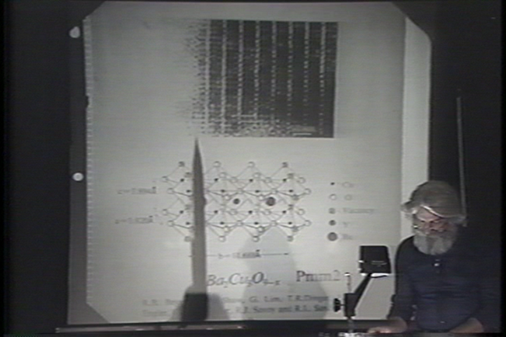
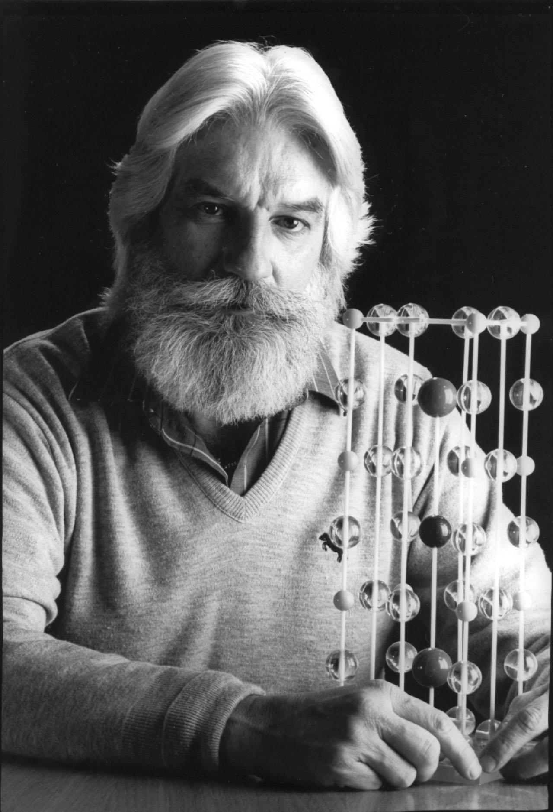
Woodstock of
Physics
17 March 1987
Revealing the Structure of “1-2-3”

Slide 5
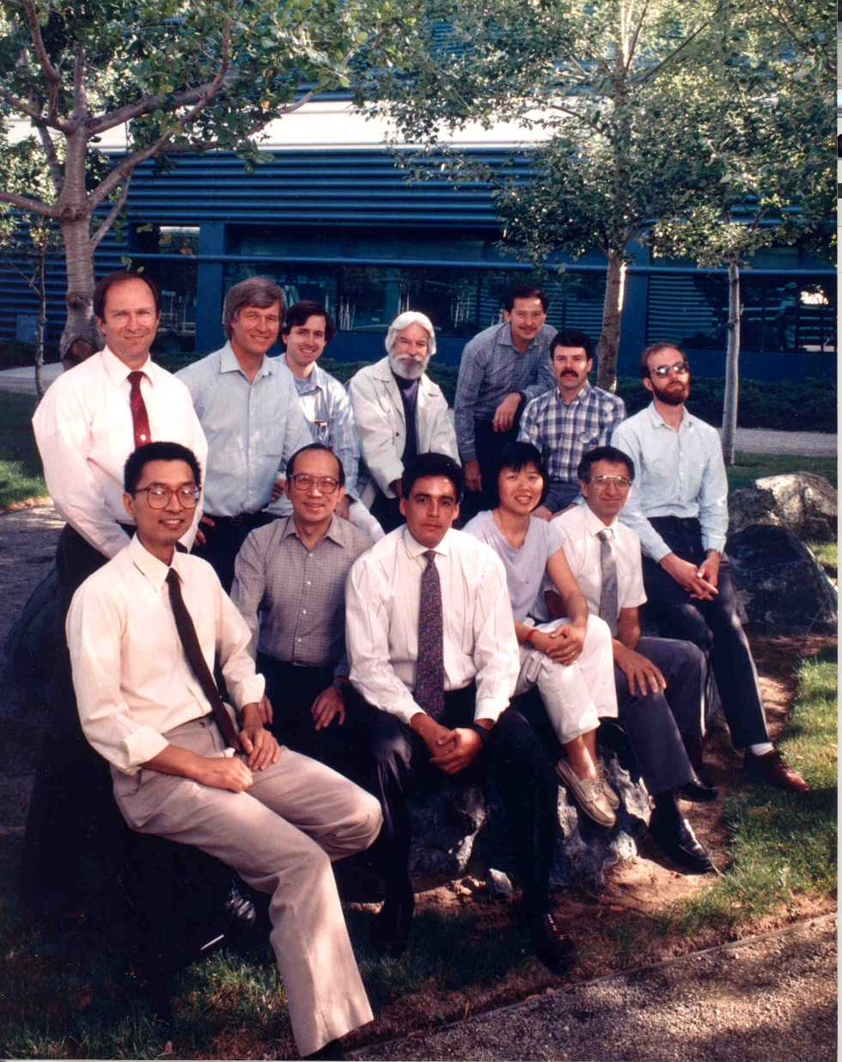
“We Band of Brothers (and a Sister!)” - IBM Almaden, March 1987 -

Slide 6
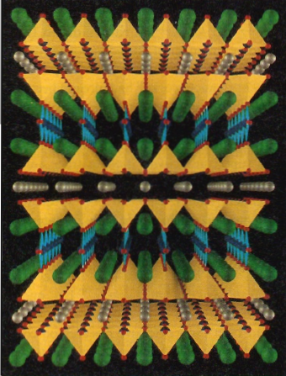
PMG, Adv. Mater. 2 (1990) No. 5 p. 236 RE-1237 (RE = Y, Pr, Nd...whatever)
c
b
Ba – Cu – O Channels
a
RE - Silver
Ba - Green
Cu - Blue
O - Red

Slide 7
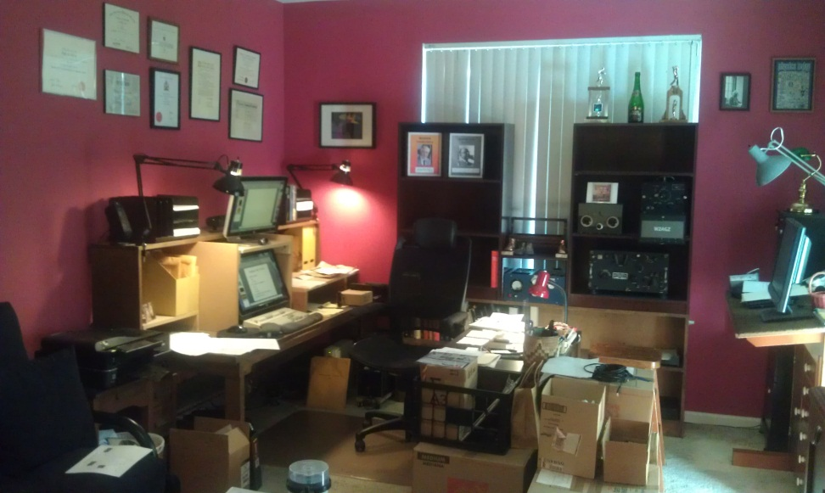
“Gadgets in My Tool Box”
Graphics/Visuals
jMol
XCrySDen (Kokalj)
DFT Table Top Calculators (Kubuntu)
PWscf (Giannozzi)
PWcond (Smogunov)
Wannier90 (Mostofi)
All available for free from Quantum-Espresso and Java!

Slide 8
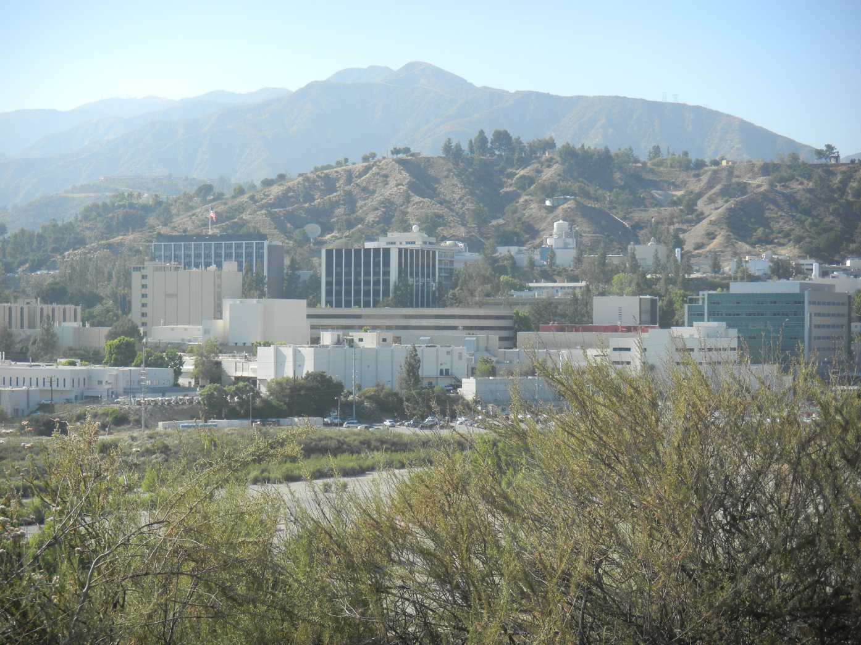
“Power Machines in My Garage”
Antpile Cluster at JPL/NASA/CalTech
Many Thanks
to
Paul von Allmen

Slide 9
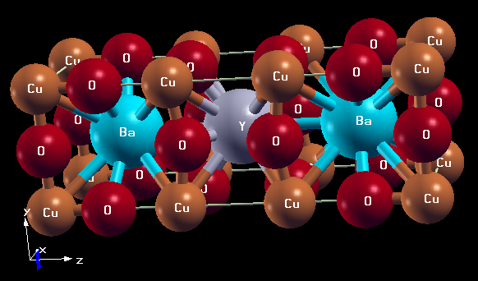
1-2-3 “The Object of My Affection”

Slide 10
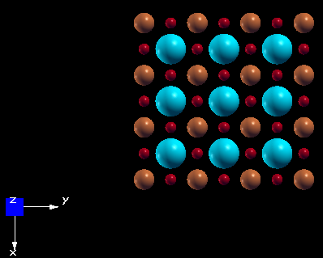
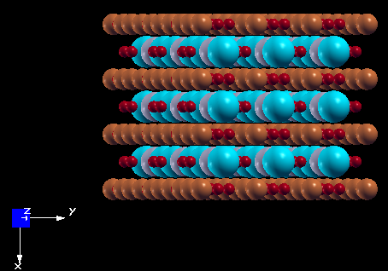
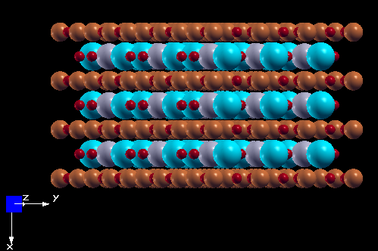
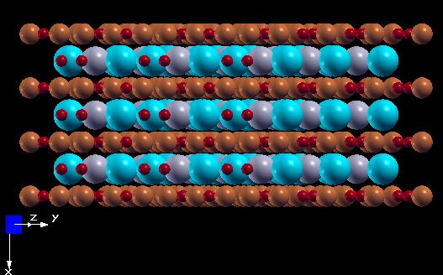
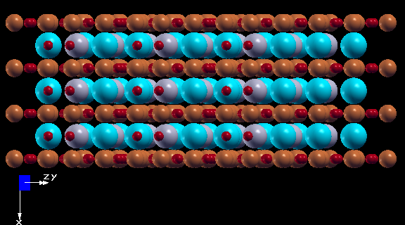
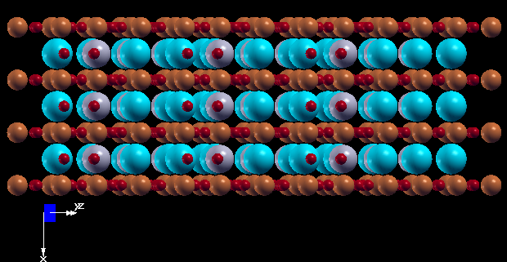
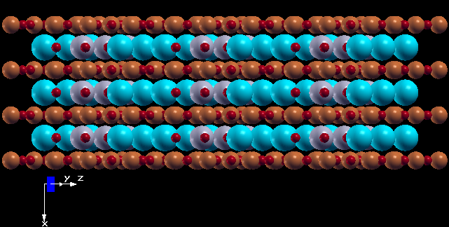
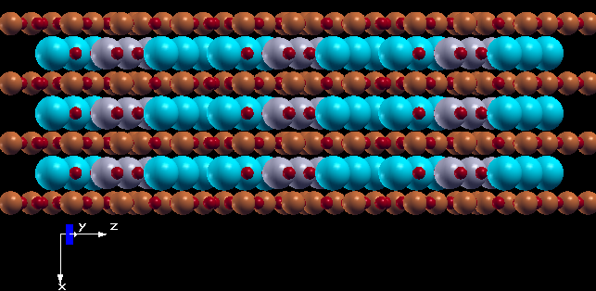
“The abc’s (xyz’s) of RE-123”
Cu
O
Ba

Slide 11
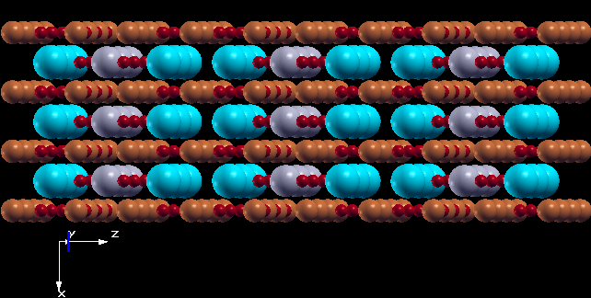
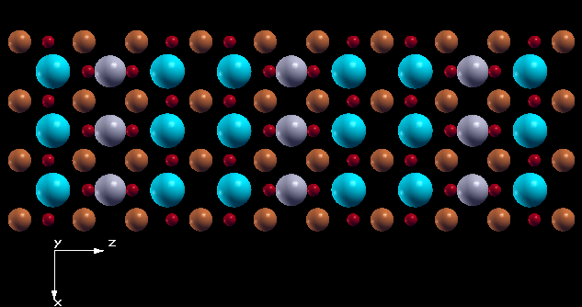
“...and Finally...”
“RE Channel”
“Ba Channel”

Slide 12
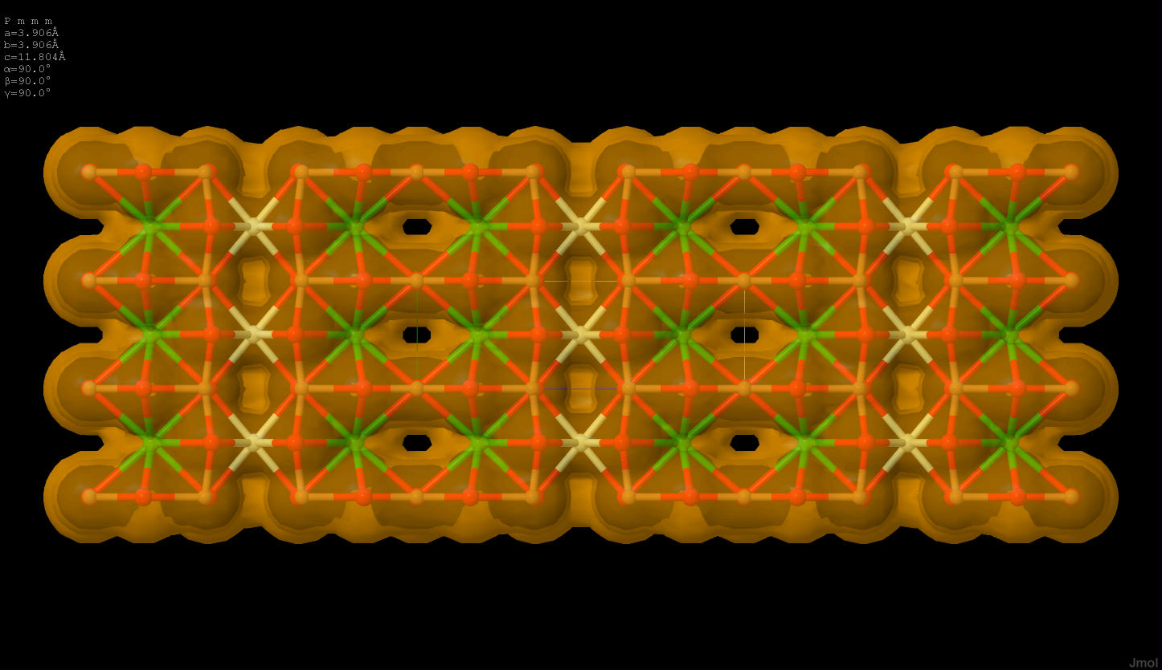
Van der Waals Surface for RE-123
a
b
c
Wow !

Slide 13
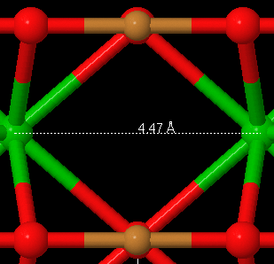
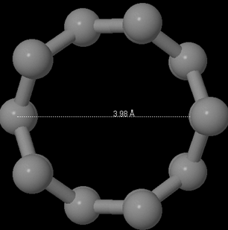
Channel Structure Comparisons
PBCO
CNT-5,0
NB: Relative Dimensions Approximate

Slide 14
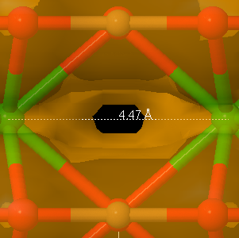
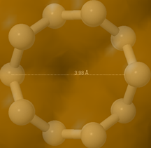
Van der Waals Surfaces
PBCO
CNT-5,0
NB: Relative Dimensions Approximate

Slide 15
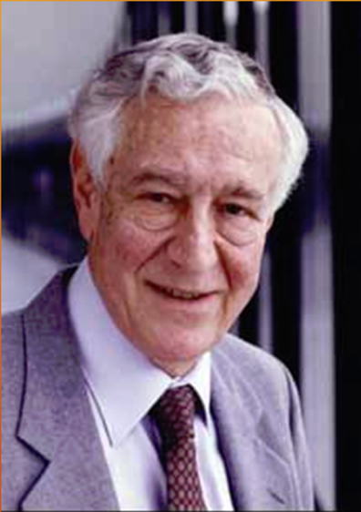
Landauer-Buettiker Formalism
W
k_{z}
L
“Channel”
R
L < l
l ≡ Electron Inelastic Mean Free Path
V
Note:
If L > l , then T(E_{F}) reverts to Ohm’s Law
If not, ballistic boundary conditions apply, a la Landauer, and T(E_{F}) can scale from 1 to >20, depending on the number of channels (eigenstates) available for transport, times 2e²/h = $7.75×{10}^{−5}$ siemons = 1/12.9 kΩ
T(E_{F}) can be calculated using the PWcond tools with the Quantum-Espresso DFT package
The following calculations for RE-123 assume only one unit cell in the “channel.”

Slide 16
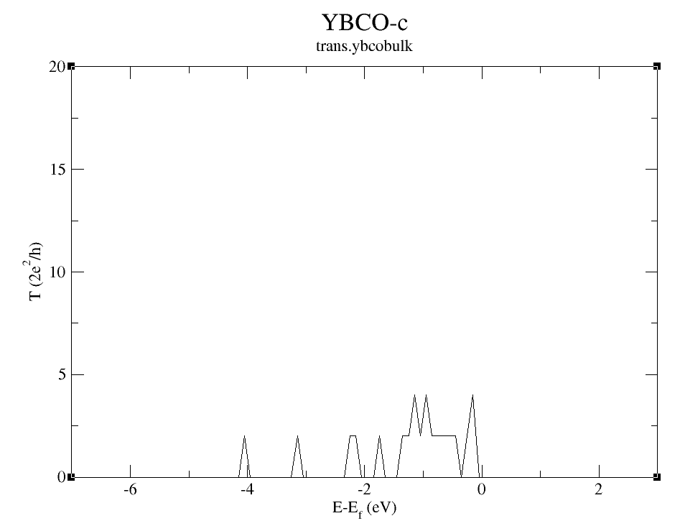
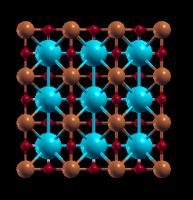

Slide 17
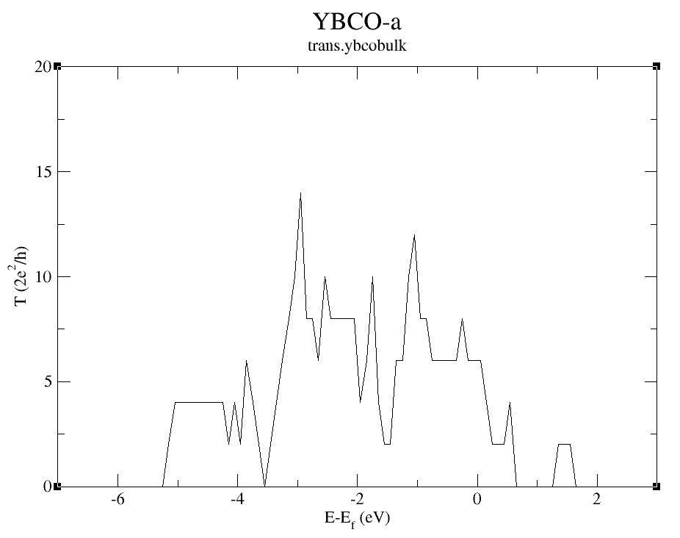
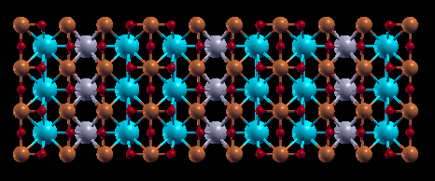

Slide 18
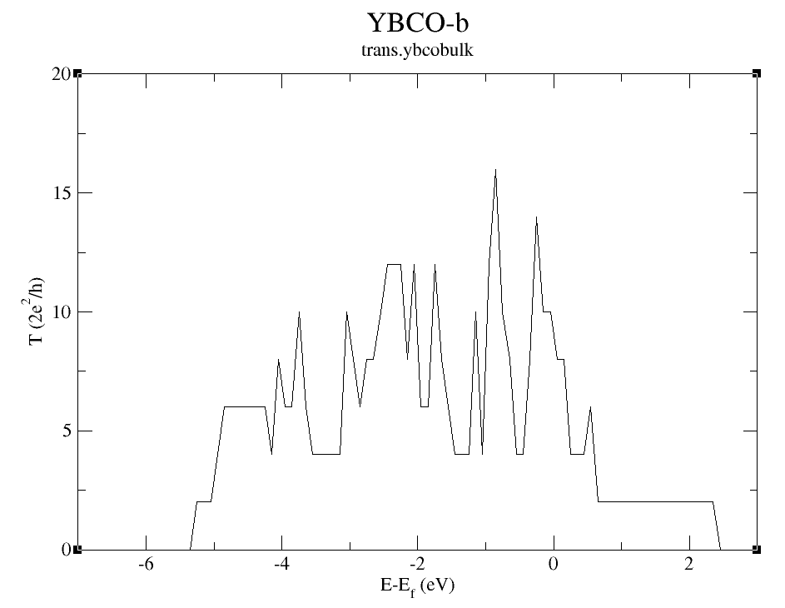
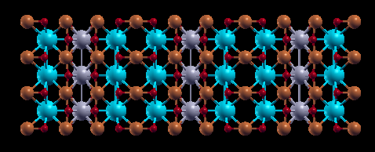

Slide 19
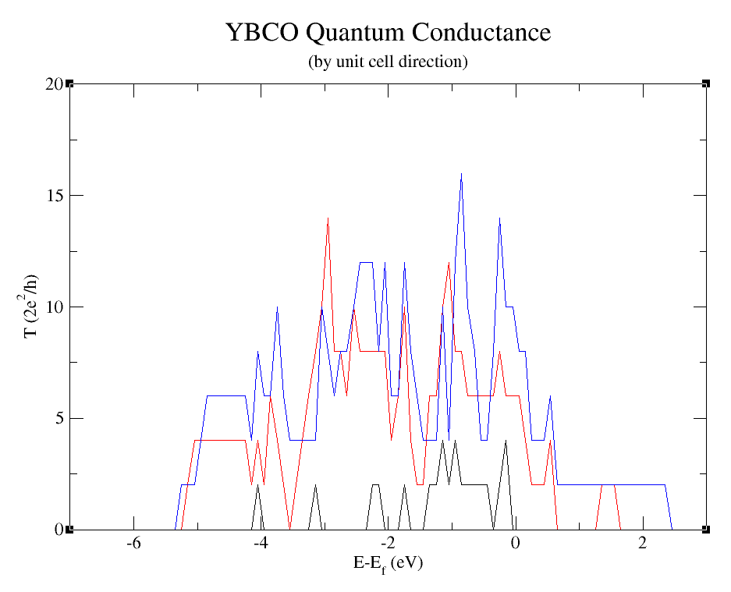
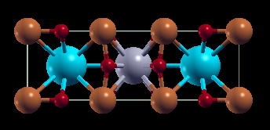
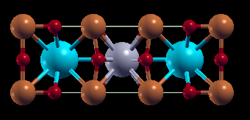
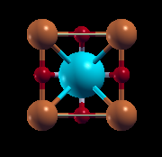
“b”
“a”
T_{max} = 16, <T> = 4.5
σ(T) = 3.3
T_{max} = 14, <T> = 3.3
σ(T) = 3.0
“c”
T_{max} = 4
<T> = 0.4
σ(T) = 0.7

Slide 20
“CNT 5,0”

Slide 21
“b”
“a”
T_{max} = 16, <T> = 4.5
σ(T) = 3.3
T_{max} = 14, <T> = 3.3
σ(T) = 3.0
“CNT 5,0”
“c”
T_{max} = 4
<T> = 0.4
σ(T) = 0.7

Slide 22
“Need to Test by Experiment”
Y-123 Conducting
Pr-123 Insulating (10 monolayers, ~ 50 Å)
Can be made by MBE
But b-axis growth not easy, might be best try a-axis first
I
Y-123
Pr-123
V
Y-123
b-axis

Slide 23
“The Last Word(s)”
Quantum Conductance in the a, and especially b, directions of RE-123 appears plausible.
Coulomb correlation (aka “Hubbard U”) needs to be taken into account.
Experimental verification is required.
Can the effect be exploited for FET gate applications? Or maybe something completely new?
Stay tuned
Attend my talk at the 2013 APS March Meeting (see you in Baltimore)

