Slide 1
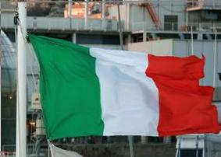

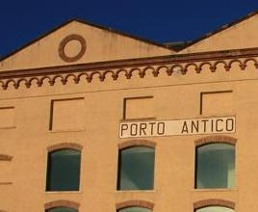


Dual use of future natural gas pipeline rights-of-way for the transport of electricity via HTSC cables
Paul M. Grant
W2AGZ Technologies
EPRI Science Fellow (retired)
IBM Research Manager Emeritus
San Jose, California USA
Author Contact
Poster 2P-LS2-10 PDF
Financial support provided by the IBM Pension Fund

Slide 2
Preavviso!
Make sure the QR Code app in your Android iToy contains a browser with pdf reader plugin!

Slide 3

Abstract
It appears likely that “clean” fossil fuels, exemplified by natural gas, given their current global abundance and accessibility, will continue to be exploited for at least the next two decades. We discuss a scenario whereby future natural gas/petroleum pipeline deployment provides an opportunity for creating a common right-of-way to transport both chemical and electrical energy, the latter via high capacity HTSC dc cables. Given the emergence of highly-Carnot efficient combined-cycle-gas-turbine (CCGT) generation technology, a significant portion of the natural gas delivered, perhaps as much as 40% or more, will be combusted at the end point to produce electricity. It would be useful to contemplate generating this electricity “in bulk” at the gas field “well head,” taking into account the savings wrought by transmitting a lower volume fraction of gas with reduced frictional and pumping losses, and also economies of scale by concentrating CO₂ capture and reprocessing at a single site, rather than at a multitude of gas delivery points. In this poster, we examine possible candidate scenarios in North America and Europe and the advantages such dual use rights-of-way might provide for increased, yet with minimal environmental impact, delivery of chemical and electrical energy. For an initial study of this concept, see:
P.M. Grant, “Cryo-Delivery Systems for the Co-Transmission of Chemical and Electrical Power,” AIP Conf. Proc. 823, 291 (2006); doi: 10.1063/1.2202428

Slide 4
Preamble
Read This Column First!
Discovery
  Cu-Perovskites: 20-135 K (1986-1993)
  MgB₂: 40 K (2001-2002)
  Fe-Pnictides: 4-55 K (2006-Present)
Power Application R&D
  Basic wire development; OPIT, IBAD, RABiTS: USA, Japan, Germany, Italy, S. Korea, Russia (1987-2008)
  ac & dc Cables; Many: USA, Japan, Europe, S. Korea, China, Russia (1992-Present)

Slide 5
  Power Control & Energy Storage (FCLs, SMES); Many: USA, Japan, Europe, S. Korea, China, Russia (1992-Present)
  Utility Demonstrations of Above Technologies
    Investor-owned (Only in USA: EPRI membership)
    “Public” (USA: LIPA, National Grid; Japan: TEPCO, Chubu)
Government-sponsored R&D
  DOE (USA, 1987-2008)
  MITI, METI, ISTEC (Japan, 1987-Present(?))
  KEPRI (S. Korea, 1990-Present(?))
Commercial Development (1987-Present)
  USA (AMSC, STI,...)
  Japan (Furakawa, Fukushima, Sumitomo...
  Europe (Columbus,...)

Slide 6

HTSC Commercial Applications in Power
  At the time of its discovery, HTSC was heralded to soon embody a multibillion dollar market in Power Applications.
  Yet today, despite billions of dollars of investment in R&D and demonstrations by governments worldwide, not one “investor owned utility” and only perhaps two or three “public utilities,” have permanently deployed HTSC apps on the Grid.
  Why not? (see “Upbraiding the Utilities”)
  Some reasons (private communications from several large US IOU’s):
Cold Facts
Economic returns do not justify the investment, even if the cost of the wire were zero!
Installation is a hassle, and current technology works pretty well and is improving (viz., “Smart Grid”)
Any new technology “skill set” would require lengthy negotiations with labor unions at the “lineman” level.
So what’s/where’s the “compelling need” to deploy HTSC on the Grid?
Upbraiding the Utilities
2011 P. M. Grant’s Editorial in Cold Facts

Slide 7
Global Energy Needs:
- Challenges & Approaches/Solutions -
Challenges
  An expanding global population aspiring to the energy-consumption standard of living existing in Europe and North America and targeted by the emerging societies of middle and western Asia, the Indian subcontinent, Africa and South America.
  Possible adverse climate impact arising from the combustion products of increased amounts of fossil fuels consumed in pursuit of their objective.
  Limited ability to address such needs via renewable alternatives and associated physical constraints and socio-eco-invasive impact imposed by widespread deployment of solar, wind, and bio-sourced alternative sources.
Approaches/Solutions
  Vast reserves of natural gas have been uncovered worldwide, and attendant cost-effective retrieval technologies have been developed.
  Let’s start using them!

Slide 8
A New Worldwide Opportunity for HTSC?
Natural Gas & Electricity!
USA
Wow!
2012 USA Electricity Generation by Primary Fuel Source

Slide 9
Preavviso!
Note different “pie slice” color code from USA
Questions:
“Gases” = NG?
Where is Hydro?
“Solid” = Coal?
Europe
About 3/4 that of US
BTW, it’s around 23% Worldwide
2011 EU Electricity Generation by Primary Fuel Source

Slide 10
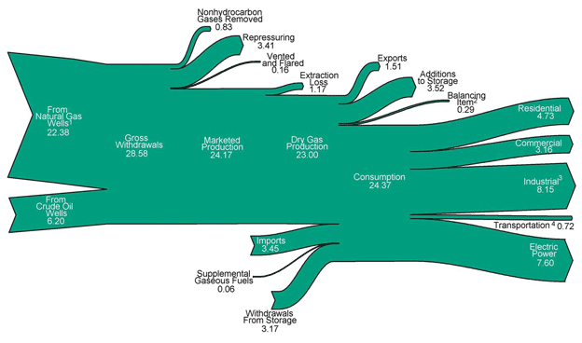
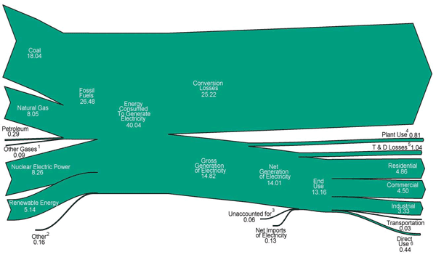
US Natural Gas Generation/End Use – 2011
Units = 10¹² ft³
= 1.35 x 10⁴ Twh
What/where are the equivalent data for the EU? (Couldn’t find any...???)
~25% 2011!
US Electricity Generation/End Use – 2011
Units = 10¹⁵ BTU
= 2.933 x 10³ Twh

Slide 11
Might be 37.5% by year end 2013 (check with USA-EIA)
Growth rate looks like
7%/yr!
USA
2013

Slide 12
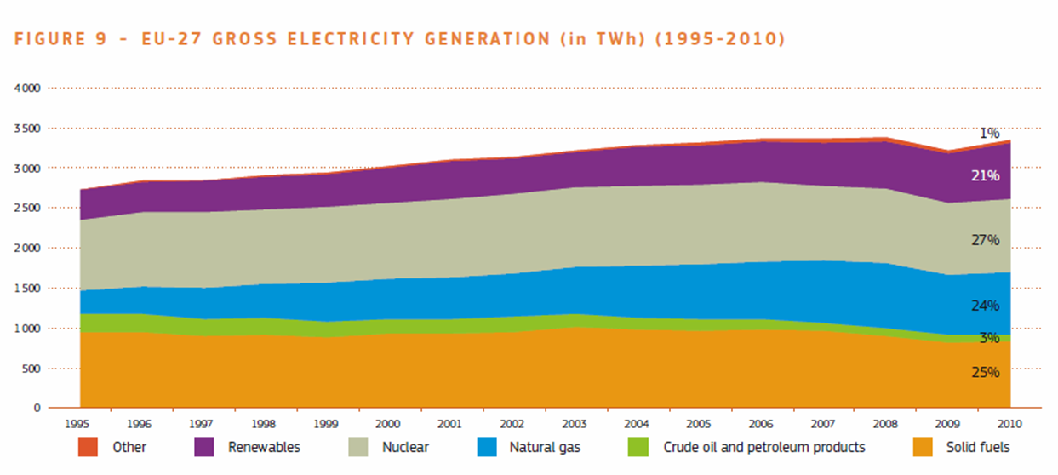
Europe
Growth rate of electricity generation by Natural Gas looks “flat” at present. Will discovery of additional reserves and deployment of fracking, especially in Poland and the Ukraine, lead to a future “upward slope?”

Slide 13
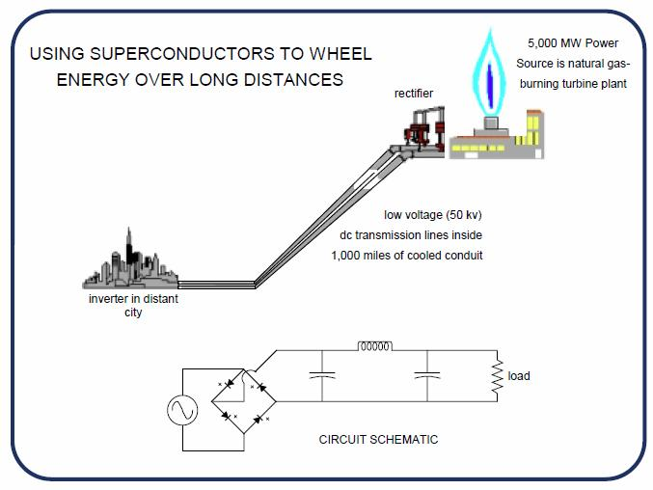

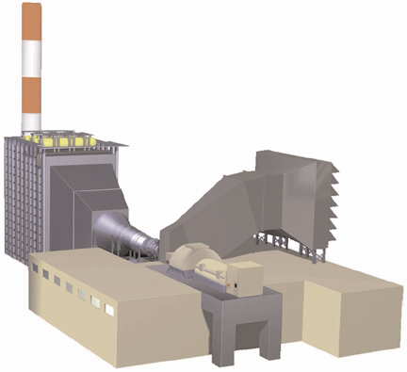
Advantages of HTSC vis-a-vis Pipelines
Almost all NG used for electricity generation is “combusted” at a “local” delivery point using modern, efficient, combined cycle gas turbine (CCGT) technology.
Why not “combust” that gas portion so-used at the “well-head” instead and deliver the “electrons” over a low-loss HTSC dc cable? As well as
reducing volume of NG transported by pipeline.
...and...consider “recycling” CO₂ emissions into alcohols!
EPRI ePipe
EPRI WO8065-12
W2AGZ Technologies

Slide 14

Power Delivery cost comparison between
Gas/HVDC/LVDC-HTSC
Technology Options
Marginal Cost of Power Delivery
EPRI ePipe
^{US cents/kWh}
HTSC ($5/kA-m @ 65 K) beats HVDC and Gas!
WOW!
EPRI WO8065-12
W2AGZ Technologies
Nota Bene! (That’s Latin for Preavviso) This figure contains 1997 “English/US” units for distance and currency and needs to be updated... Sega!

Slide 15
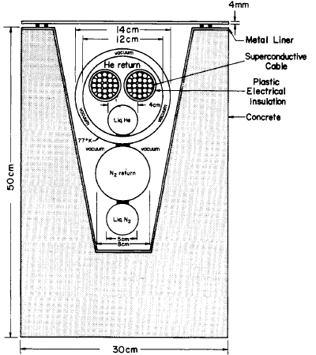
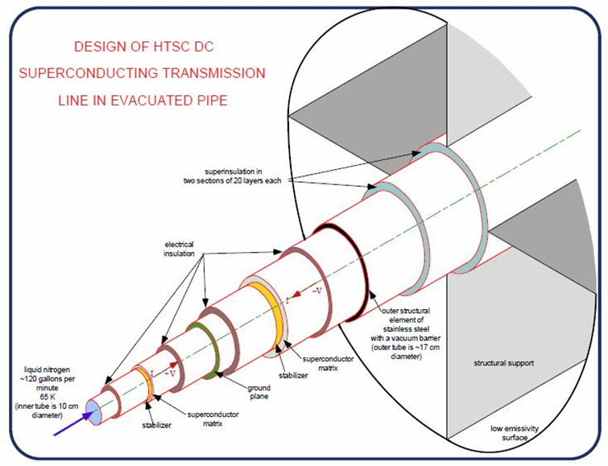

Superconducting Cable Anthology
Garwin-Matisoo (1967)
EPRI ePipe (1997)
5 GW; +/- 50 kV; 50 kA
Bi-2223; 68 °K
1610 km
Dia. ~ 70 cm
Garwin-Matisoo
EPRI ePipe
100 GW; +/- 100 kV; 500 kA
Nb₃Sn; 4 °K
1000 km
Garwin-Matisoo IEEE
W2AGZ Technologies
EPRI WO8065-12
W2AGZ Technologies

Slide 16
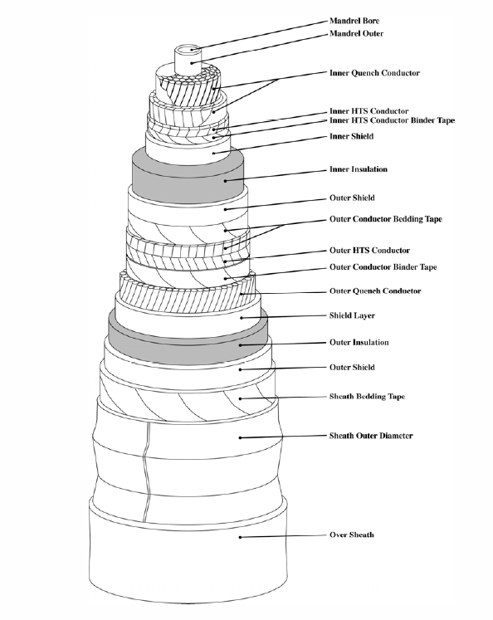

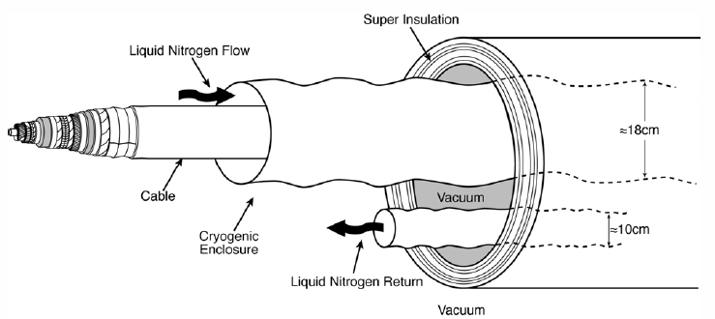
EPRI Superconducting dc Cable (2009)
10 GW; +/- 50 kV; 50 kA
YBCO; 68 °K
Constructed in 1 km segments
HTSC dc Cable
EPRI 1020458
W2AGZ Technologies
Dia. ~ 70 cm

Slide 17
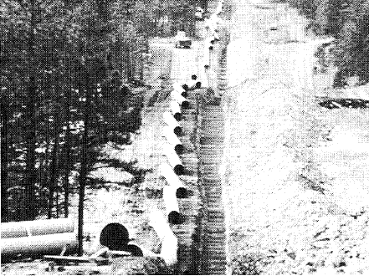
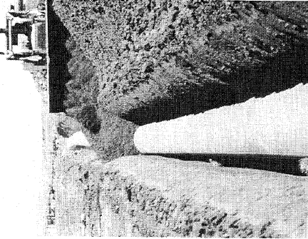
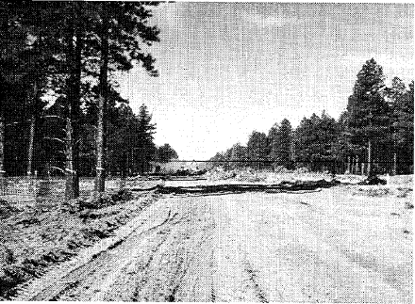
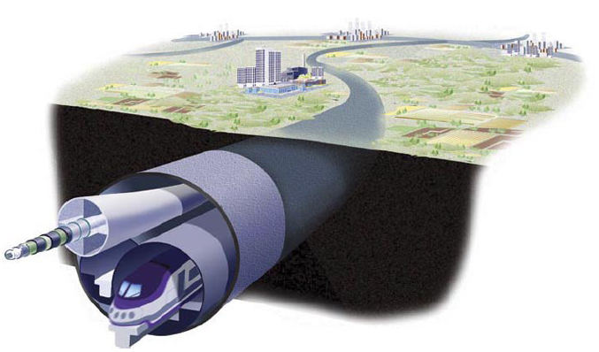
So: Is there enough room underground for both wires and pipes?
Maybe even for a Train?

Slide 18
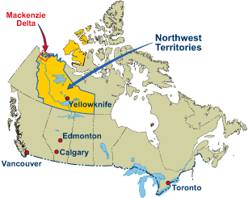
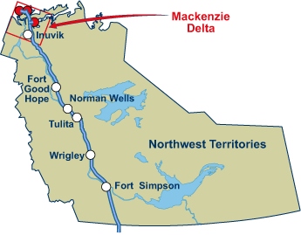
USA/Canada
A Canadian’s View of the World!
The Mackenzie Valley Pipeline
1220 km
18 GW-thermal
2000 - ?
The United States is Down Here!

Slide 19


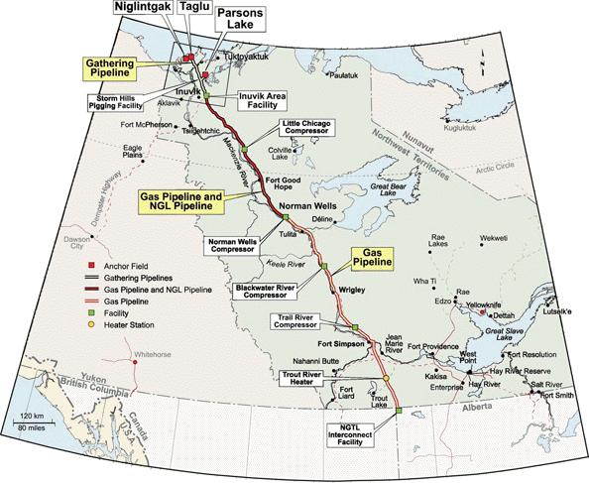

“The Really Big Picture”
Electricity Conversion Assumptions
Wellhead Power Capacity | 18 GW (HHV)
Fraction Making Electricity | 33%
Thermal Power Consumed | 6 GW (HHV)
Left to Transmit as LNG | 12 GW (HHV)
CCGT Efficiency | 60%
Electricity Output | 3.6 GW (+/- 18 kV, 100 kA)
Cryo-Delivery
Co-Transmission (2006)
W2AGZ Technologies

Slide 20
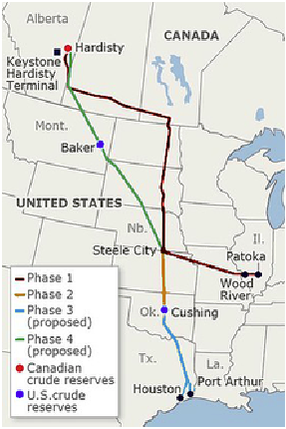
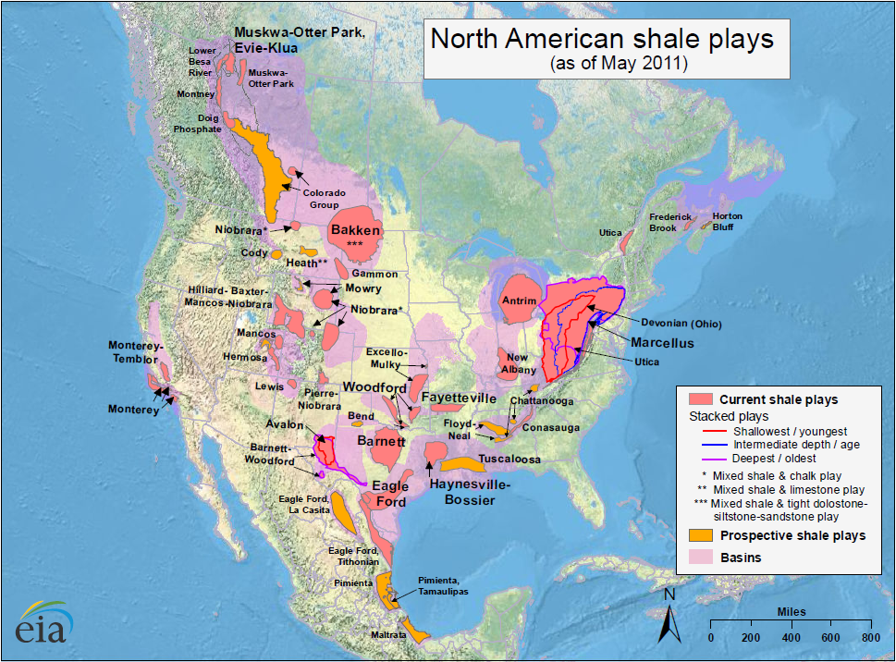

Opportunities to Exploit the Keystone XL Pipeline ROW for the Dual Transport of Chemical and Electrical Energy
Smart Grid
Fraternal Twins
2013 P. M. Grant’s Editorial in Smart Grid News

Slide 21
Europe
“A Modest Proposal”
Design/Deploy a Methane/Electricity ePipe Infrastructure to Socio-economically and Enviro-responsibly service the Emerging Energy Needs of the European Union

Slide 22
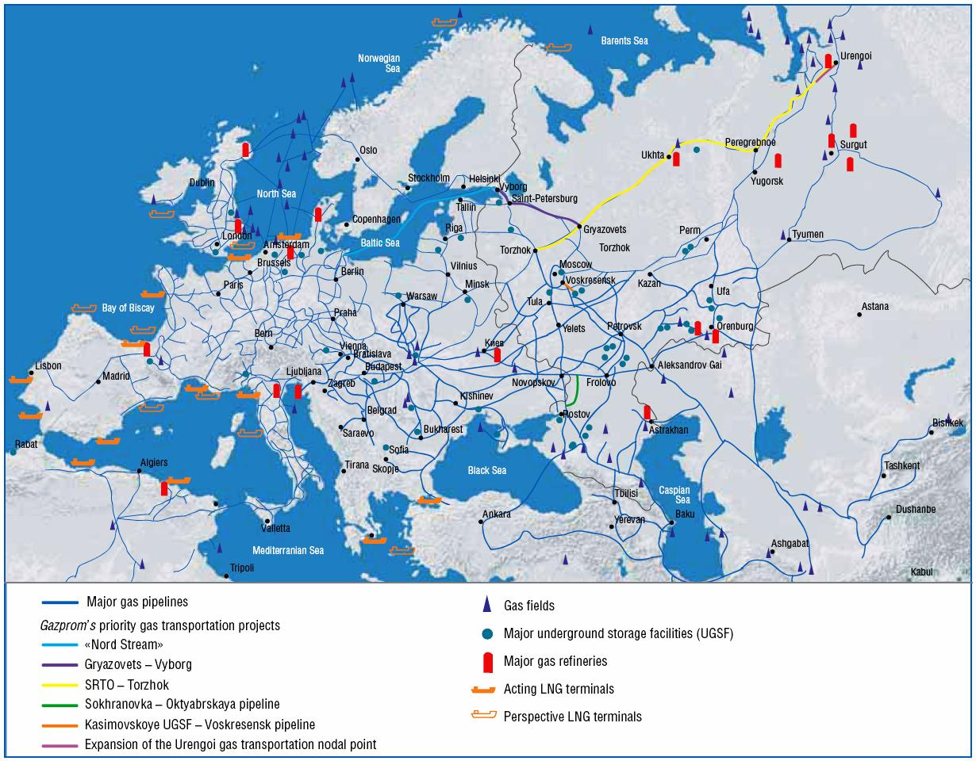
Where are the Opportunities?
Current European Natural Gas Fields/Pipelines

Slide 23
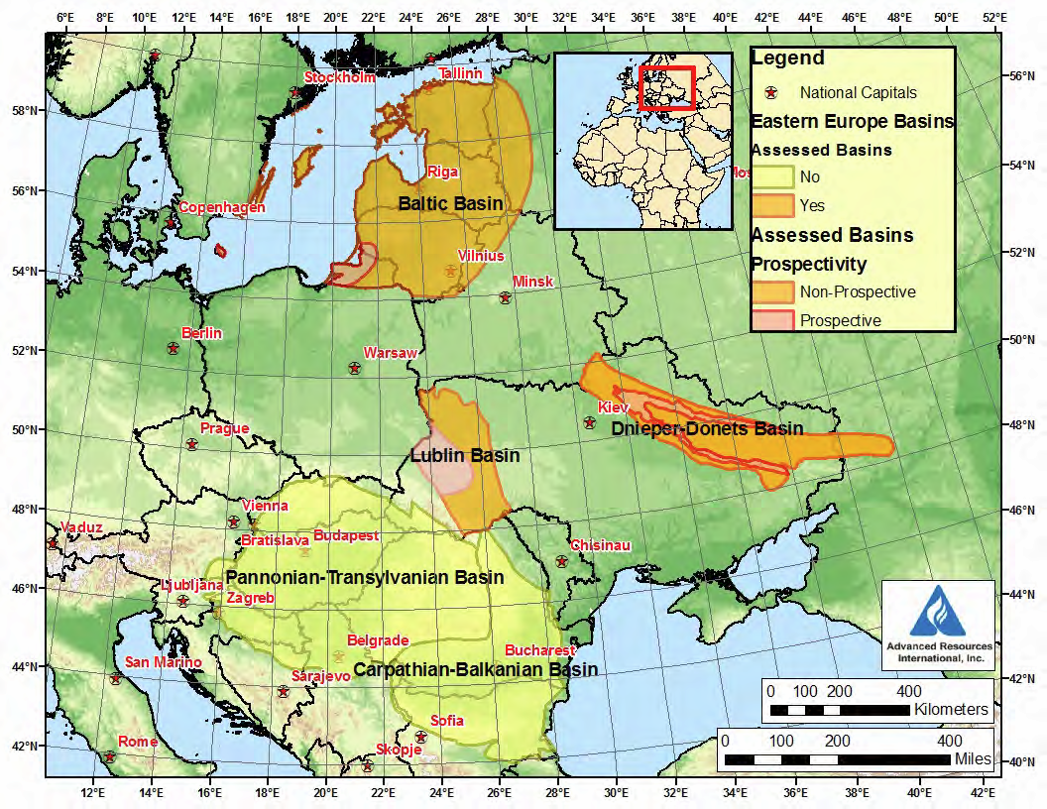


Scenario I
The Wola Obszańska (Lublin) gas field in Poland/Ukraine was discovered in 1989. It began production in 1992 and produces natural gas. The total proven reserves of the Wola Obszańska gas field are around 37 billion cubic feet (1×10⁹m³). “Dual-Pipe” to Berlin?
o Wroclaw

Slide 24
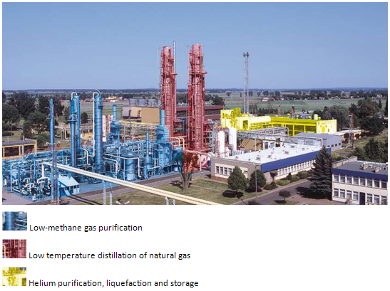
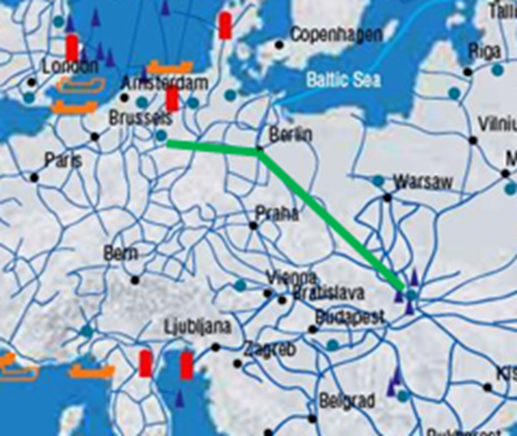
Scenario II
...along the way, there’s...
Krio Odolanow
A hundred kilometres to the north-east of Wroclaw lies KRIO Odolanów, a branch of the Polish Oil and Gas Company, which operates the only installation in Europe for helium recovery from natural gas. The technology utilized in KRIO Odolanów is based on cryogenic processes and its two main products are liquid helium and liquefied natural gas.
So, why not extend the “Dual-Pipe” to Brussels? It is the European Union...

Slide 25
”Polish-Ukraine-Pipe-Dream” vs. North American MVP Numbers
(Natural Gas Delivery Statistics...Sources/Comparisons)*
Sources | Reserves 10⁹ cu⋅ft | Reserves Twh | wrt US | wrt MVP
US Total | 28,600 | 3.86⋅10⁵ | - | -
MVP | 7060 | 9.34⋅10⁴ | 25% | -
Lublin** | 37 | 5.00⋅10² | 0.13% | 0.52%
Lublin – Berlin Pipeline Corridor “electrons/CH₄ Energy Delivery ePipe Split”
Total Delivered Power (GW) | CH₄ Portion (GW) | “electrons” Portion (GW)*** | CCGT efficiency – 50% (GW) | Years Until Exhaustion**
2.5 | 1.0 | 1.0 | 0.5 | 22.3
Scan the QR Codes in Bibliography for the references below...and then let’s discuss!
*US-DOE-EIA: http://www.eia.gov/analysis/studies/worldshalegas/ Table I (note only proven reserves data are used, not possible recoverable shale deposits).
**https://en.wikipedia.org/wiki/Wola_Obsza%C5%84ska_gas_field (if nearby Ukrainian are available provable reserves were to be included, perhaps 5 times this number could be realized).
  ***See EPRI Report WO8065-12, March, 1997 (pdf), EPRI Report 1020458 (pdf), for possible HTSC cable designs.

Slide 26

Path Forward in the European Union
Present and Encourage Consideration/Study of the R-O-W Dual Use Concept by the Following EU Institutions:
  European Institute of Innovation & Technology (EIT)
  European Research Council (ERC)
  European Executive Agency (REA)
  Institute for Advanced Sustainability Studies (IASS)
Engage/Inform the R&D and Planning Staffs of Major European Gas & Electric Utilities and Their Equipment Suppliers:
  Gazprom; RWE; EDF Group (UK & France); E.ON; PGE (Poland)
  Siemens; BASF; ABB; Nexans; Prysmian Group
  European Pipeline Group (Ductile Pipes, Valves & Fittings)

Slide 27
Engage Major European Technical Universities, Institutes and Companies Focusing on HTSC Power Application Development:
  KIT; MPI-Stuttgart; Université Paris-Sud
  CERN; CNR-INFM
  Nexans; Columbus Superconductors
Initiate, Investigate and Undertake Novel Technologies Relevant to the R-O-W Dual Use Concept:
  “Real Time” Recovery of H₂O, CO₂ from the “Tailpipe Emissions” of Wellhead CCGT Generators for Recycling into Methanol/Ethanol.
  Conduct Demonstration Projects Exploring the Efficacy of Co-transportation of Chemical and Electrical Power via a L-H₂ (or L-CH₄) Cooled HTSC “SuperGrid.” (Such as the H₂ + MgB₂ Cable Experiment Reported in Talk
  1A-LS-05).
  Finally, in Anticipation of the Exhaustion in 3-4 Decades of Recoverable Natural Gas Resources Throughout Europe, Explore the Efficacy of Re-using the Now-installed R-O-W Dual Use Delivery Infrastructure by Installing on the Sites of the Depleted Wellheads...

Slide 28

...the Exploitation of Multi-century Reserves of Recyclable, Reprocessable, Proliferation-safe Thorium-based Nuclear Fission Generation of Electricity Accompanied by Hydrogen Production...aka
“The Energy Amplifier!”
Energy Amplifier
Stanford (2011)
W2AGZ Technologies
Grazie Mille!

Slide 29
Bibliography

Slide 30


Author
YouTube
Smart Grid
Cold Facts
Paul M. Grant
W2AGZ Technologies
What’s Next For Superconductivity?
Physics World interviews Paul Grant
Fraternal Twins
2013 P. M. Grant’s Editorial in Smart Grid News
Upbraiding the Utilities
2011 P. M. Grant’s Editorial in Cold Facts
Poster PDF
2012 AER
EPRI ePipe
Pipe-to-Power
Dual Use
EUCAS 2013 Poster 2P-LS2-10
DOE AER 2012
W2AGZ Technologies
EPRI WO8065-12
W2AGZ Technologies
EPRI TR-104787
W2AGZ Technologies

Slide 31



HTSC dc Cable
Garwin-Matisoo
HTSC Power Apps
Cryo-Delivery
EPRI 1020458
W2AGZ Technologies
Garwin-Matisoo IEEE
W2AGZ Technologies
Wroclaw (2010)
W2AGZ Technologies
Co-Transmission (2006)
W2AGZ Technologies
Shale Gas Reserves
Lublin Gas Fields
Energy Amplifier
EIA Shale Data (2013)
Wola Wikipedia
Stanford (2011)
W2AGZ Technologies

