Slide 1
Setup

Slide 2


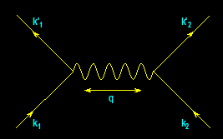
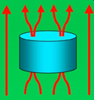
From
Electrons
Paired
To
Electric
Power Delivered
…And…
Back
Again
?
-- A Personal Journey in Applied Physics --
-- IBM, EPRI, and Beyond --
Paul M. Grant
“Aging IBM Pensioner”
Session M10
FIAP Prize Session
11:15 AM – 12:27 PM
Wednesday, 5 March
Paper 2
11:51 AM – 12:27 PM
Room 201
Wednesday, 5 March

Slide 3
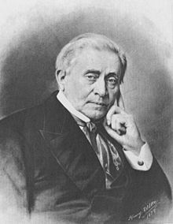
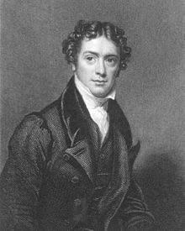
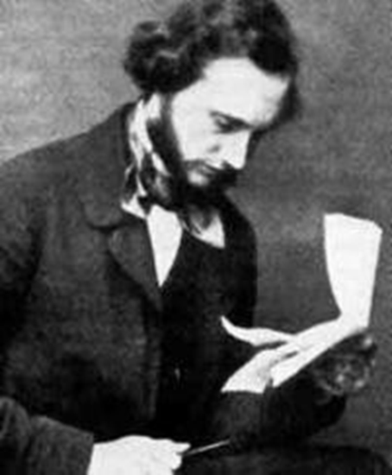
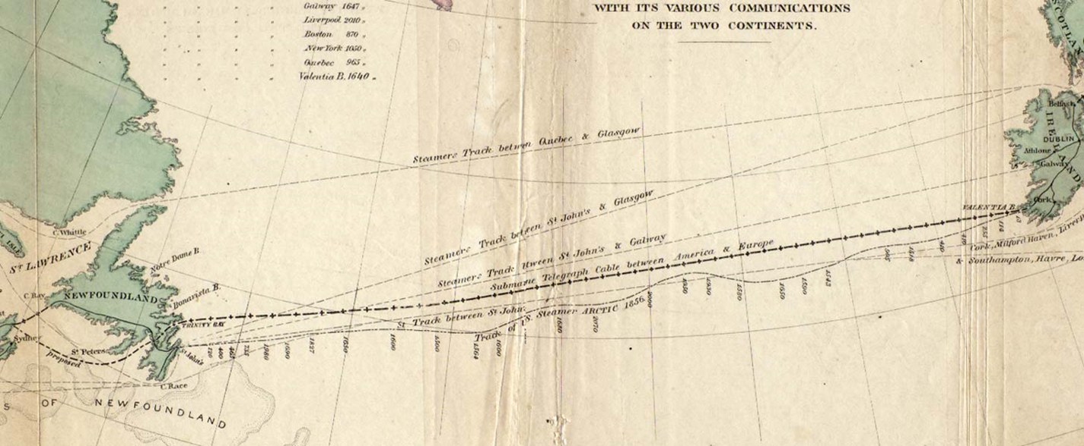
Three Famous Applied Physicists
Joseph Henry
Scottish-American
English
William Thomson
Michael Faraday
Irish-born
The Transatlantic Cable (1854 – 1866)
“A Thread Across The Ocean”
John Steele Gordon (2002)

Slide 4
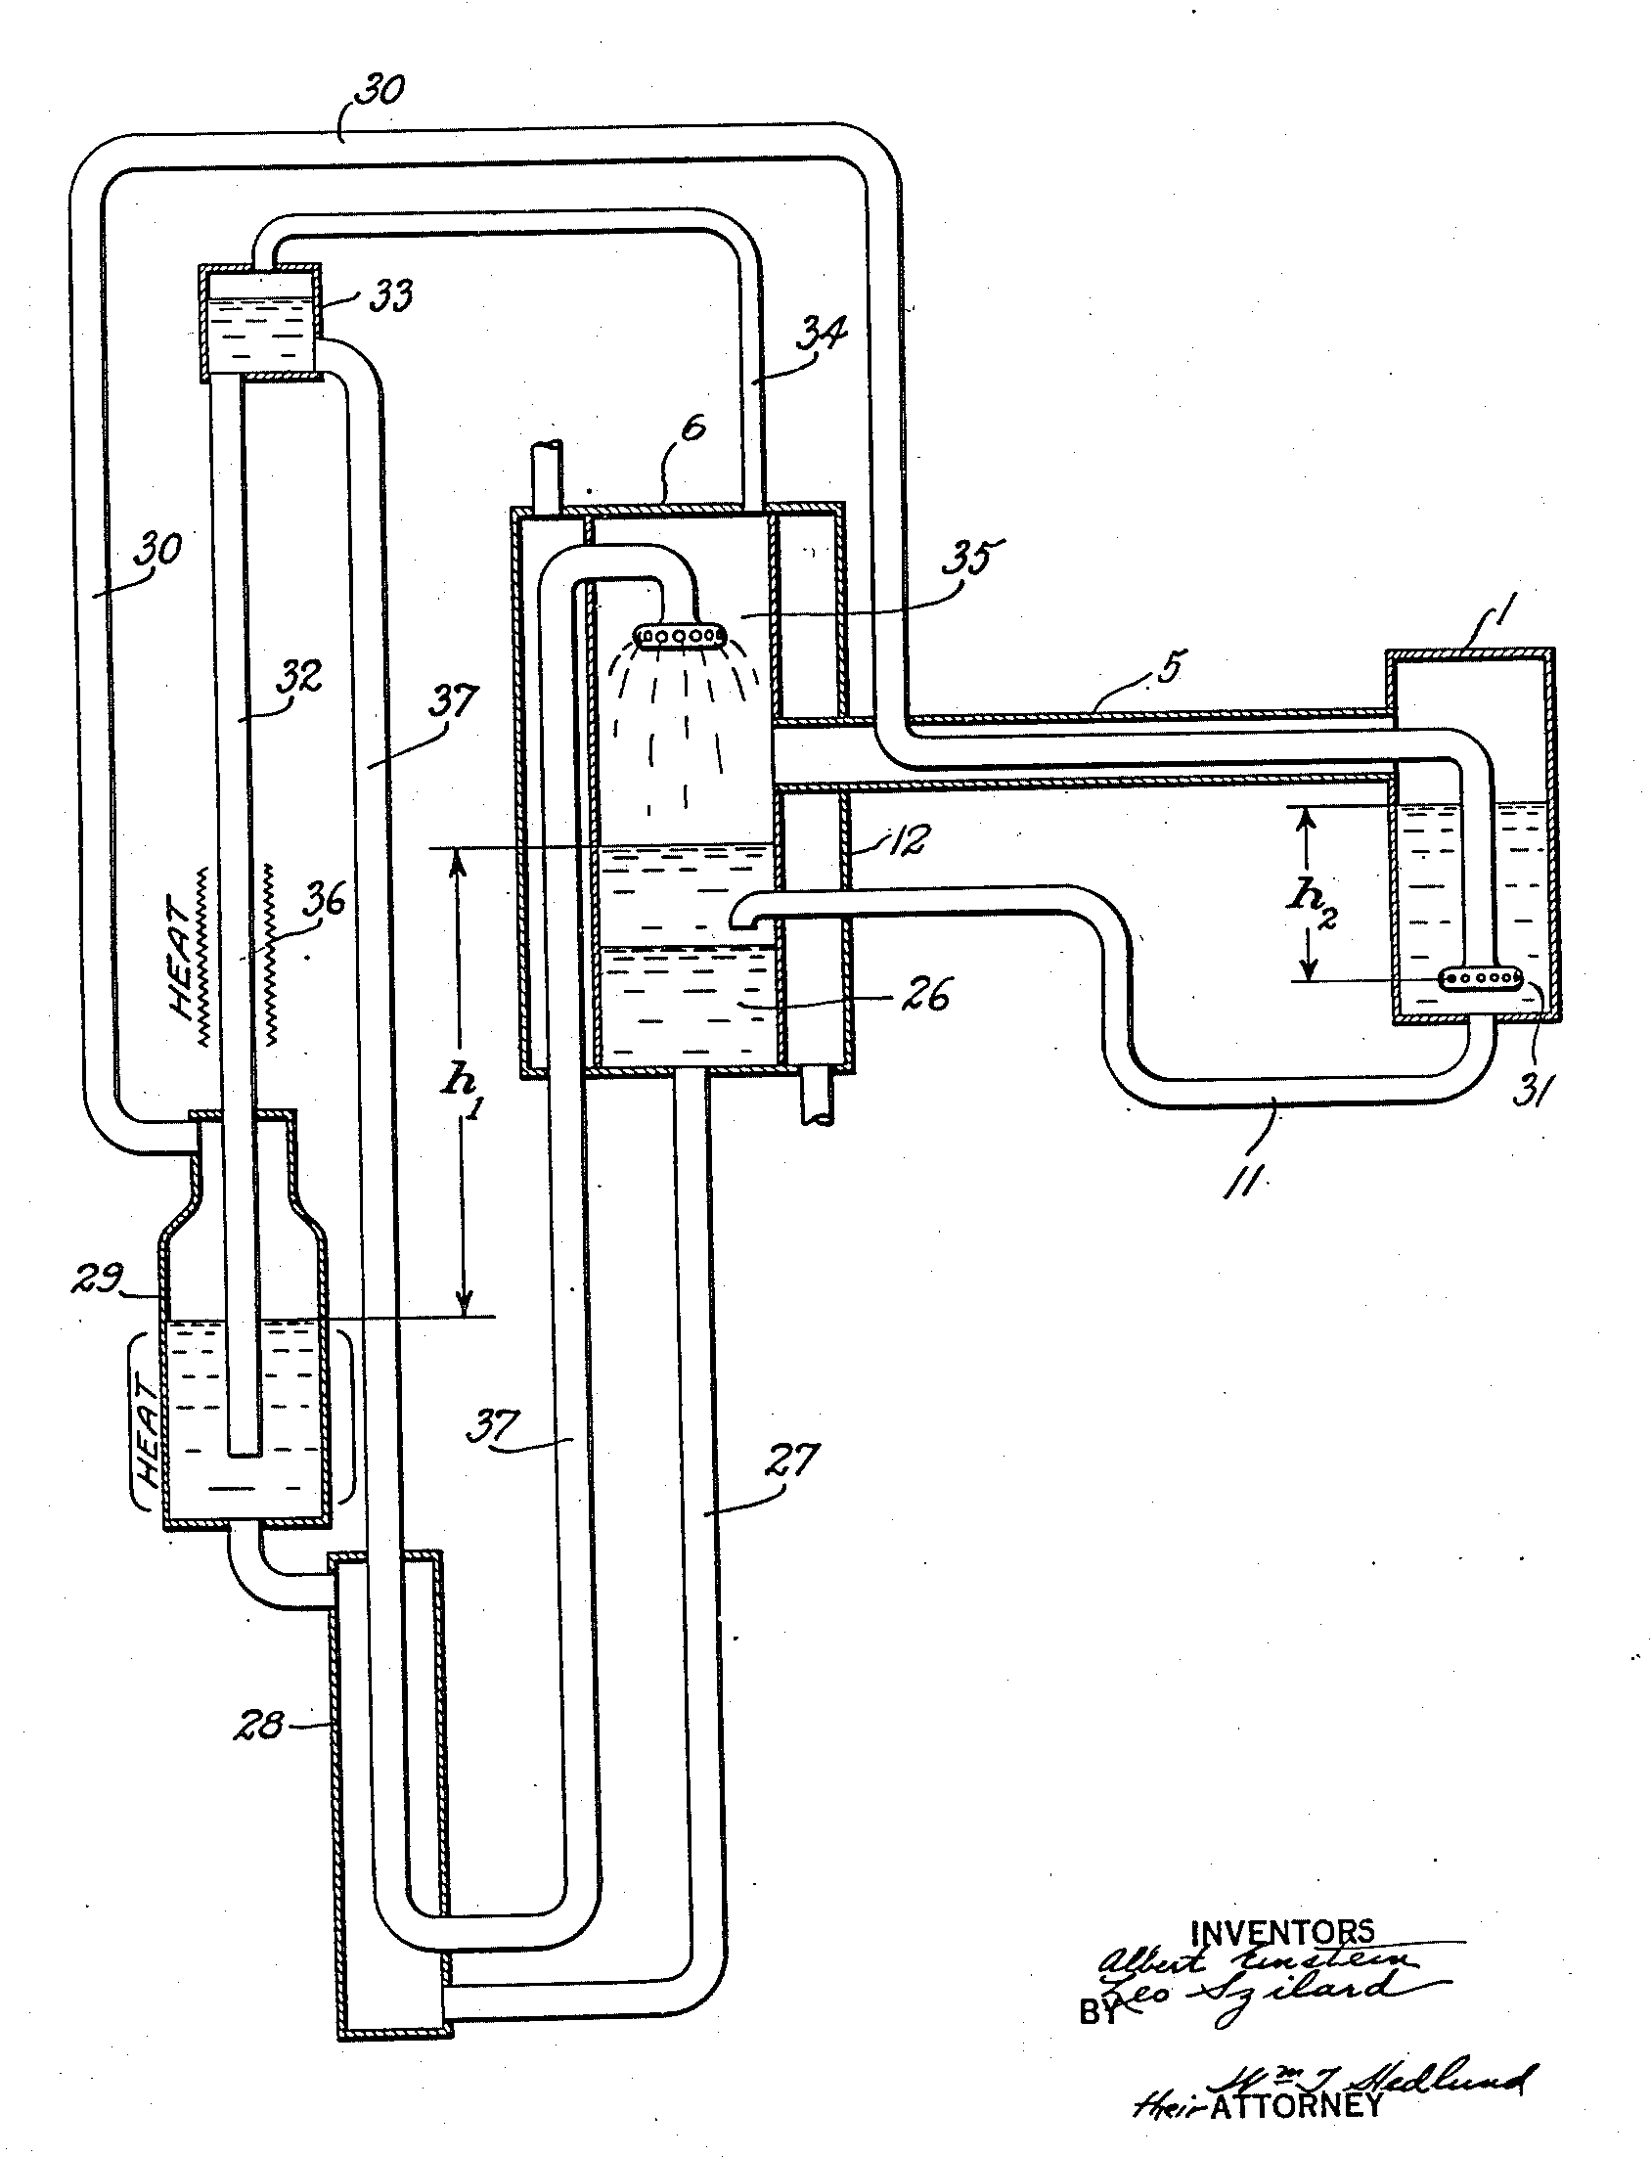
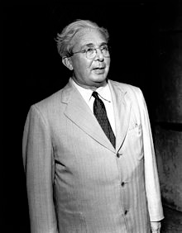
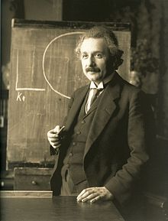
Two Other Famous Applied Physicists
A Simple Household Refrigerator!
Leo Szilard

Slide 5

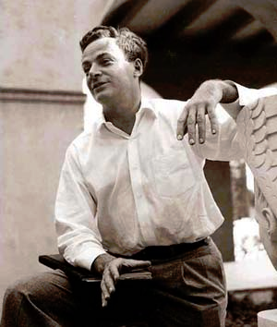
...and Finally One More...
Feynman was “inspired” by the classic 1959 British film, “Room at the Top,” wherein an ambitious young worker colludes with the daughter of a factory magnate as part of a plot to take over the company.
Richard P. Feynman...The Spiritual Father of Nanotechnology (1959)
“There’s Plenty of Room at the Bottom!”

Slide 6
PMG “IAP” Career Timeline
IBM (1953-1993)
  Project SAGE (IBM, MIT, USAF) (1953-56)
  IBM Education Plan (Clarkson, Harvard) (1956-65)
  San Jose/Almaden Research Staff Member/Manager (1965-90)
  Sabbatical: Visiting Prof @ UNAM (1990-93)
EPRI (1993-2004)
  Science Fellow (Superconductivity, Power Electronics Devices, Fusion, “Novel Concepts”)
W2AGZ Technologies (2004-?)
  Visionary Energy Societies (SuperCity, SuperSuburb, SuperGrid)
  “Due Diligence” Consulting to Silicon Valley Startups & Advising Various Energy “Think Tanks,” e.g., the Potsdam Institute for Advanced Sustainable Studies (IASS)
  Uncovering the Nature of HTSC ! (see talk Y47-8 Friday)

Slide 7
Selected Patents & Patent Publications
Thin Film Magnetoresistance Sensor (Clarkson Senior Thesis, 1959)
Interactive Graphics Program (1970)
Isostructural Organic Junctions (1977)
Method & Means for Calculation of Hypogeometric Functions on Parallel Processors (1980)
Additives for Carbon-Loaded Polymers (1984)
Preparation & Processing of High Temperature Superconductors (1987)
Preparation of Electron High Temperature Superconductors (1991)

Slide 8
Selected PRLs
Non-direct Processes and Optical Properties of Metals (1967)
Temperature Dependence of the Near-Infrared Optical Properties of TCNQ (1973)
Low-Temperature Specific Heat of (SN)x (1974)
*Optical Properties of Polymeric (SN)x (1975)
*OPW Band Structure of (SN)x (1975)
*XPS Determination of the Valence Band Structure of (SN)x (1975)
Properties of Brominated (SN)x (1977)
Broken-Symmetry Band Structure of (TMTSF)2-X (1983)
Evidence for Superconductivity in La2CuO4 (1987)
* All in one month!

Slide 9
Selected Popular Articles (IBM, EPRI, W2AGZ)
Do-it-yourself Superconductors (New Scientist, 1987)
HTSC: Four Years Since Bednorz & Mueller (Advanced Materials, 1990)
Another December Revolution? (Nature, 1994)
Researchers Find Extraordinarily High-Tc in Bio-Inspired Nanopolymer (Physics Today, 1998 (or 2028?) )
Is a Bell Tolling for Bell Labs? (Nature, 2002)
Hydrogen Lifts Off – With a Heavy Load (Nature, 2003)
A Worthy Hero for Boys and Men (San Jose Mercury News, 1999)

Slide 10
IBM

Slide 11
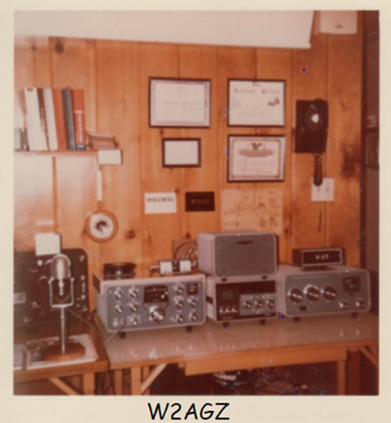
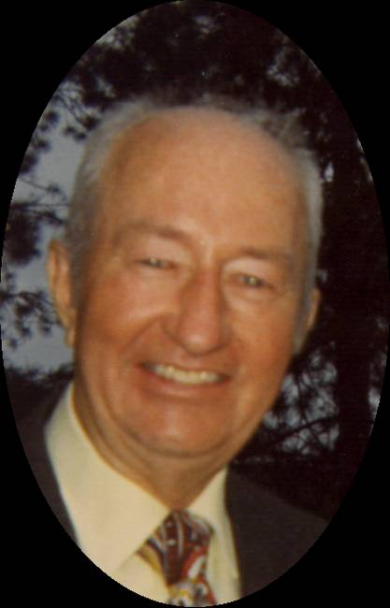
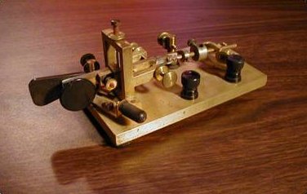
Following In His Shoes
Paul Archibald Grant, W2AGZ
Teenage Ham Radio Prodigy, 1922
Auto Assembly Line Worker, 1923-30
County Motorcycle Cop, 1930-33
Owner, Home Radio Installation Business, 1934-37
Tool & Die Machinist, 1938-42
Radar Specialist 1st Class, US Navy, South Pacific, 1943-45
Electronic Technician, Purchasing Agent, IBM, 1947-74
Founder, Catskill Mountain Volunteer Ski Patrol, 1948

Slide 12
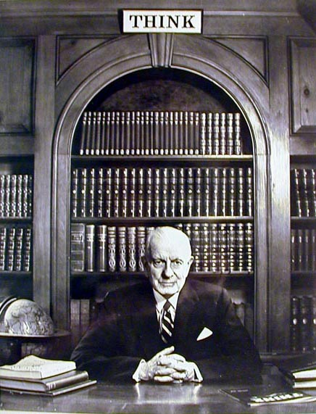

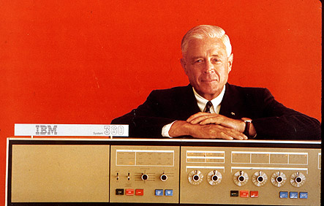
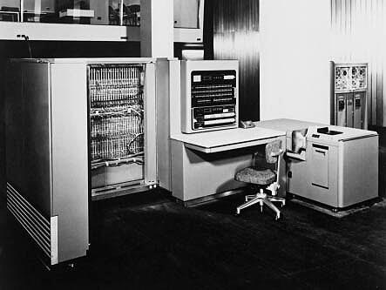
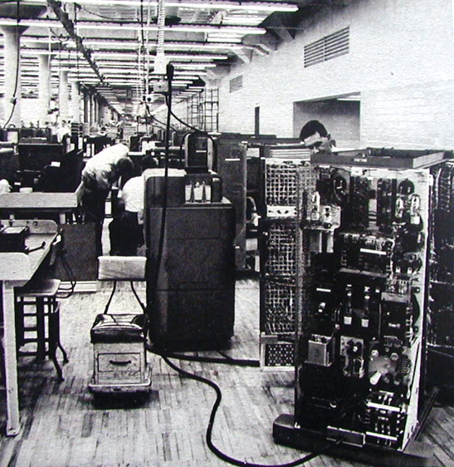

IBM – 100 Years
1952
Grant-Whalen IBM Family
-Poughkeepsie-
604 (1948)
701 (1952)

Slide 13
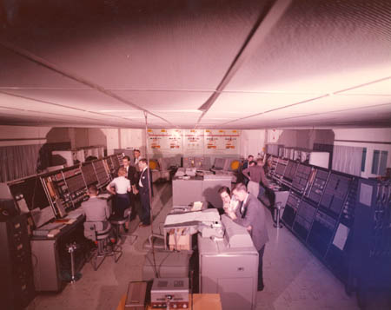
1953
Project Sage – IBM/MIT
AN/FSQ-7
The world’s first Supercomputer
The worlds’ first Parallel Computer
Notes:
13

Slide 14
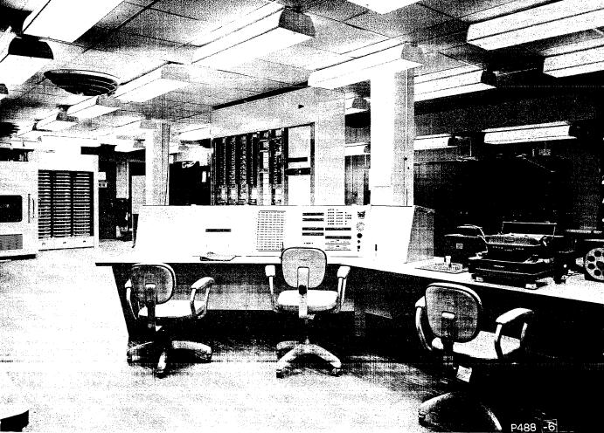
1954
TX-0: The First Transistor Computer
During my “breaks” I would sit in this chair coding “Nim”

Slide 15
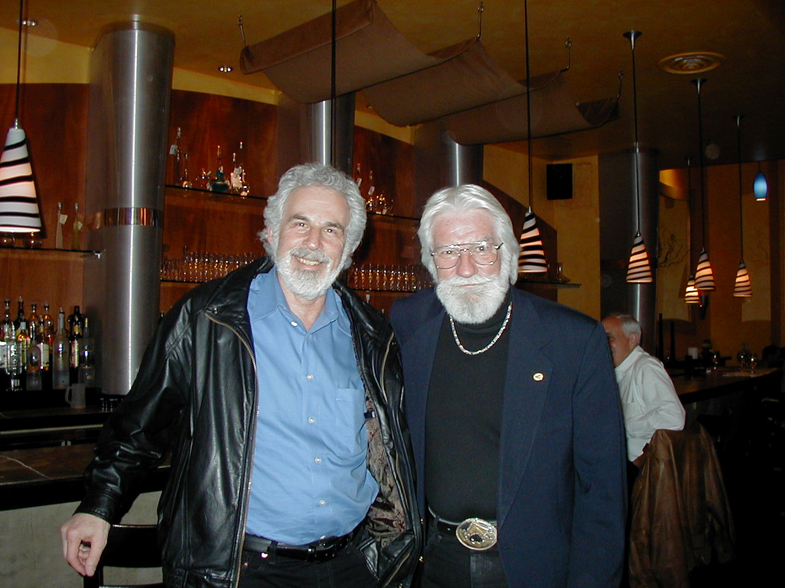
G² !
The Borscht Belt Boys

Slide 16
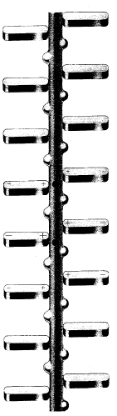
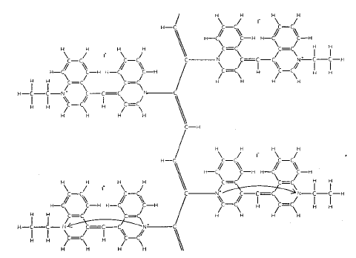
Little, 1963
₊
-
-
₊
₊
-
-
₊
₊
-
-
₊
Diethyl-cyanine iodide

Slide 17
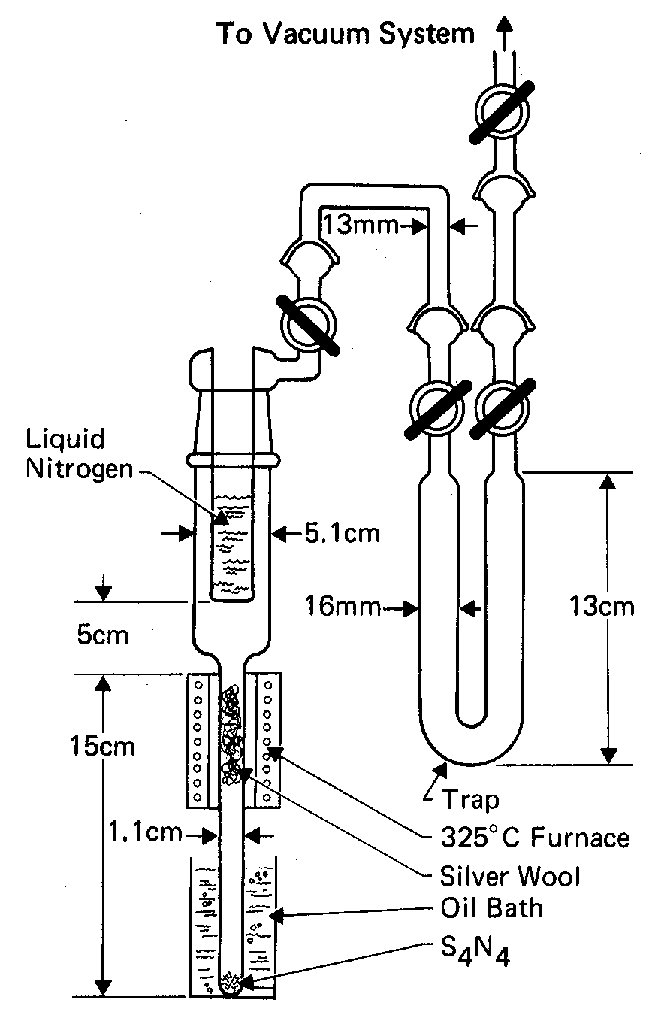
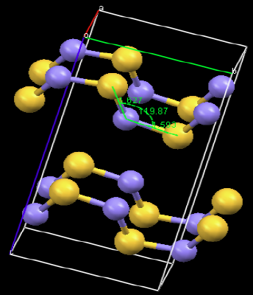
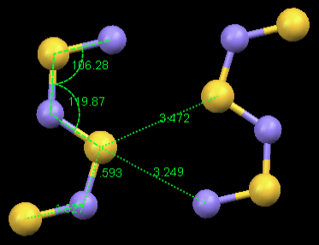
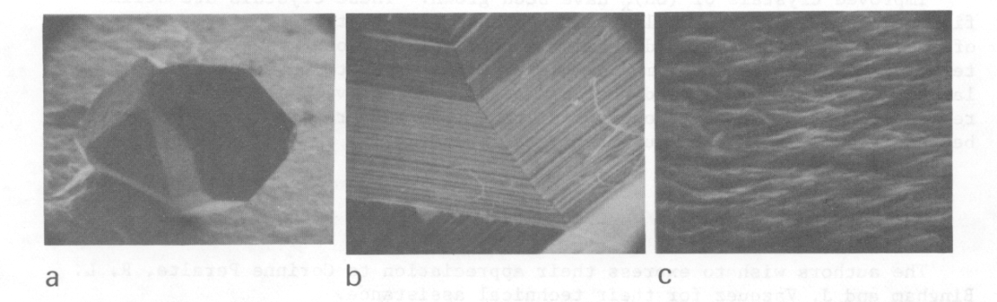
Polysulfur Nitride, (SNx)
F. B. Burt (1910)
M. Boudeulle (1974)
G. B. Street (1974)

Slide 18
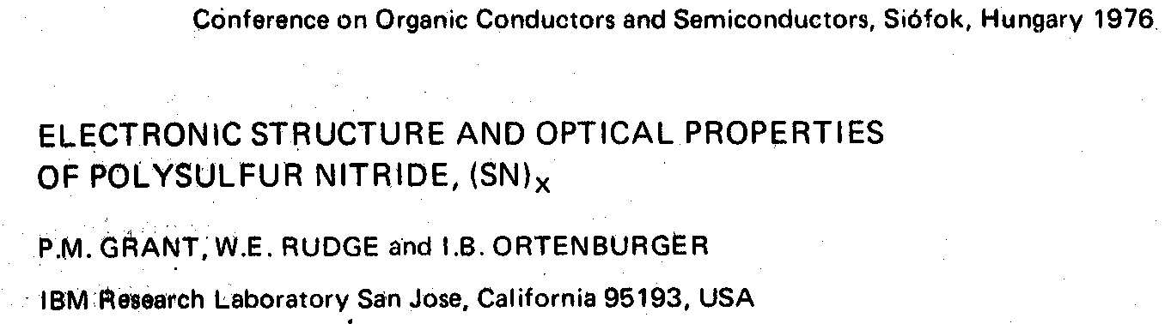

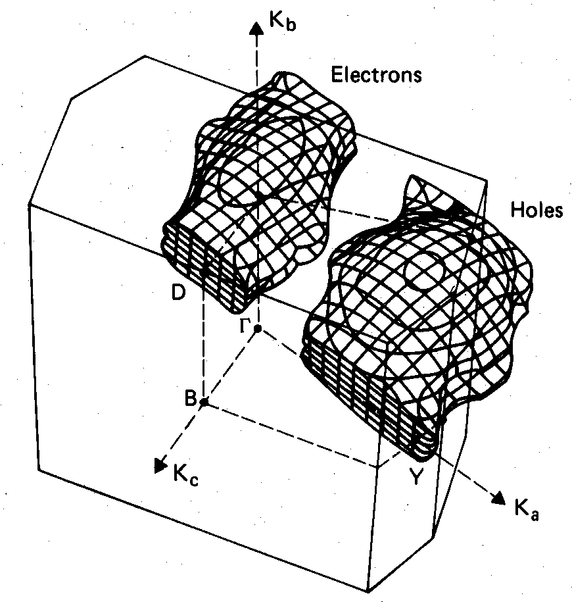
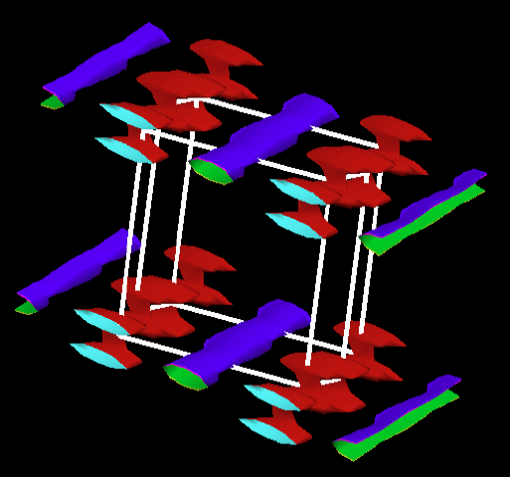
Two-Band Semimetal
MgB₂ ?
Fe-Pnictides ?
OPW, 1975-6
Quantum-Espresso, 2009
“A Women’s Place is on Top”

Slide 19
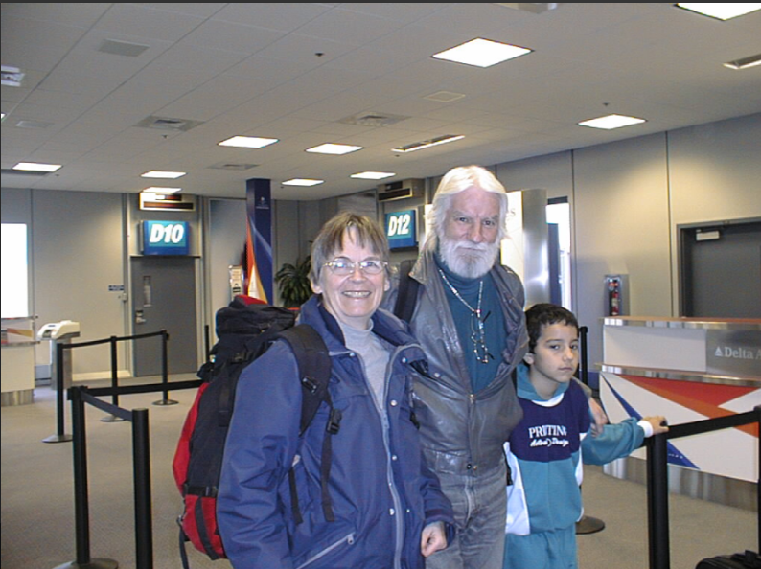

Slide 20
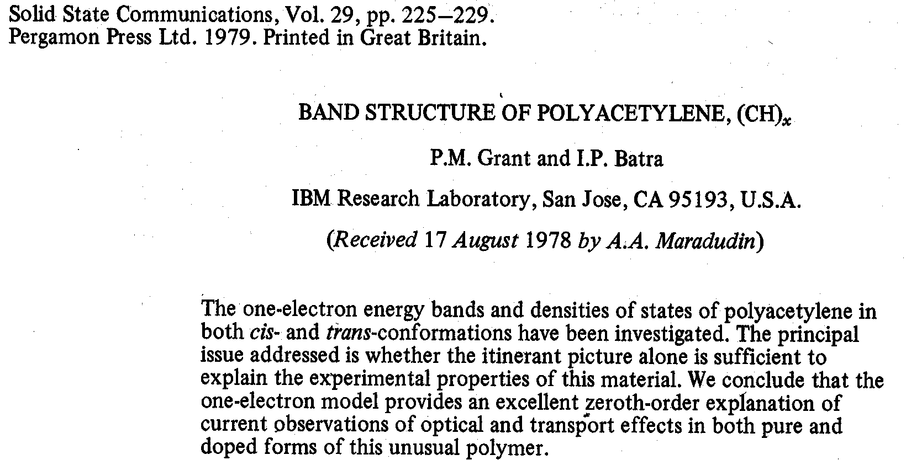
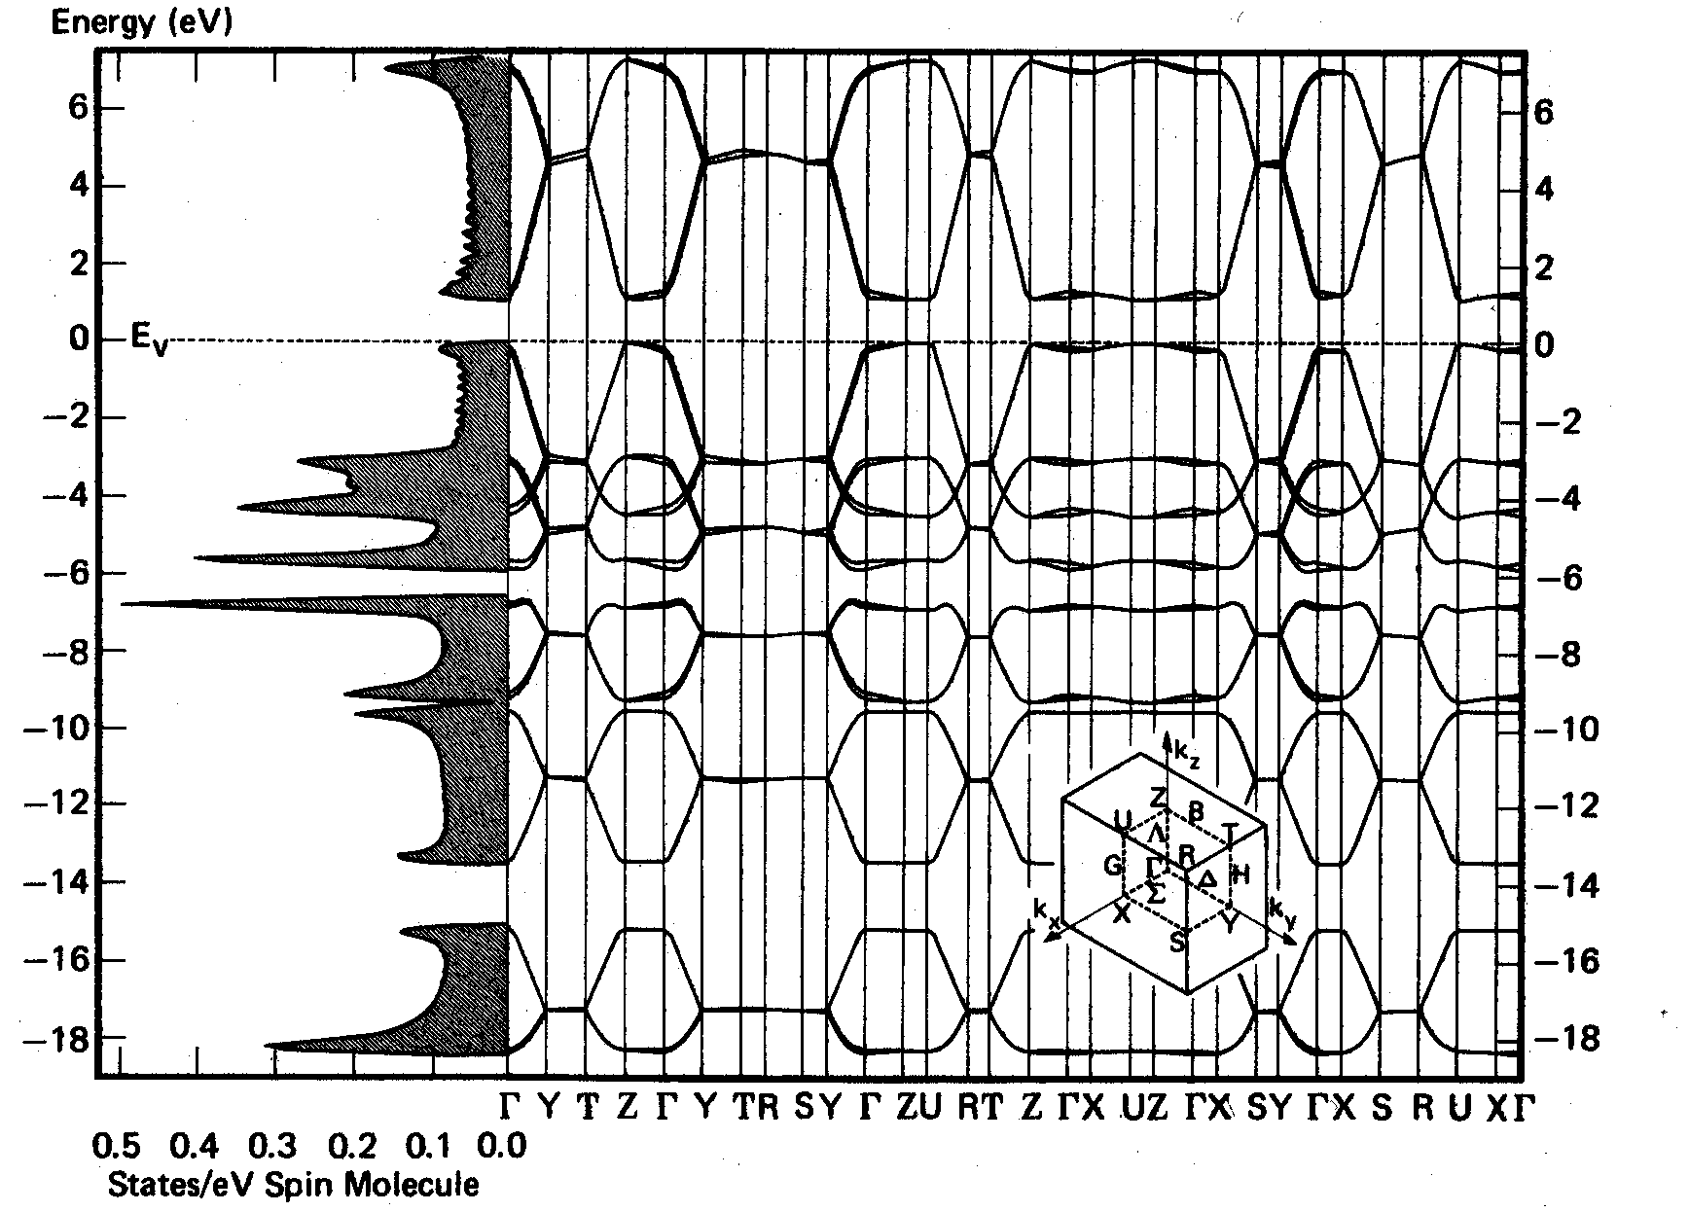
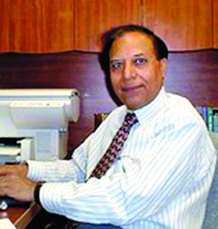

Slide 21
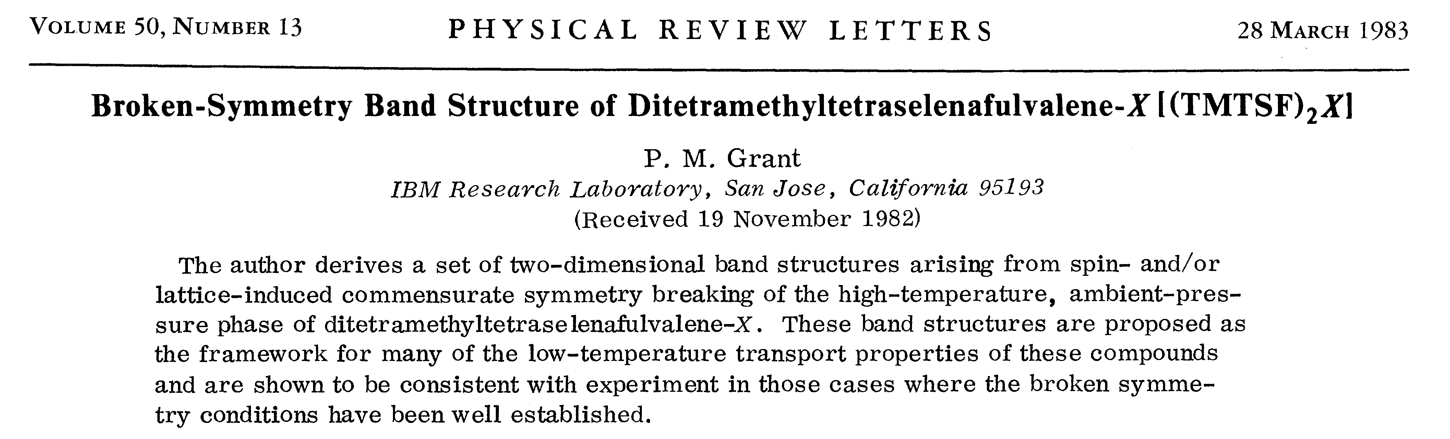
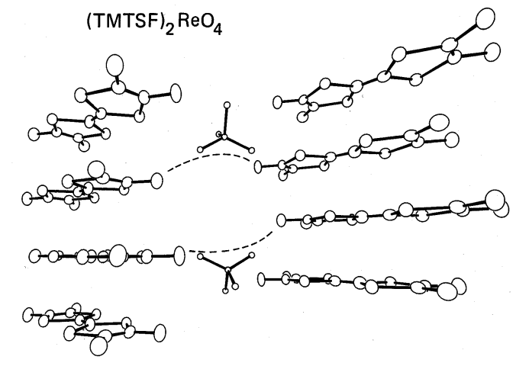
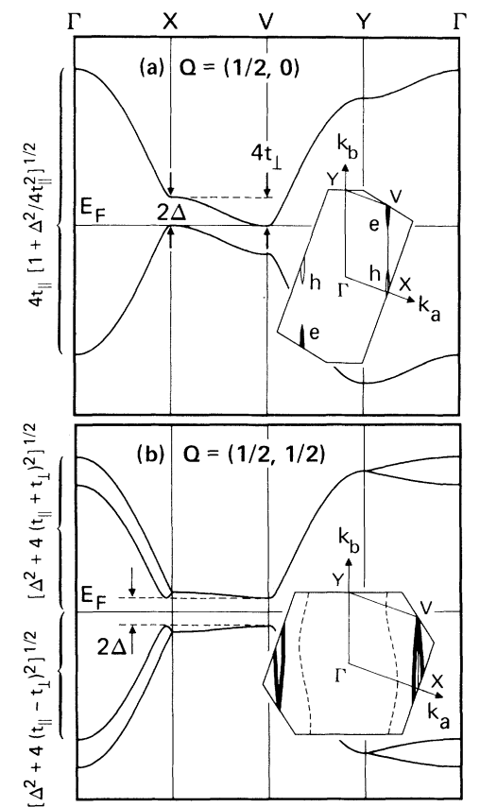
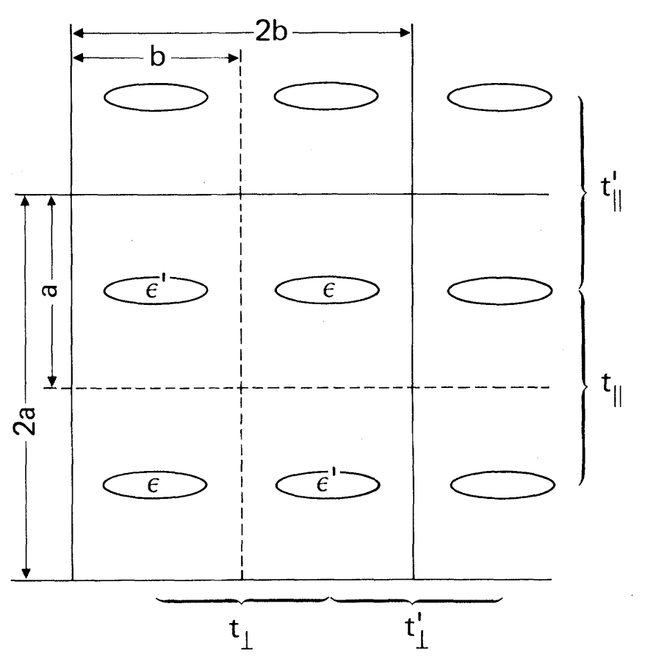
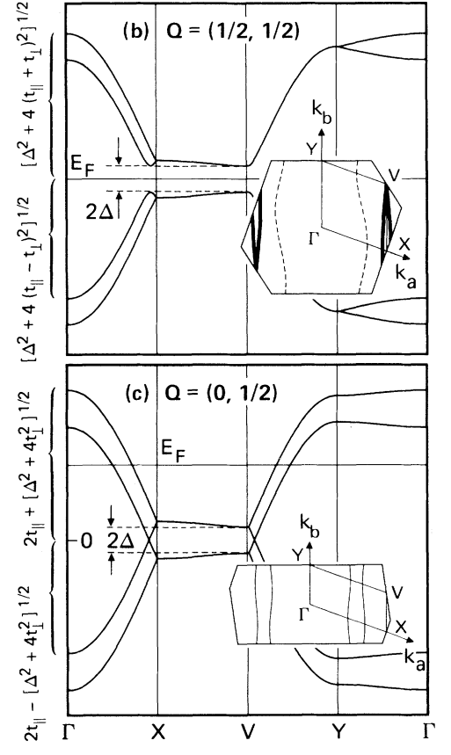
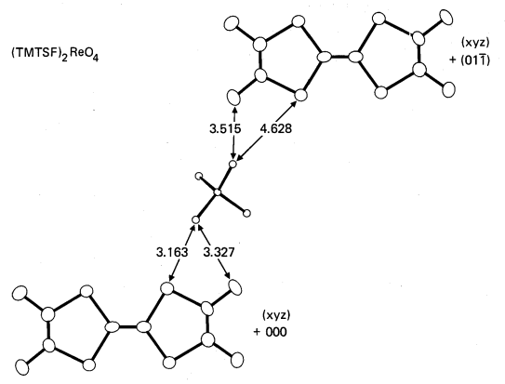
X =
PF₆
AsF₆
SbF₆
TaF₆
ClO₄
ReO₄
NO₃
Relevant to today’s T* - T_{C} conundrum?

Slide 22

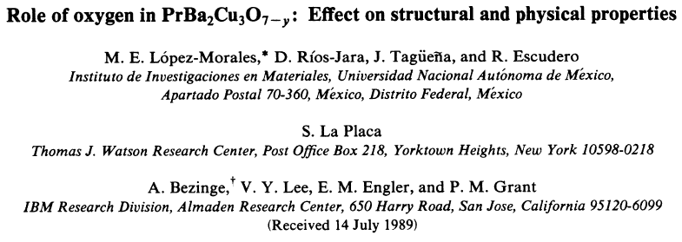
The Praseodymium Paradox
Why is Pr-123 not even a conductor?
A Clue to the mystery of HTSC?

Slide 23
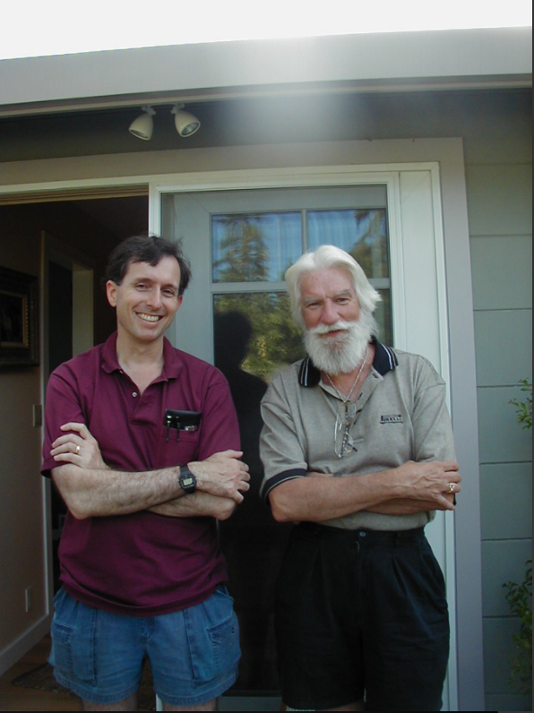
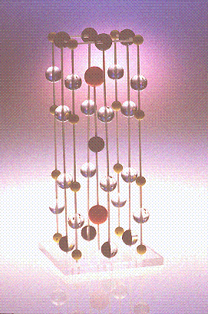
The Almaden 1-2-3 Story: 1986-89
2 March 1987
“1-2-3”

Slide 24
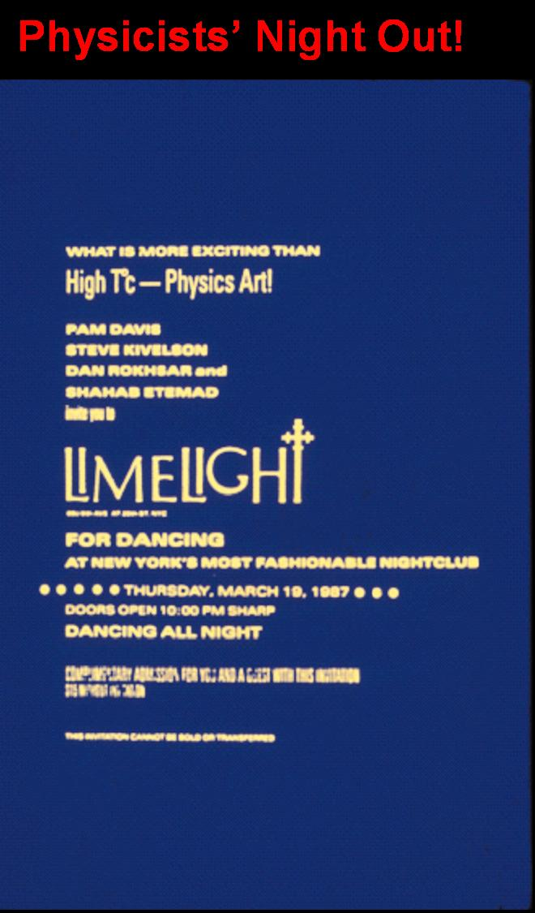

Slide 25
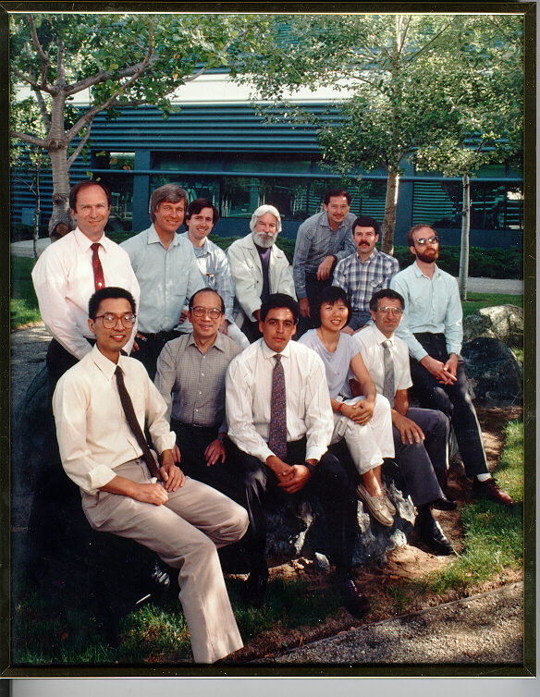
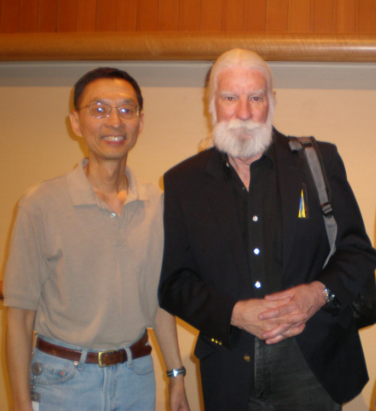
Band of Brothers (and a Sister!) http://www.w2agz.com/The%20Picture%20Story.htm

Slide 26
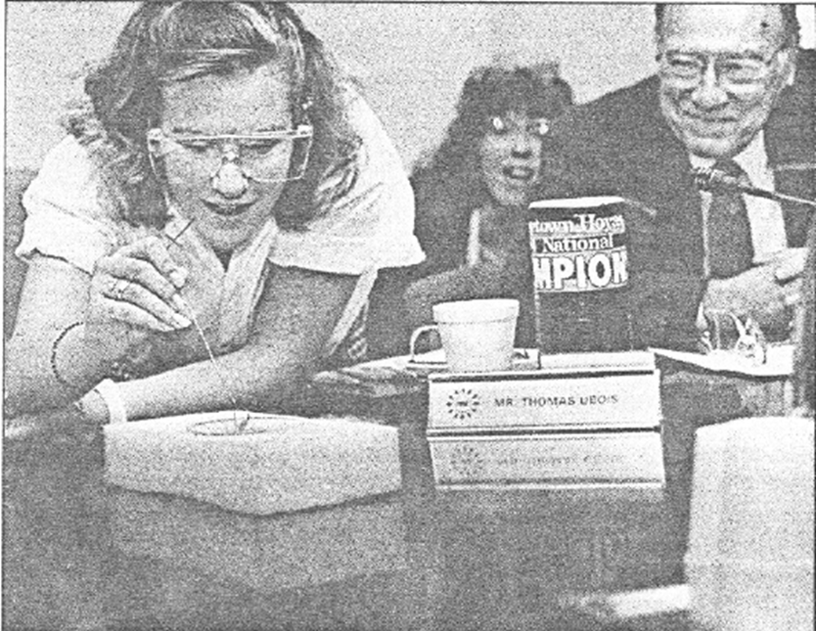
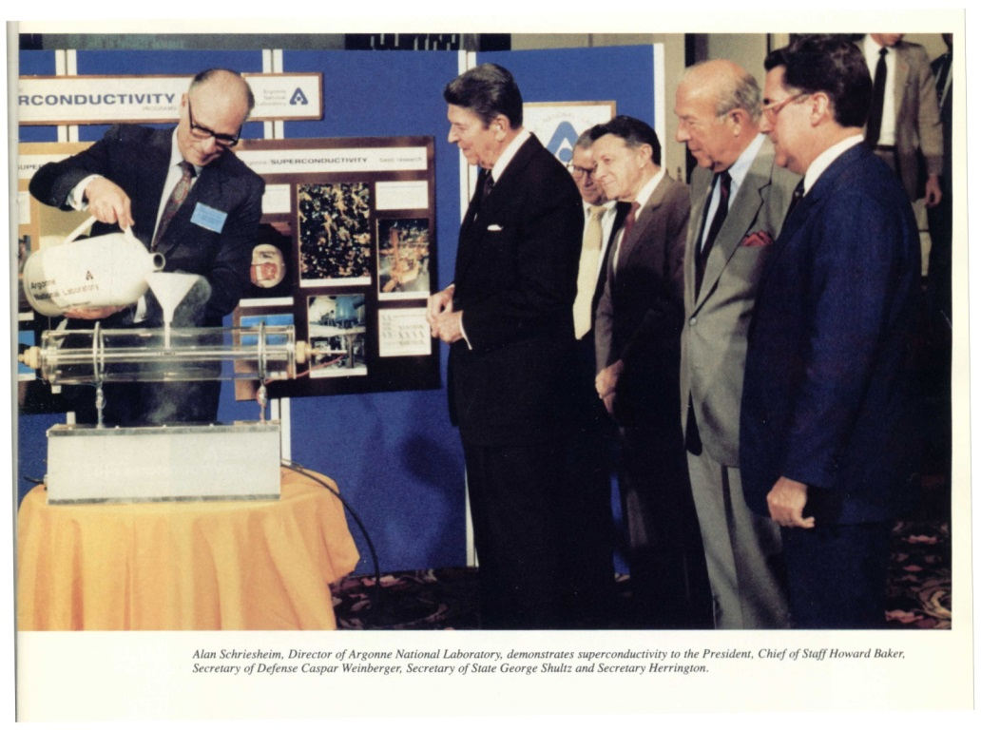
The Levitators
“The Great Communicator”
June, 1987
Heidi Grant’s 8th grade science project April, 1987 (New Scientist)
Distributed to members of US Congress (at their request)
35,000 copies distributed to high schools worldwide by ICTP-Trieste

Slide 27
EPRI

Slide 28
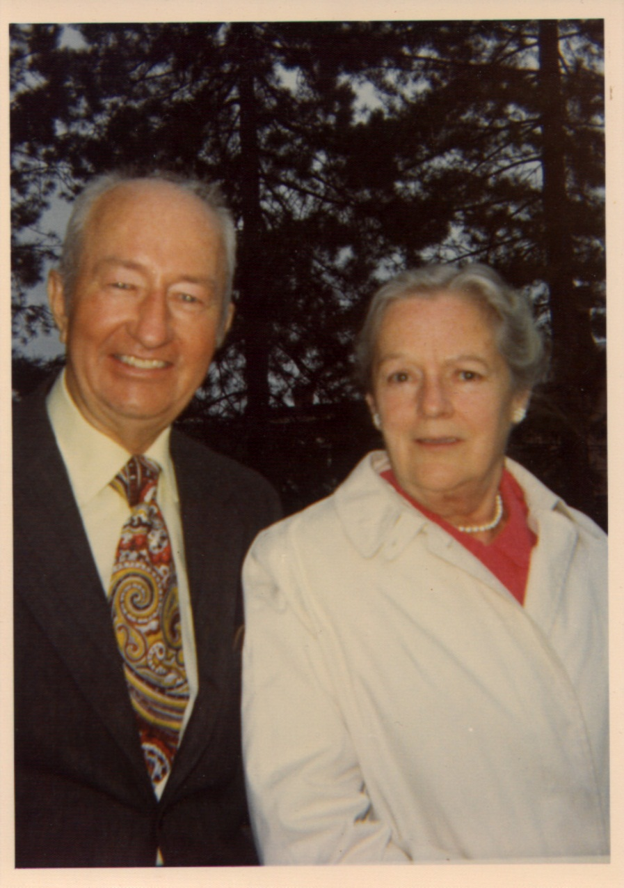
Next In Her Shoes
Mary Ann Whalen Grant
  CYO BB Champ, 1921
  NYS Bowling Champ, 1939
  Women’s Baseball, ‘33-’47
  Outstanding Skier & Golfer
  Central Hudson Gas & Electric, 1923-1965
    From teenage stenographer
    To Admin of the CEO

Slide 29
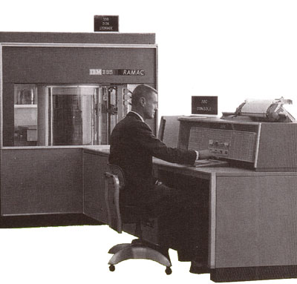
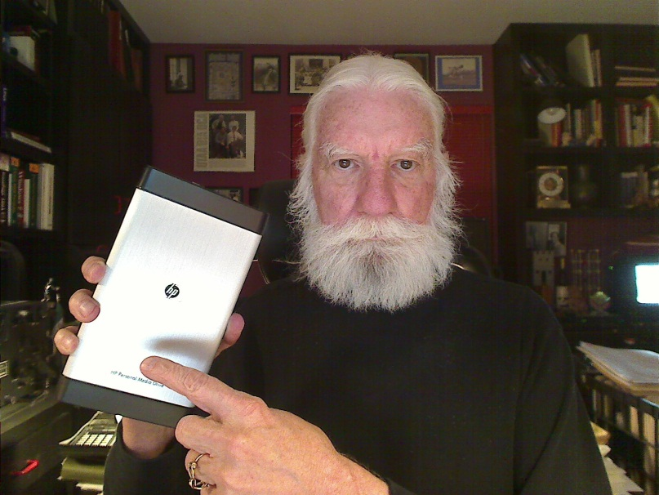
From this:..faster, smaller, cooler…and cheaper!
1956
The First Hard Drive
5 Megabytes
$300,000
6 ¢/byte
2011 (+55)
HP Personal Media
2 Terabytes
$100
5 nano-¢/byte
IBM 305 Ramac
I got two of ‘em!

Slide 30

To this…

Slide 31
…and this…
Detroit ‘00
Texas ‘03
West Coast ’96
New York ‘99
Chicago ‘99
New York ‘99
Chicago ‘99
Detroit ‘00
Northern California ‘01
18
18
West Coast ’96
Delaware ‘99
San Francisco ‘00
San Francisco ‘00
Atlanta ‘99
Atlanta ‘99
Delaware ‘99
New Orleans ‘99
New Orleans ‘99
17

Slide 32
…and this!
The PUC order is a stunning turnabout on a technology that many consider a key to managing energy use in the future. Utilities around the country have installed the electronic meters -- which can be monitored and adjusted wirelessly -- with little incident. But in Northern California, angry residents have expressed concerns that the meters can lead to overbilling and cause health problems, and PG&E has struggled to counter the bad publicity.
Bob Park!
Where are you when we need you!

Slide 33

…and…Finally This!
Spraying water to cool stressed reactor…Sure. Duh! It’s a gas/petrol storage port!

Slide 34

Pirelli

Slide 35
The Energy Enterprise...
When I retired from IBM and went to EPRI, I underwent a traumatic revelation from a culture where:
  If you made something:
    Smaller, cheaper, & which ran faster and cooler,
    You WON in the marketplace!
  To one where technology was at least only 50% of the equation, the rest dominated by politics and societal perception.

Slide 36


My Virtual Grandfather (@ 94)

Slide 37



SuperCities & SuperGrids
Nuclear Power can generate both electricity and hydrogen – “Hydricity”
Hydricity can be distributed in underground pipelines like natural gas
School
School
H
Home
H
Supermarket
Home
Supermarket
2
2
The infrastructure can take the form of a SuperGrid
Family Car
Family Car
Nuclear
…or a
SuperCity
Nuclear
plant
plant
H
DNA
H
DNA
-
-
to
to
-
-
order.com
order.com
2
2
Scientific American July, 2006
HTSC/MgB
HTSC/MgB
2
2
Notes:
37
37
The Vision Concept
Talking Points
The green, enviro- eco-gentle symbiosis of nuclear, hydrogen and superconductivity can be pictured in two limiting forms:
That of a “SuperGrid,” spanning a nation and perhaps even a continent. Throughout the spine of the hydrogen-electricity transmission system would be located nuclear power plants spaced apart on a length scale of 50 – 100 km, supplying both hydrogen and electricity – hydricity -into the network.
That of a “SuperCity,” comprising an urban residential/commercial/industrial complex of perhaps 2-3 million people. Hydrogen for personal and bus transportation, space conditioning and thermal processing, and electricity for all other power applications would be supplied by one or two peripheral nuclear power plants. These plants would be sited in connection with waste disposal and recycling facilities. Oxygen as a byproduct of hydrogen production would add in sewage and waste treatment and fire the combustion of waste biomass (zero-sum CO₂ emission), including methane decay gas, to supplement the nuclear-generated electrical power. In addition, all structures would housed under roofs engineered to supply both thermal and photovoltaic solar energy (“Solar roofs” do not require use of additional land area and thus are in accord with the enviro-eco-gentle paradigm.
A number of intermediary regional configurations also could be contemplated.

Slide 38

SuperSuburb

Slide 39

The Future?
Physics Today, November 1998
700 K !
May, 2028

Slide 40
W2AGZ & Beyond

Slide 41

A DFT (LDA+U) Study of the Electronic Properties of Square-Planar Coordinated
Copper Monoxide Structures
(does the secret to high-Tc lie within?)
...Back to the Future...
My IBM Day Job of the 60s and 70s…
Electronic Structure Calculations
What’s New?
Really cheap gaming hardware with extended cpu, core and RAM hardware
Free high end Linux platforms
Free high performance DFT software
Notes:
41
41
41

Slide 42




The Colossal Quantum Conundrum
T
U~U₀ exp(-α g), g < g*; 0, g > g*
U = 3
“Real Metal”
“Fermi Liquid”
“Funny Metal”
“Pseudogap”
“Fond AF Memories”
“SDW”
“NEEL”
“A-F”
“Funny Metal”
“Pseudogap”
“Fond AF Memories”
U = 6
U = 0
Superconductivity
“Insulator”
g*
“Conductor”
g
Somewhere in here there has to be “BCS-like” pairing!

Slide 43




Films & Tubes
States
Landauer – Buettiger?

Slide 44


So let’s do it and “compute” what happens!
q = 0.15 |e|/CuO (holes)
q = -0.15 |e|/CuO (electrons)
≈ 43 °K
≈ 25 °K
Apply DFT to obtain between electrons and phonons, followed by application of the Eliashberg-McMillan-Allen-Dynes formalism to find Tc:

Slide 45


A DFT Study of Tetragonal Rocksalt Proxy Copper Monochalcogenide Structures:
-- Implications for Possible High-Tc Superconductivity --
Paul M. Grant
W2AGZ Technologies
Robert H. Hammond
Stanford University
Session Y47
Theory of Strongly Correlated Superconductivity
8 AM – 11 AM, Friday, 7 March
Paper 8
9:24 AM – 9:36 AM
Mile High Ballroom 4F
Go...then check in for your trip back home...think about it all on your flight...and then e-mail me your thoughts.
Obnoxious comments welcome.

Slide 46



Opportunities to Exploit the Keystone XL Pipeline ROW for the Dual Transport of Chemical and Electrical Energy
Smart Grid
Fraternal Twins
2013 P. M. Grant’s Editorial in Smart Grid News

Slide 47
The Take-Home...
Wisdom gained (so far!) from a lifetime career in
Industrial and Applied Physics...

Slide 48

“You can’t always get what you want…”
Notes:
48

Slide 49

“…you get what you need!”
Notes:
49

Slide 51
From
Electrons
Paired
To
Electric
Power Delivered
…And…
Back
Again
?
-- A Personal Journey in Applied Physics --
-- IBM, EPRI, and Beyond --
Paul M. Grant
IBM (1953-1993)
Joined 1953 (age 17)
SAGE/NORAD (MIT)
Clarkson/Harvard
Magneto-optics
Displays/Printers
Organic Conductors
DFT
Superconductivity
High-Tc
Sabbatical (UNAM)
EPRI (1993-2005)
High-Tc Power Apps
Wide Bandgap SCs
Power Electronics
“Hot” Fusion
“Smart Grid”
“SuperGrid”
Visionary Energy Societies
W2AGZ (2005-?)
Due Diligence
Tet-CuO (Stanford)
“Proxy” DFT
RTSC via DFT
IASS Potsdam
Dual Use of NG Pipeline ROWs for Co-transport of Electricity via HTSC Cables (e.g., Keystone)

