Slide 1
Setup

Slide 2
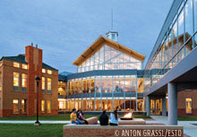
Electrical & Computer Engineering Seminar
Co-Sponsored with the Physics Department
Thursday, September 25, 2014
CAMP, Room 194, 1:00 PM
Clarkson University
Potsdam, New York
“Challenges Confronting the Physics of Superconductivity in the 21st Century: From Nanoscale Theories to Exascale Energy Applications”
Paul Michael Grant, ‘60
EPRI Science Fellow (Retired)
IBM Research Staff Member/Manager Emeritus
W2AGZ Technologies
San Jose, CA 95123, USA (w2agz@w2agz.com)
Aging Clarkson Alum
Research Supported by IBM Pension Fund

Slide 3
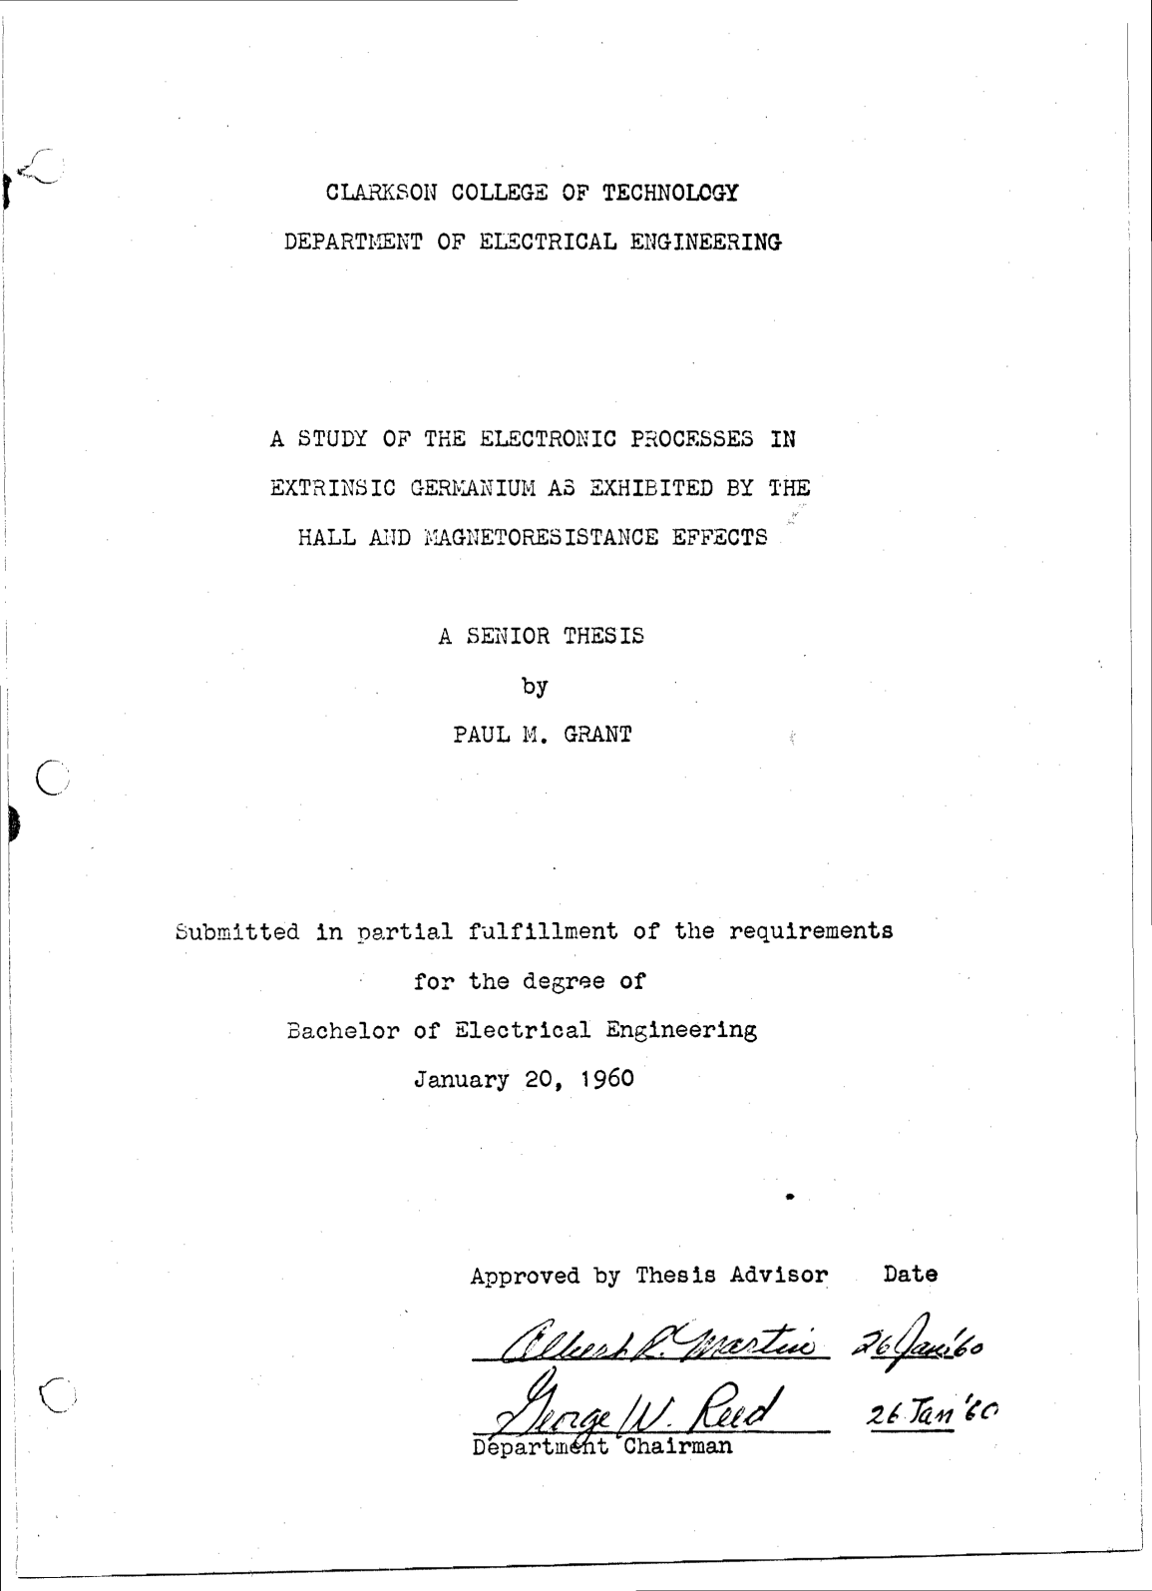
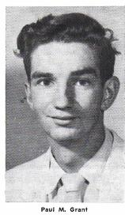
The Very First Clarkson
Internship Scholar?

Slide 4
Richard John Whalen III
BEE, Clarkson, Class of 1943
Teenage Godfather of Paul Michael Grant
First in family to graduate High School
First in family to attend and graduate college
Hired by Eastman Kodak, assigned as klystron engineer on the Oak Ridge Calutron project, separating the U-235 that constituted the Hiroshima warhead.
1945-47 Army of occupation , Korea
1947, hired by IBM, became project manager of the 604, the first vacuum tube commercial computer.
1950 manufacturing manager of the IBM 701, then the most successful commercial product of IBM.
1952 plant supervisor, IBM Poughkeepsie.
1954-1960, general manager, IBM Kingston
1956, worked behind the scenes to have his Godson admitted to Clarkson, “under the bar.”
1957 – Retirement, general manager, IBM Boulder (Western Regional IBM Corporate VP), pioneered hard drive manufacturing.

Slide 5
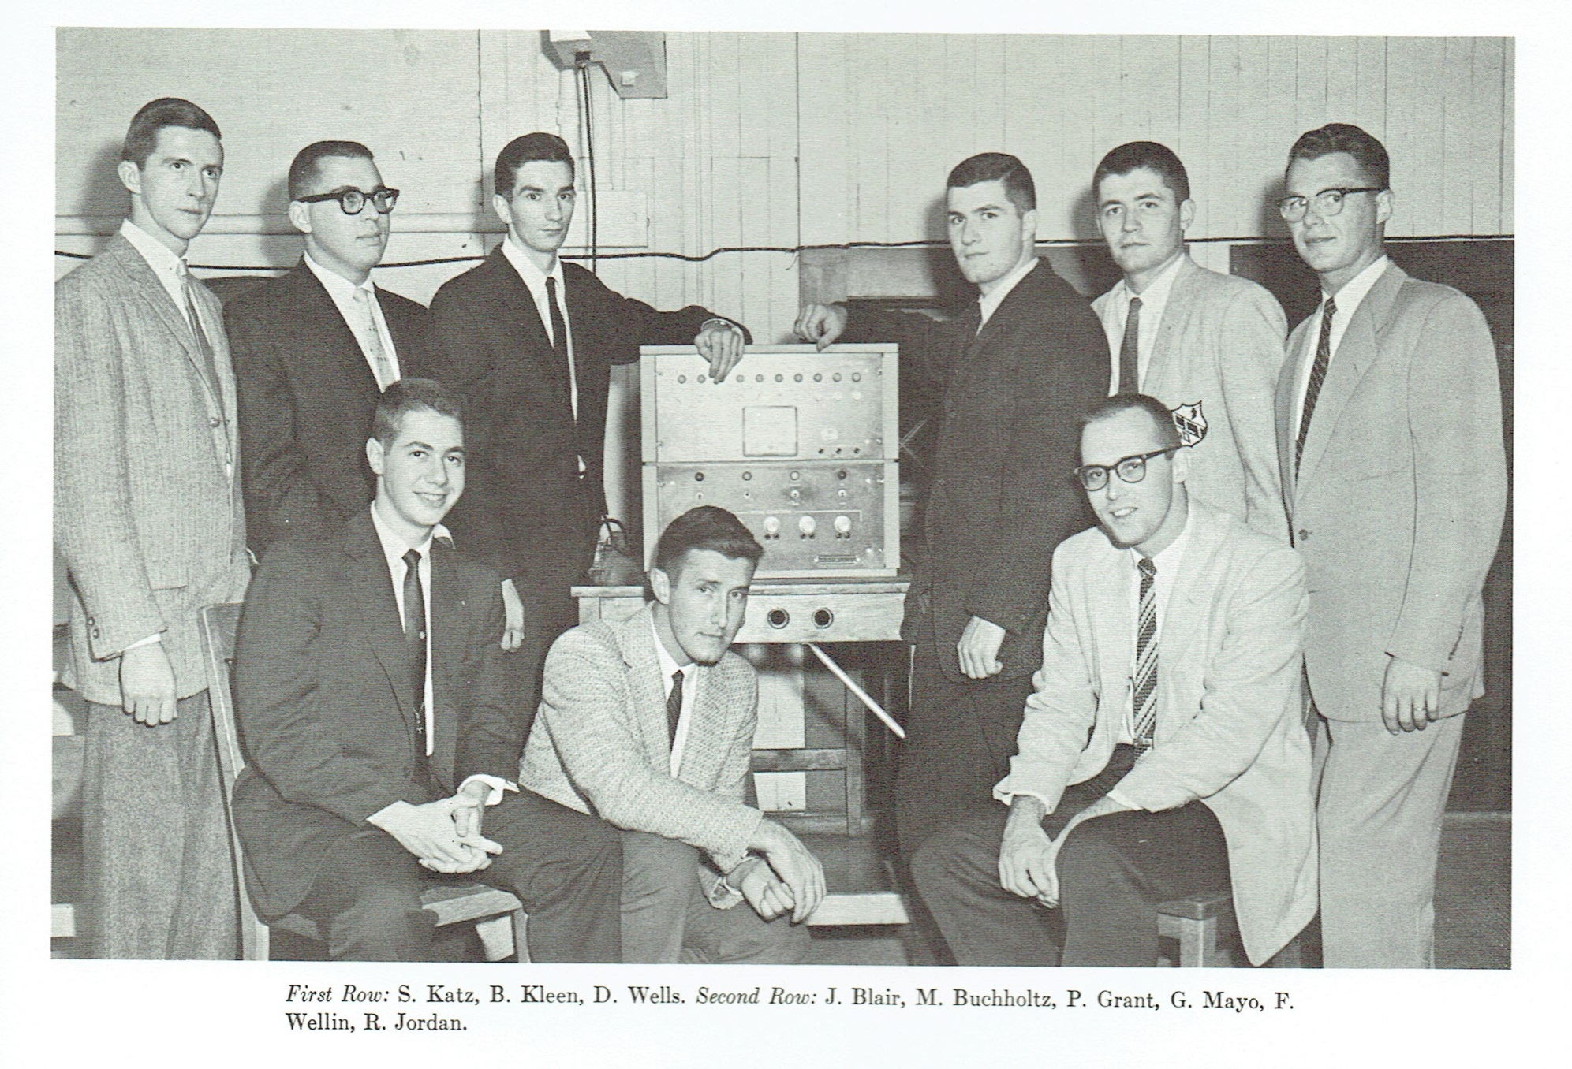
Eta Kappa Nu, ‘60

Slide 6
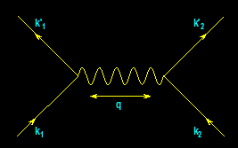
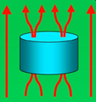
From
Electrons
Paired
To
Electric
Power Delivered
…And…
Back
Again
?
-- A Personal Journey in Applied Physics --
-- IBM, EPRI, and Beyond --
Paul M. Grant
IBM (1953-1993)
Joined 1953 (age 17)
SAGE/NORAD (MIT)
Clarkson/Harvard
Magneto-optics
Displays/Printers
Organic Conductors
DFT
Superconductivity
High-Tc
Sabbatical (UNAM)
EPRI (1993-2005)
High-Tc Power Apps
Wide Bandgap SCs
Power Electronics
“Hot” Fusion
“Smart Grid”
“SuperGrid”
“Climate Change”
Visionary Energy Societies
W2AGZ (2005-?)
Due Diligence
Tet-CuO (Stanford)
“Proxy” DFT
RTSC via DFT
IASS Potsdam
Dual Use of NG Pipeline ROWs for Co-transport of Electricity via HTSC Cables (e.g., Keystone)

Slide 7
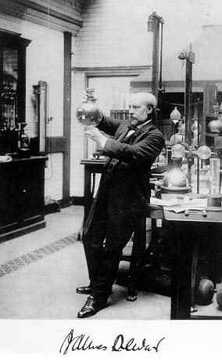
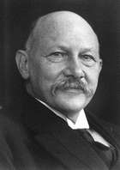
Fathers of Cryogenics
CH₄ 112 K
O 90
N₂ 77
Ne 27
H₂ 20
He 4.2
Dewar
Kammerlingh-Onnes

Slide 8
Models of
Electrical Conductivity
The Most Popular:
R
e⁻
Freezes Out!
T

Slide 9
Models of
Electrical Conductivity
Reality:
R
Limited by
Impurities!
•

e⁻
T

Slide 10
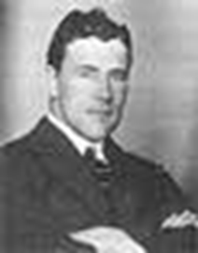
1911
A Big Surprise!
Thus the mercury at 4.2 K has entered a new state, which, owing to its particular electrical properties, can be called the state of superconductivity
Gilles Holst, H. Kamerlingh-Onnes (1911)

Slide 11

Magnetic Properties
H on
H off
H on
H on
0
0
χ
χ
-1/4π
-1/4π
T
T
Expected (Lenz’ Law)
Weird ! (Meissner Effect)

Slide 12
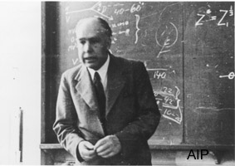
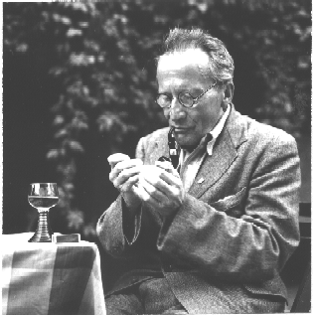
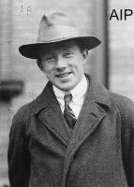
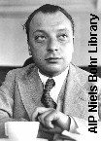
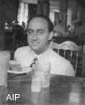
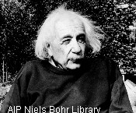
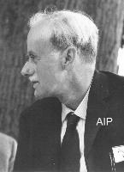

They all tried… and failed!

Slide 13
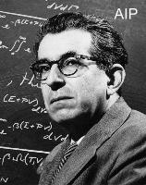
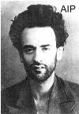
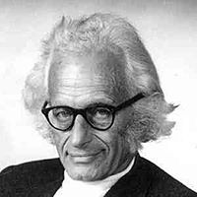
They came close...
Fritz
London
“The B-field does penetrate.”
E ~ ² dJ/dt, B ~ ² J
“Since SC is a second-order phase
transition, there must be an order
parameter involved.”
Lev
Landau
Herbert
Froehlich
“T_{C} depends on the mass of the atoms
(isotope effect), so the SC must be
tied to lattice vibrations (phonons).”

Slide 14
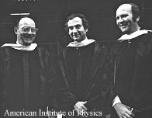
They Got It Right!
B ----- C ----- S
There has to be a regime
where the lattice vibrations
act to bind electrons together
rather than scatter them with
loss as given by Ohm’s Law.
Bardeen: “It’s a macroscopic quantum state”
Cooper: “It’s got twice the charge you’d expect”
Schrieffer: “’s a statistical wavefunction”

Slide 15
“Cooper’s Problem”

Slide 16
Physics of Superconductivity
Electrons Pair Off!
BCS Equation
•
+
+
e⁻
+
+
•
e⁻

Slide 17
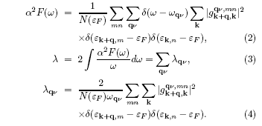
Electron-Phonon Coupling
a la Migdal-Eliashberg-McMillan
(plus Allen & Dynes)‏
Wierzbowska, et al, arXiv:cond-mat/0504077 (2006) (Nb)

Slide 18
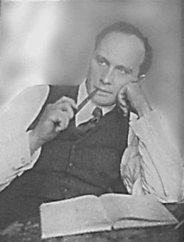

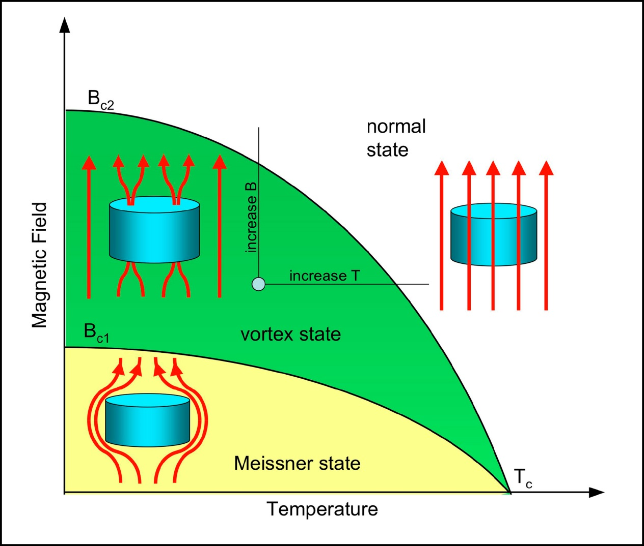
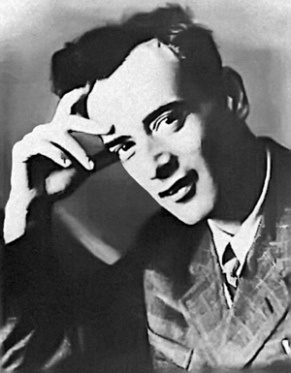
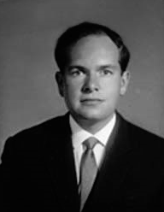
Type II (1930s +)
Lev Shubnikov
“VL” Ginzburg
Lev Landau
Aleksei Abrikosov

Slide 19

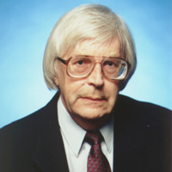
GLAG – “Engineering” Superconductors

Slide 20
Important Numbers in Superconductivity
Transition Temperature, T_{C} Way below 300 K
Critical Current Density, J_{C} 10⁻² - 10⁶ A/cm²
Critical Magnetic Field, H_{C} 10⁻⁴ - 10 T
London Penetration Depth,  10 - >1000 Å
Pippard Coherence Length, ξ 10 - >1000 Å
G-L Parameter,  = /ξ 0.01 - 100
NB! All these numbers depend on each
other. E.g., H_{C} ~  ξ

Slide 21
T_{C} vs. Year:
1911 - 1980
25
Nb₃Ge
20
Nb₃Sn
NbN
V₃Si
15
Temperature (K)
10
Pb
5
Hg
0
Cubic Metals
1900
1910
1920
1930
1940
1950
1960
1970
1980
Year

Slide 22
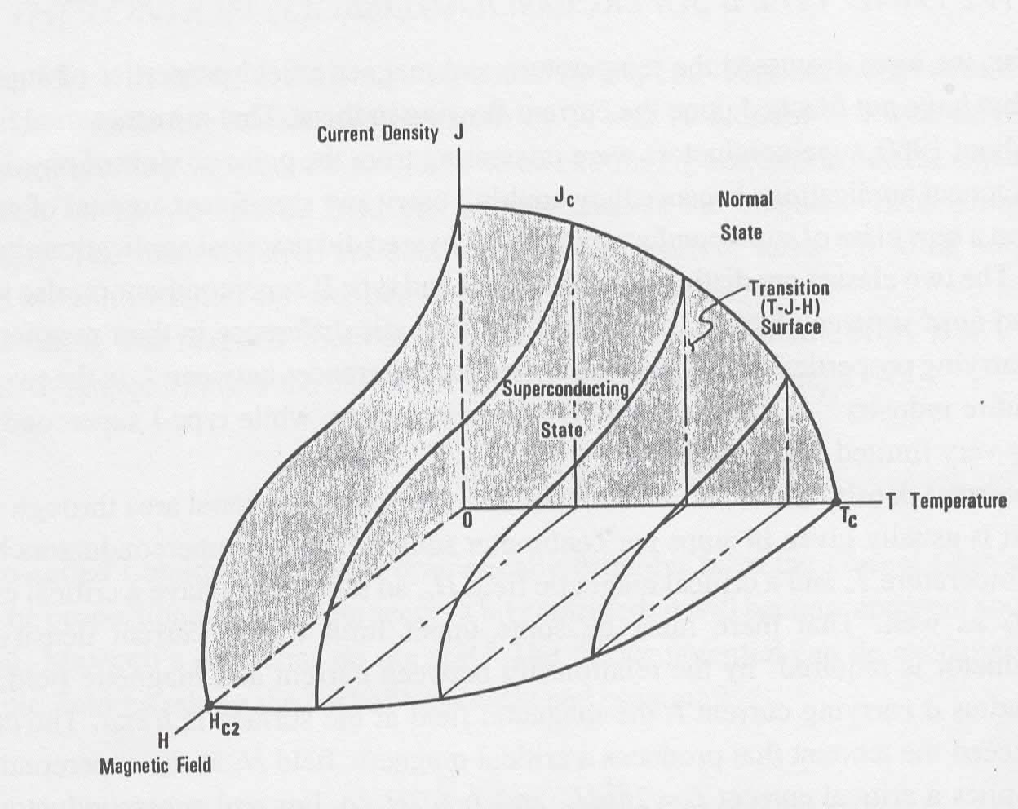
Properties

Slide 23
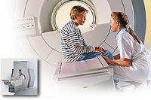
MRI & “Big Physics”
Magnetic Resonance Imaging
Philips
Tevatron
Fermi National Laboratory

Slide 24
1986
Another Big Surprise!
Onset T_{C} = 40 K !
Bednorz and Mueller
IBM Zuerich, 1986

Slide 25
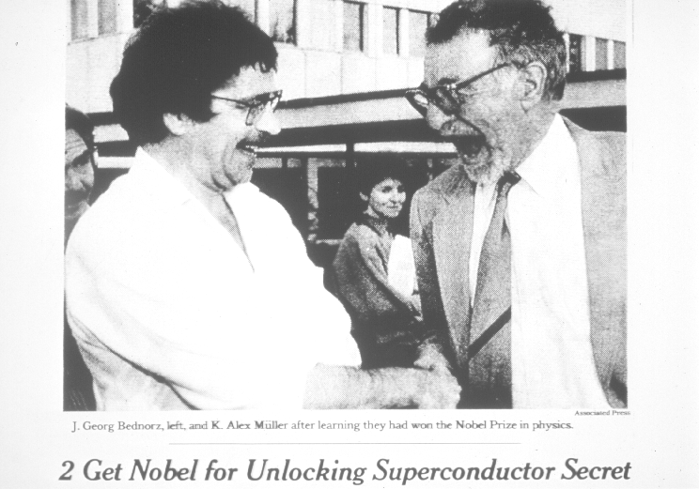
1987
“The Prize!”

Slide 26
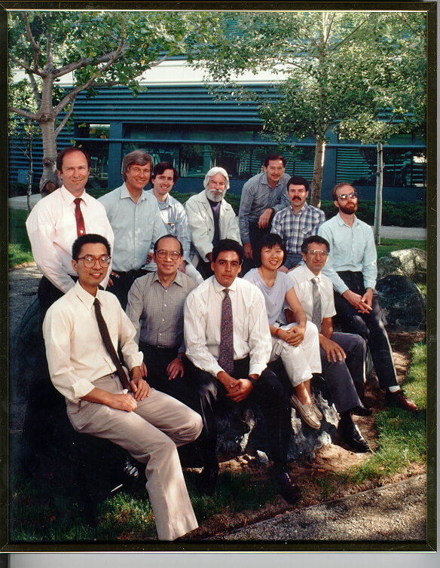
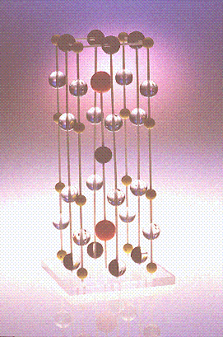
March 3, 1987
“123” Discovered

Slide 27
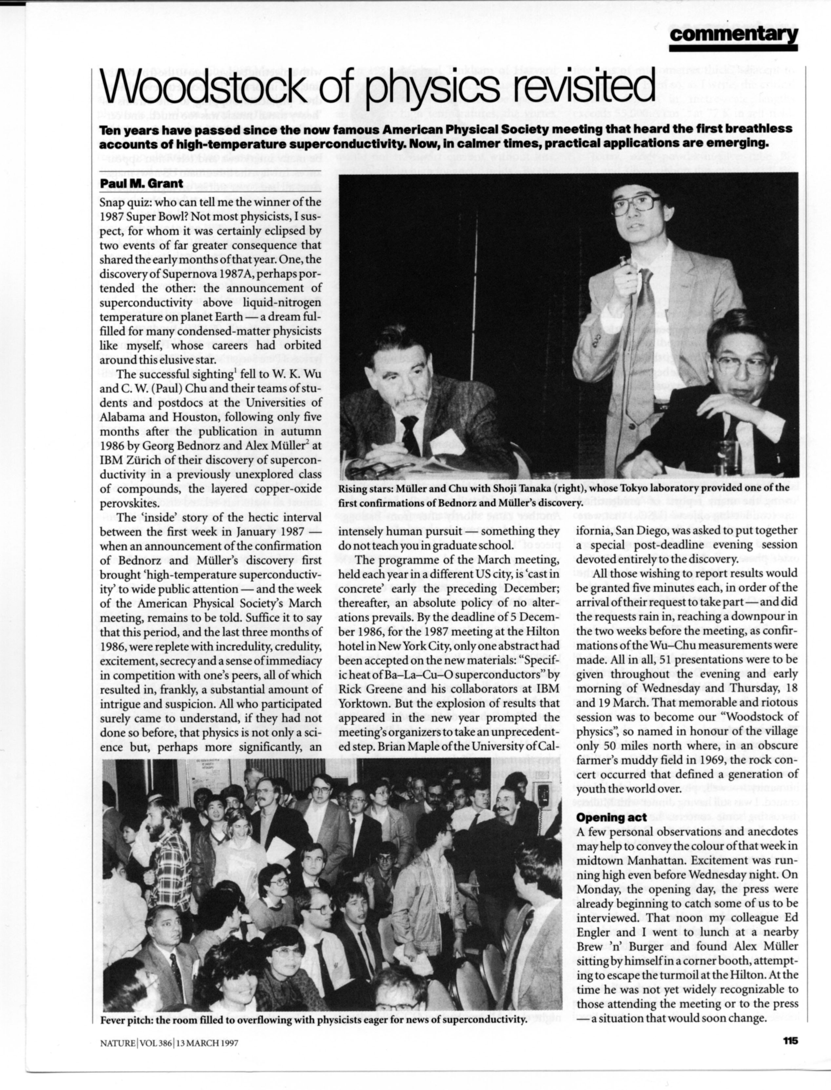
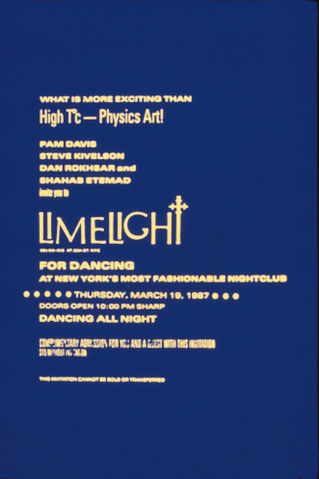
Woodstock of Physics
NYC, 1987
Physicists’ Night Out!

Slide 28
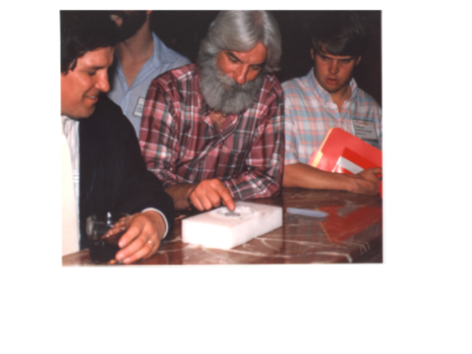
HTSC Symposium, MRS Spring Meeting, Anaheim, 23-24 April 1987
“The Altamont of Materials”

Slide 29
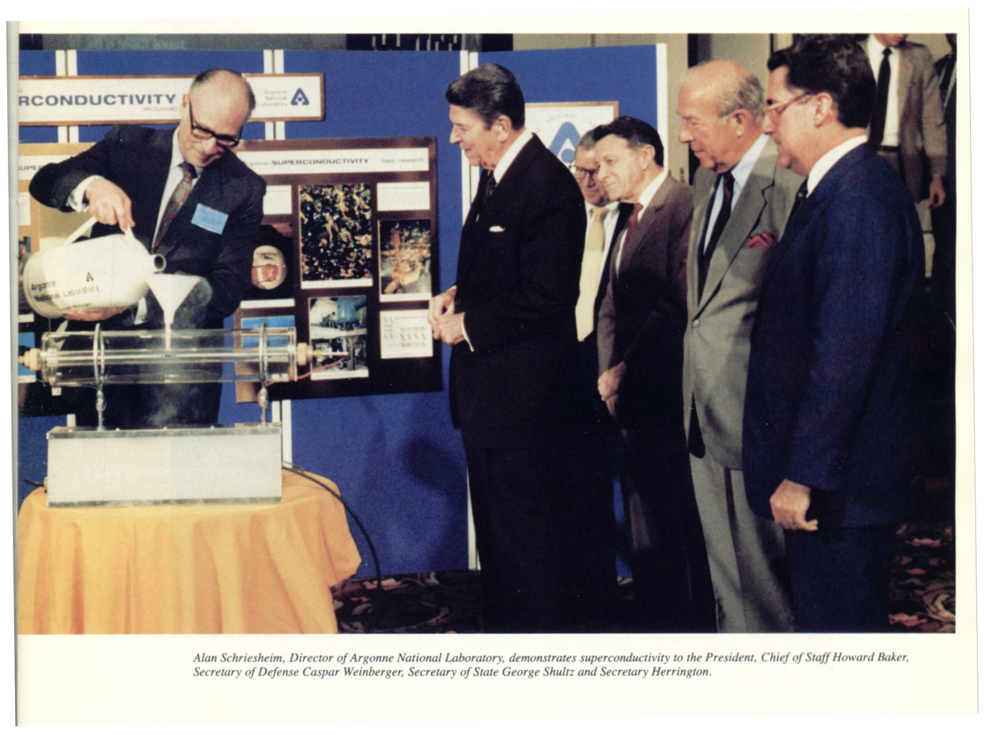
“The Great Communicator”
Notes:
29

Slide 30
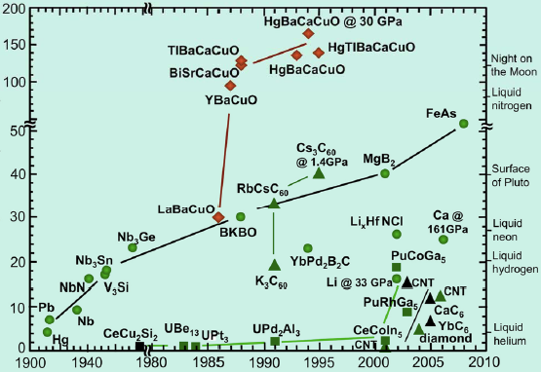
Today
Tc (K)
Year

Slide 31
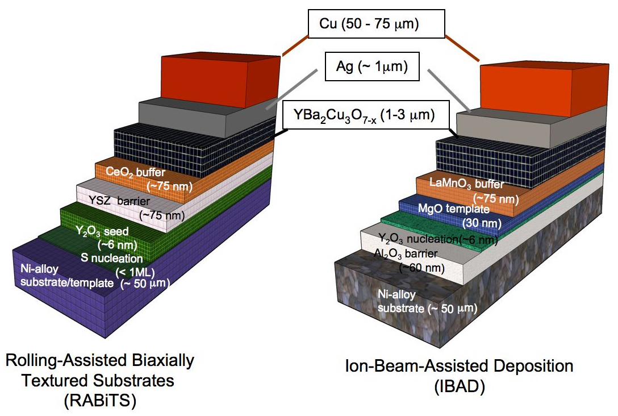
Gen II Coated Conductor
American Superconductor
SuperPower

Slide 32
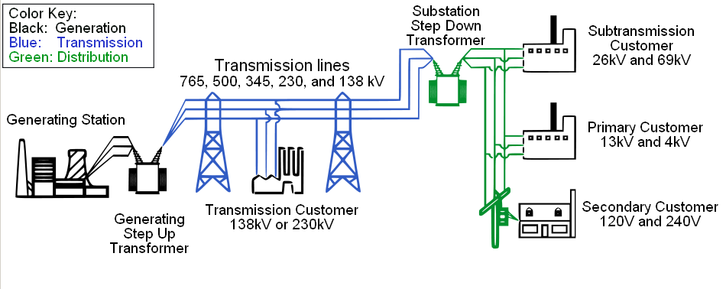
Where Can We Apply Superconductivity to Electric Power?
Potentially Everywhere
Notes:
32

Slide 33
It is now 27 years after
“Woodstock and Altamont,”
yet two major issues remain unresolved:
“The Nanoscale:”
How does HTSC even occur? We know it’s BCS, but
what’s the “pairing glue?”
“The Exascale:”
Despite more than 20 years of very successful HTSC wire development possessing outstanding critical state properties, and its use in equally outstanding and successful power application demonstrations in the US, Japan, China, Korea, Germany, Russia..., there remains no significant deployment of such technology by either government agencies or investor-owned utilities.
How come?

Slide 34
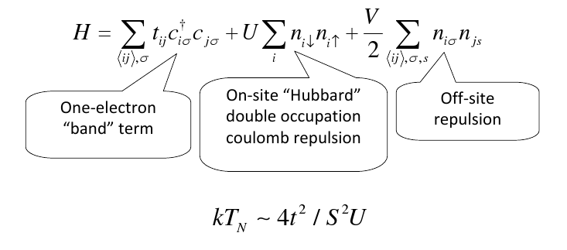
Hubbard Theory

Slide 35

DFT & (LDA + U)‏
Implemented in LMTO by Anisimov, et al, JPCM 2, 3973 (1990)‏
  Applied to NiO, MnO, FeO, CoO and La₂CuO₄
Plane-Wave Pseudopotential Implementation by Cococcioni and de Gironcoli, PRB 71, 035105 (2005)‏
  Applied to FeO and NiO
  Download open-source package from http://www.pwscf.org

Slide 36
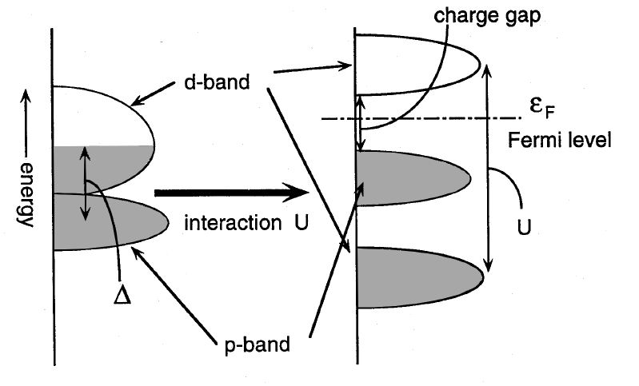
Charge Transfer Insulator
After Imada, et al, RMP 70, 1039 (1998)‏

Slide 37
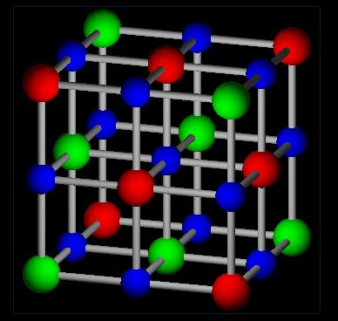
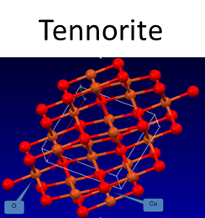
Cubic Rocksalt Divalent TMOs
TMO 3d Config Properties
MnO 5 MH-CTI (5.6)‏
FeO 6 MH-CTI (5.9)‏
CoO 7 MH-CTI (6.3)‏
NiO 8 MH-CTI (6.5)‏
CuO 9
XX Doesn't Exist!
See Imada, Fujimore, Tokura, RPM 70 (1988)‏

Slide 38
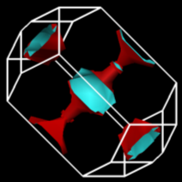
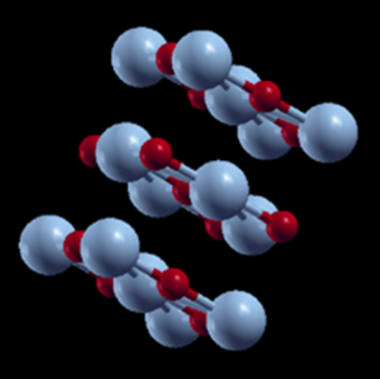
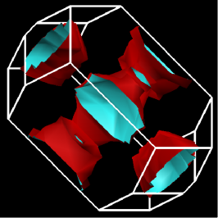

The Colossal Quantum Conundrum
T
U~U₀ exp(-α g), g < g*; 0, g > g*
NB1: These BZ’s & FS’s reflect an af-ordered, 2x periodic primitive unit cell.
U = 3
“Real Metal”
“Fermi Liquid”
Our Proxy HTSC!
“Funny Metal”
“Pseudogap”
“Fond AF Memories”
“SDW”
“NEEL”
“A-F”
“Funny Metal”
“Pseudogap”
“Fond AF Memories”
“Undoped Rocksalt
Copper Monoxide”
U = 6
U = 0
NB2: For U < 6 eV, it’s a metal!
Superconductivity
“Insulator”
g*
“Conductor”
g
Somewhere in here there has to be “BCS-like” pairing!

Slide 39
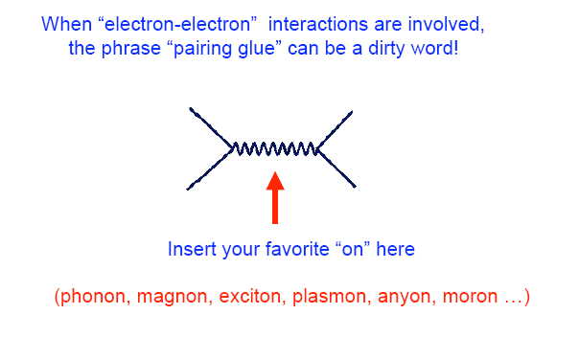
IOW, What’s theFermion-Boson Interaction That Leads to HTSC?
“Put-on !”
Notes:
39

Slide 40
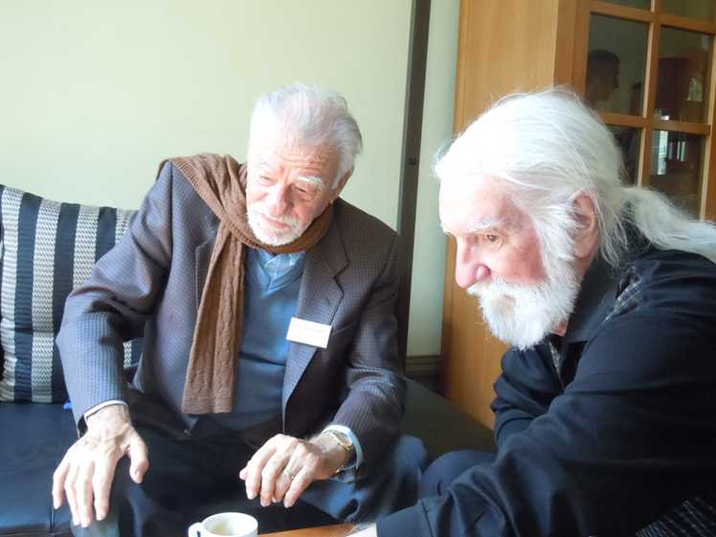
The Pairing Glue
“Alex says it’s phonons”
OK, OK...J-T polarons and/or bipolarons (after Chakravarty/Hoest)
Could he be right after all?

Slide 41
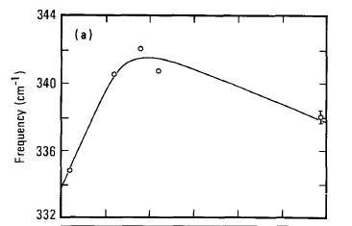

Hey! Maybe, they’re there!
Macfarlane, Rosen, Seki, SSC 63, 831 (1987)
(These data were taken in early March, 1987, a week before “Woodstock”)
Raman Spectroscopy of YBCO

Slide 42
More Phonon Phootprints!
Pyka, et al., PRL 70, 1457, (1993)
Harashima, et al., Physica C263, 257 (1996)

Slide 43
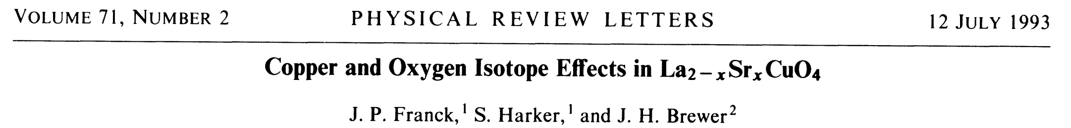
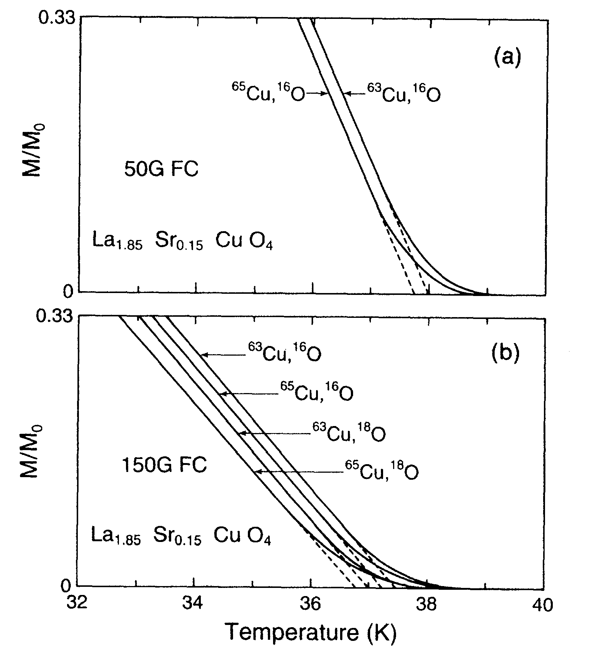
...and More!

Slide 44

Finally, T_{C} scales (roughly) with Θ_{D} !
Nota Bene!
“S” denotes Ca, Sr, Ba
Ledbetter, Physica C 235, 1325 (1994)

Slide 45
What Can DFT(LDA+U) Along With Eliashberg-McMillan-Allen-Dynes (EMAD) Formalism Tell Us About e-p Mediated Pairing in the Copper Oxide Perovskites?
Assume the simplest and highest symmetry possible Cu-monoxide to model (e.g. cubic or tetragonal rocksalt CuO...see Grant (Proc IOP (2008) and Siemons, et al., PRB (2009)).
Apply the Quantum-Espresso DFT Package to calculate the eigenspectrum and e-p coupling for these proxy structures, followed by application of EMAD to estimate Tc (Grant, Proc. MRS, to appear).
Perform the above for both hole and electron doping levels ±0.15|e|/CuO under the assumption these levels of carrier densities effectively screen Hubbard U (see “Quantum Conundrum”)

Slide 46


So let’s do it and “compute” what happens!
Assumptions: ≈ 440 °K, μ* ≈ 0.01, a = 3.06 Å, c/a = 1.3 (nmTet cell)
q = 0.15 |e|/CuO (holes)
q = -0.15 |e|/CuO (electrons)
λ = 1.2
λ = 0.7
≈ 43 °K
≈ 25 °K

Slide 47
OK...What’s Next (Materials-Wise)?
Force-epi 10 monolayers of tet-CuO
  Overlay with 2 monolayers of Li as “neighborhood” dopant...look for SC
  “Topological Metal?” ☺
Look for explicit “phonon-spinon” coupling:
  “Paramagnetic Dispersion Measurements at 77.3 °K,” C. Starr (MIT). Examines the coupling between spins and phonons in transition metal carbonates and hydrates.
  Published in Phys. Rev. 60, 241 (1941!)
  Have such studies been done on the copper oxide perovskites? If not, why not?
Apparently no DFT(LDA+U) tools yet exist to calculate electron-phonon λ in the presence of a finite Hubbard U...why not?

Slide 48




Now for something slightly bigger... by 10¹⁹ (Exascale!)
SuperCity
SuperSuburb
SuperGrid
SuperTrain

Slide 49







HTSC SuperCables:
Past, Present, and...Future?
~ 1997
Sumitomo 66 kV 3-in-1
Furakawa, 275 kV, 3 kA
EPRI SCDC
100 kV, 100 kA, 10 GW
St. Petersburg, Russia
~ 2014

Slide 50
Required Reading!
(Thanks to Steve Eckroad, EPRI)
Two EPRI Reports (available free from epri.com or w2agz.com)
  (2012) Superconducting Power Equipment; Technology Watch 2012 (1024190)
  (2013) SIU: Superconductivity for PDA (03002001)
Bottom Lines:
  Work continues on wire improvement and power application demonstration, although not at the pace of a decade ago.
  HTSC materials performance and costs have matured.
  What’s needed is a strong business case for HTSC power applications.
  Does there exist a “compelling need,” now or in the next decade, to effect a major and continuing deployment of HTSC in the electricity enterprise?

Slide 51

Pacific Intertie
HVDC, +/- 500 kV, 3.1 kA, 3.1 GW
1,362 km
~50% of LA Power Consumption
T&D Losses ~ 10%
Tear down the PI and replace with HTSC underground cables to capture this saving?
Ain’t gonna happen, baby!
Not a “compelling need!”
Even should the cost of the wire be zero!

Slide 52

However, do we have a “compelling new opportunity?”
P.M. Grant, EPRI, 1998
...& hydraulic fracturing , aka “fracking”

Slide 53
Why not make dual-use of emerging gas pipeline rights-of-way to transport electricity via HTSC cables?
Natural Gas & Electricity!
“Fraternal Twins,”
Smart Grid News
16 April 2013
Wow!
2012 USA Electricity Generation by Primary Fuel Source

Slide 54

Not exactly a new idea!
(Terry Boston, TVA VP, 2001)

Slide 55


Does “Keystone XL” Provide a “Compelling Opportunity” to
“Raise Our Fraternal Twins?”
Let’s encourage DOE to enlist EPRI, GTI, EIPC, INGAA,...in a collaboration to conduct an “engineering economy” study focused on the dual-use ROW concept.

Slide 56



...and in the long term...
Electricity Conversion Assumptions
Wellhead Power Capacity | 18 GW (HHV)
Fraction Making Electricity | 33%
Thermal Power Consumed | 6 GW (HHV)
Left to Transmit as LNG | 12 GW (HHV)
CCGT Efficiency | 60%
Electricity Output | 3.6 GW (+/- 18 kV, 100 kA)
“Cryodelivery Systems for the Cotransmission of Chemical and Electric Power,”
P.M. Grant, AIP Conf. Proc. 823, 291 (2006).

Slide 57



Let’s Not Forget Europe!
The Wola Obszańska (Lublin) gas field in Poland/Ukraine was discovered in 1989. It began production in 1992 and produces natural gas. The total proven reserves of the Wola Obszańska gas field are around 37 billion cubic feet (1×10⁹m³). “Dual-Pipe” to Berlin?
o Wroclaw

Slide 58
Back to the Future
(of Nanoscale!)
The Grand Challenge of Materials Science:
Can we make a room temperature superconductor?
  Bill Little says “yes” (1963)...simply surround a 1D metal chain with polarizable molecules and use “excitons” as the “pairing boson.”
  Problem: Periodic 1D metals are unstable and want to became insulators (dimerization).
Solution:
  Create a 1D Fibonacci (quasiperiodic) chain of “metal” atoms that resists CDW and dimerization “gapping” instabilies on a suitable “polarizable” substrate.
  How? “Decorate” a dislocation line on the [100] surface of STO, SRO, Si...

Slide 59

A Fibonacci “Dislocation Line”
From P.M. Grant, APS March Meeting, Portland, OR (2010)
Al
Al
Al
Al
SRO !
STO ?
Al
Al
Al
tan θ = 1/τ ; τ = (1 + √5)/2 = 1.618… ; θ = 31.717…°
L = 4.058 Å (fcc edge) s = 2.869 Å (fcc diag)

Slide 60


Does the
Hold the Key to Room Temperature Superconductivity?
50th Anniversary of Physics Today, May 1998

Slide 61
Lessons from
“Four Altamont Philosophers”
...for engineers and physicists under 50...

Slide 62

“You can’t always get what you want…”

Slide 63

“…you get what you need!”

