Slide 1
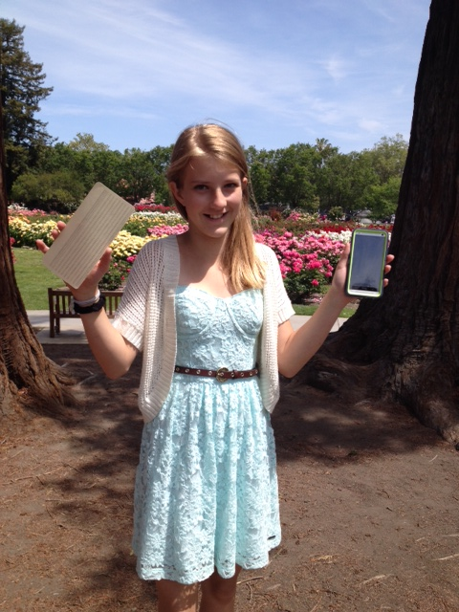
“Harvard” Entrance Exam:
How many 1950 IBM punched cards does it take to...
Fill up a 32 gig “idiot”Phone?
???
A stack about 30 miles high!
Talk about room at the bottom! Thanks, Dick F. !
Devin Joan Grant
“Famous-to-be” 12-year-old
Grandaughter
of Paul Michael Grant

