Slide 1
Setup

Slide 2
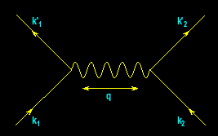
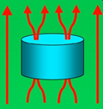
From
Electrons
Paired
To
Electric
Power Delivered
…And…
Back
Again
?
-- A Personal Journey in Applied Physics --
-- IBM, EPRI, and Beyond --
Paul M. Grant
IBM (1953-1993)
Joined 1953 (age 17)
SAGE/NORAD (MIT)
Clarkson/Harvard
Magneto-optics
Displays/Printers
Organic Conductors
DFT
Superconductivity
High-Tc
Sabbatical (UNAM)
EPRI (1993-2005)
High-Tc Power Apps
Wide Bandgap SCs
Power Electronics
“Hot” Fusion
“Smart Grid”
“SuperGrid”
Visionary Energy Societies
W2AGZ (2005-?)
Due Diligence
Tet-CuO (Stanford)
“Proxy” DFT
RTSC via DFT
IASS Potsdam
Dual Use of NG Pipeline ROWs for Co-transport of Electricity via HTSC Cables (e.g., Keystone)

Slide 3
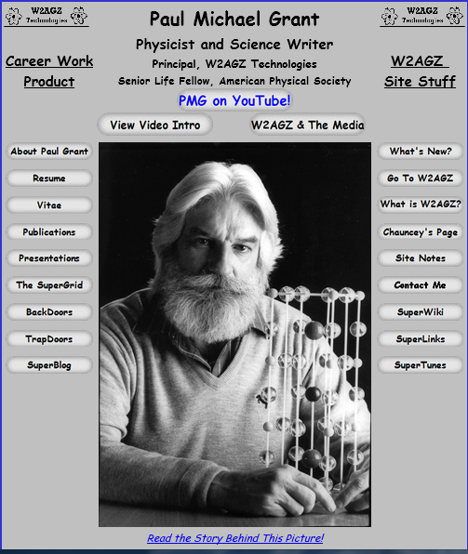

Slide 4
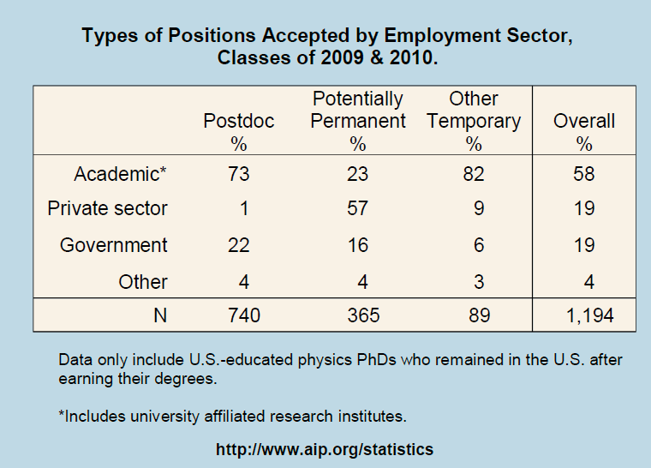
What are PhDs doing with their degrees?
Data courtesy of Crystal Bailey, bailey@aps.org
The largest percentage of Physics PhDs found initial employment in Postdoctoral and other temporary positions…
…but a significant number of graduates went straight into potentially permanent employment in the private sector.

Slide 5
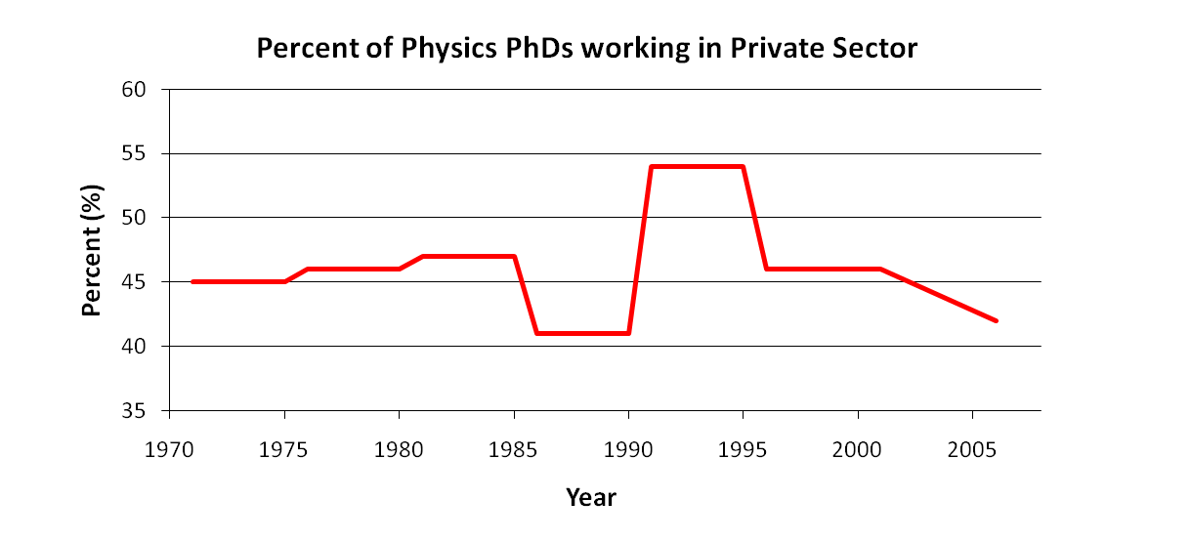
PhD Employment in the Private Sector
Recall that the majority (57%) of graduates who initially went into permanent employment positions were in the private sector.
According to the NSF Survey of Doctoral Recipients, in 2010 the private sector was the largest single employment base of Physics PhDs: about 47% (the next highest was 4 year colleges, at 38%).
This was also true in 2001, when the private sector employed 46% of Physics PhDs¹…
…and was also true in 1993, when the private sector again employed 46% of Physics PhDs².
In fact, the same data has shown consistent support for Physics PhDs in the private sector since 1971.
¹NSF Survey of Doctoral Recipients, 2001
²NSF Integrated Survey Data, 1993
Industry has been the largest employment base for Physics PhDs for decades.

Slide 6
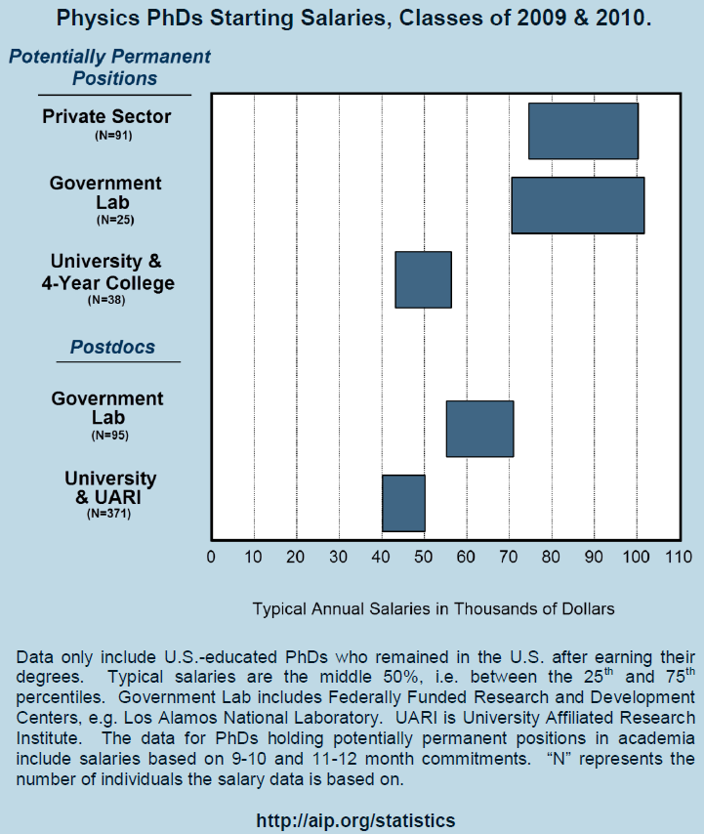
Not only does the private sector provide the largest number of jobs for physics PhDs, it also provides the highest-paying jobs, with a starting salary of $90K
By comparison, average typical starting salaries at Universities and 4-year colleges is around $50K…
…and a University postdoc position typically offers between $40K and $50K.
So, the private sector also offers well-paying employment to Physics PhDs.

Slide 7
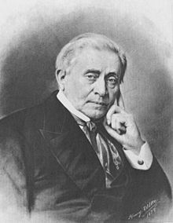
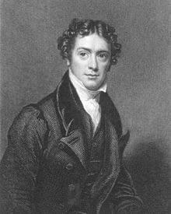
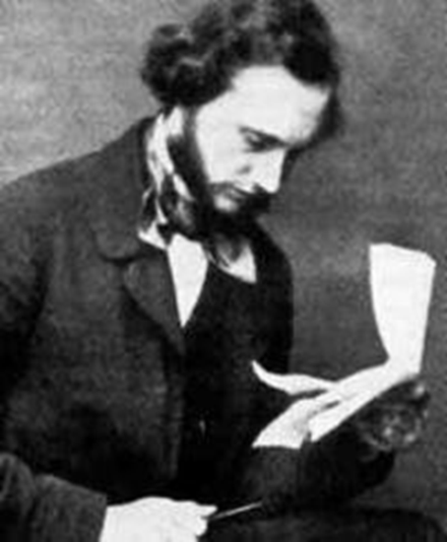
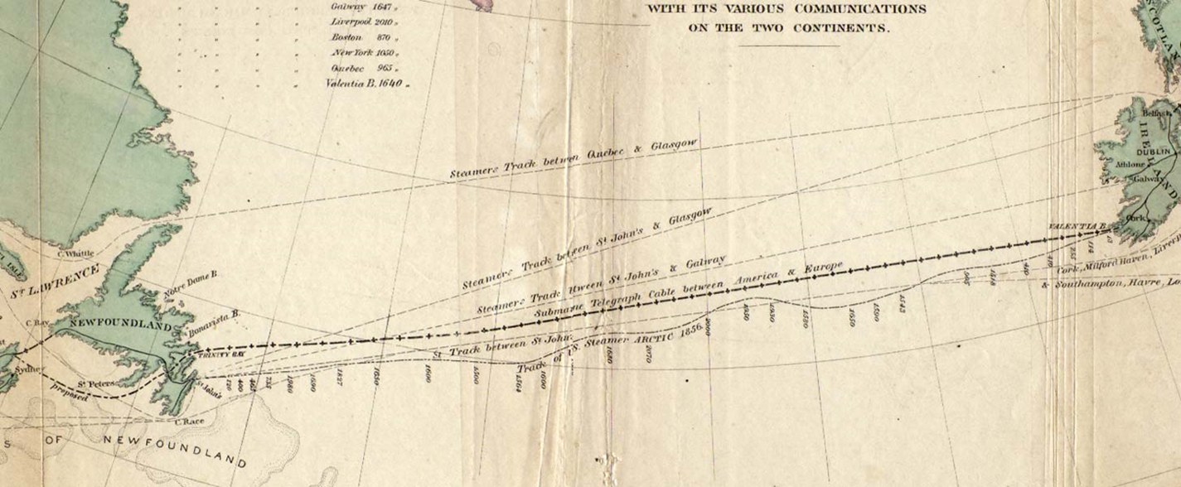
Three Famous Applied Physicists
Joseph Henry
Scottish-American
English
William Thomson
Michael Faraday
Irish-born
The Transatlantic Cable (1854 – 1866)
The First Thread in the World Wide Web!
“A Thread Across The Ocean”
John Steele Gordon (2002)

Slide 8
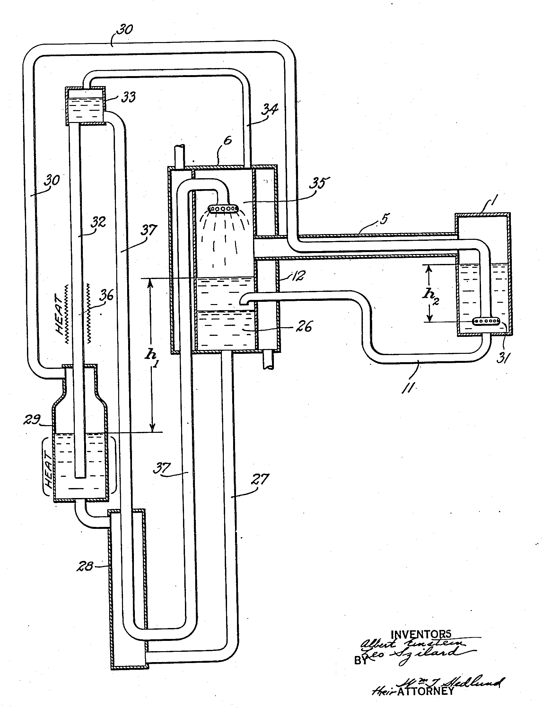
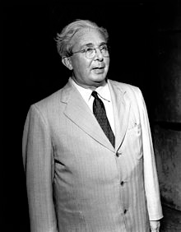
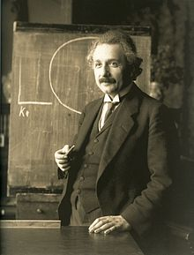
Two Other Famous Applied Physicists
A Simple Household Refrigerator!
Leo Szilard

Slide 9

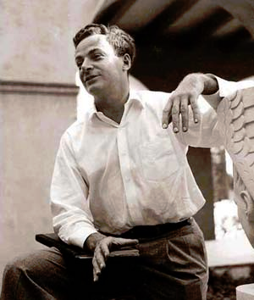
...and Finally One More...
Feynman was “inspired” by the classic 1959 British film, “Room at the Top,” wherein an ambitious young worker colludes with the daughter of a factory magnate as part of a plot to take over the company.
Richard P. Feynman...The Spiritual Father of Nanotechnology (1959)
“There’s Plenty of Room at the Bottom!”

Slide 10
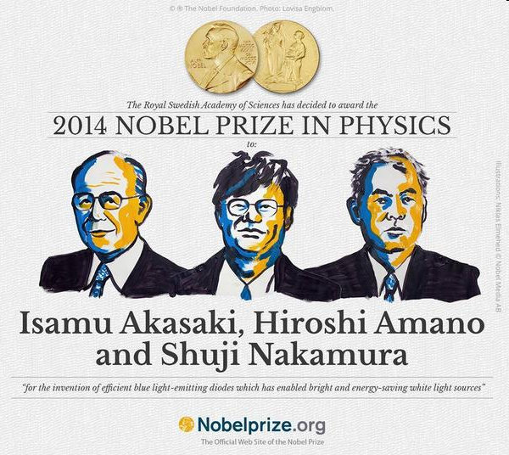
But Wait…Last Week!
Invention of the “Blue Light” GaN
Light Emitting Diode (LED)

Slide 11
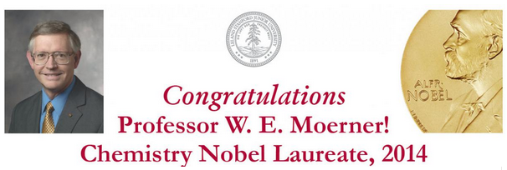
And Then a Day Later!
“for the development of super-resolved fluorescence microscopy”
The principle breakthroughs occurred during “WE’s” career at the IBM Almaden Research Center spanning 1981-1995 as an industrial physicist!

Slide 12
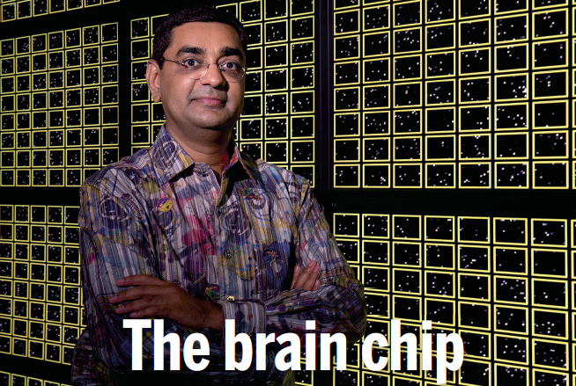
And Next the Future...
“The TrueNorth Chip”
Microprocessors modeled on networks of nerve cells promise blazing
speed at incredibly low power
Science, August 2014
Dharmendra Modha
IBM Almaden Research Center
But what happens when Moore’s Law meets the Landauer Limit? The end of von Neumann computers?
A challenge awaiting the generation of physicists sitting before me!

Slide 13
IBM

Slide 14
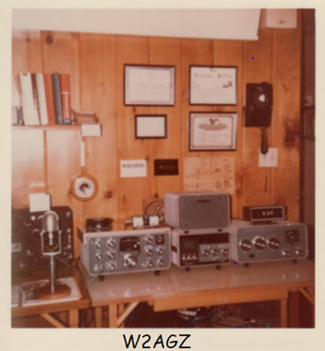
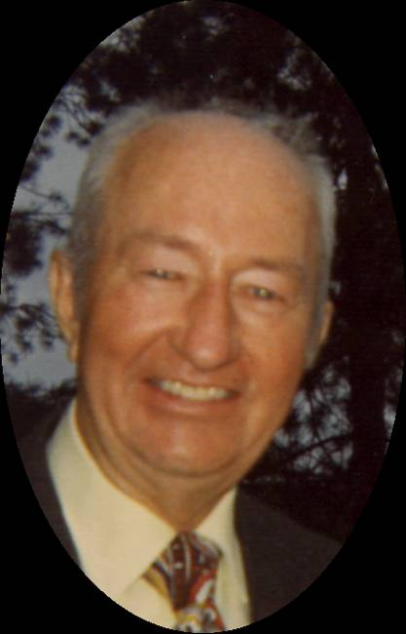
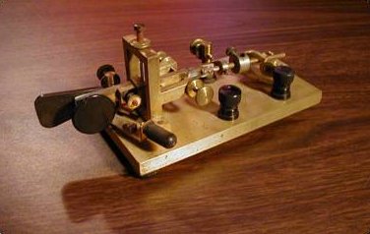
Following In His Shoes
Paul Archibald Grant, W2AGZ
Teenage Ham Radio Prodigy, 1922
Auto Assembly Line Worker, 1923-30
County Motorcycle Cop, 1930-33
Owner, Home Radio Installation Business, 1934-37
Tool & Die Machinist, 1938-42
Radar Specialist 1st Class, US Navy, South Pacific, 1943-45
Electronic Technician, Purchasing Agent, IBM, 1947-74
Founder, Catskill Mountain Volunteer Ski Patrol, 1948

Slide 15
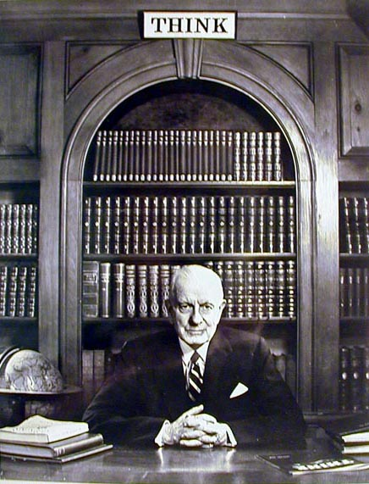

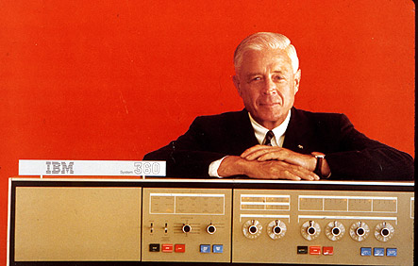
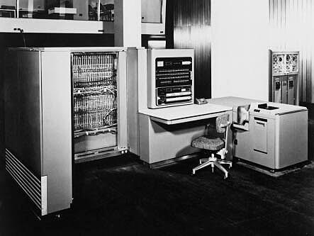
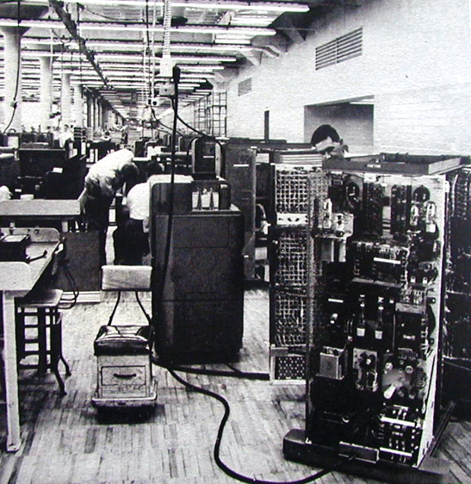

IBM – 100 Years
1952
Grant-Whalen IBM Family
-Poughkeepsie-
604 (1948)
701 (1952)

Slide 16
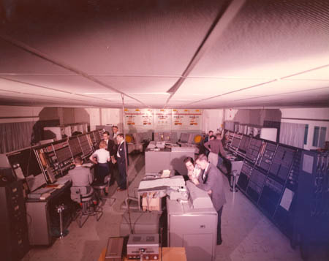
1953
Project Sage – IBM/MIT
AN/FSQ-7
The world’s first Supercomputer
The worlds’ first Parallel Computer
Notes:
16

Slide 17
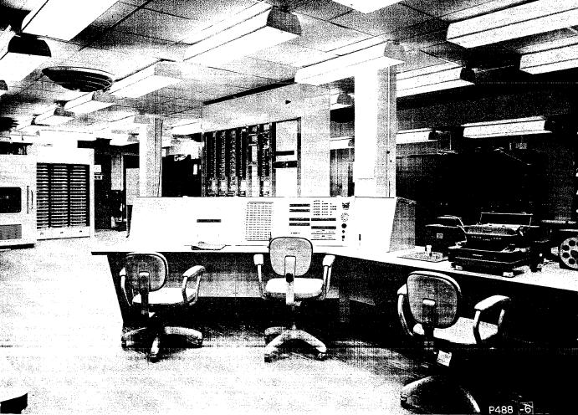
1954
TX-0: The First Transistor Computer
During my “breaks” I would sit in this chair coding “Nim”

Slide 18
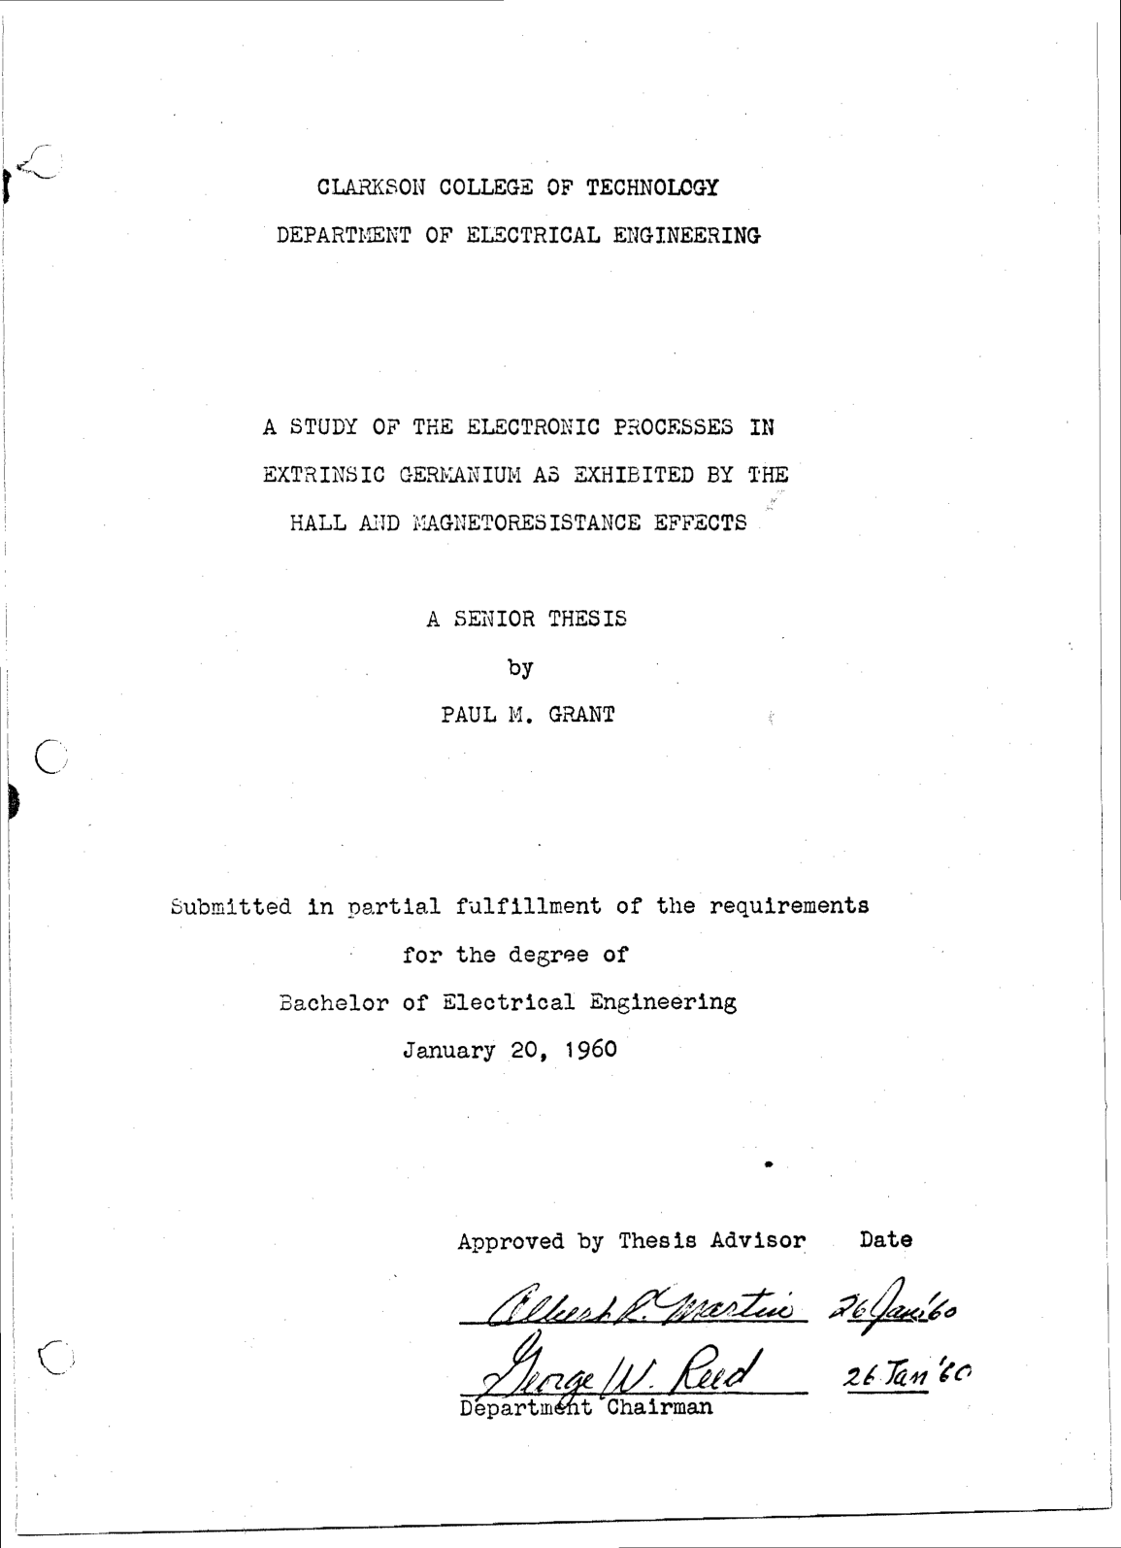
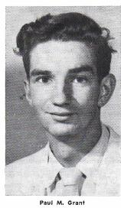
The Very First Clarkson
Internship Scholar?

Slide 19
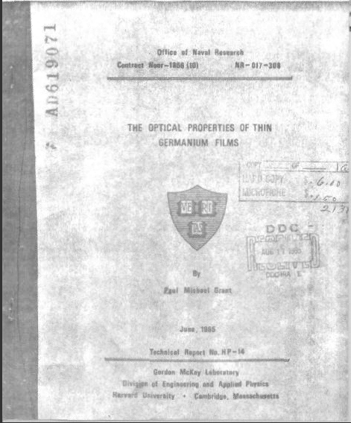
PhD Thesis
1965:
Back from Harvard,
Out to IBM San Jose,
Optical Properties of Europium Chalcogenides
Optical Properties of Chromium Trihalides
Laboratory Automation and Data Acquisition (Labview)
SJRL Director’s Staff: Materials Research Overview
Now It’s
1973!

Slide 20
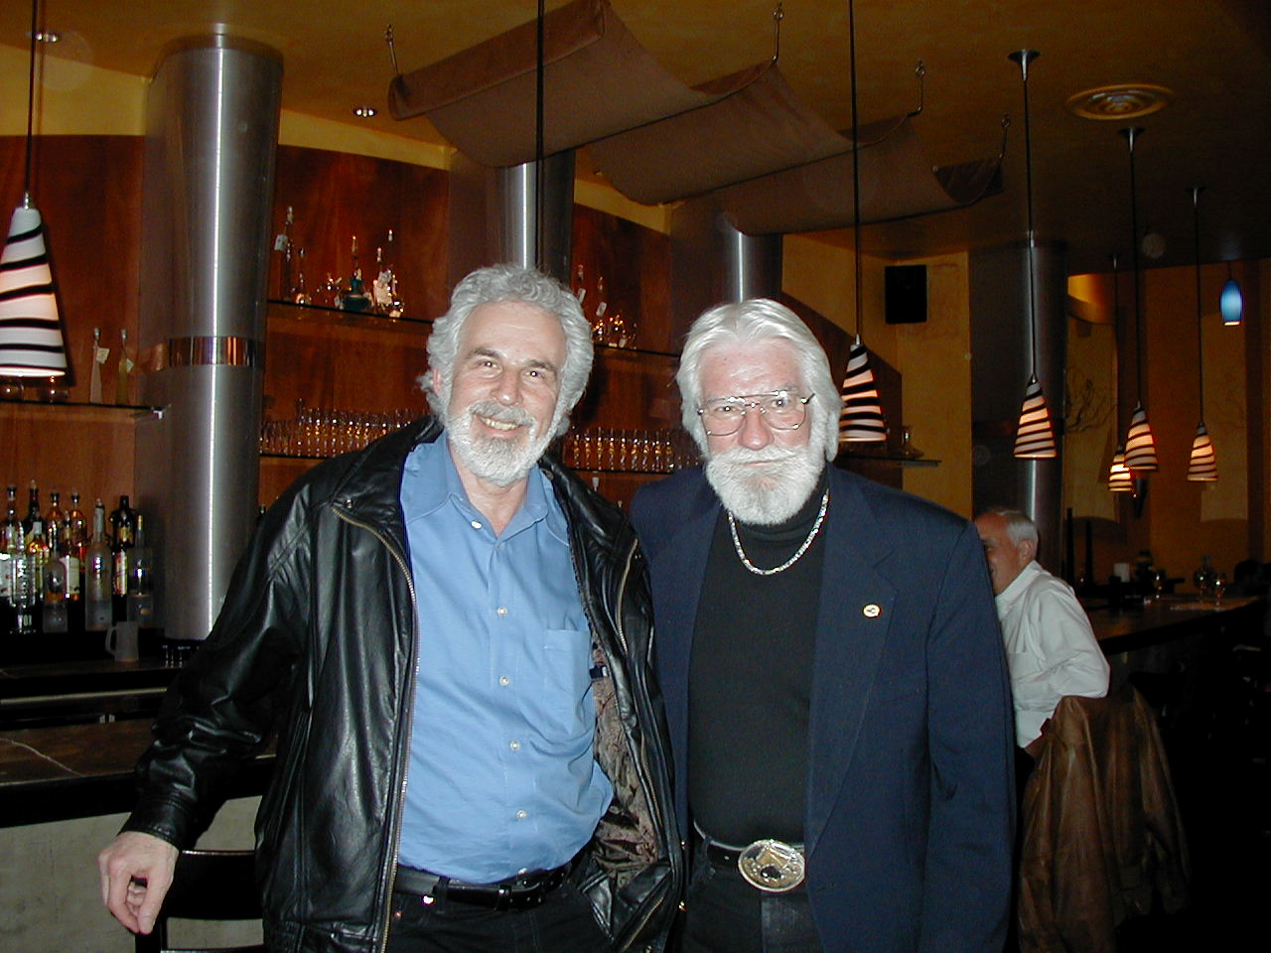
G² !
The Borscht Belt Boys

Slide 21
Physics of Superconductivity
Electrons Pair Off!
BCS Equation
•
+
+
e⁻
+
+
•
e⁻

Slide 22
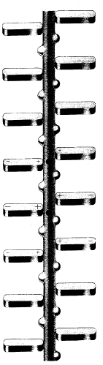
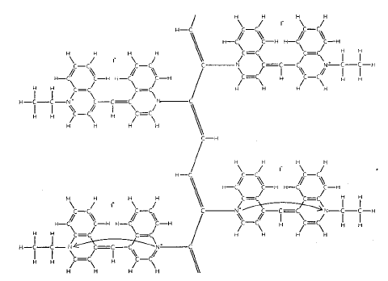
Little, 1963
₊
-
-
₊
₊
-
-
₊
₊
-
-
₊
Diethyl-cyanine iodide

Slide 23
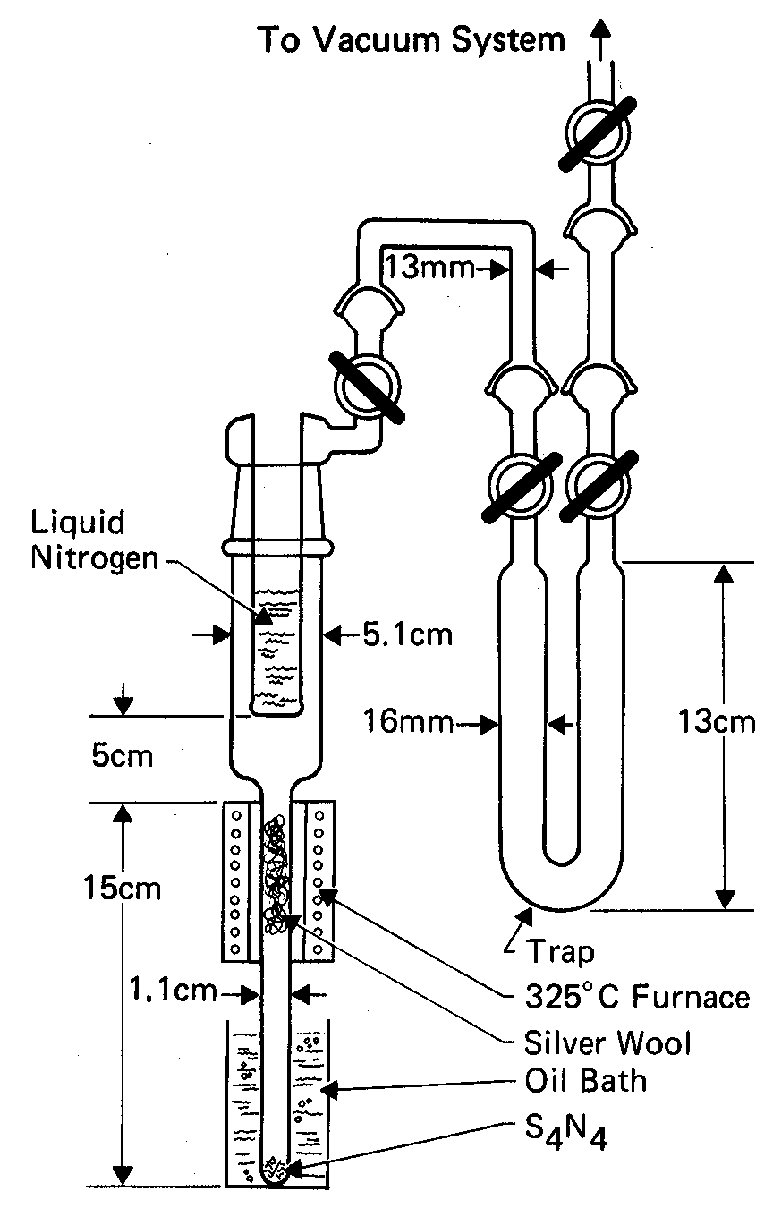
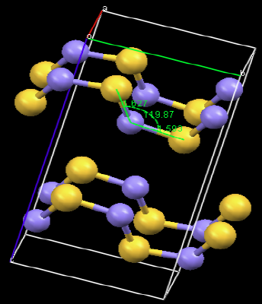
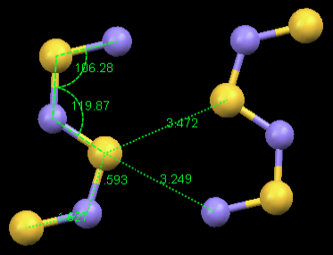
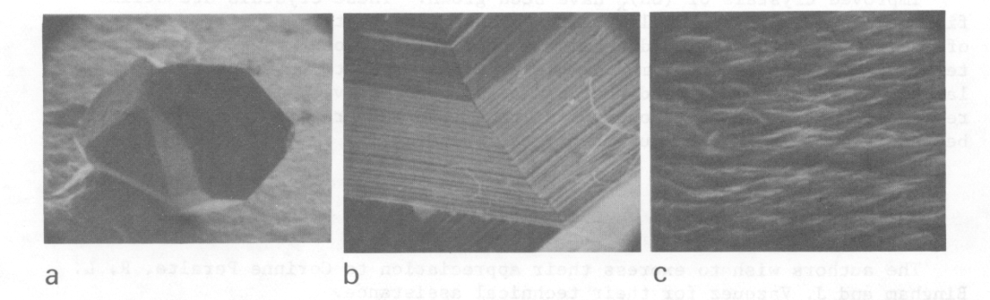
Polysulfur Nitride, (SNx)
F. B. Burt (1910)
M. Boudeulle (1974)
G. B. Street (1974)

Slide 24
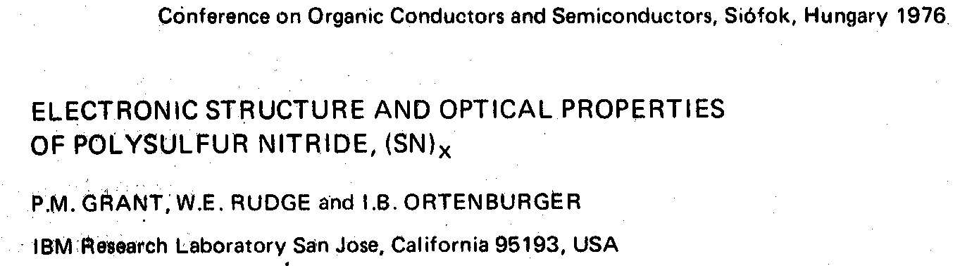

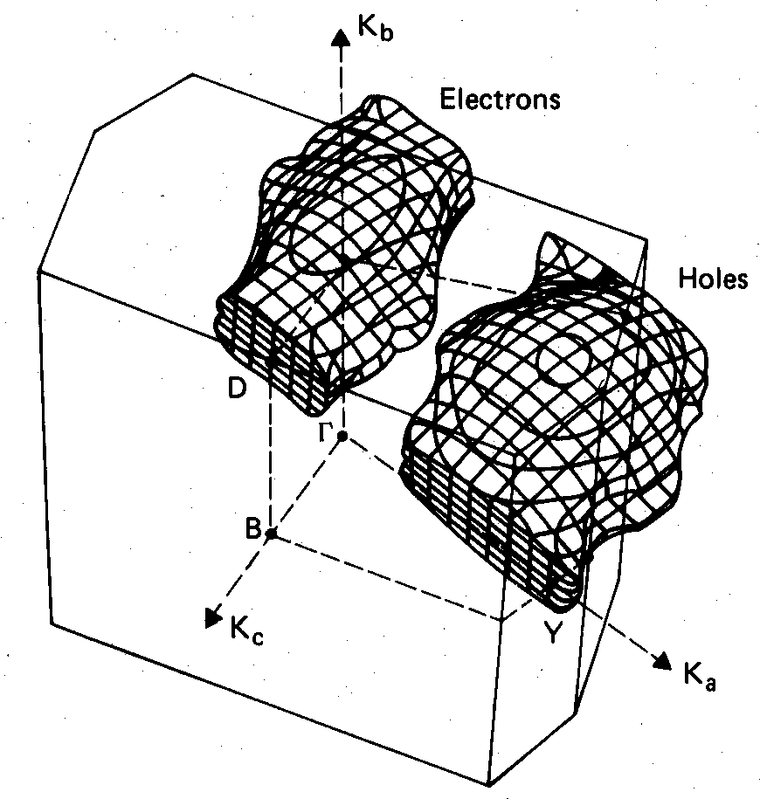
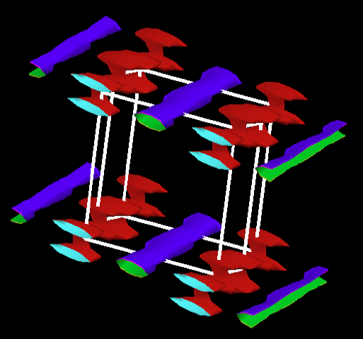
Two-Band Semimetal
MgB₂ ?
Fe-Pnictides ?
OPW, 1975-6
Quantum-Espresso, 2009
“A Women’s Place is on Top”

Slide 25


Slide 26
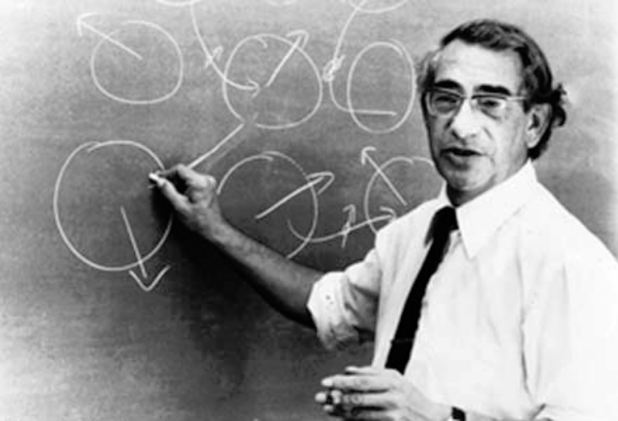
John Hubbard (1931-1980)
Famous for the basic theory of strongly correlated electron systems, e.g., NiO
In 1977, collaborated with P. M. Grant on the exact and unique solution of the non-linear extended Helmholtz equation elucidating the “current focusing” phenomenon underlying “resistive ribbon” printing (IBM Confidential)

Slide 27
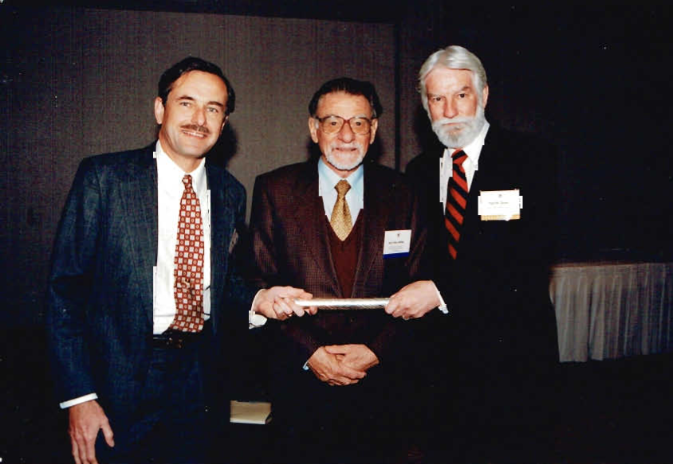
1986 – 87
High Temperature Superconductivity Discovered at IBM
First HTSC Cable
...more later!

Slide 28
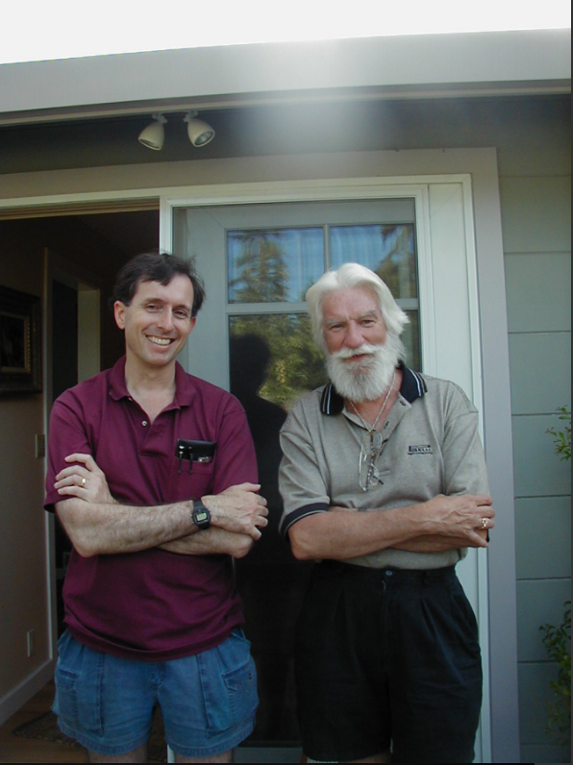
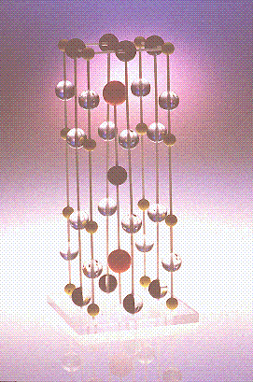
The Almaden 1-2-3 Story: 1986-89
2 March 1987
“1-2-3”

Slide 29
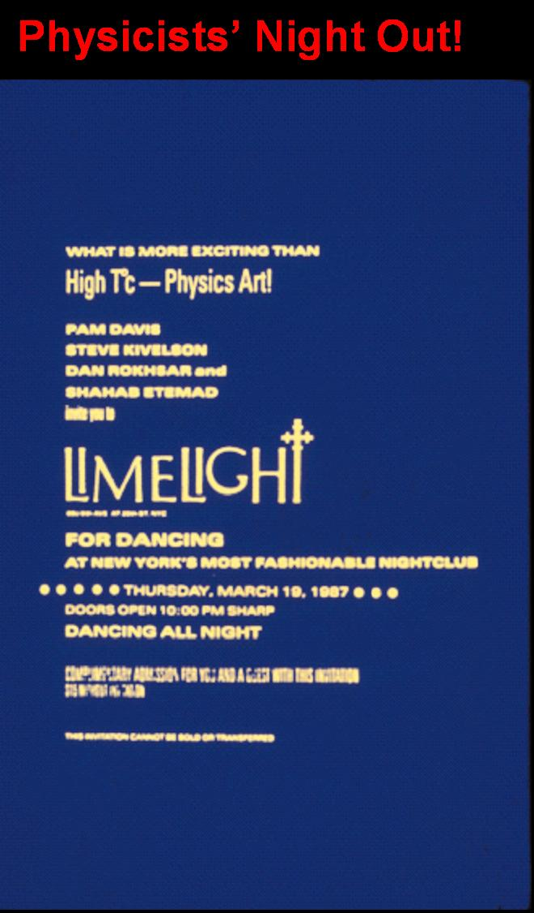

Slide 30
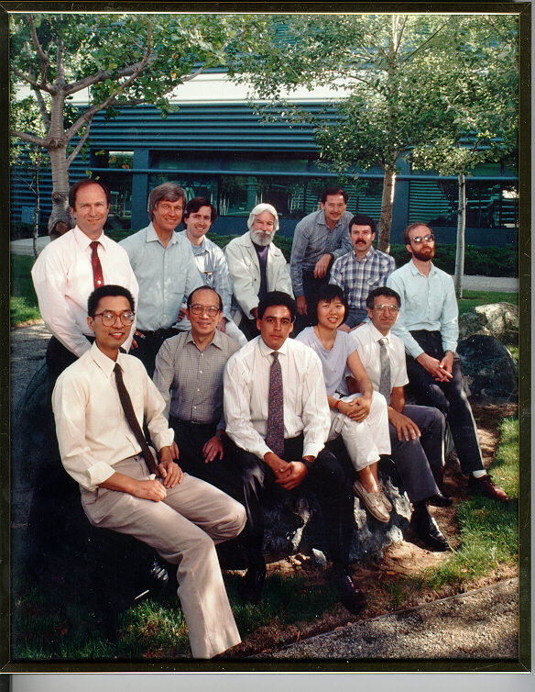
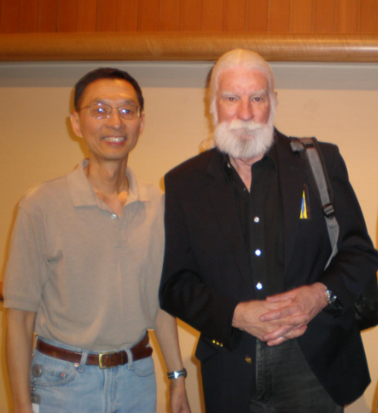
Band of Brothers (and a Sister!) http://www.w2agz.com/The%20Picture%20Story.htm

Slide 31
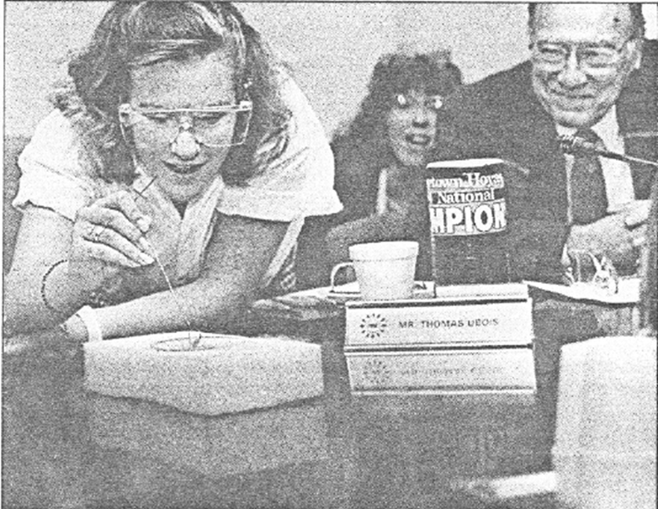
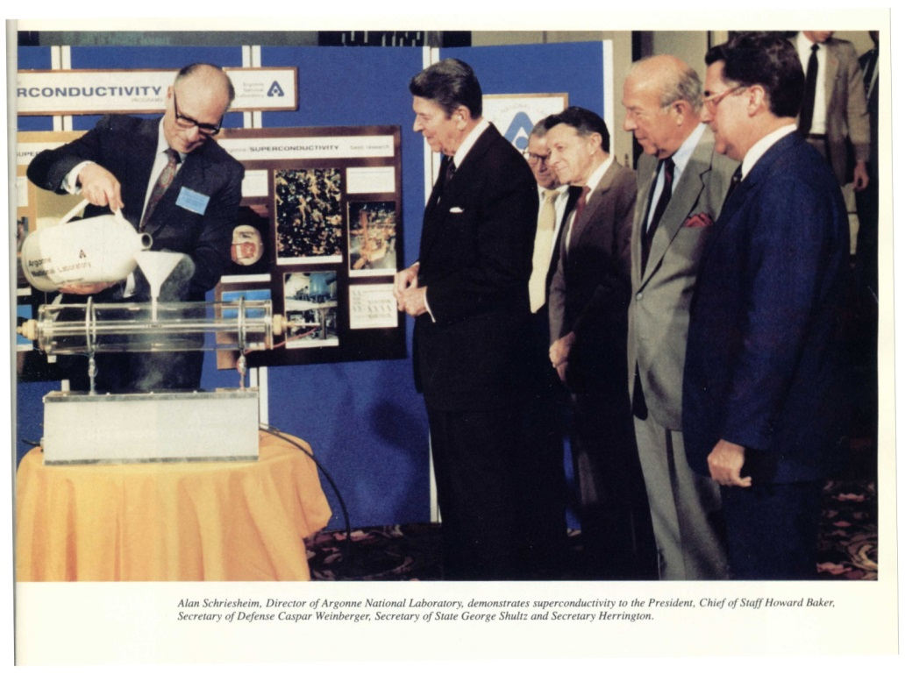
The Levitators
“The Great Communicator”
June, 1987
Heidi Grant’s 8th grade science project April, 1987 (New Scientist)
Distributed to members of US Congress (at their request)
35,000 copies distributed to high schools worldwide by ICTP-Trieste

Slide 32

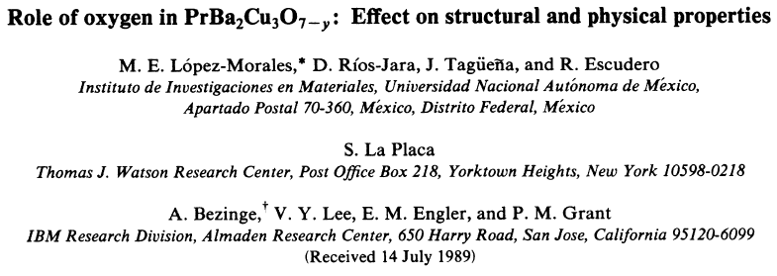
The Praseodymium Paradox
Why is Pr-123 not even a conductor?
A Clue to the mystery of HTSC?

Slide 33
Selected Patents & Patent Publications
Thin Film Magnetoresistance Sensor (Clarkson Senior Thesis, 1959)
Interactive Graphics Program (1970)
Isostructural Organic Junctions (1977)
Method & Means for Calculation of Hypergeometric Functions on Parallel Processors (1980)
Additives for Carbon-Loaded Polymers (1984)
Preparation & Processing of High Temperature Superconductors (1987)
Preparation of Electron High Temperature Superconductors (1991)

Slide 34
Selected PRLs
Non-direct Processes and Optical Properties of Metals (1967)
Temperature Dependence of the Near-Infrared Optical Properties of TCNQ (1973)
Low-Temperature Specific Heat of (SN)x (1974)
*Optical Properties of Polymeric (SN)x (1975)
*OPW Band Structure of (SN)x (1975)
*XPS Determination of the Valence Band Structure of (SN)x (1975)
Properties of Brominated (SN)x (1977)
Broken-Symmetry Band Structure of (TMTSF)2-X (1983)
Evidence for Superconductivity in La2CuO4 (1987)
* All in one month!

Slide 35
EPRI

Slide 36
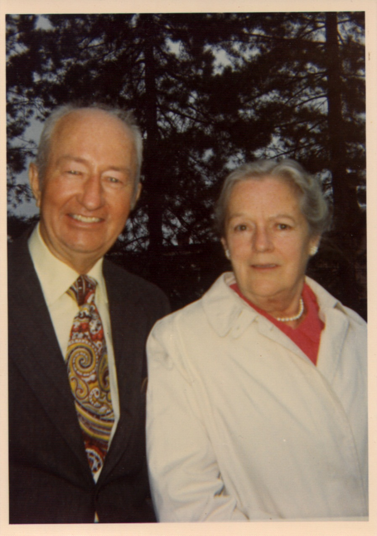
Next In Her Shoes
Mary Ann Whalen Grant
  CYO BB Champ, 1921
  NYS Bowling Champ, 1939
  Women’s Baseball, ‘33-’47
  Outstanding Skier & Golfer
  Central Hudson Gas & Electric, 1923-1958
    From teenage stenographer
    To Admin of the CEO

Slide 37


From this:..faster, smaller, cooler…and cheaper!
1956
The First Hard Drive
5 Megabytes
$300,000
6 ¢/byte
2011 (+55)
HP Personal Media
2 Terabytes
$100
5 nano-¢/byte
IBM 305 Ramac
I got two of ‘em!

Slide 38

“Harvard” Entrance Exam:
How many 1950 IBM punched cards does it take to...
Fill up a 32 gig “idiot”Phone?
???
A stack about 30 miles high!
Talk about room at the bottom!
Thanks, Dick F. !
Devin Joan Grant
“Famous-to-be” 12-year-old
Grandaughter
of Paul Michael Grant

Slide 39

To this…

Slide 40
…and this…
Detroit ‘00
Texas ‘03
West Coast ’96
New York ‘99
Chicago ‘99
New York ‘99
Chicago ‘99
Detroit ‘00
Northern California ‘01
18
18
West Coast ’96
Delaware ‘99
San Francisco ‘00
San Francisco ‘00
Atlanta ‘99
Atlanta ‘99
Delaware ‘99
New Orleans ‘99
New Orleans ‘99
17

Slide 41
…and this!
The PUC order is a stunning turnabout on a technology that many consider a key to managing energy use in the future. Utilities around the country have installed the electronic meters -- which can be monitored and adjusted wirelessly -- with little incident. But in Northern California, angry residents have expressed concerns that the meters can lead to overbilling and cause health problems, and PG&E has struggled to counter the bad publicity.
Bob Park!
Where are you when we need you!

Slide 42

…and…Finally This!
Spraying water to cool stressed reactor…Sure. Duh! It’s a gas/petrol storage port!

Slide 43

Pirelli

Slide 44
The Energy Enterprise...
When I retired from IBM and went to EPRI, I underwent a traumatic revelation from a culture where:
  If you made something:
    Smaller, cheaper, & which ran faster and cooler,
    You WON in the marketplace!
  To one where science and technology is at best only 50% of the equation, the rest dominated by politics and societal perception (e.g., policies and legislation motivated by uncertainties underlying the physics of the climate).

Slide 45


My Virtual Grandfather (@ 94)

Slide 46



SuperCities & SuperGrids
Nuclear Power can generate both electricity and hydrogen – “Hydricity”
Hydricity can be distributed in underground pipelines like natural gas
School
School
H
Home
H
Supermarket
Home
Supermarket
2
2
The infrastructure can take the form of a SuperGrid
Family Car
Family Car
Nuclear
…or a
SuperCity
Nuclear
plant
plant
H
DNA
H
DNA
-
-
to
to
-
-
order.com
order.com
2
2
Scientific American July, 2006
HTSC/MgB
HTSC/MgB
2
2
Notes:
46
46
The Vision Concept
Talking Points
The green, enviro- eco-gentle symbiosis of nuclear, hydrogen and superconductivity can be pictured in two limiting forms:
That of a “SuperGrid,” spanning a nation and perhaps even a continent. Throughout the spine of the hydrogen-electricity transmission system would be located nuclear power plants spaced apart on a length scale of 50 – 100 km, supplying both hydrogen and electricity – hydricity -into the network.
That of a “SuperCity,” comprising an urban residential/commercial/industrial complex of perhaps 2-3 million people. Hydrogen for personal and bus transportation, space conditioning and thermal processing, and electricity for all other power applications would be supplied by one or two peripheral nuclear power plants. These plants would be sited in connection with waste disposal and recycling facilities. Oxygen as a byproduct of hydrogen production would add in sewage and waste treatment and fire the combustion of waste biomass (zero-sum CO₂ emission), including methane decay gas, to supplement the nuclear-generated electrical power. In addition, all structures would housed under roofs engineered to supply both thermal and photovoltaic solar energy (“Solar roofs” do not require use of additional land area and thus are in accord with the enviro-eco-gentle paradigm.
A number of intermediary regional configurations also could be contemplated.

Slide 47

The Future?
Physics Today, November 1998
700 K !
May, 2028

Slide 48
W2AGZ & Beyond

Slide 49

A DFT (LDA+U) Study of the Electronic Properties of Square-Planar Coordinated
Copper Monoxide Structures
(does the secret to high-Tc lie within?)
...Back to the Future...
My IBM Day Job of the 60s and 70s…
Electronic Structure Calculations
What’s New?
Really cheap gaming hardware with extended cpu, core and RAM hardware
Free high end Linux platforms
Free high performance DFT software
Notes:
49
49
49

Slide 50


A DFT Study of Tetragonal Rocksalt Proxy Copper Monochalcogenide Structures:
-- Implications for Possible High-Tc Superconductivity --
Paul M. Grant
W2AGZ Technologies
Robert H. Hammond
Stanford University
Be Sure to Stay Tuned!
Calculations Underway

Slide 51


Here’s Where We Are So Far
q = 0.15 |e|/CuO (holes)
q = -0.15 |e|/CuO (electrons)
≈ 43 °K
≈ 25 °K
Apply DFT to obtain between electrons and phonons, followed by application of the Eliashberg-McMillan-Allen-Dynes formalism to find Tc:

Slide 52



Opportunities to Exploit the Keystone XL Pipeline ROW for the Dual Transport of Chemical and Electrical Energy
Smart Grid
Fraternal Twins
2013 P. M. Grant’s Editorial in Smart Grid News

Slide 53
Selected Popular Articles
(IBM, EPRI, W2AGZ)
Do-it-yourself Superconductors (New Scientist, 1987)
HTSC: Four Years Since Bednorz & Mueller (Advanced Materials, 1990)
Another December Revolution? (Nature, 1994)
Researchers Find Extraordinarily High-Tc in Bio-Inspired Nanopolymer (Physics Today, 1998 (or 2028?) )
Is a Bell Tolling for Bell Labs? (Nature, 2002)
Hydrogen Lifts Off – With a Heavy Load (Nature, 2003)
A Worthy Hero for Boys and Men (San Jose Mercury News, 1999)

Slide 54
The Take-Home...
Wisdom gained (so far!) from a lifetime career in
Industrial and Applied Physics...

Slide 55

“You can’t always get what you want…”
Notes:
55

Slide 56

“…you get what you need!”
Notes:
56

