Slide 1

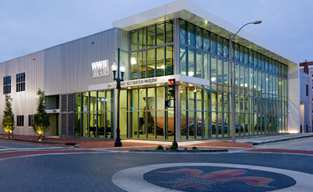
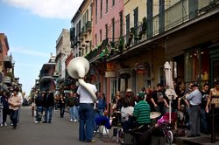
The Woodstock of Physics:
The Hyped Future Then (1987)...
The Actual Situation Now (2017)
Paul M. Grant
W2AGZ Technologies
Tuesday, 3/14, Paper 2, 8:36 – 9:12 AM, Room 387
Aging IBM Pensioner
Research supported under the IBM retirement fund

Slide 2
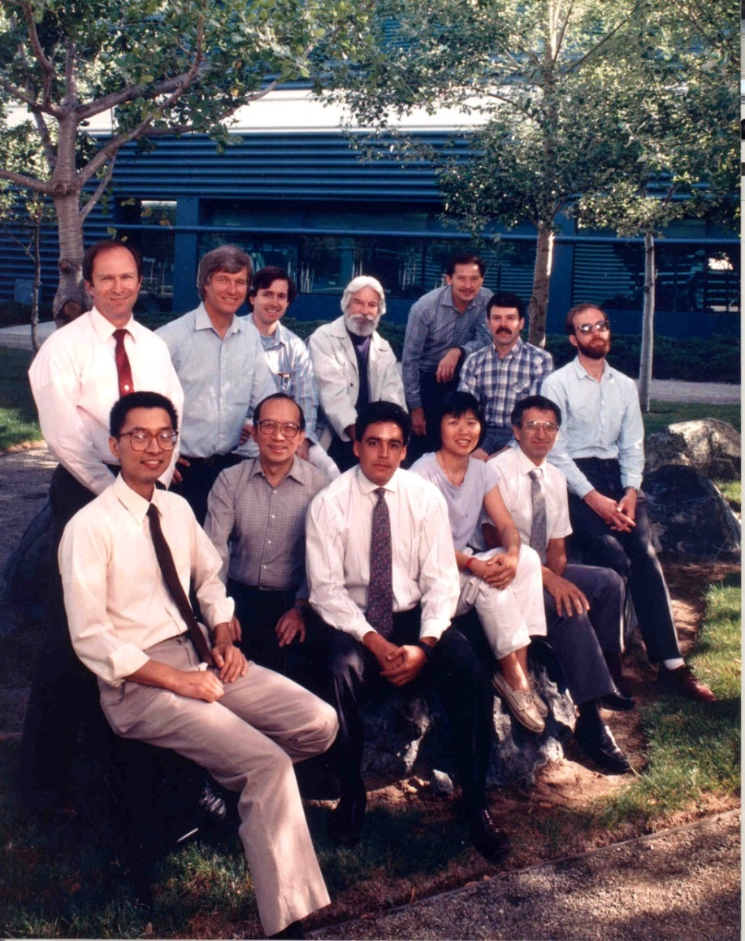
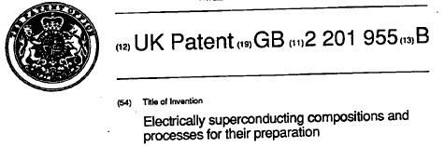
“IBM Almaden - 1987”
“Band of Brothers (and a Sister!)”
- IBM Almaden, March 1987 -
AU, CA, CH, EU, JA, KO, UK

Slide 3
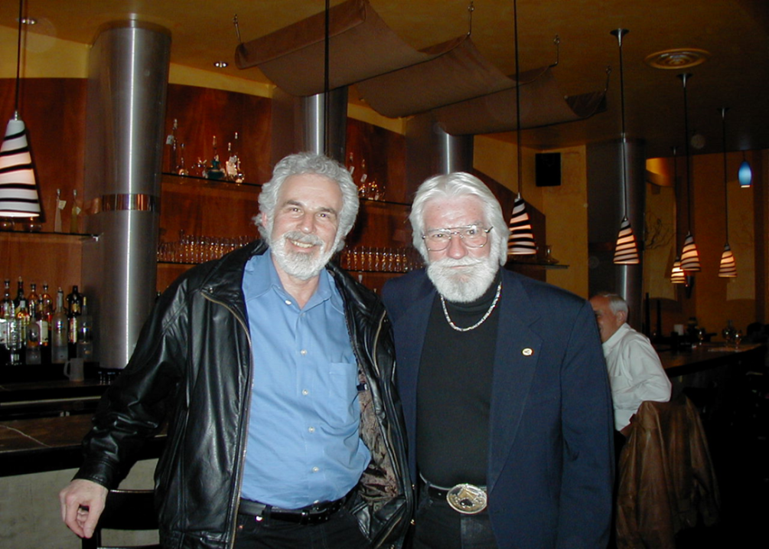
Greene-Grant
Organic Superconductivity Team
IBM San Jose (1972-1984)

Slide 4
The Week(s) Before Woodstock
Dec 86 -> Feb 87
Last week of 86: Went to ZRL to see Mueller
  Alex is off skiing.
  Met with Bednorz: Learned Georg had already synthesized and measured properties of single-phase of the Ca and Sr counterparts to La-Ba-Cu-O (Bell Labs later took credit for this!).
First week of 87: Gave a department seminar at ARC on my ZRL trip (few in my group believed the discovery).
  That afternoon, Ed Nazzal brought me a sample of La-Ba-Cu-O.
  The next morning, a Saturday, Mike Ramirez came in and found a sharp 21 K transition.

Slide 5
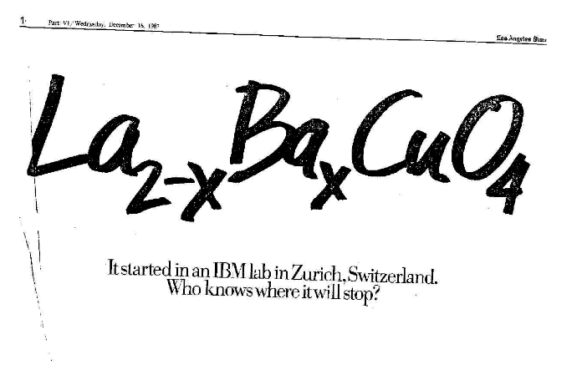

Slide 6
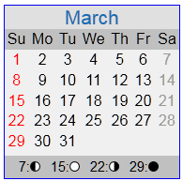
Now It’s March
Monday 2nd:
  PC gives seminar at Stanford. PMG & RBB attend. RBB has in his pocket a mixed phase sample of “multi-phase black and green Chu-stuff.”
  Mon-Tue overnight, RBB uses TEM and determines the stoichiometry and position of the cations of the black stuff (1-2-3) and the green stuff (2-1-4).
Wed-Sat (11-14 March):
  RBB, EME and the PMG group determine the “green stuff” is insulating and 1-2-3 is superconducting for most of the RE elements...(but not Pr!).

Slide 7
Cont’d (1)
Third week of Jan 87:
  RLG comes to ARC bringing samples from GB.
  We perform thermopower...find zero TP below 23 K on “undoped” La-Cu-0. Due to ~1% of excess oxygen. Results published in PRL May 87.
  In 1954, John Goodenough studied La-Cu-O at MIT Lincoln Labs...but not at low temps where he would have discovered high-Tc!
  We never would have needed NbTi!

Slide 8
Cont’d (2)
Last week of Feb 87:
  PMG attends “private” seminar organized by DJS at UCSB to hear PC announce details of his 91 K superconductor...”black stuff plus green stuff.”
  Next day PMG visits THG at Stanford and obtains the PC PRL preprint with the 91 K chemical composition. Telephones EME at ARC with the “numbers.”
  That afternoon, we have at ARC reproduced “Chu stuff,” but with Nd and most of the other REs, but not Y...we didn’t have any in stock...for a day!

Slide 9
Now It’s March
Monday 2nd:
  PC gives seminar at Stanford. PMG & RBB attend. RBB has in his pocket a mixed phase sample of “multi-phase black and green Chu-stuff.”
  Mon-Tue overnight, RBB uses TEM and determines the stoichiometry and position of the cations of the black stuff (1-2-3) and the green stuff (2-1-4).
Wed-Sat (3-7 March):
  RBB, EME and the PMG group determine the “green stuff” is insulating and 1-2-3 is superconducting for most of the RE elements...(but not Pr!).

Slide 10
Now It’s March (2)
Sunday 8th:
  PMG emails/faxes the ARC findings to YKT.
  Then flies overnight to YKT/Westchester.
Monday 9th:
  PMG delivers 90 minute talk revealing all ARC findings.
  Praveen Chaudhari and Bob Laibowitz at YKT verify the ARC findings overnight.
Tue – Fri (10-13):
  RBB working with Bill Gallagher extend processing space for YBCO derived compounds.
  PMG delivers documents to PRL and US Patent offices on Long Island.
Sunday 15th:
  IBM ARC+YKT drive to the New York Hilton Hotel and register for APS March.
  THE REST IS HISTORY!

Slide 11
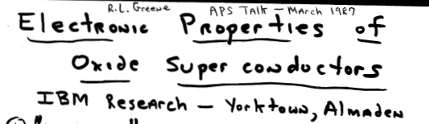
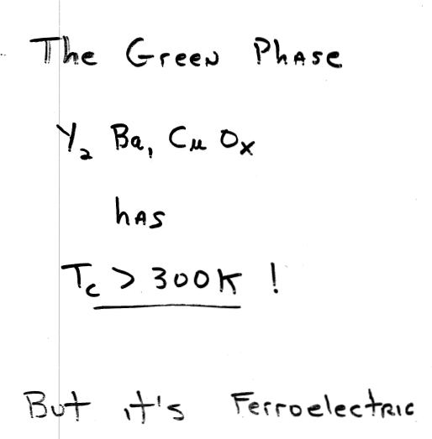
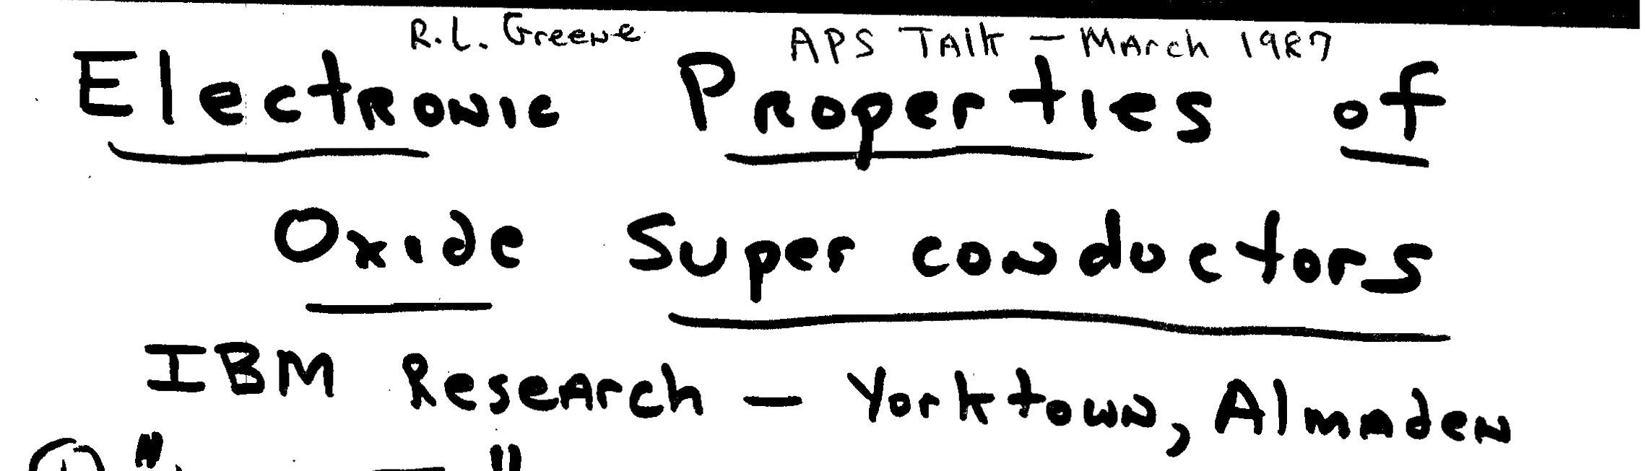
“Obscure Contributed Talk”
17 March 1987

Slide 12
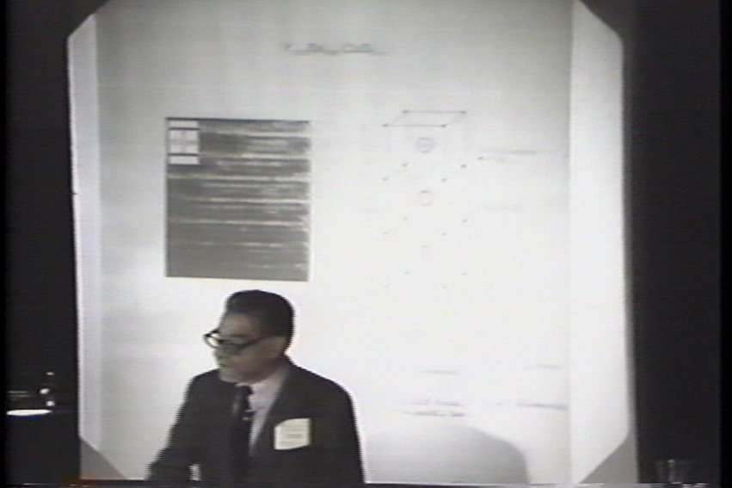
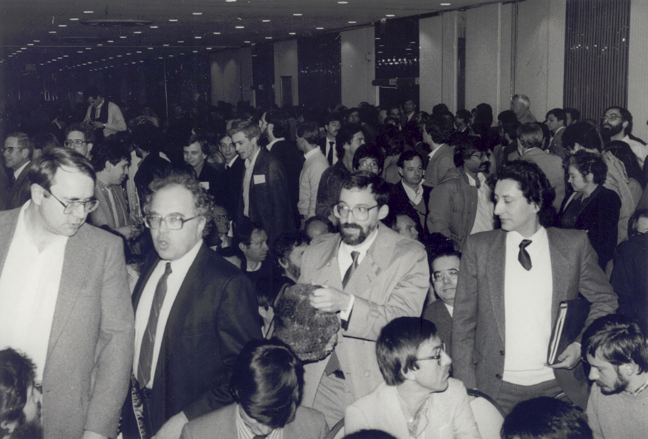
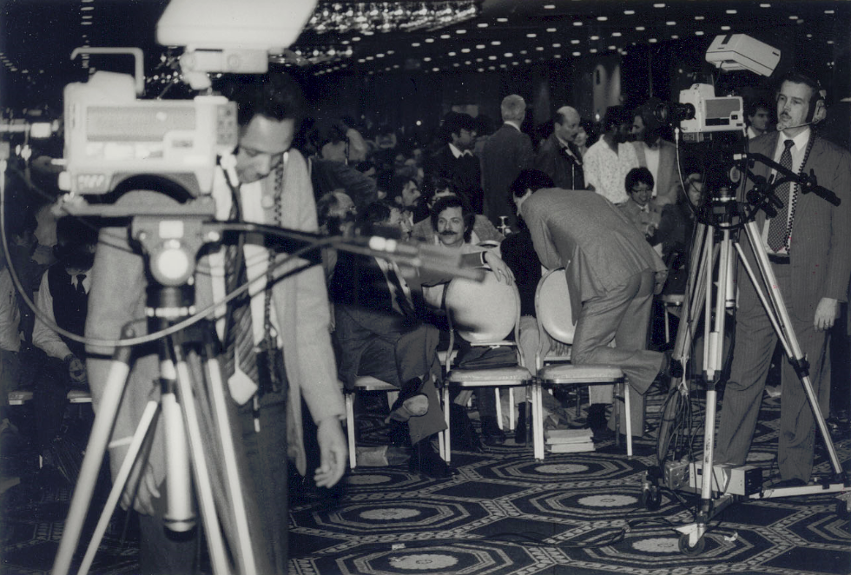
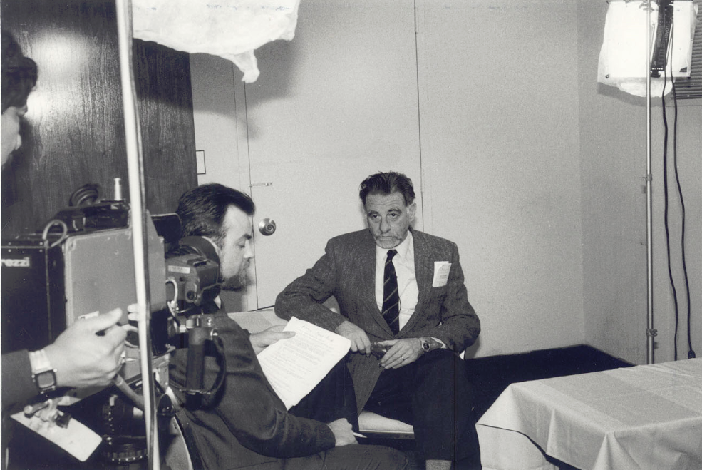
“The Happening”

Slide 13
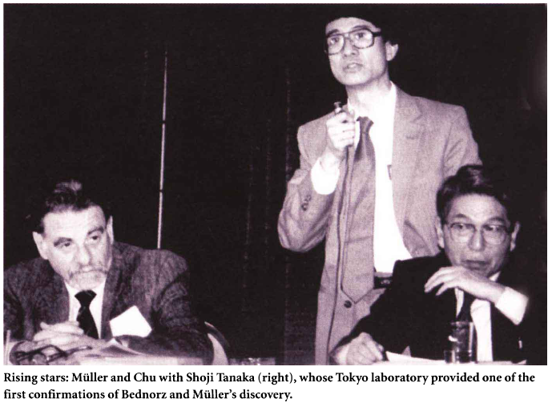
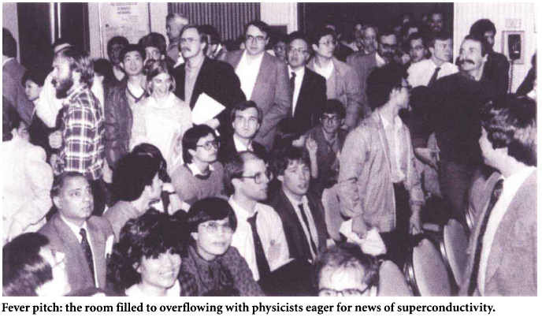
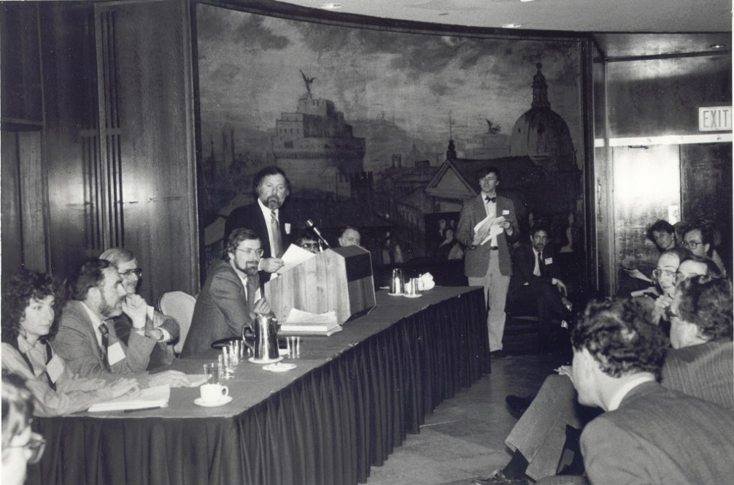
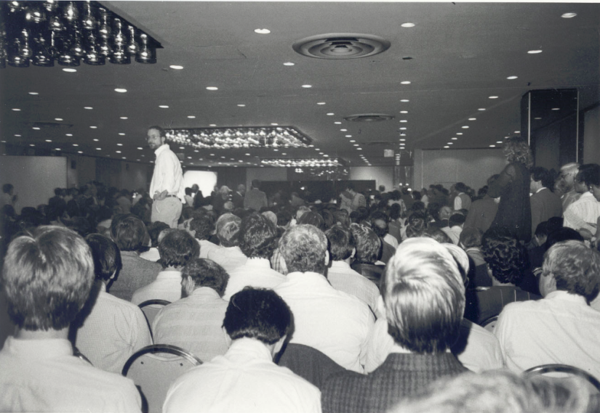
“The Happening +”

Slide 14
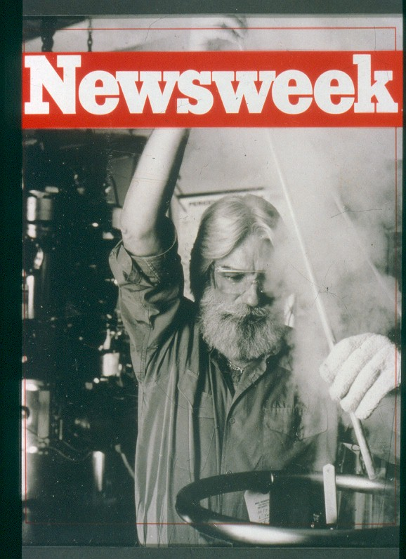
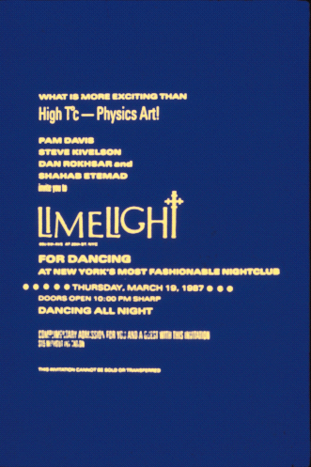
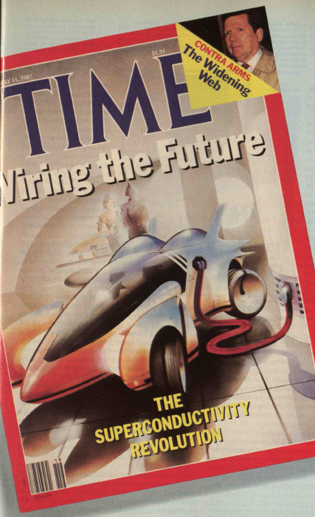
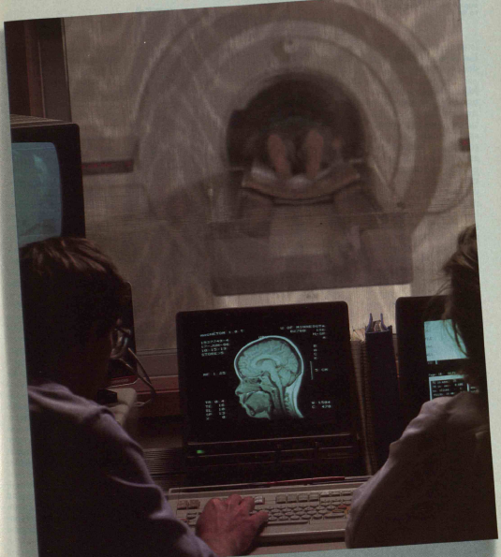
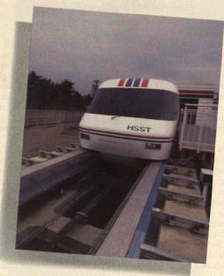
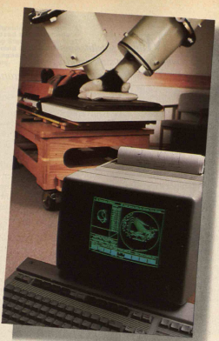
“The Hype”

Slide 15
“The Hype +”
“Superconductor Progress is Electrifying Researchers”
  ”If the results . . . hold up and can be translated into productive devices, it will revolutionize both the electrical industry and the electronics industry.”
  “The amount of energy to be saved would go into the billions of dollars.”
  “More efficient transmission lines that would let utilities build power plants hundreds of miles away from cities.”
  “Smaller, faster computers and other electronic devices.”
  “Trains zipping nearly frictionless down their tracks, supporting themselves with powerful magnets maintained by endlessly circulating electricity.”
  “More efficient electric motors and generators.”
  “Inexpensive medical diagnostic instruments that can provide vivid images of the body's interior without the invasive effects of X-rays.”
  “I think that these developments are potentially as important as the discovery of the transistor and laser.”

Slide 16
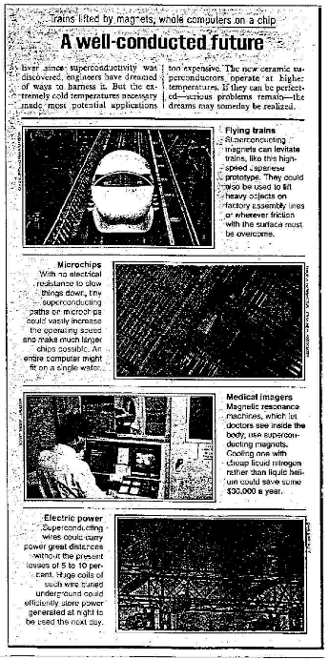
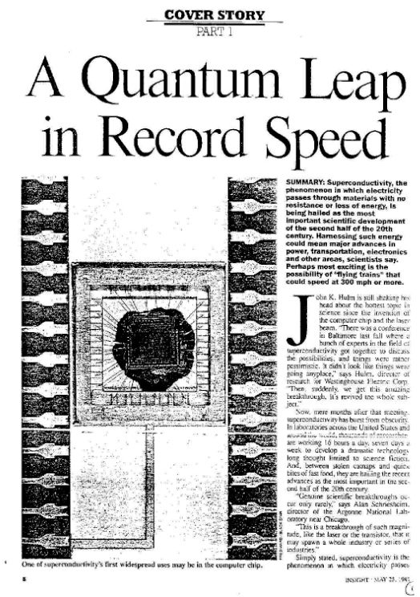
“The Hype ++”
Thanks,
Brian Maple!
USN&WR, May 1987
Insight, May 1987

Slide 17
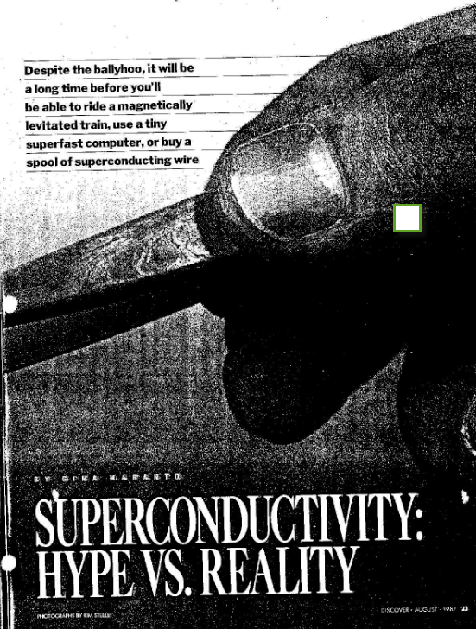
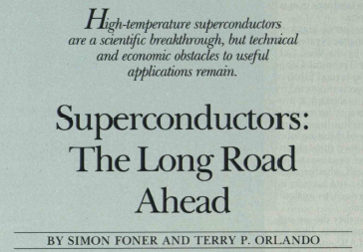
“Sobriety Sets In”
“High-temperature superconductors are a scientific breakthrough, but technical and economic obstacles to useful applications remain.”
“All...indicators suggest that superconductivity has entered a dynamic new phase. But a great deal remains to be done.”
MIT Technology Review, April 1988
Discover Magazine, August 1987
MIT Technology Review, April 1988

Slide 18
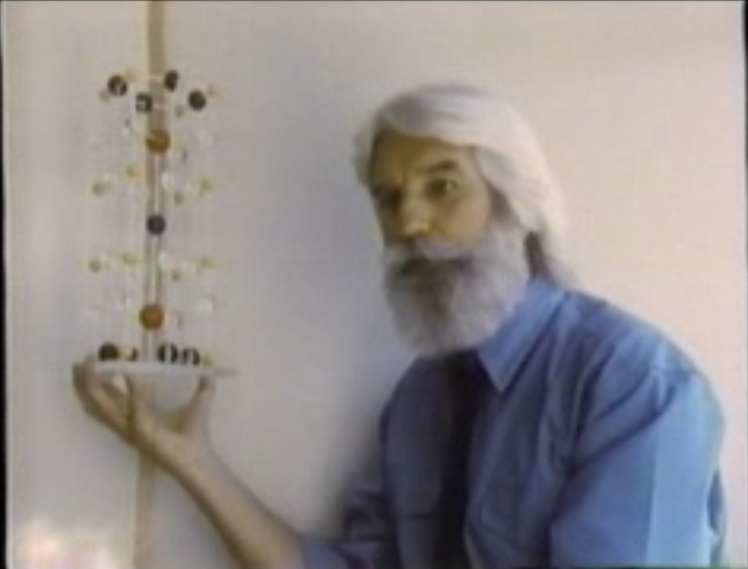
“Followed By Entertainment”
Race for the Superconductor
Nova, Horizon 1988

Slide 19
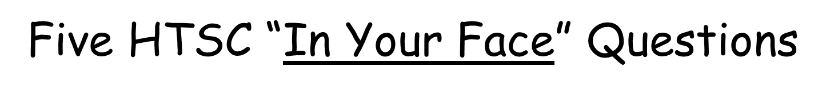
T
What about RTSC?
U = 3
Is it “shakes or spins”...or both?
U = 0
“Funny Metal”
“Pseudogap”
“Fond AF Memories”
“SDW”
“NEEL”
“A-F”
“Funny Metal”
“Pseudogap”
“Fond AF Memories”
“Real Metal”
“Fermi Liquid”
U = 6
Where is Pr-123 ?
Is “bulk SC” a function of g* ?
Superconductivity
“Insulator”
g*
“Conductor”
g
When and where can we use HTSC/RTSC in the
Electricity Enterprise?

Slide 20
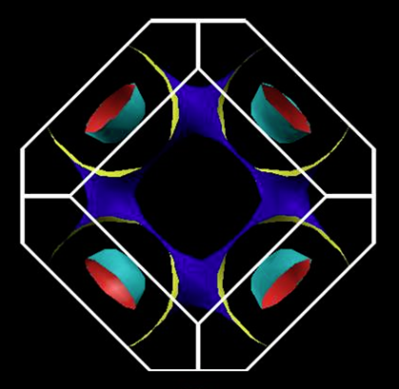
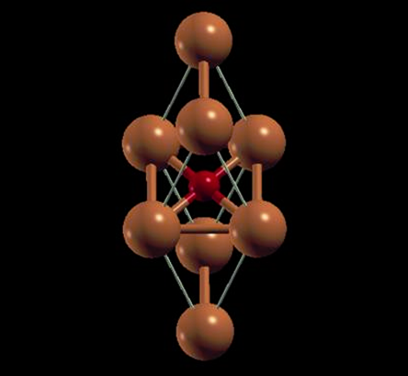
The Holy Grail of HTSC
“The Energy Salvation of Mankind?”

Slide 21
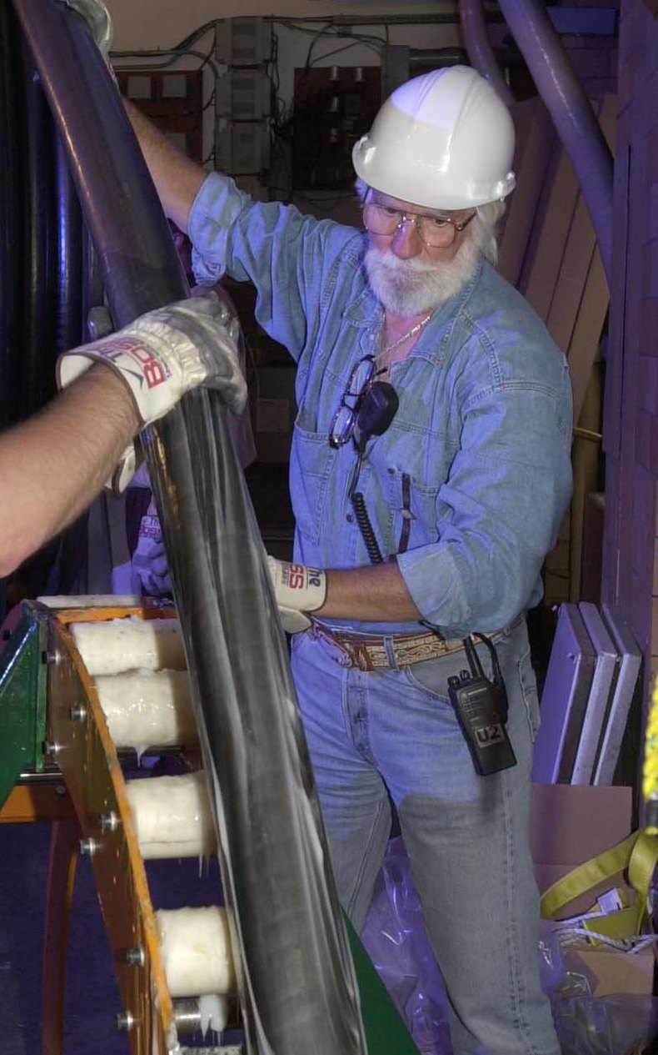
Pirelli-EPRI-AMSC-Detroit Edison
1996 - 2001
Pirelli

Slide 22
2011 Physics World Interview
APS March 2011 Dallas
Approaching 25th Anniversary of the Discovery of High Temperature Superconductivity
YouTube Interview by Hamish Johnston of Physics World re “Where Next for Superconductivity.”
  Go to https://www.youtube.com/watch?v=8yCX1WAhK2M
Conclusion: Situation More or Less the Same Today in 2014!

Slide 23
“The Short Story”
Following the 1911 discovery, Kamerlingh Onnes attempted the construction of an electromagnet...unsuccessfully.
Throughout the second half of the 20th Century and up to the present, many successful demonstrations of superconducting cables, transformers, current limiters, storage units, rotating machinery, etc., have been carried out. Yet, to date, no significant markets (> 10⁸ USD/yr) have emerged for deployment worldwide in the Electricity Enterprise.
  For a 1997 review, see “Superconductivity and Electric Power: Promises, Promises...Past, Present and Future,” P. M. Grant, IEEE Trans. Appl. Supercon. 7, 112 (1997). Available on request from www.w2agz.com.
  Today, the principal “power” applications of superconductivity remain cabling and deflection magnets for hadron colliders and solenoids for medical MRI.
As of today, all US HTSC power app demos have been concluded or are “on hold.”
What might constitute a “Longer Story?”
  Advancing a current “technology addiction.”
  Satisfying a compelling social need.
  Identifying a new opportunity.

Slide 24
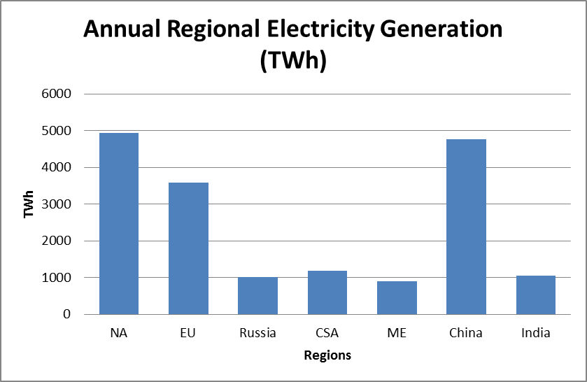
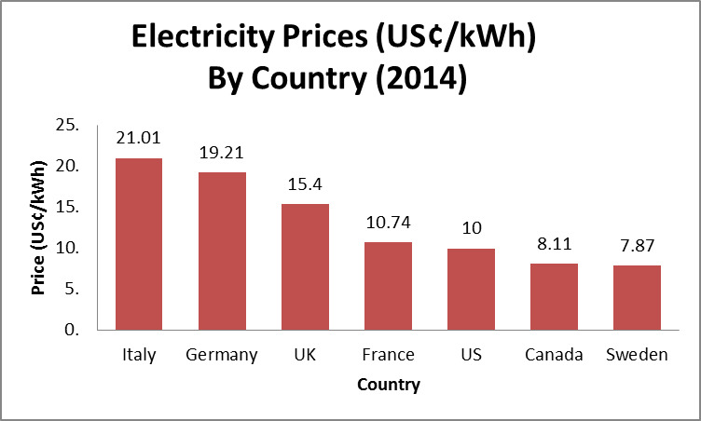
Electricity is Plentiful
...and Cheap!

Slide 25
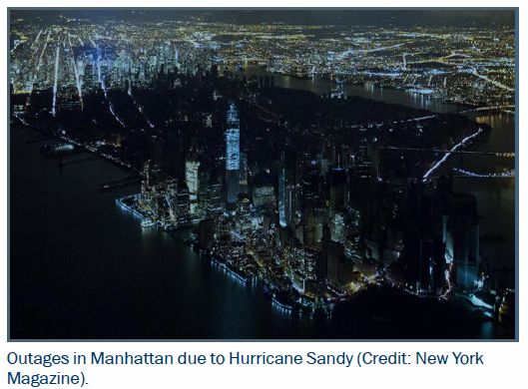
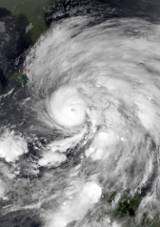
But...You Can Lose It Suddenly!
October, 2013

Slide 26






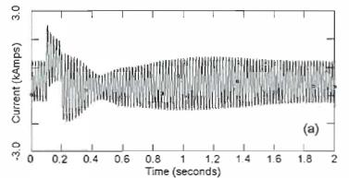
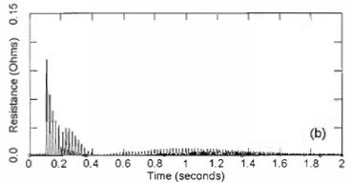
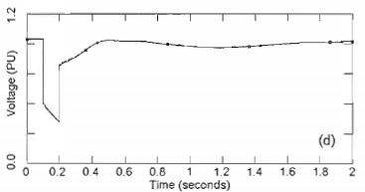
IFCL-HTS
“I” = “inherently”
What is it?
Substation “A”
Superconducting Cable
Substation “B”
A Transient Model of High-Temperature Superconducting Cables in Electric Power Supply
Kim Hoj Jensen and Vladislav Akhmatov
(Tech. U. Denmark, 2005?)
AMSC US Patent 8,886,267,B2 Nov. 11, 2014

Slide 27
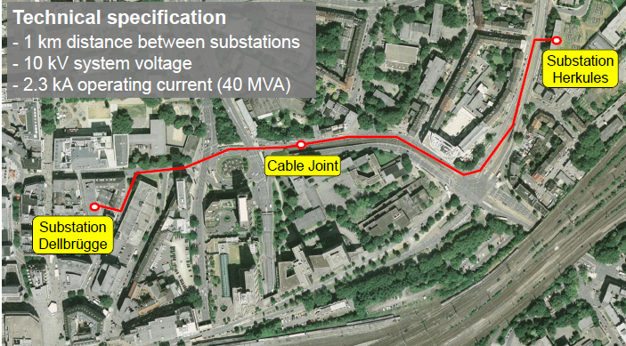
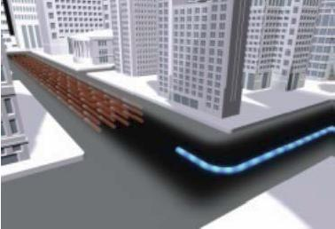
IFCL-HTS “Implementations”
AmpaCity – Essen (RWE, Nexans, KIT,...)
Pilot operation in progress
Funding: 13.5 M Euros
  Nexans 36%
  RWE 33%
  BMWi 25%
  KIT 6%
Next...Muelheim (2020) ?
Project Hydra – (AMSC, ConEd, DHS,...)
First proposed in 2007 by DHS
Funded by DHS at 30 M USD
Contracted with AMSC & ConEd for installation in mid-Manhattan
Put on hold in 2011
Project moved to two adjacent substations in Yonkers
Cable conductor now sits on site
Future “uncertain”

Slide 28
DHS “Resilient Electric Grid” (2015)
Objective: Protection of the US Grid against:
  Natural Disasters
    e.g. “SuperStorm Sandy”
  “Unnatural” Disasters
    1960-70 attacks on California & Oregon substations by the SLA and environmental extremists
    Most recent 2013 attack on PGE Metcalf transmission substation in San Jose
“Due Diligence” Study Underway
  Objective: Assess the risk and readiness of the US (and some international ) HTSC wire, cable, and cryogenic companies to undertake large scale production necessary to implement the REG
    e.g., would Gen I wire be sufficient, or is Gen II really needed, or both?
  DHS and EPRI have formed a 7 person team of “experts” to report their recommendations by 4Q15.
    Full Disclosure: I’m a member! Con Quidado!

Slide 29
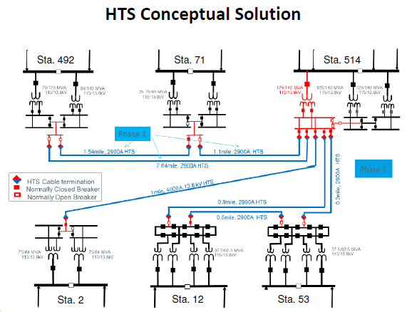
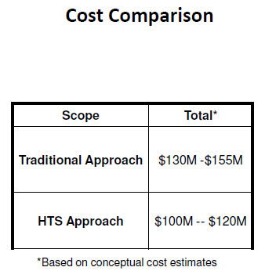
March 2017-The Latest
B&V-AMSC-PG&E “Pipe-type” Cable Retrofit
Eversource-AMSC Substation Re-routing

Slide 30
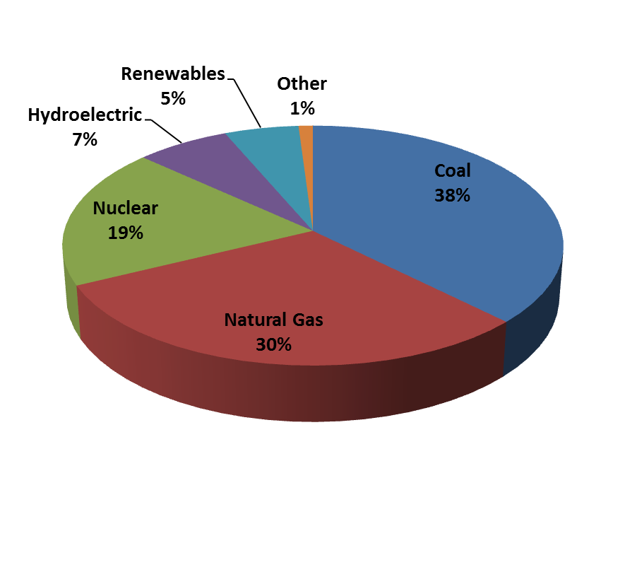
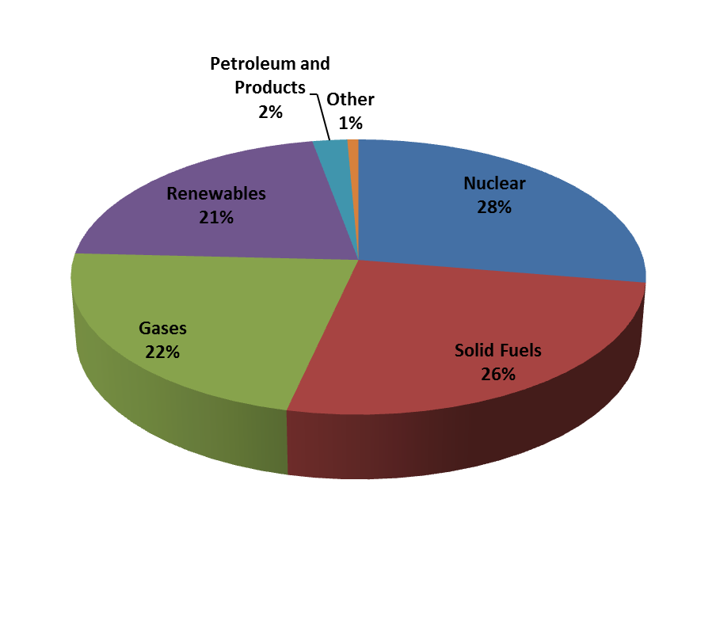
“Dual Use” of Energy Transport Corridors
Electricity Generation by Primary Fuel Source (2011-12)
USA
Wow!
Europe

Slide 31
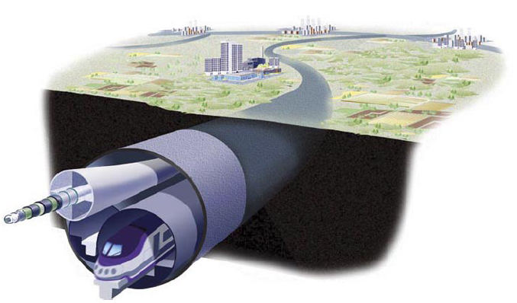
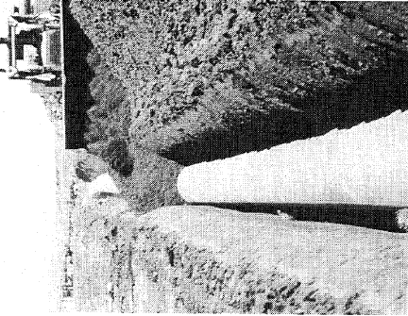
The “Dual Use” Concept Embodied
Almost all NG used for electricity generation is “combusted” at a “local” delivery point using modern, efficient, combined cycle gas turbine (CCGT) technology.
Why not “combust” that gas portion so-used at the “well-head” instead and deliver the “electrons” over a low-loss HTSC dc cable? As well as reducing volume...and...frictional loss due to NG transported by pipeline.
...and...consider “recycling” well-head generated CO₂ emissions into alcohols...and “pipe” those down the same ROW!
The ROW Dual Use concept has been documented in several peer reviewed journals as well as member magazines of the APS, IOP, IEEE, and Nature...contact the author/speaker for a linkable anthology.

Slide 32
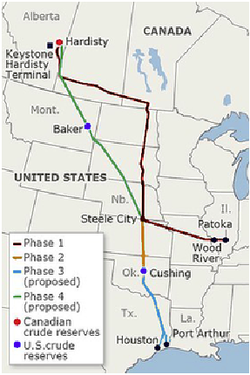
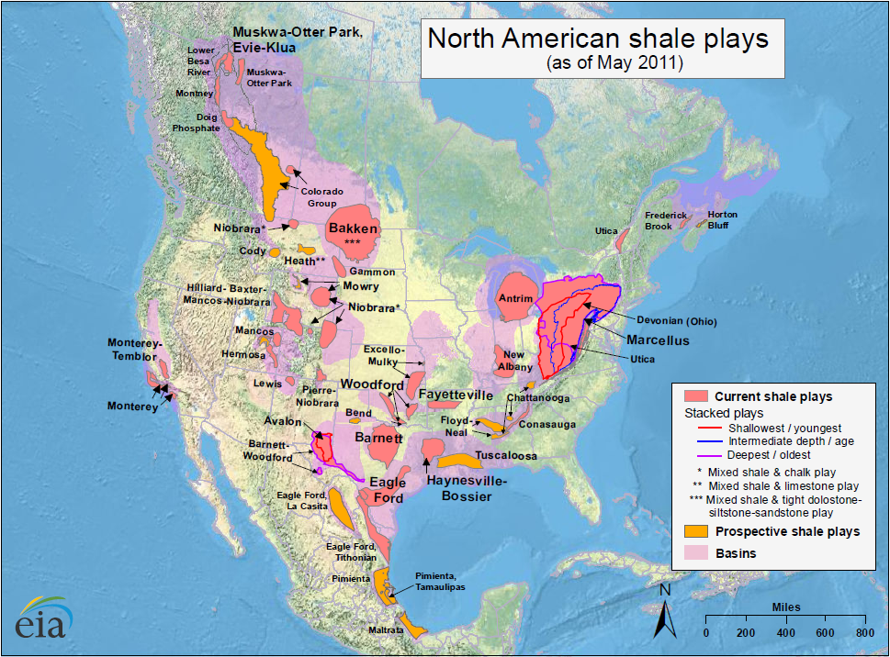

Opportunities to Exploit the Keystone XL Pipeline ROW for the Dual Transport of Chemical and Electrical Energy
Smart Grid
Fraternal Twins
2013 P. M. Grant’s Editorial in Smart Grid News

Slide 33





“The Only Commercial Application of HTSC”
Now it’s graphene!

