Slide 1
Setup

Slide 2
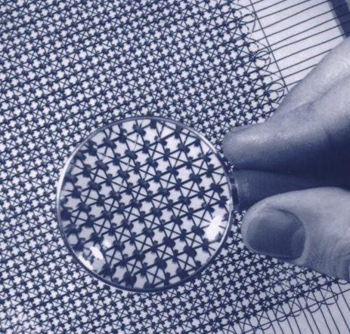
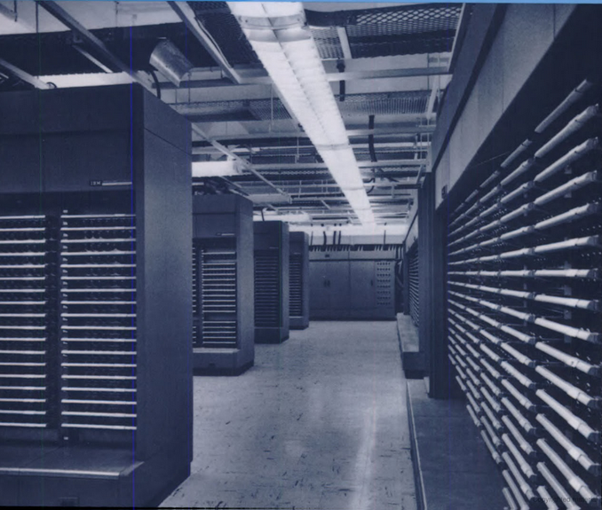

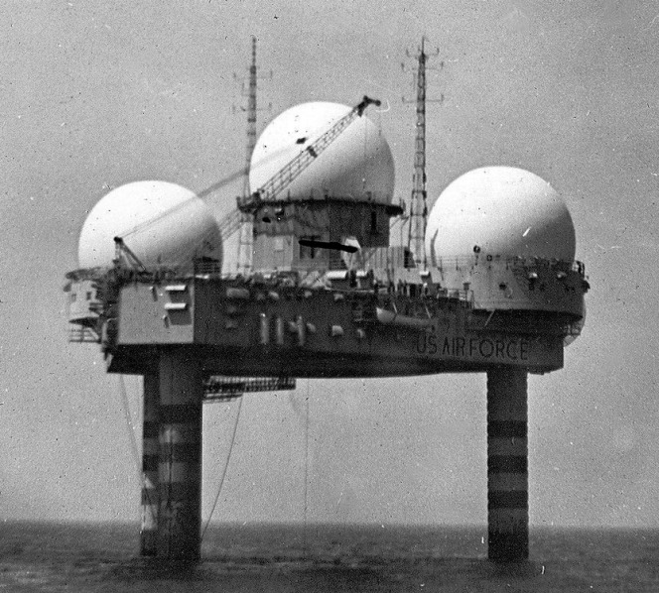
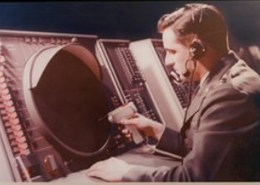
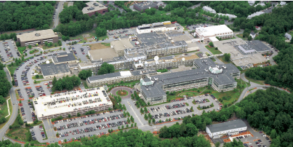
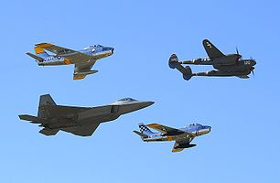
Actualization of the IoT
APS-FIAP
17-19 April 2017
Monterey, CA
The Internet of Things
– Present at Its Creation –
SAGE – 1954
Paul M. Grant
W2AGZ Technologies
www.w2agz.com
Aging IBM Pensioner
Research supported under the IBM retirement fund

Slide 3
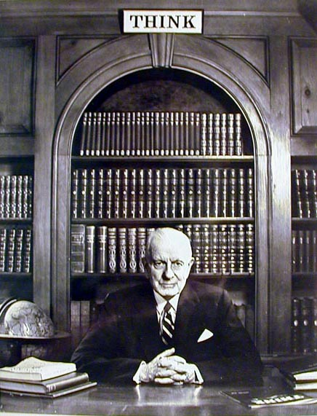
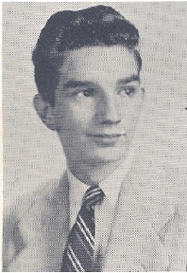
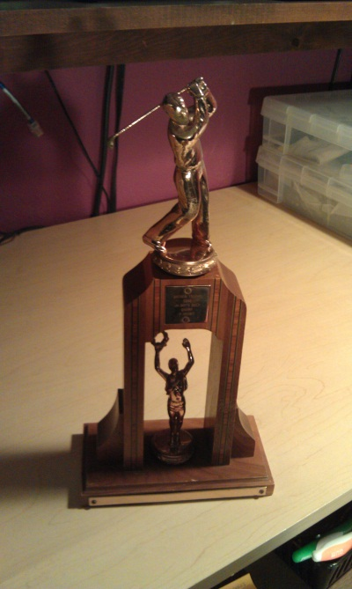
IBM Poughkeepsie - 1952
Visit www.w2agz.com for the whole story

Slide 4
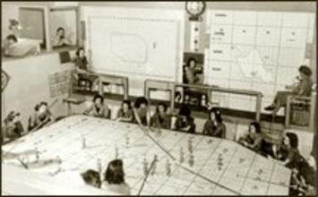
Prologue: 1949-50
It’s 1949: The USSR has developed nuclear weapons.
Deliverable via supersonic bombers and elementary ballistic missiles.
Here was our defense at the time!
Obviously, we needed a new technological approach...
(and not just by substituting XXs with XYs)!

Slide 5
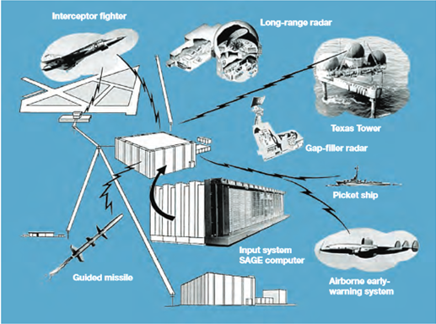
Proposal: 1951-53
George Valley and Jay Forrester of MIT propose:
  A net of radars and other data sources, along with computers,
  That receive radar and additional information to detect and track aircraft,
  Process such data to depict the total challenge to confront militarily,
  Then guide weapons to destroy incoming enemy munitions.
Wow! Ambitious! Their vision became SAGE (Semi-Automatic Ground Environment), first prototyped as XD-1 at MIT Lincoln Labs in 1954.
Hmmm...seems like a lot of “things” “netted” together. That’s why “t=0” of the IoT began back then!

Slide 6
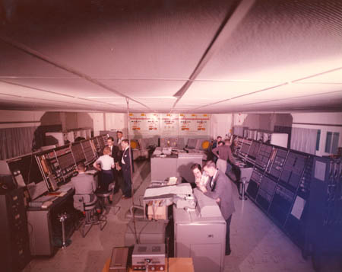
1953
Project Sage – IBM/MIT

Slide 7
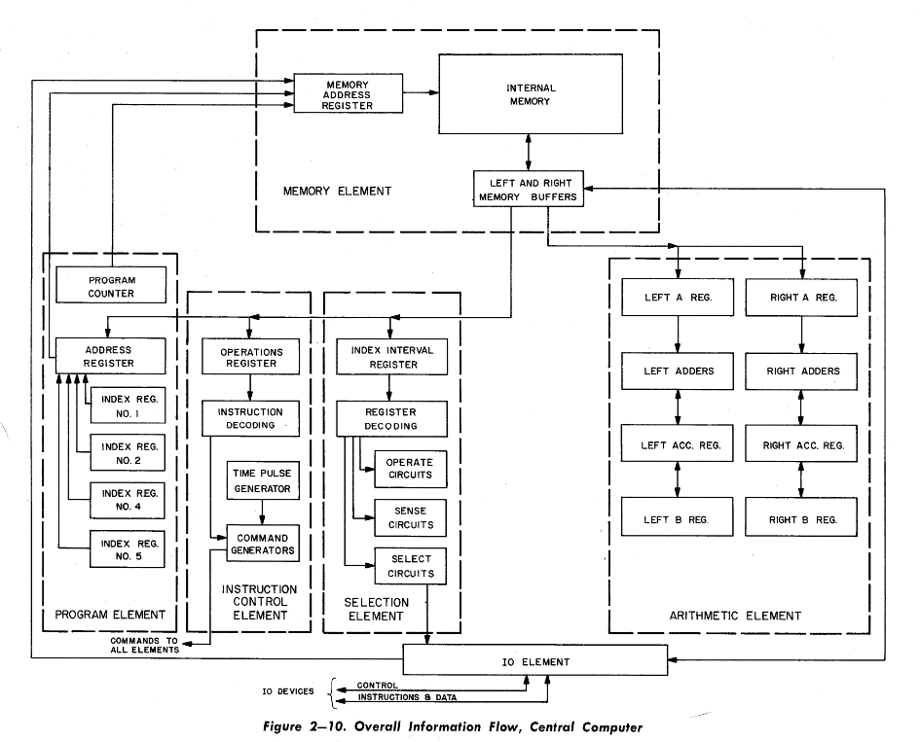
AN/FSQ-7 Architecture
The World’s First
Parallel Computer!
x = ρ cos Θ
y = ρ sin Θ

Slide 8
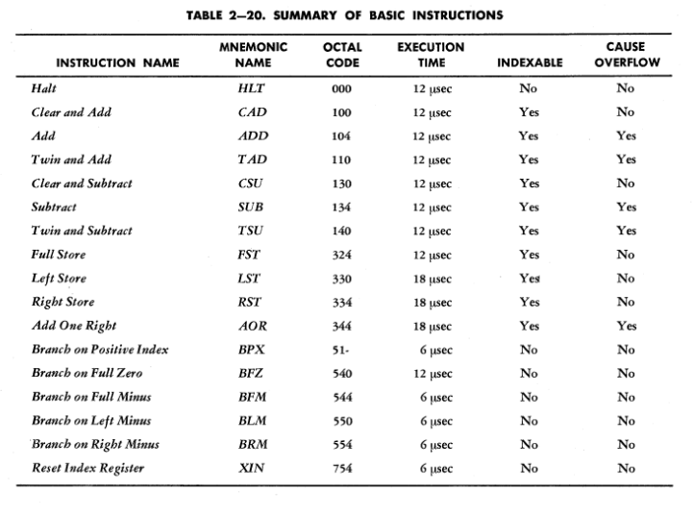
AN/FSQ-7 Instruction Set

Slide 9
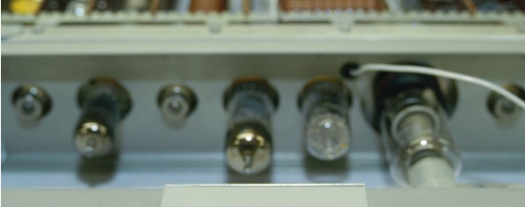
PMG@IBM: 1953-56
July, 1953: At age 18, hired as mail boy, Project High laboratory, Poughkeepsie
November, 1953: Promoted to bench technician...
  Helped build pluggable unit and core memory test equipment for XD-1 assembly line.
  Worked on assembly line of XD-2, Poughkeepsie Manufacturing.
Summer, 1954: Attended first SAGE support programming class, IBM Poughkeepsie, taught by Art Samuel, pioneer of “Checkers AI” gaming.
  With a TvN machine instruction set of only three operations (store, substact, branch on minus), you can compute anything!
Spring, 1955: Posted to MIT Lincoln Lab as member of XD-1 service team.
August, 1956: Now 21, began pursuit of undergraduate degrees in EE and physics at Clarkson as IBM employee on educational leave.

Slide 10
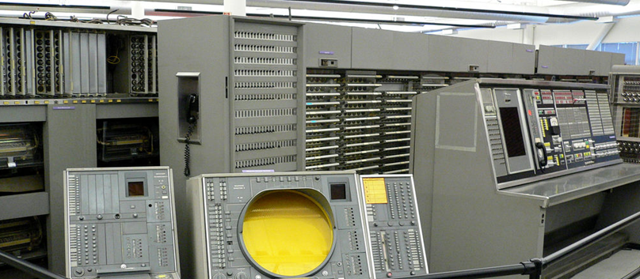
It’s 2017 = SAGE + 64 Years
Is the IoT of today any different from the IoT of SAGE?
I.E., Does Ecclesiastes 1:9 Hold? Depends...
SAGE
AN/FSQ-7
Weighed 250 tons
Consumed 3 MW
60,000 vacuum tubes
75,000 instructions per second (6 µsec/memory cycle)
3rd class phone linkage: (400-3400 Hz)
IBM card reader, card punch, line printer, magnetic tape units
70,000 15-bit words of magnetic core RAM
100,000 15-bit words of magnetic drum SATA storage
> 50 CRT display consoles, keyboards, light guns
Total Cost of NORAD: 10x10^9 USD
wow!

Slide 11
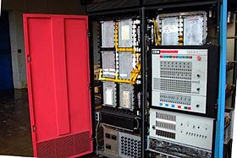
Some More “Things”
Nov 1964 : IBM 1800 Data Acquisition & Control System
World’s first production mainframe capable of processing analog input/output acquired externally and in real time

Slide 12


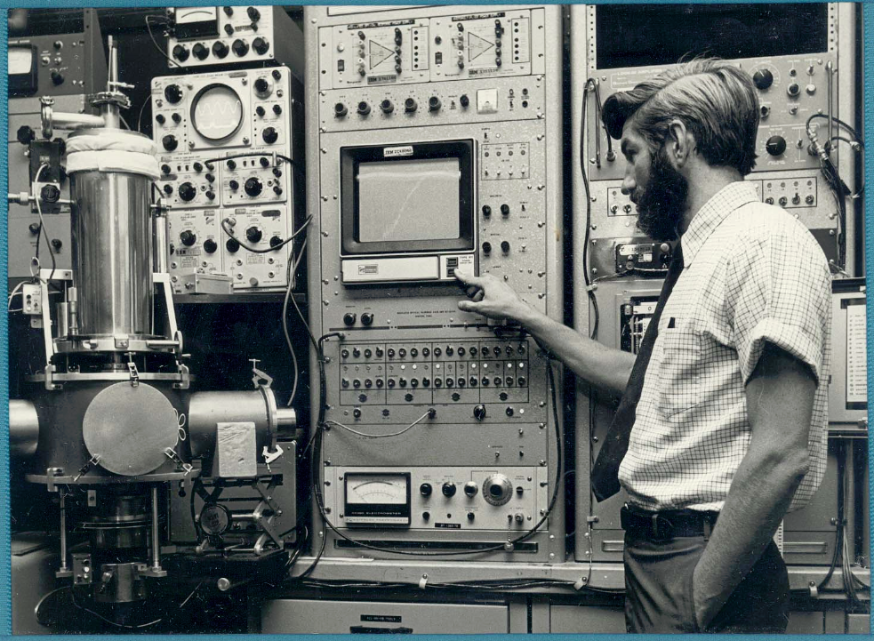


Semi-Anthology of 1800 Lab DAC Papers from IBM San Jose Research published in IBM J. Res. Devel., 1968 Special Issue
Authors: Grant, Schechtman, Ramondi, Winters, Clarke, Gladney...
... and many others

Slide 13
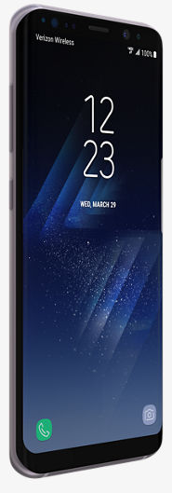
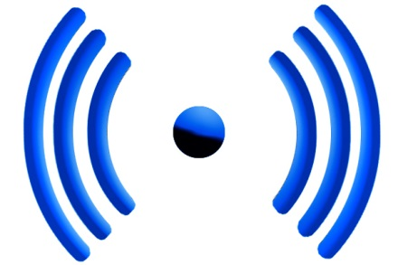

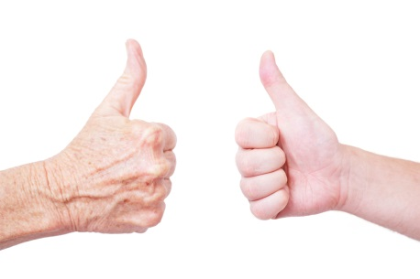
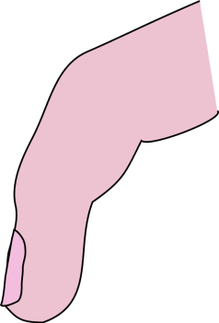
Now We Have!
Our iToys + Wireless + The Cloud
...and...oh, yeah...APPS!

Slide 14
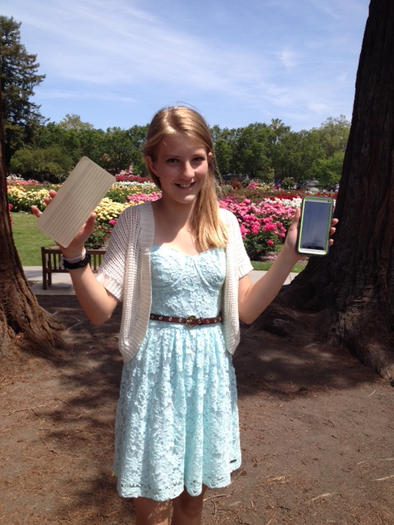
12-Year Old Devin Grant’s
“ Big Data” Homework Assignment
How many of GrandPa’s really silly 1953 IBM Punched Cards does it take...
...to fill up a 32 gig iPhone?
Well?
A stack about 30 miles high!
> 3000 miles in a 4 TB home CLOUD!
Wow!* That’s really “Big Data! ”
So What’s Next?
Putting Your 1’s & 0’s in a Black Hole?
*Assumptions:
120 bytes/card
Thickness = 0.007 inches

Slide 15
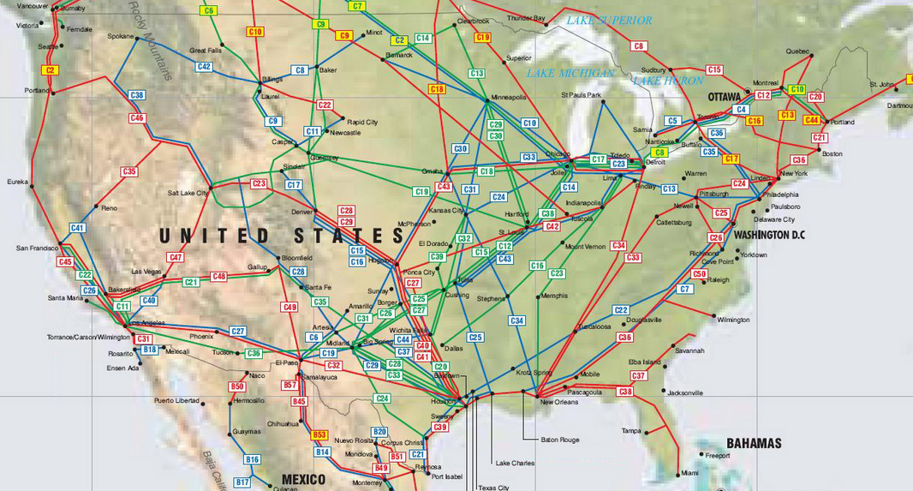
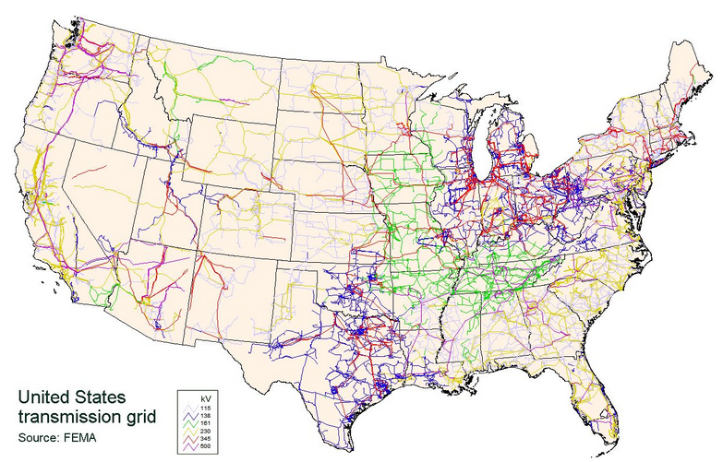
The Ultimate IoT
- The Energy Enterprise -
Molecules
Electrons
The barriers to widespread deployment of sensors and actuators
within the EE are complex political and sociological issues,
not technology (which we already have plenty of).

Slide 16
Lastly...Questions for the Audience
Quantum Computers...what are they?
  What I understand:
    Prime number factorization, e.g., 15=5x3
    Qubit arithmetic and manipulation
    Entanglement/Encryption (I’ve consulted for a 3-letter US agency...oops!)
    Quantum Monte Carlo Calculations
    (See next slide)

Slide 17
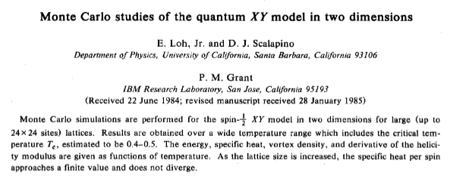
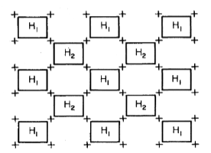

PRB 31, 4712 (1985)

Slide 18
QC Questions Continued
Quantum Computers...what are they?
  What I don’t understand:
    Is there a basic architecture and instruction set...like there is for a Turing – von Neumann machine?
    I’ve asked D-Wave Systems, BC Canada, and, so far, their response has been deafening in its silence
    Can I take the square root of pi on a QC ... like I can on a TvN ?
    Finally...and most critically...is a QC exempt from the Landauer Limit?
OK...basta...enough already...
Thanks for your attention!
-Slainte

