Slide 1
Setup

Slide 2
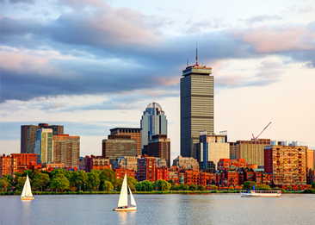
Continuing Search for the Origin of HTSC:
DFT Studies of Selected CuO Proxy Structures
Were the Basic Physics Underlying HTSC Actually
Revealed in 1941?
Paul Michael Patrick Grant
Aging IBM Pensioner
APS Senior Life Fellow
w2agz@w2agz.com
Research Jointly supported under the IBM and SSA retirement funds

Slide 3
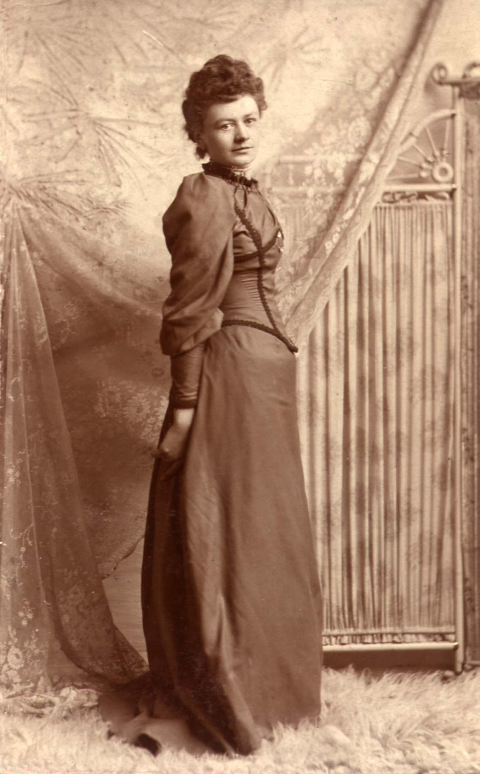
St. Patrick’s Day – 2019 (In 13 Days!)
Paul Michael Patrick Grant
-2014-
A Grandson of
Two Proud Lands
PMPG Accepted as a Dual National by the Republic of Ireland
Bridget Ann Mullen-Whalen

Slide 4
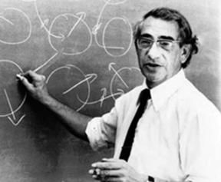
The Great Colossal Quantum Conundrum of HTSC in Cuprates, Ferrous Oxides, etc.
T
U = 3
U = 0
“Funny Metal” “Pseudogap” “Fond AF Memories”
“SDW” “NEEL” “A-F”
“Funny Metal” “Pseudogap” “Fond AF Memories”
“Real Metal” “Fermi Liquid”
U = 6
Is HTSC driven by “shakes or spins”
...or both? Well?
Superconductivity
“Insulator”
g*
“Conductor”
g
“Order Parameter”
(charge, magnetic field, pressure...whatever)

Slide 5
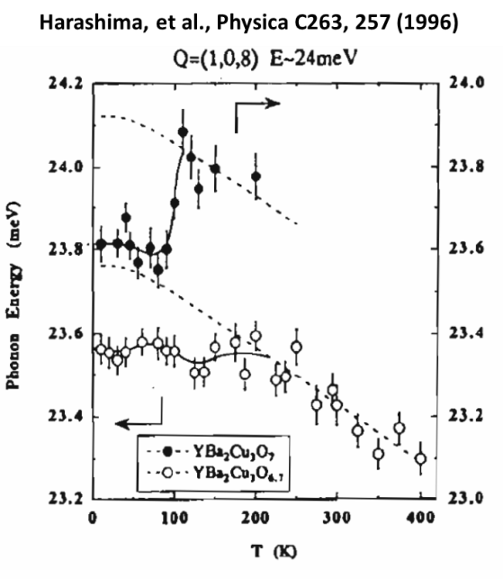
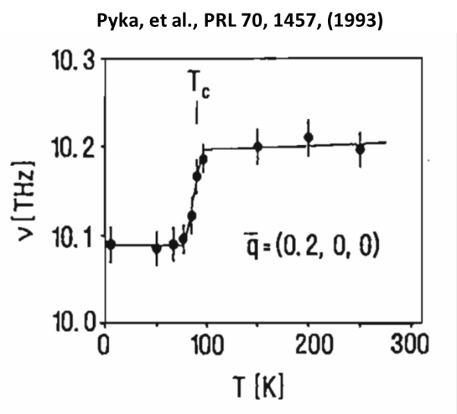
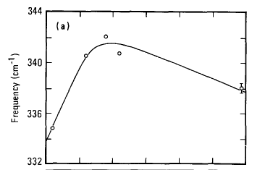
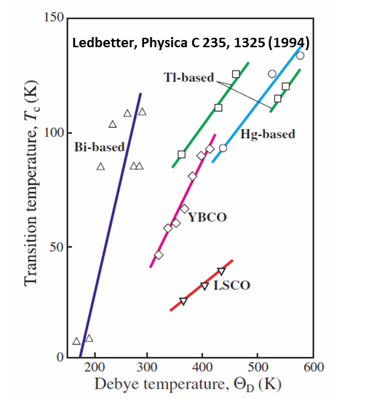
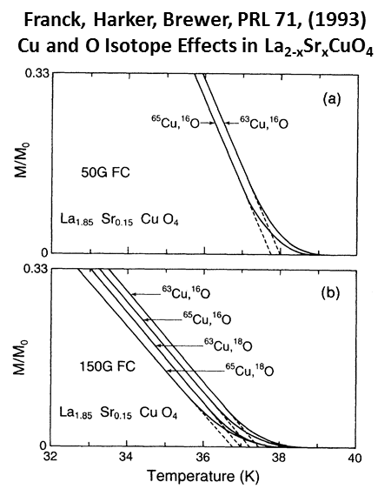
The Story Since 1987
Macfarlane, Rosen, Seki, SSC 63, 831 (1987)
Raman Spectroscopy of YBCO
We can see Shakes have been there ever since the
Creation of HTSC!
...But so have Spins!
(Cu3+/Cu2+)

Slide 6
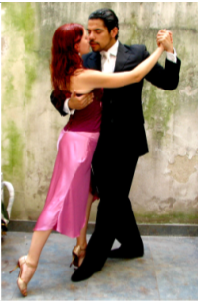
Well...Maybe It Takes Two to Tango!

Slide 7
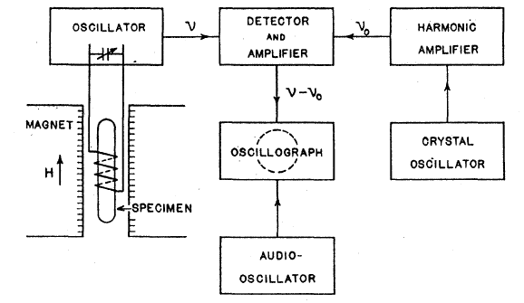
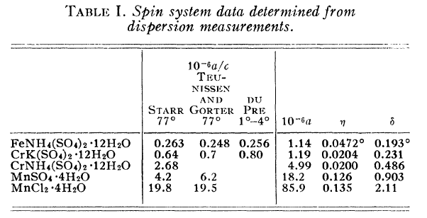
So Might the “Other Partner” Be Spins?
So Perhaps the Past May Indeed be Prologue!
Attributed to Bill S., edited by Paul G.
_______________________________________________________
____________________________________________________________________________
Did this former Harvard/MIT postdoc guess the mechanism of HTSC 78 years ago? !

Slide 8
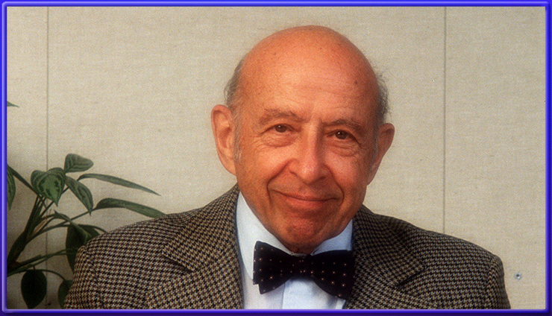
Chauncey Starr 1912 - 2007
The Physics Years (1936 - 1943)
Birth of the Nuclear Age (1944 - 1965)
UCLA & Risk Analysis (1966 - 1971)
The EPRI Years (1972 - 2007)
Please Visit Chauncey’s Page at www.w2agz.com

Slide 9
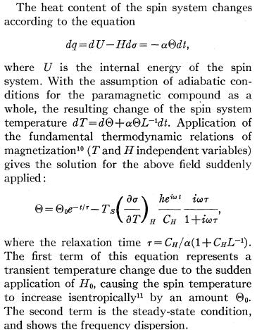
Relevant Sreen Shots from Chauncey’s 1941 PR Paper
CduP, Physica V, 507 (1938)
Read and search the content and references in Starr’s paper, especially the selection on the left. Decide what the relative contributions of lattice and spin fluctuations are to thermodynamic equilibrium temperatures such as the Debye and Neel constant values in the presence (and absence) of an applied external magnetic field. And then, how do we incorporate all this into the creation of a new general BCS pairing formalism to replace/augment the current Migdal-Eliashberg-Allen-Dynes-Bardeen algorithims for fermion-boson-fermion coupling, with relevant adjustment/replacement of lamba and mu*star?

Slide 10
So What’s Needed Next?
A DFT + U package (Elk? Quantum-Espresso? VASP?) that will allow the simultaneous calculation of electron-phonon interactions as well as spin-spin excitations, and thus enable an estimation of the Casimir/du Pre coupling…and maybe...MAYBE... a combined phonon-spin pairing λ plus μ∗ calculation tool?

Slide 11
What a Great PhD Thesis Project!
Thoroughly review the 1941 Starr paper and all its references.
Configure an appropriate PSD setup with a cryogenic sample chamber between 10 T dipoles.
Check out a few of the Starr measurements on paramagnetic compounds of Fe, Mn and/or Cr.
Then grind up some Y-123 (with various oxgyen levels), and measure...if results mimic Chauncey 1941...
Derive an alternative to McMillan-Eliashberg fermion-fermion coupling which contains spins as well as phonons, and apply. If it “works,” then...
Buy a new suit...or dress...for your upcoming trip to Stockholm!

Slide 12
“You can’t always get what you want…”
Notes:
12

Slide 13
“…you get what you need!”
Notes:
13

